Slide 1
Salary Predictions
By: Spencer Reno

Slide 2
Introduction
Data used for this project was salary data from 1600 different tech companies
Features such as Total Salary, Age, Work exp, Years at company, etc.
regression model to predict their salary

Slide 3
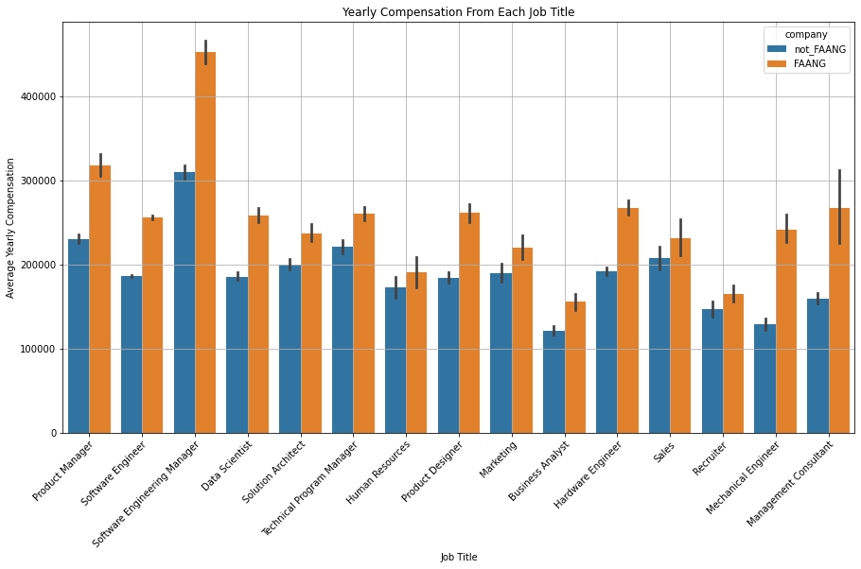
Split companies to compare FAANG vs non_FAANG
All Job titles within FAANG are paid more than other companies across the board
Software Engineering Manager is paid the most out of all job titles

Slide 4
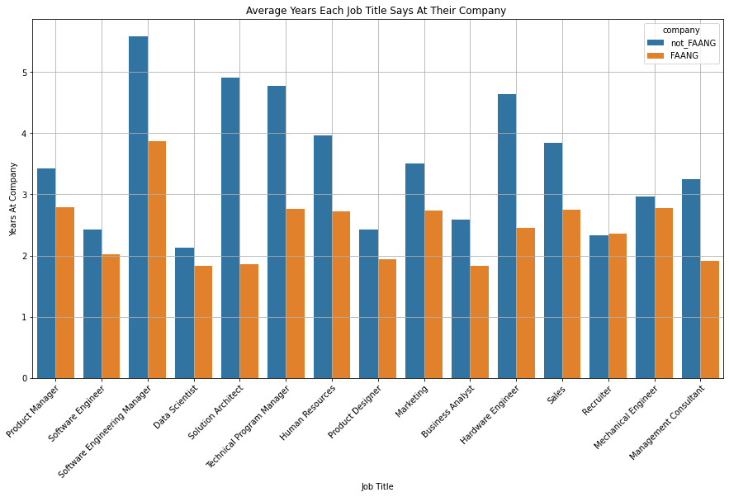
The average years for each job title is higher for non FAANG companies.
FAANG is the end goal in most cases.
Software engineering manager is again the highest of all job titles explains why they are highest paid

Slide 5
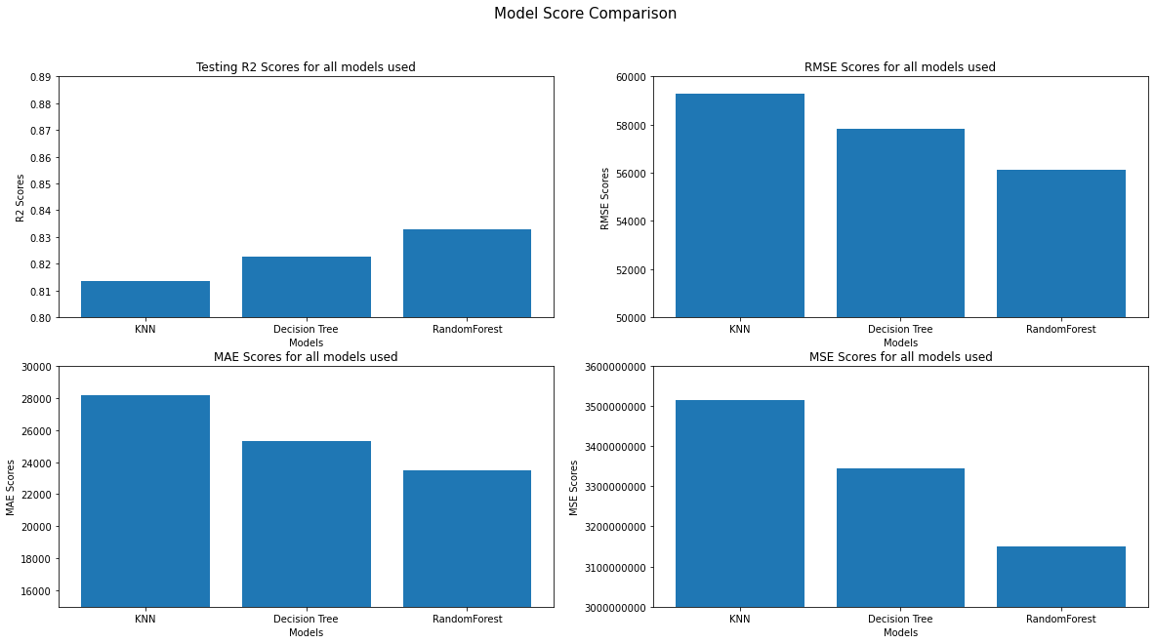
In the 1st graph the highest score is the best as it shows how well the model predicts
For the other 3 graphs the lowest score is the best since you want the least amount of error.
Random forest model did the best for each criteria

