Slide 1
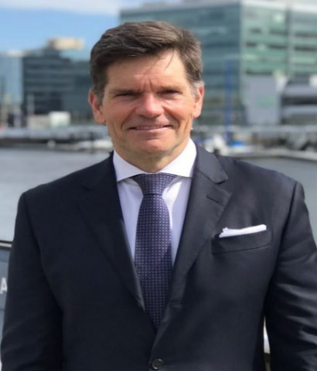
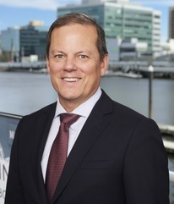
G David Bednar
Principal
David Bednar founded Devotio Capital Management: The Real Estate Private Bank^{R} in 2018. Mr. Bednar is a 25-year global real estate lending and investing veteran with experience spanning the real estate capital structure. Prior to founding Devotio, Mr. Bednar was a Managing Director for eight years at Ladder Capital, a NYSE listed real estate finance company where Mr. Bednar focused on equity, mezzanine, bridge and CMBS transactions. Before joining Ladder, Mr. Bednar ran the New York office of JPMorgan Real Estate Special Situations, a proprietary commercial real estate equity and high yield debt investing group. Prior to JPM, Mr. Bednar worked at Dillon Read Capital Management, a UBS sponsored investment manager based in NY where Mr. Bednar focused on equity investing. Prior to Dillon Read Mr. Bednar worked at Goldman, Sachs and Co. in the Global Special Situations Group, a proprietary investment team based in New York focused on distressed asset investing and mezzanine lending. To begin his business career, Mr. Bednar spent eight years at Morgan Stanley Real Estate, heading the non-Japan Asia business for the Morgan Stanley Real Estate Fund in Hong Kong for the final three years.
Mr. Bednar received a BA and MBA from Harvard University and served for four years as an infantry officer in the United States Marine Corps, serving in Operations Desert Storm and Desert Freedom.
Greg Galusha
Principal
Greg Galusha is a Partner of Devotio Capital Management: The Real Estate Private Bank based out of Santa Barbara. Mr. Galusha is a 34-year real estate investment management and capital markets veteran with experience spanning equity joint ventures, bridge and mezzanine lending, development and asset/portfolio management across a wide variety of property types in the United States and Asia. Prior to joining forces with Devotio, Mr. Galusha founded Arris Capital Advisors, a real estate advisor and intermediary to clients developed over five years as an Executive Managing Director at Newmark, where he led capital markets equity placement, mezzanine debt, and multifamily construction debt financing for the Western U.S. Prior roles included Head of Commercial Real Estate at PeerStreet, an Andreessen Horowitz-backed fintech startup, Partner at Kearny Real Estate Company, directing acquisition strategy and asset management for a California-focused operating company, Partner at Pacific Coast Capital Partners (PCCP-minority owned by Calstrs) for nine years, where he was part of the senior management team that grew AUM from $800M to $6B, Vice President with the Morgan Stanley Real Estate Fund in Hong Kong and Los Angeles.
Mr. Galusha received a BA in Urban Studies from the University of Pennsylvania with Wharton School of Business coursework in real estate finance.

Slide 2
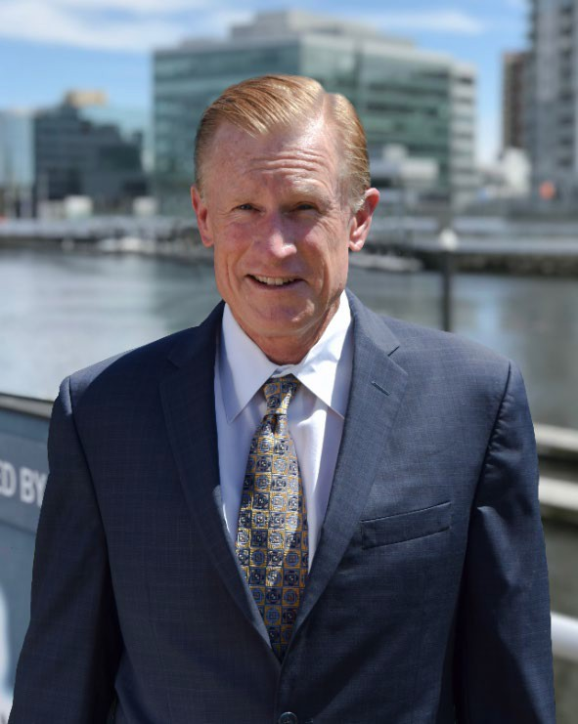
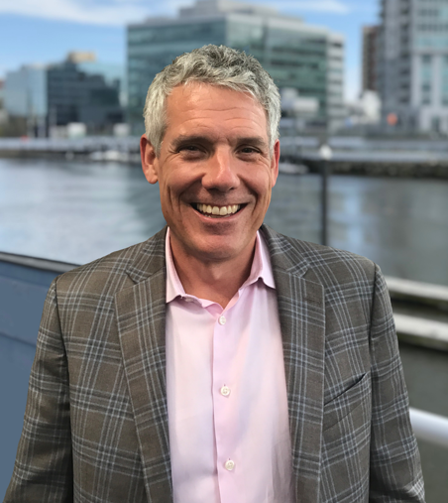
Doug Thompson, CFA
Managing Director
Douglas M. Thompson, CFA, is a Member of Devotio Capital Management: The Real Estate Private BankR based out of the firm’s west coast office. Mr. Thompson is a 33-year national real estate development and investment veteran with experience in a wide variety of property types and geographic markets. Prior to Devotio Mr. Thompson operated his own development and investment platform which invested in a series of partnership sponsored by him. He led development teams for vertical projects located in CA, FL, TX, VA, and MD. During that time he also actively managed a real estate consulting business serving both private and institutional clients with a wide variety of needs. Mandates have included the underwriting, structuring and acquisition of performing and non-performing debt portfolios, land for development, and income producing properties and portfolios.
Mr. Thompson received his Bachelor of Arts degree in Political Science from Stanford University in 1985 and the Chartered Financial Analysts (CFA) designation in 2001. As a CFA, he has chosen to pursue an investment career guided by a higher level of integrity and committed to adhere to the CFA Institute's strict Code of Ethics and Standards of Professional Conduct.
Steve Haggerty
Managing Director
Steve Haggerty has more than 20 years of experience in hospitality investing, mergers and acquisitions, and strategic business planning. Over the course of his prestigious career, he has led the development and capital strategies for some of the industry’s most prominent corporations. He is formerly a Managing Partner at Trinity Investments. Prior to Trinity, Mr. Haggerty held a number of finance, asset management and development roles at Marriott International Inc. in various locations around the world. These positions include Vice President of Development in Hong Kong and Senior Vice President of Global Asset Management in London. Mr. Haggerty also has experience serving as a director for various institutions including Playa Hotels & Resorts, Cornell University’s School of Hotel Administration and the University of Denver’s Fritz Knoebel School of Hospitality Management.
Mr. Haggerty earned a Bachelor of Science from Cornell University’s School of Hotel Administration.

Slide 3
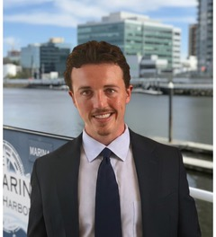
Spencer Cassell
Vice President
Spencer Cassell is a real estate and private-markets professional whose experience spans principal investing, asset management, and underwriting across multiple asset classes. Before joining Devotio, he has sourced, underwritten, and structured residential land development projects in the Southeast through his own firm, Owl Rock Capital LLC. Earlier in his career, Mr. Cassell worked with various private equity companies and investment banks, to name a few: Atlantic Equity Partners on hotel acquisitions, Wincoram Asset Management on upstream energy assets, Fidelity Investments on high yield and distressed real estate and bonds, Alantra LLC on generalist, middle market corporate finance deals, and Deutsche Bank’s investment-banking group on live M&A transactions in the software sector.
Mr. Cassell earned his B.A. in Economics from Harvard University, where he was a varsity football player and LaCroix Award recipient, and completed post-baccalaureate studies in Real Estate Finance and Business Management at Rice University.

