Slide 1
Team Carbon
Sprint 3
CS504 Team Project
Spring 2021

Slide 2
Team Carbon Organization
Team Roles:
Product Owner – Spencer Marlen-Starr
Scrum Master – Jhony Islam
Developer – Cassidy Laskodi
Developer – Radha Kanuri
Developer – Stavros Kalamatianos

Slide 3
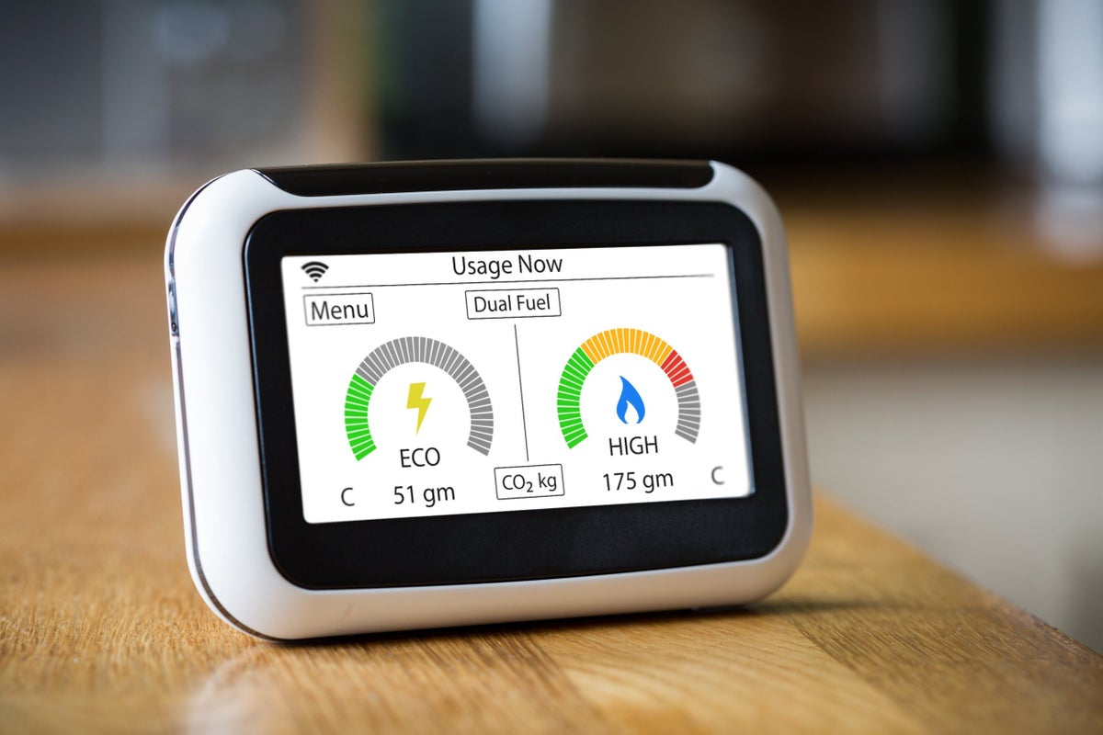
Smart Meters in London

Slide 4
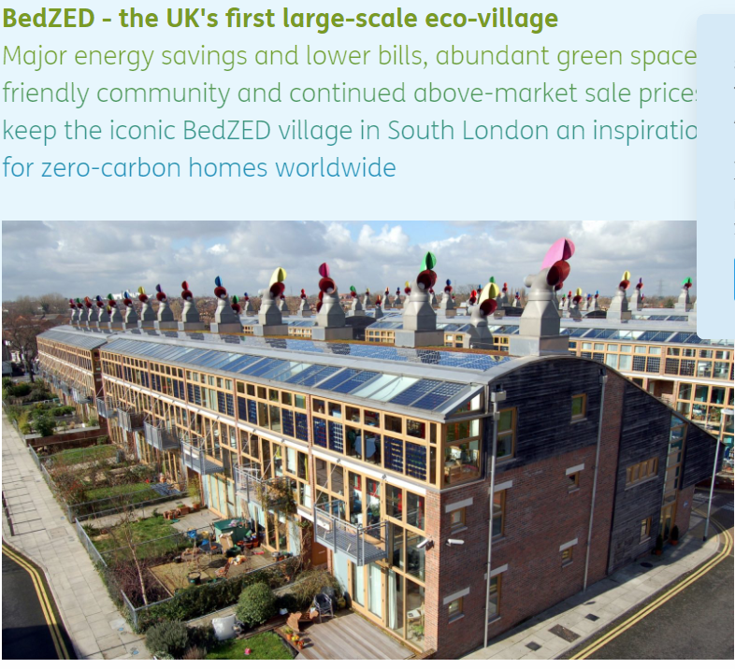
Green architected house energy infrastructure supplemented by Smart Meters

Slide 5

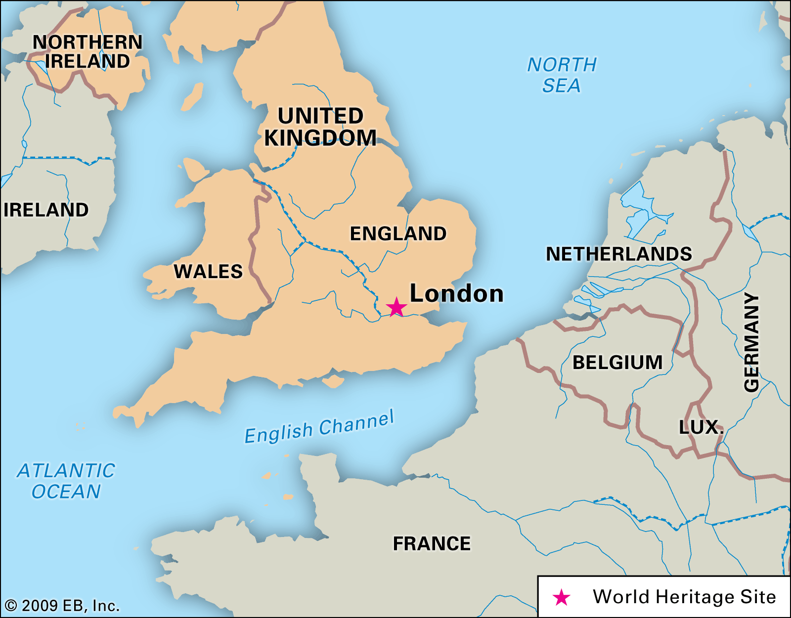
Problem Definition
In this study, we look at homes in London, England and attempt to find out how people consume energy in their homes. The data is a sample of 5,567 homes in the London area from November 2011 to February 2014. This data comes from “smart meters'' placed in people’s homes by the British Government at the European Union’s recommendation. The weather data is from a darksky Application Programming Interface (API).

Slide 6
Potential Data Sources
The main data source for the course group project will be Kaggle’s Smart Meters in London data set
The original data set consists of 6 main files and 112 half-hour energy consumption block files from the sample house smart meters we consolidated into a single relation using Python.
All raw data was provided in xls or csv format and they span from November 2011 through February 2014.
Our data content includes:
Households information, such as a sample residence Smart Meter ID, the residents ACORN group, whether they belong to the control or the experimental group of participants and some energy descriptive statistics.
Daily half-hour energy consumption measurement set per household’s Smart Meter through the period of the study
An index of the ACORN lifestyle defined hierarchy that shows the number of people in the ACORN group comparing it with the national scale baselined at 100
Detailed weather hourly/daily pressure, temperature and water/air content/velocity/direction meteorological variables
No further external data sources will be used in this project

Slide 7
SPRINT 3: ALGORITHMS AND ANALYTICS

Slide 8
Weather Time Series & Normality Tett
We performed a Dickey-Fuller Test (Alternative Hypothesis as Stationary) and a Shapiro-Wilks Normality test on the columns temperatureMax and pressure.
temperatureMax Results:
Dickey-Fuller = -2.9886, Lag order = 9, p-value = 0.1598
Results conclude temperatureMax is not stationary
W = 0.98656, p-value = 3.112e-07
Results conclude temperatureMax is not Normally Distributed
pressure Results:
Dickey-Fuller = -5.8983, Lag order = 9, p-value = 0.01
Results conclude pressure is stationary
W = 0.99115, p-value = 3.822e-05
Results conclude pressure is not Normally Distributed

Slide 9
Correlations
Energy_mean correlated with:
temperature_Max = -0.1742
pressure = -0.0400
humidity = 0.0847
uvIndex = - 0.1477
cloudcCover = 0.0581
windSpeed = 0.0342

Slide 10
Rudimentary Exploratory Data Analysis
Updated ERD
Rudimentary Exploratory Data Analysis
Time Series Forecasting
Visualizations in progress

Slide 11
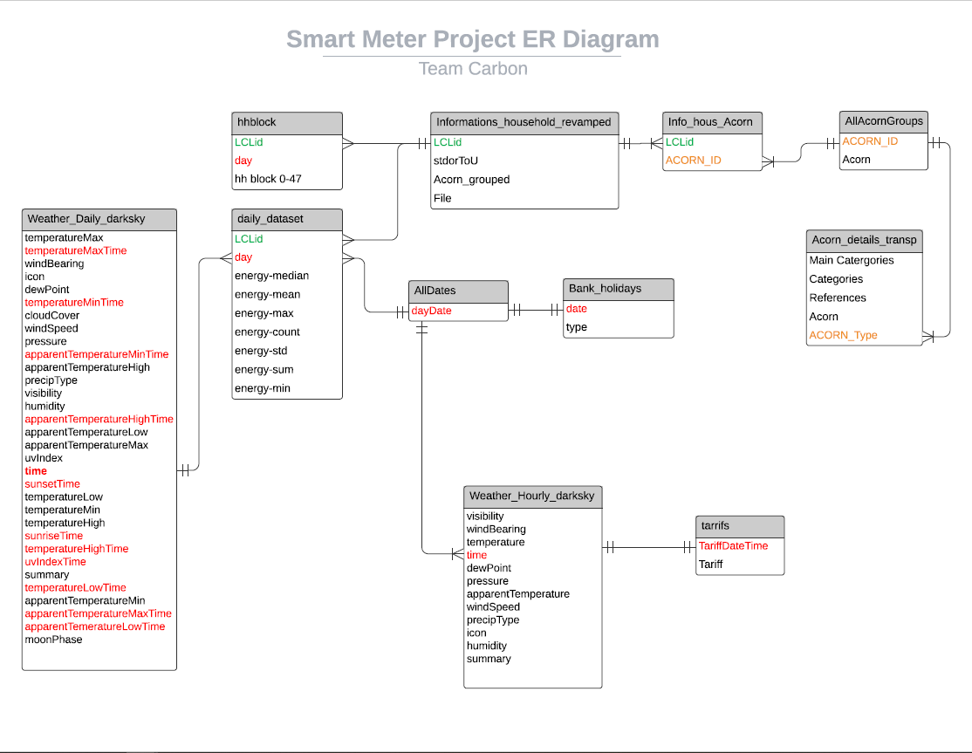

Slide 12
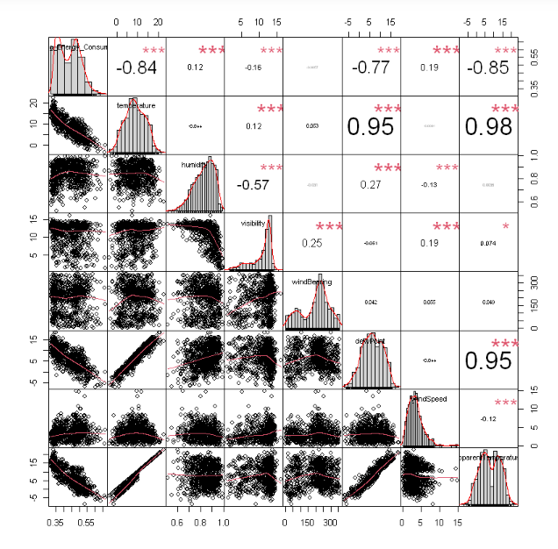

Slide 13
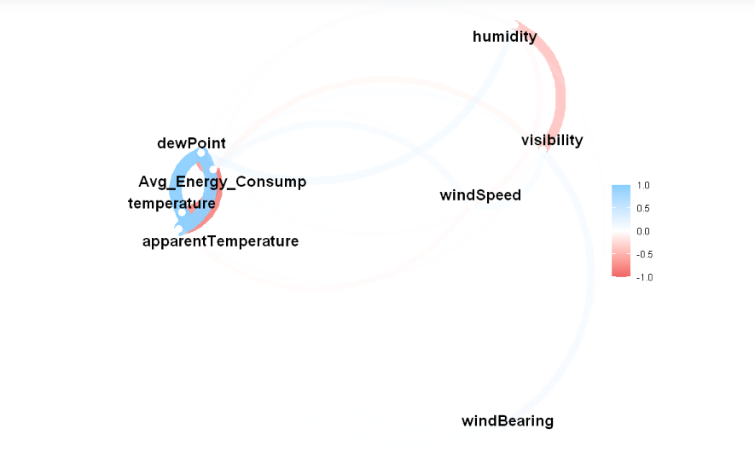

Slide 14
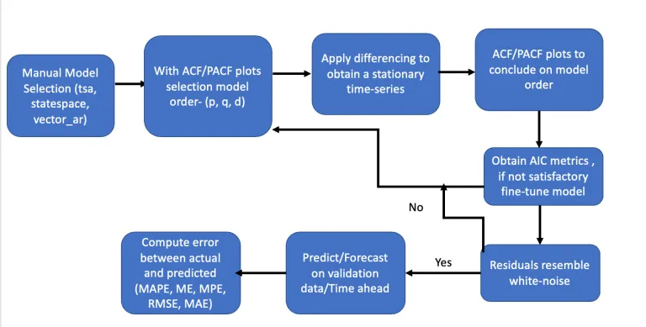
SARIMA (Seasonal Auto-Regressive Integrated Moving Average)

Slide 15
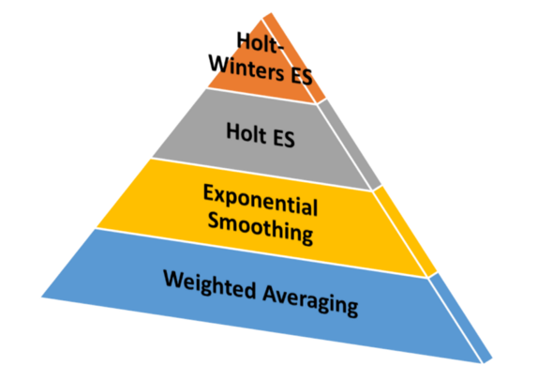
Holt-Winters Forecasting Technique

Slide 16
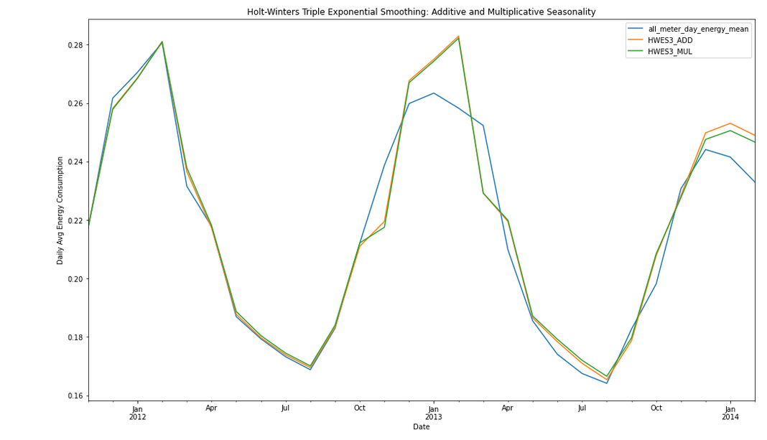

Slide 17
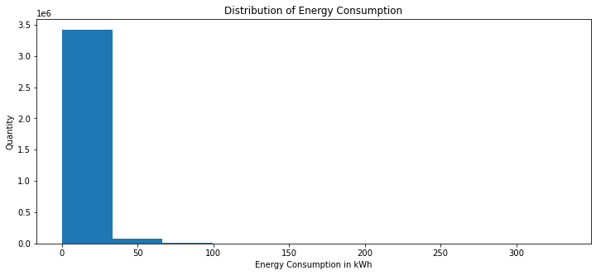
Energy Consumption Modeling/Normality
Test to see if we can predict energy consumption on a day-to-day basis
Does the data follow a normal distribution?
Jarque-Bera Test for normality

Slide 18
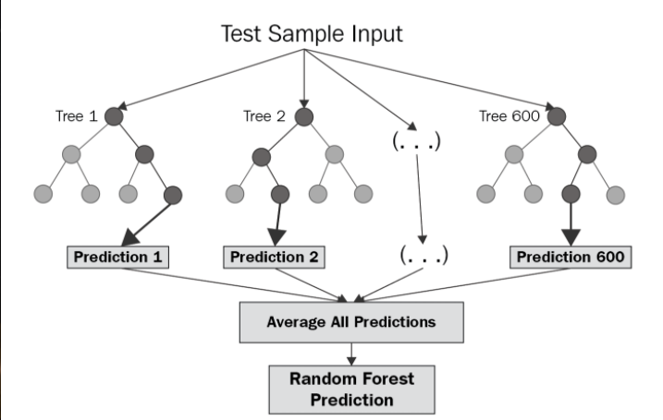
Random Forest Regression
Supervised machine learning algorithm
Normality not a requirement
Utilizes features and labels for training and test data partitions

Slide 19
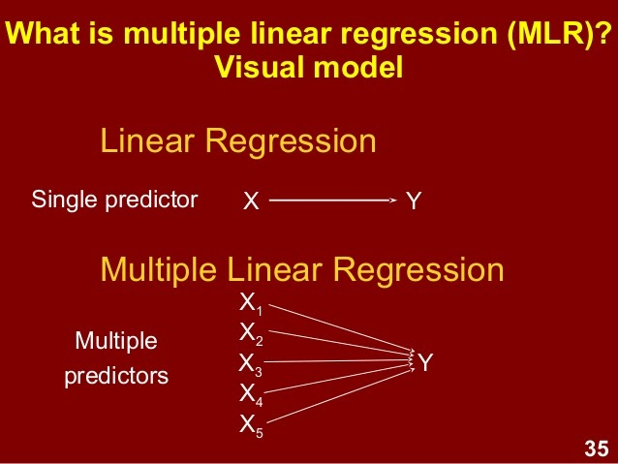
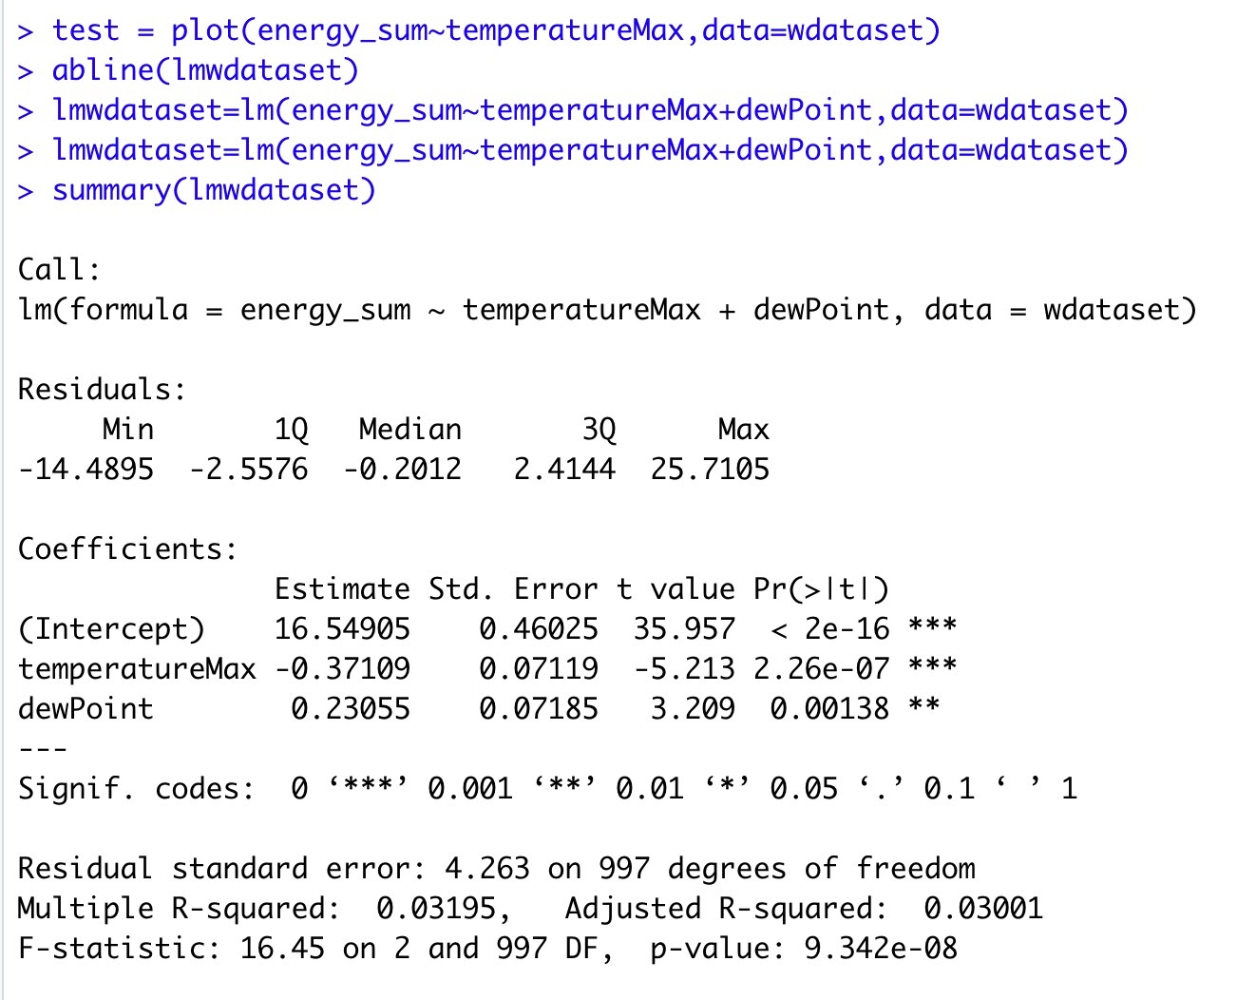
Multiple Linear Regression

Slide 20
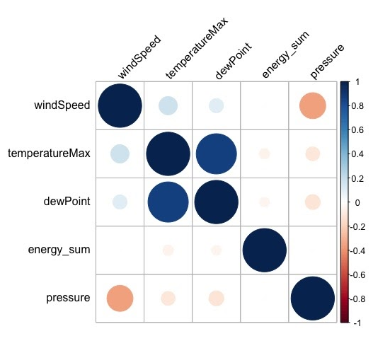
Pearson’s Correlation Coefficient Test

Slide 21
The Effects of Time of Use Energy Pricing
Panel aka longitudinal data of 5,567 London homes
Treatment group subjected to dynamic time of use energy pricing
Rates went up during peak usage hours and down in low use hours
Control group subjected to a flat rate of 14.288 pence per kWh

Slide 22


Mann-Whitney/Wilcoxon Rank Sum Tests
Results of the Mann-Whitney test for a decrease in total daily energy use
Results of the Mann-Whitney test for a decrease in total peak energy use

Slide 23
Fixed Effects Regression
The coefficient for time of use pricing in the output of the fixed effects model was around -1.07 which means that implementing dynamic time of use pricing on a home in London can be expected on average to lead to a decrease in daily energy consumption by that home of 1.07 kWh.
This coefficient had a p-value that was all but indistinguishable from zero.

Slide 24
Risks and Planned Mitigations
Risk: Sample is too small
Probability: low
Impact: high
Mitigations:
Identify a different dataset
Risk: Computing power may not be enough
Probability: low
Impact: high
Mitigations:
Partitioning the dataset
Risk: Integrity of data may not be up to standards
Probability: medium
Impact: high
Mitigation:
Scrub the data

Slide 25
Assumptions
We are assuming the quality of the data provided in Kaggle will be accurate to answer our problem
We are also assuming that we will have appropriate resources to process and analyze the data set

Slide 26
Backup Slides

Slide 27
CS 504 Project Sprints
Sprint | Milestone Goals | Presentation
0 - Team Formation | Team Members & Roles Brief description of Team Problem Request WebEx with instructor | Week 1
1 - Problem Definition and Project Plans | Problem (decision) defined Understanding of complexity Potential data source identified Potential analytics identified Project schedule defined Participant roles assigned Risks identified and mitigation plan | Week 2
2 - Data Sets | Data located and accessed Initial processing underway Risks identified and mitigated | Week 3
3 - Analytics/algorithms | Algorithms defined and coded Initial applications completed Risks identified and mitigated | Week 5
4- Visualizations | Visualization concepts defined Visualization implemented Risks identified and mitigated | Week 7
Final Presentations | Project components completed Project components integrated Project supports final decision Presentation made | Week 8

Slide 28
SPRINT 0: TEAM FORMATION

Slide 29
Sprint Goals
Analyzing the dataset
Identifying and mitigating risks within our algorithms
Answering our problem objectives through algorithms
Determining the validity of our analysis

Slide 30
Sprint Tracking
As a head of a household, I want to understand how my energy usage rate works, so that I can be more cost effective.
Understand what usage rates are accessible to households
Determine what households can change to affect usage rates
Determine if changes can make households more cost effective
Identifying if economic status plays a significant role and if so its effect
As an energy supplier, I want to determine which factors impact energy usage, so that I can improve my revenue.
Which factors can energy suppliers manipulate (e.g. household income, long term investments, family size, occupations and others that collectively define accurately the social strata of the city of London where the energy consumption data was collected from.)
How do I manipulate these factors to improve revenue?
How do I balance supply and demand to determine pricing?
What services are offered to promote reduction in costs, i.e. savings for energy usage?
As a government official, I want to identify the different factors that affect energy usage, so that I can create relevant policies which will reduce energy usage.
Discover the factors that are impacted through government policies
Will government officials be more aggressive or passive with their policies?
Understand what drives the consumption of energy and it will perhaps stimulate ideas for possible changes in how to decrease useless energy consumption.

