Slide 1
Syracuse University CCDC Info Session
@sthulin
"The screen is white and the taskbar is gone ... is this expected?" #NECCDC
‏@mjbrender
I should have brought my t-shirt that says 'Network Administrators eat babies.' #NECCDC

Slide 2

Table of Contents
What exactly is CCDC?
Teams
Injects and Incident Reports
Scoring
Rules
What do I have to do?
Questions
Official team motto: “When in doubt…

Slide 3
What exactly is CCDC?
CCDC – Collegiate Cyber Defense Competition.
Scenario based active network defense- with a twist.
Competing against other colleges (RIT, SUNY Buffalo, etc)
Multiple rounds:
Virtual competition
University hosted event
Last year was at University of Maine. iSchool funded complete trip.
Nationals (Texas?)
10 team members. Undergrad and grad.

Slide 4
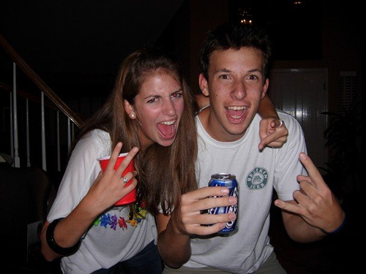
CCDC – Blue Team
Us, the trusty collegiate network warriors.
Scenario: Blue team is the new IT team for a faux company, everyone was fired prior to your arrival due to a security leak. Given minimal information… anddddd GO!
Room for all kinds of people needed:
Windows, Linux, Unix (OpenSuse anyone?)
Cisco devices, ios (not your phone)
Services: email, DNS, Active Directory, web, MySQL
Business tasks: PCI compliance, report submission,
incident tracking. White team interaction.

Slide 5

CCDC – Red Team
Red Team
The enemy. (but also kinda your friend)
They may or may not be hung over while owning your network.
THEY WILL GET IN!
All machines were owned from the start last year
EVERYTHING is in play.
Did you notice the guy outside the room taking pictures
of the whiteboard? YES THIS ACTUALLY HAPPENED!
They will try to social engineer you.
Fake Ethernet ports in the bathrooms? WTF?
Strange pony obsession.

Slide 6
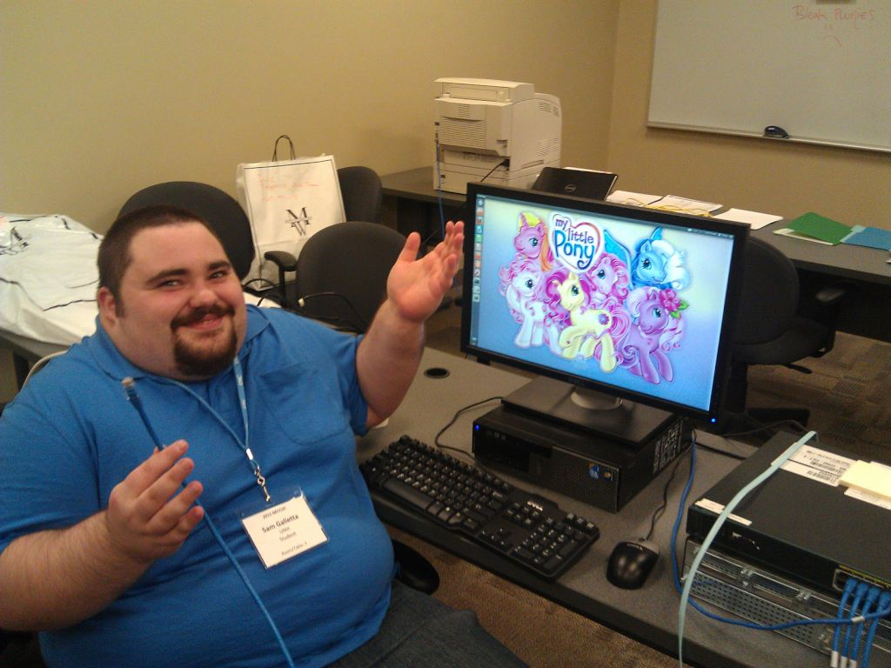

Slide 7

CCDC – Other Teams
White Team
The judges and “CEO” of the faux company
blue team works for.
Any incident reports go to these guys.
Any requests for downtime go to these guys.
Any clarification on rules go to these guys.
Black Team
The ones that set up the network.
Gold Team (optional)
Subject of myth and legend.
Gamboge Team
Now we’re just messing with you.
“Computer? I don’t know anything
about that- you’re the IT guy, right?”

Slide 8
CCDC – Injects & Incident Reports
Injects
Business-related tasks that come from the white team.
Ex: We want to improve the security of our website. Look through this PHP code to find any vulnerabilities. You have 2 hours to complete this task.
Some are reasonable, others not. These suck, either way.
Incident reports
Reports filed with the White Team that describe actions taken on Blue team servers by the Red Team.
“Someone NMAP’d all our ports!” – this counts as a incident.
“The printer is spitting out My Little Pony prints!” – this counts as a incident.

Slide 9
CCDC – Scoring
Blue team receives points for:
Services being up.
Exponential loss per repeated outage.
Injects completed on time.
Incident reports submitted.

Slide 10
CCDC – Rules
Some parts are very nebulous.
Only free tools: What is free? Free trial? Open source?
White team can be very unhelpful.
Some things are left for us to determine:
Ex: White team direct access to computers.
Other parts are very rigid.
No coaches allowed in rooms.
No USB drives allowed.
Large packet, tl;dr rules.

Slide 11
Not convinced?
Chance to practice what you’ve heard about in class.
Chance to learn new things.
Malware you’ve read about (NY Times hacking?) is used here.
Big money sponsors, they want YOU!
Dell, EMC, Boeing, Un-named 3 letter agencies.
Lots of networking. You will see these guys at other industry events.
Super detailed after-action report with the red team. (AWE-some!)
Candy room. Yeah, I said it. A room with free candy. And stuff.

Slide 12
What do I have to do?
Outside reading and research, highly collaborative.
Practices happen whenever most of us can meet. Usually informal.
CCENT room on the second floor of Hinds.
A few late nights as we get closer to competition.
We have a sheet going around, put your email address on it, and you’ll be added to our listserv.
Listserv email is: team@syr-ccdc.com
Way for us to communicate to everyone at once.
Collaborative structure, all members can post, once we get going.

Slide 13

Who “runs” this thing?
James Dollbaum
jmdollba@syr.edu
Leaves port 22 unsecure.
Anthony Herbert Jr.
alherber@syr.edu
Likes resetting routers.
Alex Rydzak
adrydzak@syr.edu
Has no idea what CCDC is.

Slide 14

Question time…

