Slide 1
Cloud Infrastructure Problem Statement
Designing a secure, segmented, production-ready Azure platform without flattening the network.
Secure public ingress was needed for multiple application entry points.
Backend, database, and AI services needed private communication without public exposure.
Routing had to support both host-based and path-based traffic separation.
Outbound access needed to be controlled while still supporting scalable workloads.
Lijaz Salim

Slide 2
APPLICATION CONTEXT
The Workloads Running on This Infrastructure
Spend Control Platform
Frontend, backend, PostgreSQL, and AI-assisted components — all on segmented Azure infrastructure.
Static Demo Site
Separate static app demonstrating host-based routing through the same Application Gateway.

Slide 3
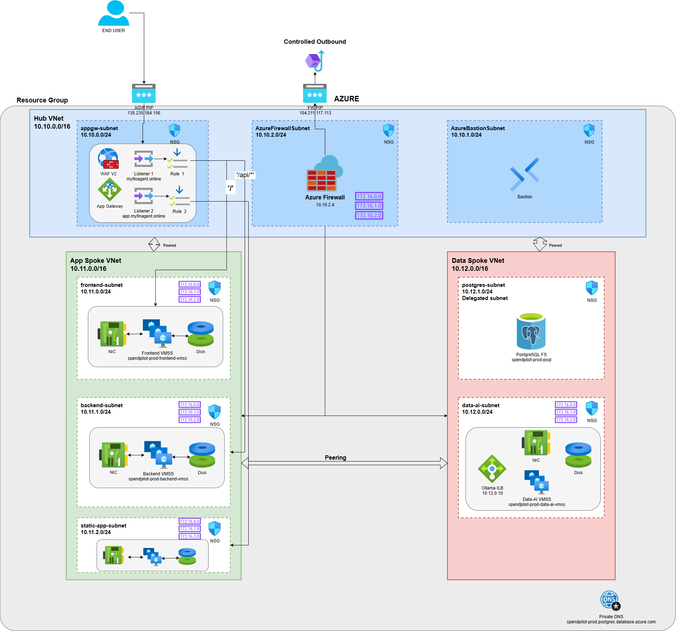

Slide 4
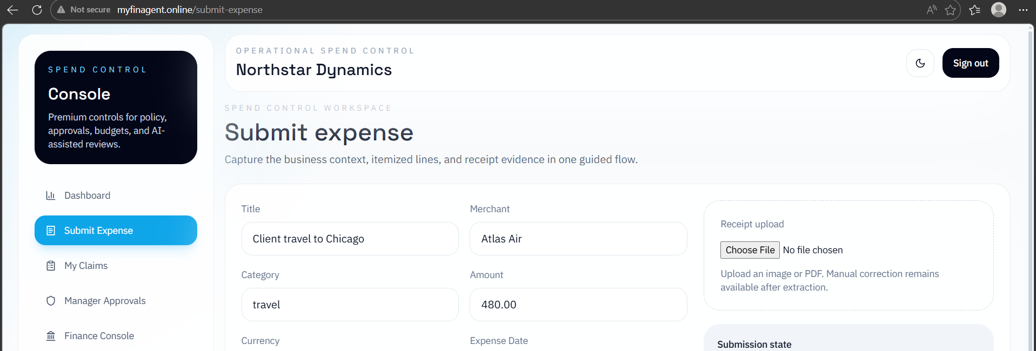
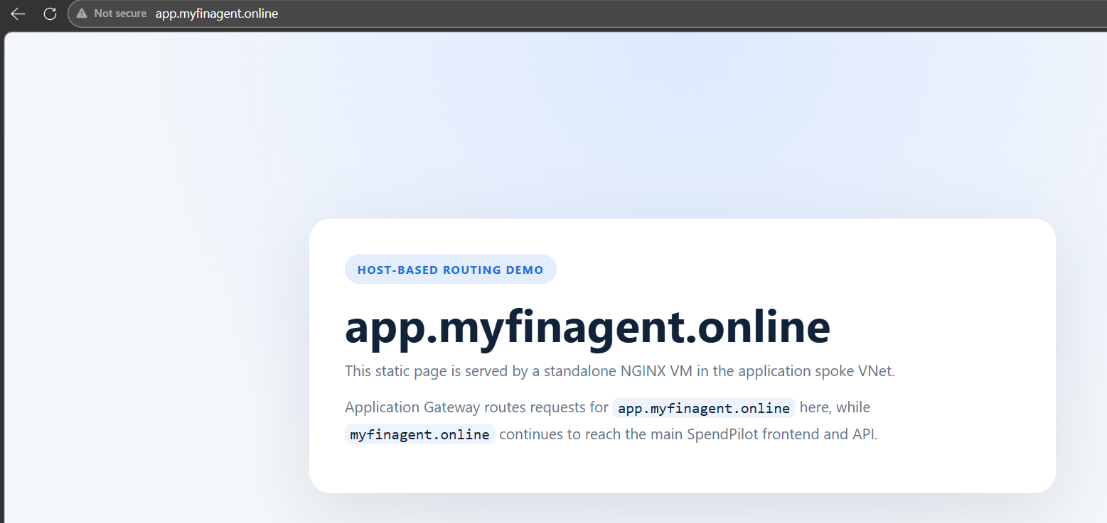
Host Based Routing
myfinagent.online
app.myfinagent.online

Slide 5
Infrastructure Design Goals
Central Hub
Shared ingress and security controls
Isolated Spokes
App and data VNets fully separated
Private Data Access
PostgreSQL with no public exposure
Firewall-Controlled Egress
All outbound traffic through Azure Firewall
Scalable Compute
VM Scale Sets for frontend, backend, and AI
Host & Path Routing
Host-based and path-based traffic separation

