Slide 1
SpendPilot
A multi-tenant finance SaaS deployed on Microsoft Azure — built to solve fragmented expense management with cloud-native architecture, infrastructure as code, and automated DevOps pipelines.
Budgets
Expenses & Approvals
Plan, track, and enforce spending limits per department or project
Submit, review, and approve expenses through structured multi-level workflows
Documents & AI
Audit Visibility
Upload receipts and invoices — AI extracts key fields automatically
Full traceability across every transaction, approval, and document change
Lijaz Salim

Slide 2
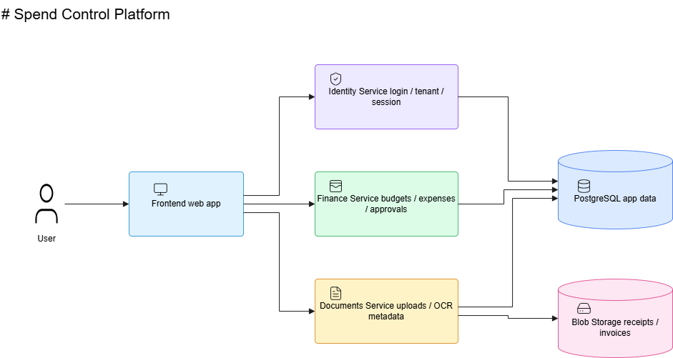
Application Architecture

Slide 3
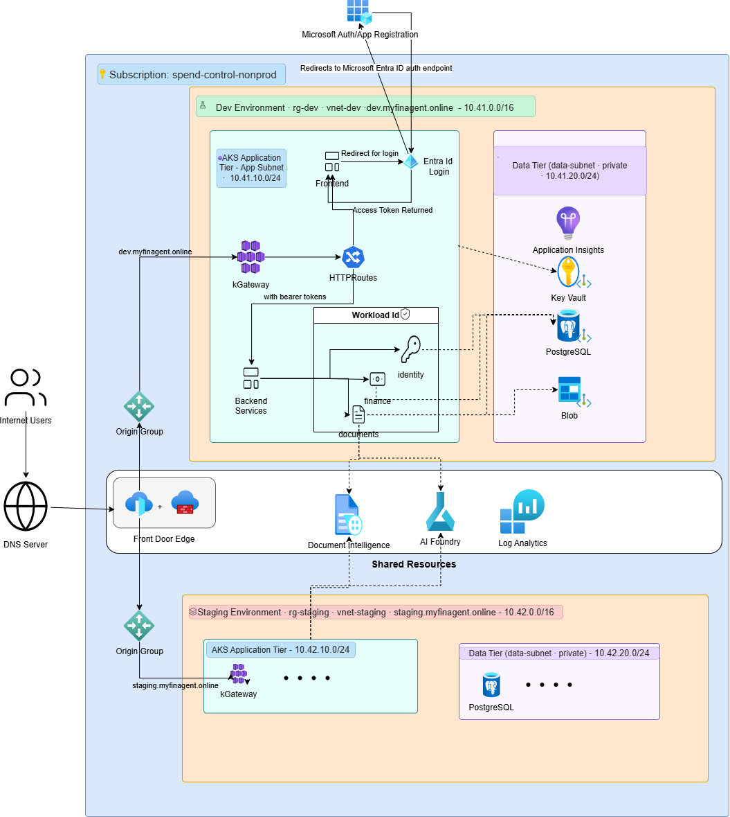
Cloud Architecture

Slide 4
AZURE INFRASTRUCTURE
Azure Cloud Services
Every layer maps to a purpose-built Azure service — cloud-native, fully managed, and isolated by design.
Azure Front Door + WAF — Global entry point with threat protection
AKS + kGateway — Container orchestration and L7 routing
PostgreSQL Flexible Server — Managed relational database
Azure Blob Storage — Document and receipt storage
Azure AI Document Intelligence + OpenAI — Intelligent extraction
Log Analytics + App Insights — Observability stack

Slide 5
SECURITY
Identity, Security & Access Control
Microsoft Entra ID
Workload Identity
Managed Identities
Users authenticate via Entra ID. Separate app registrations for frontend (SPA) and backend (API) enforce least-privilege OAuth2 scopes.
AKS pods use Workload Identity to access Blob Storage, AI services, and ACR — no static secrets in code or config.
Azure services (PostgreSQL, Storage, AI) use managed identities for secure, passwordless service-to-service communication.

Slide 6
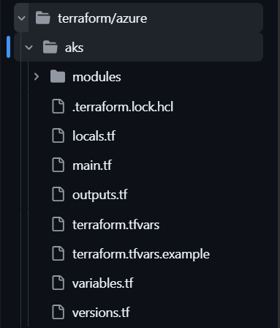
Terraform structure

Slide 7
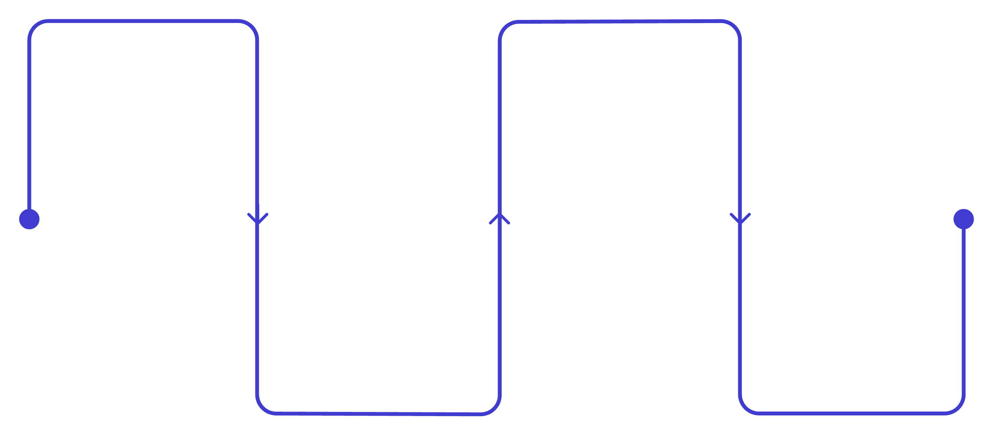
DEVOPS PIPELINE
CI/CD & Infrastructure Automation
Code Push
Provision
Developer pushes branch, triggers GitHub Actions
Terraform plan & apply to update Azure infra
Authenticate
Release
OIDC to Azure and Terraform init with remote backend
Build image, push to ACR, deploy to AKS via Helm
GitHub Actions uses OIDC federation for secretless Azure authentication. Terraform manages infrastructure; container builds and Helm deployments handle application releases — fully automated on every merge.

Slide 8
INFRASTRUCTURE AS CODE
Terraform Workspace & State Strategy
Remote Backend
State stored in Azure Blob Storage — enabling team collaboration, locking, and audit history.
Workspace Strategy
Dev/Staging/Prod Seperation
Why It Matters
Isolated state per environment prevents accidental cross-environment changes and supports safe promotion workflows.

Slide 9
LESSONS & TAKEAWAYS
Challenges Learned — And What Works
Environment Separation
OIDC Setup
Terraform workspaces + remote state prevent cross-environment drift
Federated credentials eliminate secrets — worth the initial configuration effort
Front Door Routing
State Migration
Correct backend pool and routing rule config is critical for AKS ingress
Planning state moves early avoids disruption as the infrastructure grows
Outcome: A scalable, multi-tenant SaaS on Azure — Terraform + GitHub Actions + AKS deliver a production-ready, maintainable platform.

