Slide 1
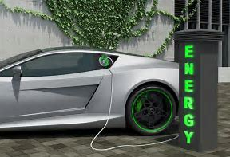
ELECTRIC VEHICLES
DO I Want one?

Slide 2




Introductions
TEAM #7 CREW:
anuradhasingh.gailakoti@gmail.com
seannoone29@gmail.com
Spenserwhilton@gmail.com
khandelwal.anu@gmail.com

Slide 3
Our Thought Process
Pure Electric and Hybrid cars are finding way towards a more greener world. Makers are spending large amounts to manufacture better, stable, and safe vehicles. We wanted to study
Are Electric Vehicles becoming more popular amongst the public? Which Brands specifically?
What years did we see the greatest increase in EV purchases
are the sales numbers increasing rapidly, year-by-year
Is there a preference of Pure electric over Hybrids

Slide 4
Our Strategy
We looked for the vehicle data that was available to us for free.
Found and collected 10 years monthly sales data for Electric, and Hybrids and 4 years of gasoline vehicle sales.
Based on the data we collected, We decide to do:
Comparison for the top 10 Make/Models for the last 3 years in the US.
We decided US to limit ourselves to manageable datasets.
Comparison of yearly data to see the rate of change in the EV sales from 2010-2017
Comparison of the EVS Sales and the Traditional sales to see the trend and if the portion of the total market of AEVS is increasing

Slide 5
DATA COLLECTION - WEBSITES
Team researched which websites to collect data from.
EV Car sales :
https://insideevs.com/monthly-plug-in-sales-scorecard/
Gasoline Car Sales:
http://carsalesbase.com/us-car-sales-data/dodge/

Slide 6
Challenges with Data Collection / Aggregation
Finding sources with complete useable data.
Most were graphs, charts.
Data cleansing
Total of EV Sales for the last 3 years, and top 5 ev makers
How is the trend
Percentage of EV sales how change in EV sales per year

Slide 7
Data Manipulations
Removed extraneous value, including Nulls from our dataset
Sorting and grouping of data

Slide 8
Results and Analysis

Slide 9
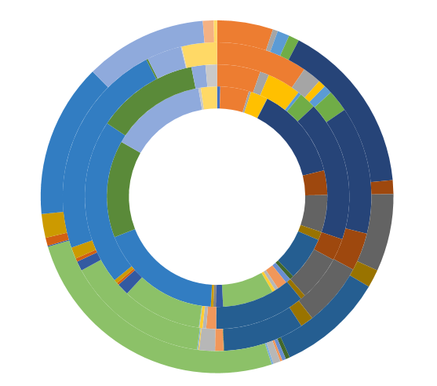
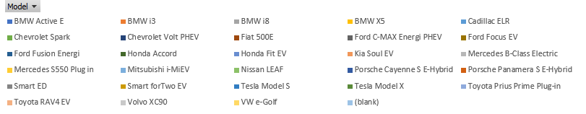
Sum of Yearly Sales of Hybrids & EVs
2014
2017

Slide 10
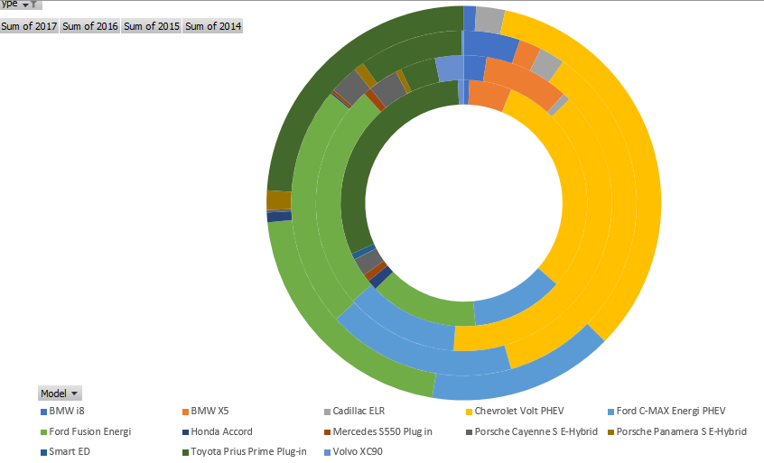
Sum of Yearly Sales of Hybrids
2014
2017

Slide 11
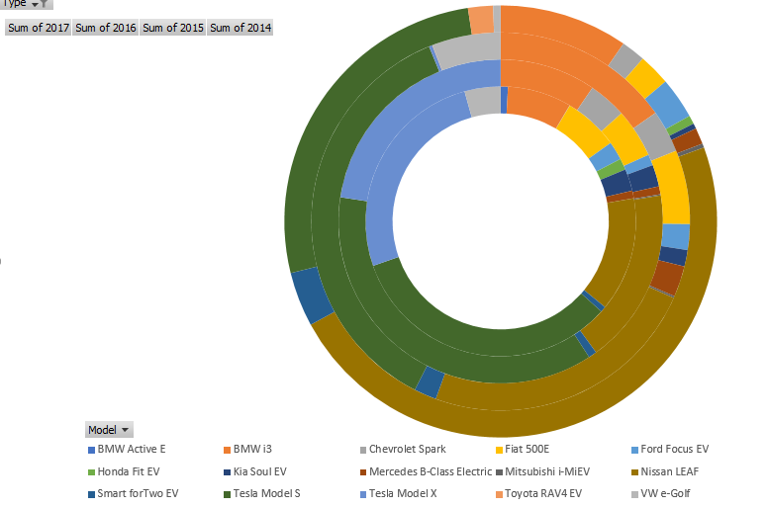
Sum of Yearly Sales of Electric Vehicles
2014
2017
2017

Slide 12
Electrics Hybrids Overall
In 2014 the top 3 models were:
Nissan Leaf started strong at 48% sales
Tesla Model S at a 28%
BMW i3 at 10%
In 2015 the top 3 models were:
Tesla Model S at a 36%
Nissan Leaf decreases at 24%
BMW i3 at 15%
In 2016 the top 3 models were:
Tesla Model S at a 37%
Tesla Model X at a 23%
Nissan Leaf decreases to 18%
In 2017 the top 3 models were:
Tesla Model S at a 33%
Tesla Model X at a 23%
Nissan Leaf decreases to 14%
In 2014 the top 3 models were:
Chevrolet Volt 34%
Toyota Prius P 24%
Ford Fusion Energi 21%
In 2015 the top 3 models were:
Chevrolet Volt 36%
Ford Fusion Energi 23%
Ford C-Max Energi 18%
In 2016 the top 3 models were:
Chevrolet Volt 38%
Ford Fusion Energi 25%
Ford C-Max Energi 12%
In 2017 the top 3 models were:
Chevrolet Volt 30%
Toyota Prius Prime 31%
Ford Fusion Energi 14%
In 2014 the top 3 models were:
Nissan Leaf 25%
Chevrolet Volt 16%
Tesla Mode S 14%
In 2015 the top 3 models were:
Tesla Model S 23%
Nissan Leaf 15%
Chevrolet Volt 13%
In 2016 the top 3 models were:
Tesla Model S 20%
Chevrolet Volt 17%
Tesla Model X 13%
In 2017 the top 3 models were:
Tesla Model S 18%
Chevrolet Volt 14%
Tesla Model X 14%
Toyota Prius Prime 14%

Slide 13
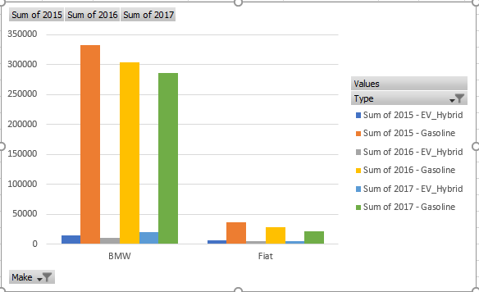
Electric Vehicles vs Gasoline Sales
For Makers of BMW and Fiat, we see a significant decrease in the Gasoline car sales, and an increase in the EV/hybrids for the last 3 years.

Slide 14
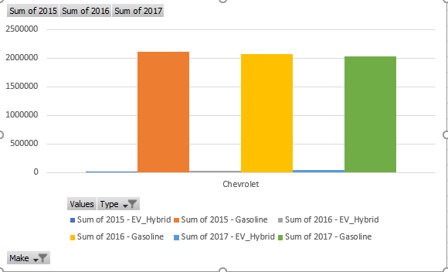
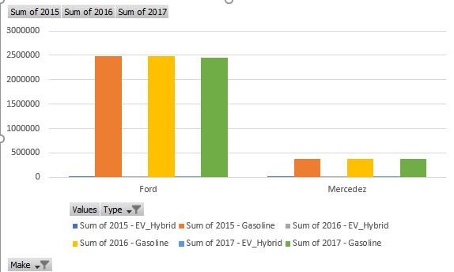
Electric Vehicles vs Gasoline Sales
Fiat, Mercedez and Chevrolet show a decrease, however not so significant in the gasoline car sales, while there is an increased sales in EV/Hybrids for them..

Slide 15
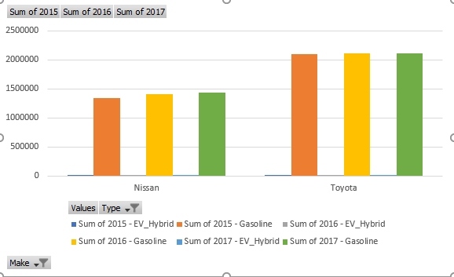
Electric Vehicles vs Gasoline Sales
Toyota and Nissan have a growth in both gasoline and EV/Hybrids for the last 3 years

Slide 16
Analysis
Overall we see that the pure Electric Vehicles were popular until 2016
In 2017 Hybrids have taken over the sales over the Electrics.
For Makers of BMW and Fiat, we see a signifact decrease in the Gasoline car sales, and an increase in the EV/hybrids for the last 3 years. Fiat and Chevrolet both show a decrease, however not so significant.
Totota and Nissan have a growth in both gasoline and EV/Hybrids.

Slide 17
Conclusion
Overall we see that the pure Electric Vehicles were popular until 2016
In 2017 Hybrids have taken over the sales over the Electrics.
For Makers of BMW and Fiat, we see a signifact decrease in the Gasoline car sales, and an increase in the EV/hybrids for the last 3 years. Fiat and Chevrolet both show a decrease, however not so significant.
Totota and Nissan have a growth in both gasoline and EV/Hybrids.

Slide 18
Anaysis

Slide 20
Add a Slide Title - 4

Slide 21
Add a Slide Title - 5

