Slide 1
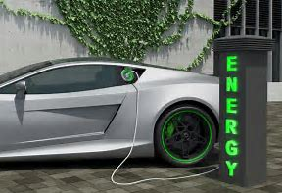
ELECTRIC VEHICLES in U.S.
Passing fad or transportation of the future?

Slide 2
Last year, the Dutch parliament voted through a motion to end all gas and diesel car sales by 2025 (it still has to go through the Dutch senate).
In June, India announced that it would end sales of gas and diesel cars by 2030.
In June, Norway agreed to end sales of gas and diesel cars by 2025. (Norway leads the world in EVs — almost 40 percent of its newly registered vehicles were hybrid, electric, or hydrogen in 2017.)
In July, France and Britain announced it would end sales of gas and diesel cars by 2040.
In August, German Chancellor Angela Merkel hinted that her country would follow suit. "I cannot name an exact year yet,” she said, “but the approach is right, because if we quickly invest in more charging infrastructure and technology for electric cars, a general changeover will be structurally possible.“
This month, the Scottish government announced it would phase out gas and diesel cars by 2032.
Sources:
https://www.vox.com/energy-and-environment/2017/9/13/16293258/ev-revolution
(The International Energy Agency’s Global EV Outlook )

Slide 3




Introductions
TEAM #7 CREW:
anuradhasingh.gailakoti@gmail.com
seannoone29@gmail.com
Spenserwhilton@gmail.com
khandelwal.anu@gmail.com

Slide 4
Our Thought Process
Questions at the core of our analysis:
Are Electric Vehicles becoming more popular amongst the public over the past few years?
If so, in which years is the increase most apparent?
are the sales numbers increasing rapidly, year-by-year
Are there clear leaders in the EV market? What EV models are most popular?
Is there a preference of Pure electric over Hybrids.
Is there infrastructure in place to support the increasing popularity of Electric Vehicles.

Slide 5
DATA COLLECTION
3 years monthly sales data for Electric, Hybrids and years of gasoline vehicle sales.
We decided US to limit ourselves to manageable datasets.
Websites data was collected from:
EV Car sales :
https://insideevs.com/monthly-plug-in-sales-scorecard/
Gasoline Car Sales:
http://carsalesbase.com/us-car-sales-data/dodge/

Slide 6
Challenges with Data Collection, Manipulations/Aggregations:
Collections:
Finding sources with complete useable data.
Most were graphs, charts and images
Manipulations:
Data cleansing
Converting png files into ‘excel ‘and ‘csv’ formats.
Removed extraneous value, including Nulls from our dataset
Sorting and grouping of data
Aggregations:
Total of EV Sales for the last 3 years, and top 5 EV makers
How is the trend of EV sales over past few years
Percentage of EV sales how change in EV sales per year

Slide 7
Data Analysis

Slide 8
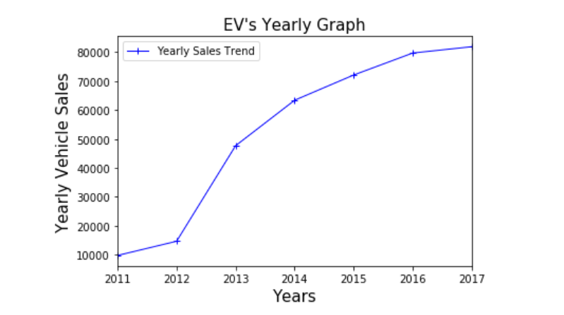
Yearly Sales of Electric Vehicles:
The tend shows that gradually but there has been increase in EV sales over the years
We can also see the major hike from 2012 to 2013 from ~15k to 50k sales

Slide 9
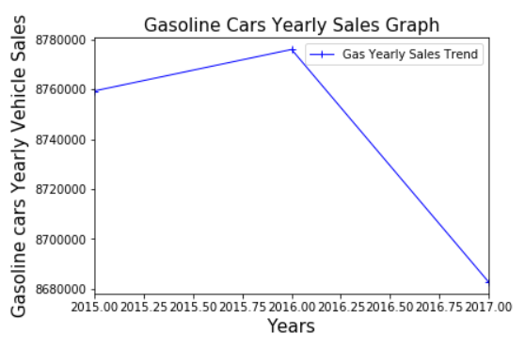
Yearly Sales of Gasoline Vehicles:
The trend shows a decrease in Gasoline car sales since last year.

Slide 10
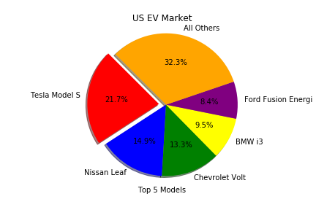
2015 US EV Sales Leaders (by Model)
Top 5 models = 67.7% of EV sales
Tesla Model S is the top seller by a ~50% margin

Slide 11
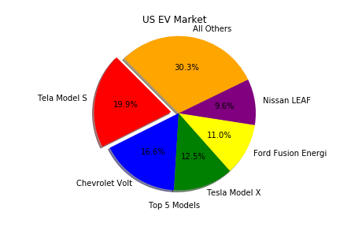
2016 US EV Sales Leaders (by Model)
Top 5 models = 69.7% of EV sales
Start of a more even distribution among leaders

Slide 12
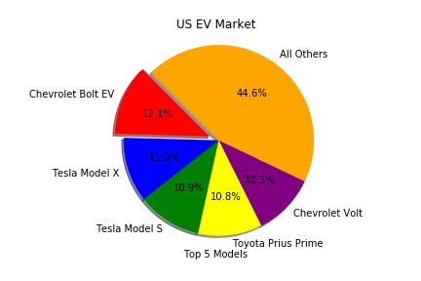
2017 US EV Sales Leaders (by Model)
Top 5 models = 55.4% of EV sales
Further evening of distribution among leaders
Goes along with an increase in available options in the market.
3 of the top 5 models are non-luxury.

Slide 13
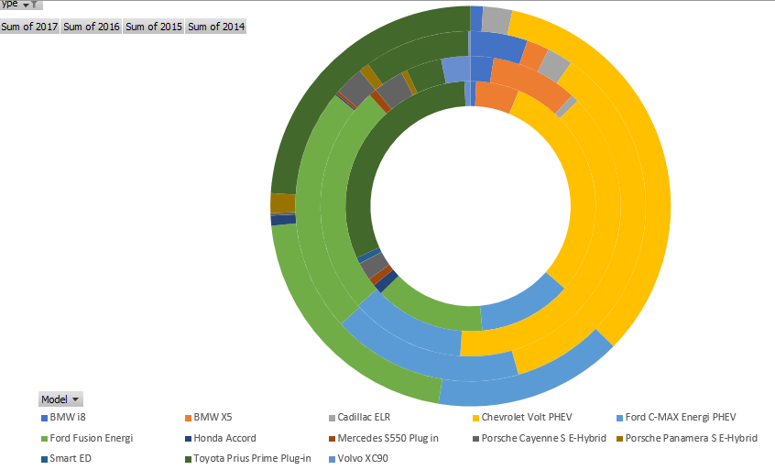
Sum of Yearly Sales of Hybrids
2014
2017

Slide 14
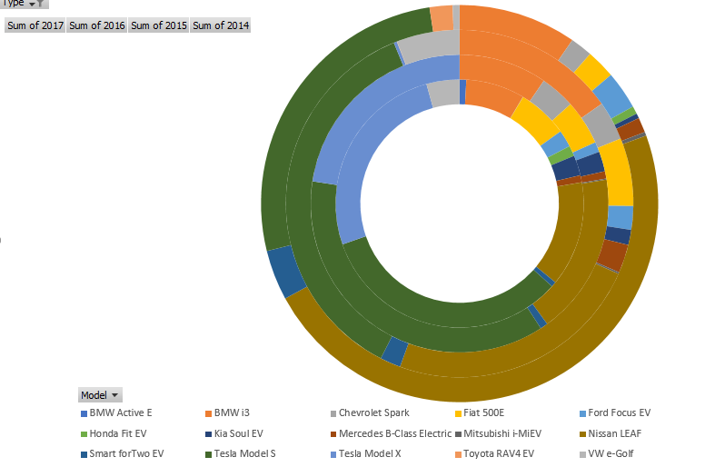
Sum of Yearly Sales of Electric Vehicles
2014
2017
2017

Slide 15
Top Models of Each Categories:
Electrics
In 2015 the top 3 models were:
In 2016 the top 3 models were:
Overall
In 2015 the top 3 models were:
Hybrids
Tesla Model S 36%
Nissan Leaf 24%
BMW i3 15%
Tesla Model S 37%
Tesla Model X 23%
Nissan Leaf to 18%
In 2017 the top 3 models were:
Tesla Model S 33%
Tesla Model X 23%
Nissan Leaf 14%
In 2015 the top 3 models were:
Chevrolet Volt 36%
Ford Fusion Energi 23%
Ford C-Max Energi 18%
In 2016 the top 3 models were:
Chevrolet Volt 38%
Ford Fusion Energi 25%
Ford C-Max Energi 12%
In 2017 the top 3 models were:
Chevrolet Volt 30%
Toyota Prius Prime 31%
Ford Fusion Energi 14%
Tesla Model S 23%
Nissan Leaf 15%
Chevrolet Volt 13%
In 2016 the top 3 models were:
Tesla Model S 20%
Chevrolet Volt 17%
Tesla Model X 13%
In 2017 the top 3 models were:
Tesla Model S 18%
Chevrolet Volt 14%
Tesla Model X 14%
Toyota Prius Prime 14%

Slide 16
Electric Vehicles vs Gasoline Vehicle Sales
For Makers such as BMW, we see a significant decrease in the Gasoline car sales, and an increase in the EV/hybrids for the last 3 years.

Slide 17
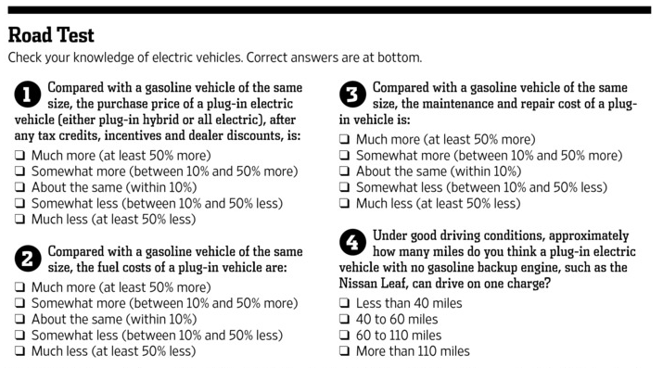

Slide 18

Source:
https://www.wsj.com/articles/what-s-holding-back-electric-car-sales-1411937798

Slide 19
Conclusion
Growing trend in Electric and Hybrid Vehicles.
Tesla dominates the market for Pure Electric vehicle sales
In 2017 Hybrids have taken over the sales over the Electrics.
For Makers of BMW and Fiat, we see a significant decrease in the Gasoline car sales, and an increase in the EV/hybrids for the last 3 years. Fiat and Chevrolet both show a decrease, however not so significant.
Toyota and Nissan have a growth in both gasoline and EV/Hybrids.
I am buying Electric. Are you?

