Slide 1
Course Project in CS5351 Software Engineering
Dr W.K. Chan
Department of Computer Science
Email: wkchan@cityu.edu.hk
Website: http://www.cs.cityu.edu.hk/~wkchan

Slide 2
Goal
This is a code project
This is a team-based project
Develop a software engineering tool, in which you realize your original new idea
A software engineering tool is for software developers to assist the development team in carrying out their development technical tasks.
It is not developing software for ordinary people. (e.g., don’t develop apps we install on our mobile phones for daily use)

Slide 3
Project Size
The project accounts for 30% of the coursework component.
For a team of 6 students, the project size is akin to a single-person final-year project (FYP) in your undergraduate degree.
Assessment Expectation: Each student will spend 30 to 40 hours on the project

Slide 4
Project Progress
Team size: 5-8 students
5-6 students: at least two non-functional requirements
7-8 students: at least three non-functional requirements
Each non-functional requirement is required to be addressed by a software architectural design option with rationale
Apply an Agile methodology with at least three cycles (sprints in Scrum).
Sprint 1
Weeks 2-5
Sprint 2
Weeks 6-9
Sprint 3
Weeks 10-13
At least one standing meeting per week
Use burndown chart

Slide 5
Project Progress
Sprint 1 (Weeks 2-5)
Develop user stories, sketch architecture to address non-functional requirements, code, test, review, identify/track/resolve technical debts
Sprint 2 (Weeks 6-9)
Activities in Sprint 1 + code quality
Sprint 3 (Weeks 10-13)
Activities in Sprint 2 + automated testing, debugging and maintenance support
Project wrap up
Presentation, video, report writing
Each team must maintain a project in a code repository (e.g., Github) which captures the team’s weekly activities to serve as evidences of activities conducted during the project period stated in the final report.

Slide 6
Project Mark Components
Presentation Video and Demo Video (5%)
Presentation
The presentation should cover the background, motivation, key technical problem solved, review closely related works, explain the challenges to address when solving the technical problem, the solution that solves the technical problem, explanation of to what extent the challenges have been solved and what the creativity of the project is, empirical evaluation of the software through scenarios in acceptance tests and user feedbacks if any.
Demo Video
Demonstrate the most significant end-to-end usages of the constructed software.
Walk through the software development process used and explain why any process improvement you made during the execution of the project. Focus on the most significant, innovative, or unique features rather than going through all the details.
Future enhancement should not be considered as a demonstration of the software constructed as a part of the demonstration.
Final Report (25%)
Technical innovation and creativity (i.e., a project without innovation cannot get A+/A/A-)
Reporting (including organization, clarity, readability, completeness, and consistency)
System design, Implementation, testing, and evaluation of the solution (solution prototype is sufficient)
Applied advanced software engineering processes, activities, techniques, and tools applied in the project to produce the solution and self-reflection.
Weekly evidences in project repository

Slide 7
Week 13
Owing to the class size, we will use a poster session to make the presentation more interactive.
Teams prepare printed posters or computer-based slides
All visit a computer lab (e.g., MMW2450, not fixed yet)
Session A: 18:30-20:00 (for 50% of all teams)
Session B: 20:05-21:35 (for 50% of all teams)
Every student may attend any session to chat with any team and listen to the team’s elaboration on its project.

Slide 8
Note: Software Engineering Tool
It is a tool to help software developers (programmers or project teams) to complete software development tasks.
not operating a software after software/service deployment
E.g., a scrum tool, project management tool, a code review assistance, a testing tool, a debugging tool, a code smell tool, a technical debt tool, a design framework, a requirement tracking tool, a tool to identify critical issue in app review pool, …
It can be developed using whatever programming languages you choose.
It can be developed as a standalone tool, a web service, an app, a browser extension, plugin, ….

Slide 9
Counterexamples of software engineering tool
[Don’t do it] Developing a web-based e-commerce system for selling and buying items
[Don’t do it] Developing a library loan system
[Don’t do it] Developing a machine learning model
[Don’t do it] Developing a script to train a machine learning model

Slide 10
Recommendation
Warning 1: A full-feature tool is too large for a student team to target it within the project timeline (12 weeks).
Don’t do it!
Recommendation: Start with an operable open-source project (e.g., a project with its source code you can get from Github) or a project allows plug-in development.
The best kind is a tool related to a research paper so that you can read the paper about the key algorithm implemented in the tool.
Implement your original/improved algorithms to solve a specific software development problem.
A tool can be a standalone tool or a component of a larger tool (e.g., a plugin in Eclipse IDE)

Slide 11
Some Areas You May Consider (1)
Improvement on existing tasks: The main focus of a SE tool is to implement a SE technique, which consists of a sequence of tasks. Some existing tasks may not be good enough (not accurate, far too slow, ineffective, not scalable enough etc). If this is the case, you may develop an alternate method to handle the task (i.e., replacing the existing module by your module for that task)
Lower the acceptance boundary of an existing tool: The input/output of a tool may depend on too many setups or assumptions to prevent them to be used practically. Your project may develop a module to solve that problems

Slide 12
Some Areas You May Consider (2)
Extension on top of existing tool: The tool provides an API and solves a particular problem. Your project may modify or enhance the tool to solve a related problem.
E.g., in your ML course, you may use Pytorch to write code for training deep learning models. Can you develop a drag-and-drop GUI so that developers can write code like playing Lego?
Changing the applicability of an existing tool: A tool may statically check the source code and then generate an outputs. Or, a tool may dynamically analyse the execution logs to generate outputs to spot errors in the program executions. You may change the static analysis component to a dynamic analysis component, and vice versa.
Your Own Idea: Highly preferable. Do not bound by what have been described above or presented in lecture notes.

Slide 13
Some Areas You May Consider (3)
Your Own Idea: Highly preferable. Do not bound by what have been described in the previous slides or presented in lecture notes.

Slide 14
Contributions of Team Members
Suggest using contributed efforts (e.g., hours or story points) in determining the relative contributions of team members (as all of us are students). Teams can decide their own measures on contributions. Team should reward students who take up difficulty tasks
Marks will be pro-rated accordingly. [bounded for extreme, e.g., the presence of a free rider]
Present the contributions in the final report
Respect your teammates, as not everyone wants A+.
MyTool | Actual productive hours spent on the project (hrs) or story points
 | Sprint 1 | Sprint 2 | Sprint 3 | Sprint 4 | Sprint 5 | Total
Zhou, Qilin | 12 | 12 | 12 | 12 | 12 | 60
Wang, Haipeng | 12 | 10 | 5 | 20 | 8 | 55
Chan, W.K. | 5 | 10 | 5 | 5 | 5 | 35
Mean contribution = ( 60+55+35) / 3 = 50 Zhou: 60 / Mean contribution = 60 / 50 = 1.2 Wang: 55 / Mean contribution = 55 / 50 = 1.1 Chan: 35 / Mean contribution = 35/50 = 0.7 If the project gets 69 (in the range of B+ [66.5, 69.5), then Zhou gets 82.8 (A+), Wang gets 75.9 (A), and Chan gets 48.3 (C)

Slide 15
Milestone 0
Form team in Week 1
Nominate a team leader
Team leader chooses and joins an empty project group.
the first one to join an empty group is the team leader.
Other team members join that group
Email to TAs and the course lecturer about your team member list and project number by Week 2
Choose your team name (e.g., Panda) and project name (Bamboo). TA will update the name in Canvas accordingly
Late comer: Use the discussion forum or find team members in the class.

Slide 16
Final Deliverable
a 15-minute Video Clip to present your project
Submit in Week 13
a poster presentation on Monday of Week 14
Your session (Session A or Session B) will be known by Week 11
Venue: MMW2450
Session A (6:30-8:00 pm) and Session B (8:00 pm-9:30 pm)
Submit the poster/presentation slides on the morning of that day so that other students can get the contents and go to your poster stand to chat with your team members.
a Final Report and the source code
Submit in Week 13
Place your project code in a GitHub project.

Slide 17
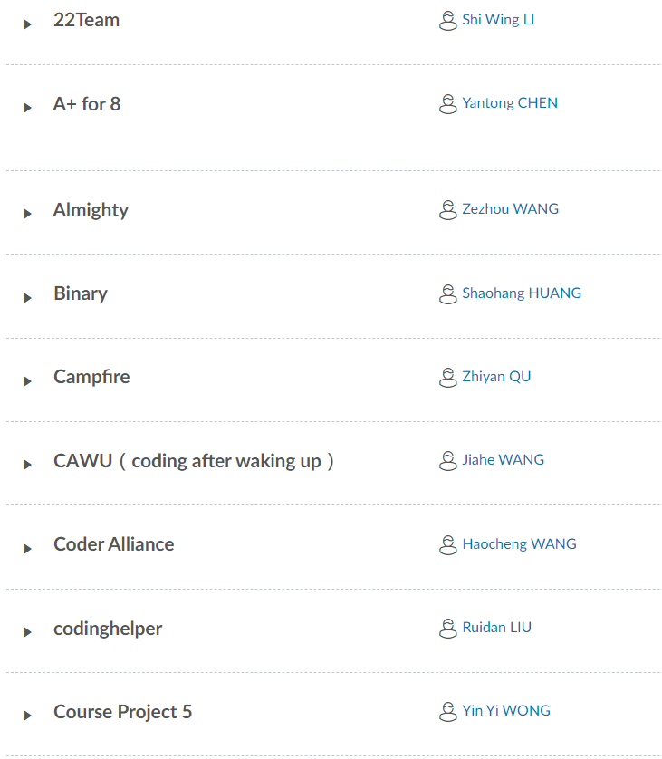
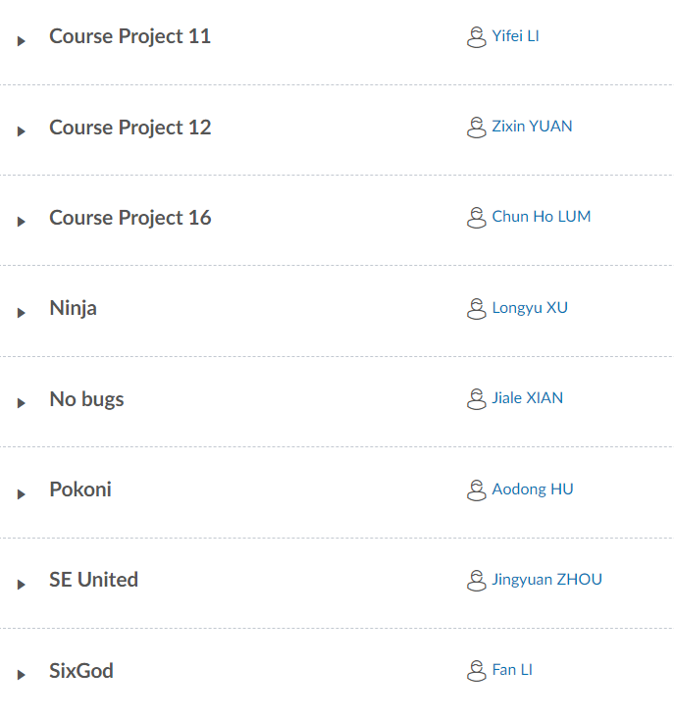
Team Allocations to Sessions A & B MMW2450 on 4 Dec 2023
Session A (6:30pm-8:00pm)
Session B (8:00pm-9:30pm)

Slide 18
Content of Final Report (1/4)
Around 10000 words, excluding all figure/table, self-reflection and references.
Contents includes project title, student name, abstract, introduction, related work, preliminaries, all figures/tables, technical contents, evaluation, relative contribution, self-reflection, references, and the bio of each student including the declaration of the contribution of the student.
Format your report in the IEEE Transactions on Software Engineering format.
https://template-selector.ieee.org/secure/templateSelector/publicationType
Transactions➔IEEE Transactions on Software Engineering ➔ Original Research ➔ Word or LaTeX ➔ Download Template

Slide 19
Content of Final Report (2/4)
Project Title: An informative title
Present your team name before listing out each student with their student ID (not EID!), e.g., CHAN Tai Man 54321987
Abstract: (150 words) Summarize the main problem solved, how your project solves it, and its evaluation results.
Introduction (1-1.5 pages): Summarize the background, the problem you solve, the solutions taken by existing approaches/tools, the reason why existing tools/approaches are still inadequate to solve the problem, your idea, your solution, evaluation.

Slide 20
Content of Final Report (3/4)
Related Work (1 page): Present your fact finding about existing solutions toward solving the problem stated in the section on Introduction.
Preliminaries (1-2 pages): Summary of the technical background information necessary to follow your idea and solution.
Solution (2-3 pages): Present your solution, probably with algorithms, figures, code listing, and an example walkthrough to assist you in presenting your solution. Relate the content to each topic covered in CS5351.
Software Process: Document the activities and the achieved of each sprint in 2 pages (a total of 2*N pages for a project with N sprints). Include the burndown chart for the whole project.（3个sprint，分前后端，一共6页）
Evaluation (2-5 pages): Summarize what you have verified or evaluated your solution to have solved the problem stated in the report, and compare to the results of existing tools
Conclusion (1 page): Recap the main achievement (process, activities, techniques, deliverables, tool, people, and best practice) and future work.

Slide 21
Content of Final Report (4/4)
Student Bio: Present a bio of each student. Who you are, your background, technical ideas, current interests, etc. Give a self-reflection on the work done by you. Stateand justify your contribution to the project.
Relative Contribution: Present the relative contribution as illustrated on Slide 8. If the information is missing, all team members will assume equal contributions.

Slide 22
Enjoy Your Project

