Slide 1
Task-2 :EC2 INSTANCE WITH JENKINS INSTALLATION USING TERRAFORM

Slide 2
Jenkins
Jenkins is used to build and test your product continuously, so developers can continuously integrate changes into the build.
Jenkins is the most popular open source CI/CD tool on the market today and is used in support of DevOps, alongside other cloud native tools.
Continuous integration (CI):
Developers frequently merge code changes into a shared repository. Automated tests are run to ensure the code is reliable.
Continuous delivery (CD)
Developers automatically deploy code changes into a testing or staging environment. This ensures that the code has passed testing and is ready for deployment.

Slide 3
Terraform
Terraform is an open-source tool that allows users to manage infrastructure using code.
It's used to develop, modify, and version infrastructure components, such as servers, databases, and network storage.
Terraform is a powerful Infrastructure as Code (IaC) software tool offered by HashiCorp. It facilitates provisioning and managing your infrastructure on-prem and in the cloud. It can be easily extended with the help of its plugin-based architecture.
IaC makes this process much easier by allowing you to define and provision your infrastructure with the help of a declarative language.

Slide 4
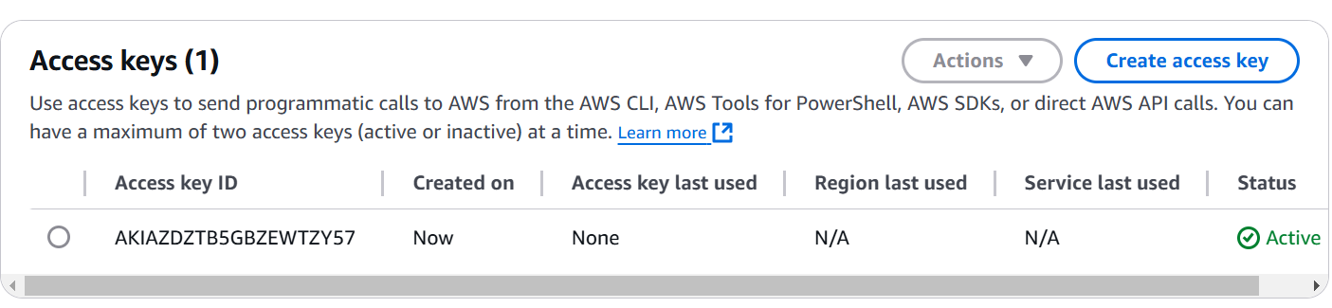
SECURITY CREDENTIALS:​
When working with Terraform and provisioning infrastructure, security credentials are an essential aspect. These credentials authenticate and authorize Terraform to interact with the cloud provider's APIs (such as AWS, Azure, or Google Cloud). It's important to handle credentials securely to prevent unauthorized access to your cloud resources.​
Go to the AWS MANAGEMENT CONSOLE and search the IAM service and create the Access key and the image is shown below.​

Slide 5
VPC
VPC (Virtual Private Cloud) is a logically isolated network within AWS where you can define your resources (like EC2, RDS, etc.) to ensure they are secure and segmented from other networks.​
CIDR Block: Defines the IP address range for your VPC.​
In your case, cidr_block = "10.0.0.0/16" gives you a range of 10.0.0.0 to 10.0.255.255, which allows you to create multiple subnets.​
DNS Support & Hostnames:​
enable_dns_support = true: Enables DNS resolution within the VPC, which is useful for resolving domain names to IP addresses within your VPC.​
enable_dns_hostnames = true: Enables DNS hostnames for instances within the VPC, making it easier to access EC2 instances by hostname.​

Slide 6
VPC TERRAFORM CODE:​
provider "aws" {
region = "ap-south-1"
}
resource "aws_vpc" "main" {
cidr_block = "10.0.0.0/16"
enable_dns_support = true
enable_dns_hostnames = true
tags = {
Name = "main-vpc"
}
}

Slide 7
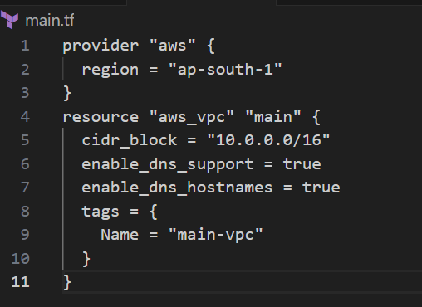
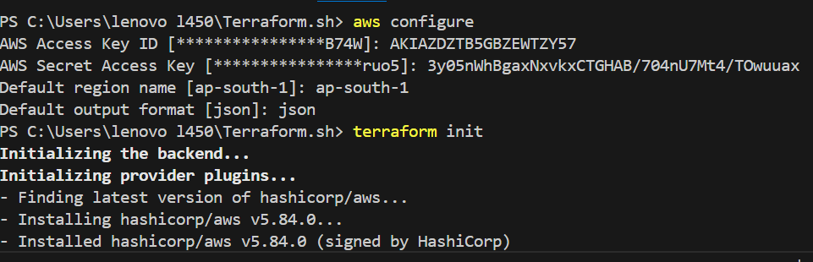
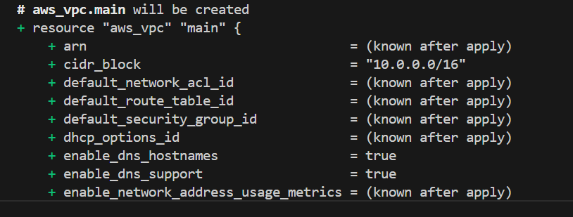
In visual studio code app how the vpc can be created by using terraform code and give the terraform init,validate,plan,apply commands and the images are shown below.​

Slide 8
WHAT ARE SUBNETS?​
Subnets divide the VPC into smaller, isolated networks. Typically, you create public subnets for resources that need internet access (e.g., web servers, Jenkins) and private subnets for internal resources (e.g., databases).​
Public Subnets: These subnets have routes to the internet and can host resources like EC2 instances that need to be accessed externally.​
In your case, you created two public subnets:​
subnet_a with CIDR 10.0.1.0/24 in ap-south-1a​
subnet_b with CIDR 10.0.2.0/24 in ap-south-1b​
Private Subnets: You might consider creating additional subnets in the future for more secure, internal resources (e.g., database servers).​

Slide 9
SUBNETS TERRAFORM CODE:​
resource "aws_subnet" "public_subnet_1" {
vpc_id = aws_vpc.main.id
cidr_block = "10.0.1.0/24"
availability_zone = “ap-south-1a"
map_public_ip_on_launch = true
tags = {
Name = "Public Subnet 1"
}
}

Slide 10
resource "aws_subnet" "private_subnet_1" {
vpc_id = aws_vpc.main.id
cidr_block = "10.0.2.0/24"
availability_zone = “ap-south-1a"
tags = {
Name = "Private Subnet 1"
}
}

Slide 11
resource "aws_subnet" "public_subnet_2" {
vpc_id = aws_vpc.main.id
cidr_block = "10.0.3.0/24"
availability_zone = “ap-south-1b"
map_public_ip_on_launch = true
tags = {
Name = "Public Subnet 2"
}
}

Slide 12
resource "aws_subnet" "private_subnet_2" {
vpc_id = aws_vpc.main.id
cidr_block = "10.0.4.0/24"
availability_zone = “ap-south-1b"
tags = {
Name = "Private Subnet 2"
}
}

Slide 13
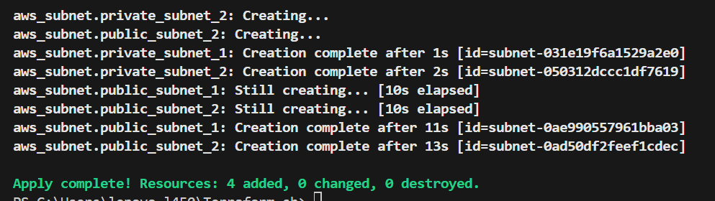
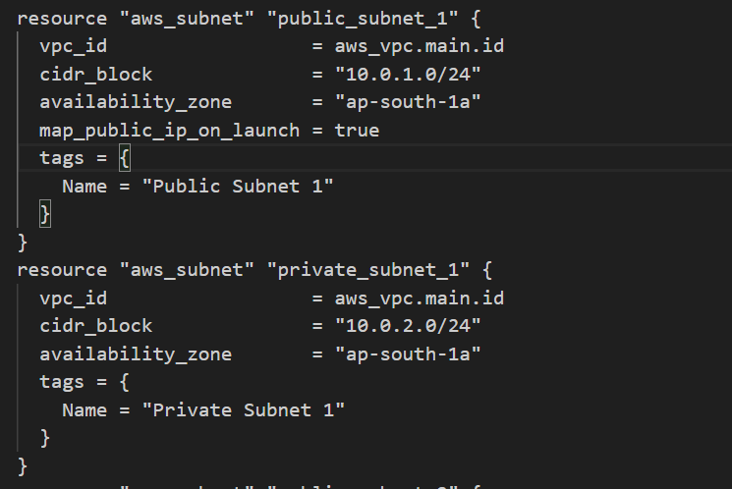
In visual studio code app how the subnets can be created by using terraform code and give the terraform plan and apply commands the images are shown below.​

Slide 14
WHAT IS INTERNET GATEWAY?​
An Internet Gateway (IGW) is required to allow communication between your VPC and the internet. ​
By attaching an IGW to your VPC, you provide external access to resources in your public subnets (e.g., Jenkins EC2 instance).​
An internet gateway serves as a highly available, redundant, and horizontally scaled gateway that facilitates two-way communication between your VPC resources and the internet.

Slide 15
INTERNET GATEWAY TERRAFORM CODE:​
resource "aws_internet_gateway" "main" {
vpc_id = aws_vpc.main.id
tags = {
Name = "Main Internet Gateway"
}
}

Slide 16
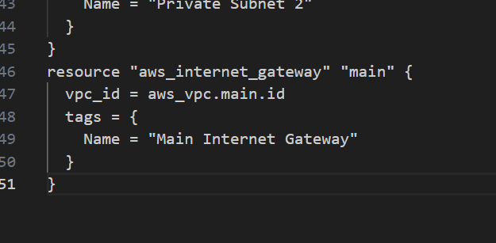
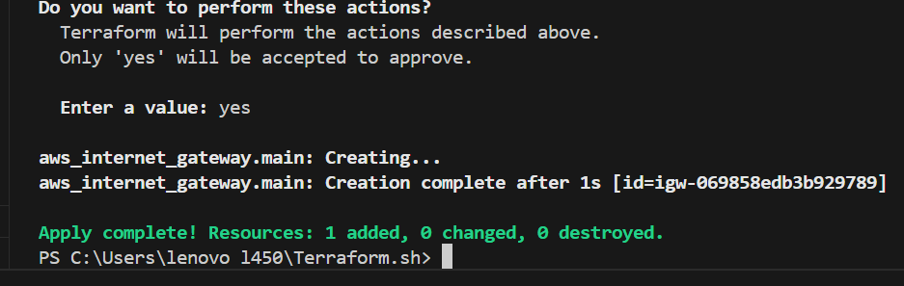
In visual studio code app how the internet gateway can be created by using terraform code and give the terraform plan and apply commands and the images are shown below.​

Slide 17
WHAT ARE ROUTE TABLES AND ROUTES?​
Each subnet in a VPC can be associated with a Route Table to define how network traffic is routed. If a subnet is meant to have access to the internet (public subnet), it should have a route directing traffic (0.0.0.0/0) to the internet gateway.​
Main Route Table: This table defines the default routing for your VPC. In this case, it directs all outbound traffic (0.0.0.0/0) to the Internet Gateway.​

Slide 18
ROUTE TABLES TERRAFORM CODE:​
resource "aws_route_table" "public_route_table" {
vpc_id = aws_vpc.main.id
route {
cidr_block = "0.0.0.0/0"
gateway_id = aws_internet_gateway.main.id
}
tags = {
Name = "Public Route Table"
}
}

Slide 19
resource "aws_route_table_association" "public_association_1" {
subnet_id = aws_subnet.public_subnet_1.id
route_table_id = aws_route_table.public_route_table.id
}
resource "aws_route_table_association" "public_association_2" {
subnet_id = aws_subnet.public_subnet_2.id
route_table_id = aws_route_table.public_route_table.id
}

Slide 20
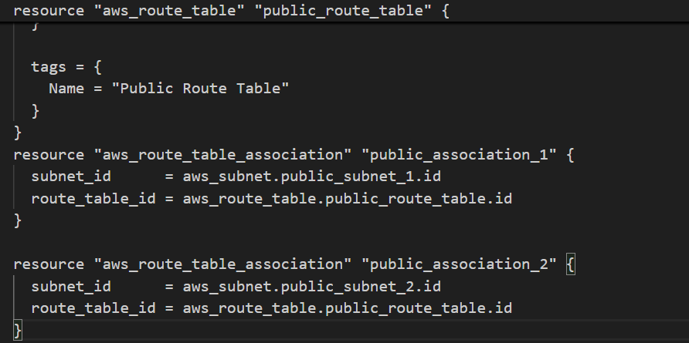
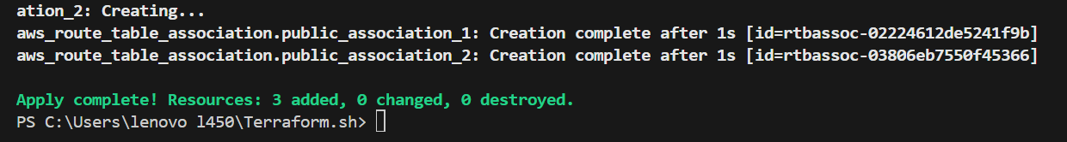
In visual studio code app how the route tables and routes can be created by using terraform code and give the terraform plan and apply commands the images are shown below.​

Slide 21
WHAT ARE SECURITY GROUPS?​
A Security Group in AWS functions as a virtual firewall that controls inbound and outbound traffic to resources (like EC2 instances and RDS databases). It works at the instance level and is stateful (meaning responses to allowed inbound traffic are automatically allowed, regardless of outbound rules).
We have defined a security group (jenkins_sg) with the following inbound rules:​
SSH Access (Port 22): Allows SSH access from anywhere (0.0.0.0/0), which is typically used for managing EC2 instances.​
Jenkins Web UI (Port 8080): Allows HTTP traffic for Jenkins on port 8080 from anywhere.​

Slide 22
SECURITY GROUP TERRAFORM CODE:​
resource "aws_security_group" "jenkins_sg" {
name = "jenkins-sg"
description = "Allow access to Jenkins"
vpc_id = aws_vpc.main.id
ingress {
description = "SSH"
from_port = 22
to_port = 22
protocol = "tcp"
cidr_blocks = ["0.0.0.0/0"]
}

Slide 23
ingress {
from_port = 8080
to_port = 8080
protocol = "tcp"
cidr_blocks = ["0.0.0.0/0"]
}
egress {
from_port = 0
to_port = 0
protocol = "-1"
cidr_blocks = ["0.0.0.0/0"]
}
}

Slide 24
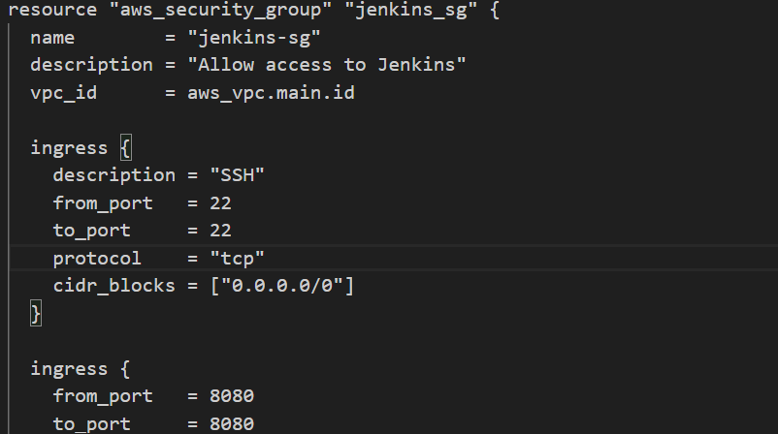
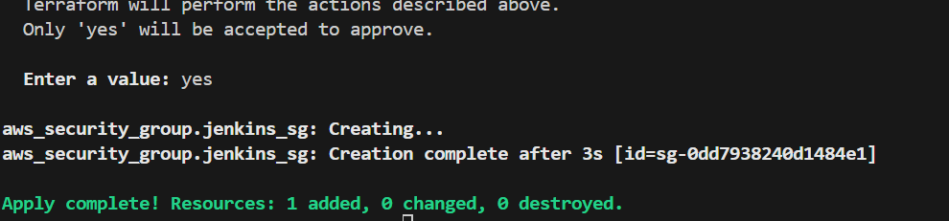
In visual studio code app how the security groups can be created by using terraform code and give the terraform plan and apply commands the images are shown below.​

Slide 25
WHAT IS EC2 INSTANCE?​
An EC2 instance (Elastic Compute Cloud instance) is a virtual server in Amazon Web Services (AWS) that you can use to run applications, host websites, or perform other computing tasks. ​
EC2 instances provide scalable computing capacity in the cloud and are one of the core services in AWS.​

Slide 26
JENKINS INSTALL IN AN EC2 INSTANCE:​
AMI (ami):This defines the Amazon Machine Image (AMI) used for the EC2 instance. The AMI ID you provided, “ami-05fa46471b02db0ce", is for a specific instance in the ap-south-1 region. Make sure this AMI is available in the region you're provisioning the EC2 instance.​
Instance Type (instance_type):You have selected a t2.micro instance, which is part of the free tier for AWS but may have limitations for production workloads. This is generally suitable for small, development, or test environments.​
Key Pair (key_name):The key_name “Dev" refers to the SSH key pair used to access the EC2 instance. Make sure this key pair exists in AWS before provisioning the instance. You can either create a new key pair in the AWS Console or import an existing one.​

Slide 27
Security Group (security_groups):The security_groups line refers to a security group named jenkins_sg (presumably defined elsewhere in your Terraform configuration). This security group should allow access to relevant ports such as SSH (port 22) and HTTP/HTTPS (ports 8080/443 for Jenkins).​
Tags (tags):The EC2 instance is tagged with Name = "Jenkins-Server1", which is useful for identifying and managing resources in AWS.​
​User Data (user_data):The user_data block is a shell script that will run automatically when the EC2 instance is launched. This script installs Java 17, Maven, and Jenkins, then starts the Jenkins service. This is helpful for automating the setup of the Jenkins server.​

Slide 28
JENKINS INSTALL IN AN EC2 INSTANCE TERRAFORM CODE:​
resource "aws_instance" "jenkins" {
ami = "ami-05fa46471b02db0ce"
instance_type = "t2.micro"
key_name = “Dev"
subnet_id = aws_subnet.public_subnet_1.id # Assign to the public subnet
# Corrected: Use vpc_security_group_ids instead of security_group_ids
vpc_security_group_ids = [aws_security_group.jenkins_sg.id] # Reference by ID
tags = {
Name = "Jenkins-Server1"
}

Slide 29
user_data = <<-EOF
#!/bin/bash
sudo dnf update -y
sudo dnf install -y java-17-amazon-corretto.x86_64
sudo wget -O /etc/yum.repos.d/jenkins.repo https://pkg.jenkins.io/redhat-stable/jenkins.repo
sudo rpm --import https://pkg.jenkins.io/redhat-stable/jenkins.io-2023.key
yum install -y maven jenkins
sleep 10
systemctl restart jenkins.service
systemctl enable jenkins.service
systemctl status jenkins.service
EOF
}

Slide 30
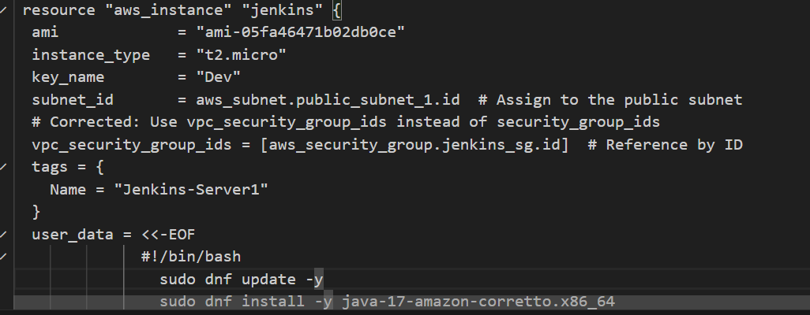
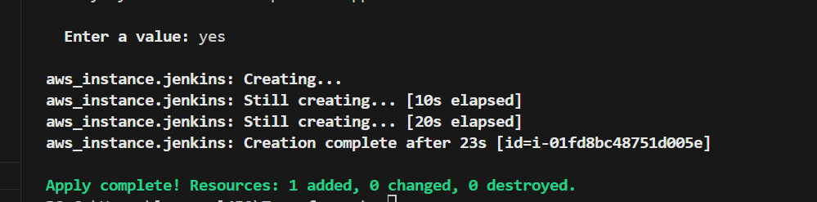
In visual studio code app how the Jenkins install in an ec2 instance can be created by using terraform code and give the terraform plan and apply commands the images are shown below.​

Slide 31
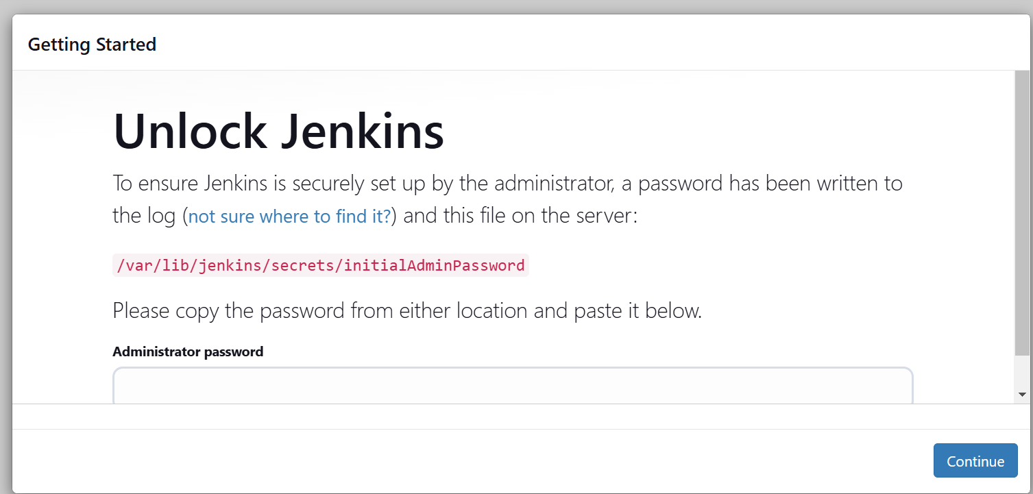
Click on the instance ID and copy the public IPV4 address of your running instance and paste it with port no.8080 on google new tab and the image unlock Jenkins dashboard is shown below.​

Slide 32
WHAT IS RDS(MYSQL DATABASE)?​
Amazon RDS (Relational Database Service) is a managed database service provided by Amazon Web Services (AWS). It simplifies the setup, operation, and scaling of relational databases in the cloud, making it easier to manage databases without having to deal with the underlying hardware and database maintenance.​
Amazon RDS supports multiple database engines, including MySQL, PostgreSQL, MariaDB, Oracle, SQL Server, and Amazon Aurora.​

Slide 33
RDS(MYSQL DATABASE) TERRAFORM CODE:
resource "aws_db_instance" "my_db" {
identifier = "my-jenkins-db"
engine = "mysql"
engine_version = "8.0.39"
instance_class = "db.t3.micro"
allocated_storage = 20
db_name = "jenkinsdb"
username = "admin"
password = "YourDbPasswordHere"

Slide 34
multi_az = true # Enable Multi-AZ for high availability
storage_type = "gp2"
publicly_accessible = true # Keep database private
vpc_security_group_ids = [aws_security_group.jenkins_sg.id] # Restrict access from Jenkins SG
db_subnet_group_name = aws_db_subnet_group.main.id
tags = {
Name = "Jenkins-Database"
}
}

Slide 35
Create a DB Subnet Group for RDS
resource "aws_db_subnet_group" "main" {
name = "main-db-subnet-group"
subnet_ids = [
aws_subnet.private_subnet_1.id,
aws_subnet.private_subnet_2.id
]
tags = {
Name = "Main DB Subnet Group"
}
}

Slide 36
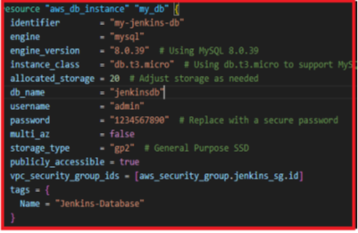
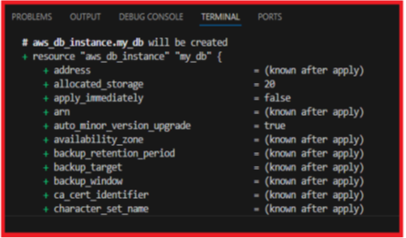
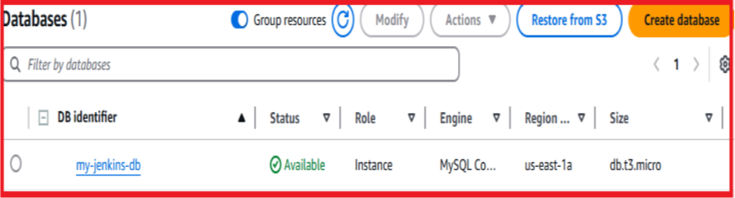
In visual studio code app how the RDS(MYSQL DATABASE) can be created by using terraform code and give the terraform plan and apply commands the images are shown below.​

Slide 37
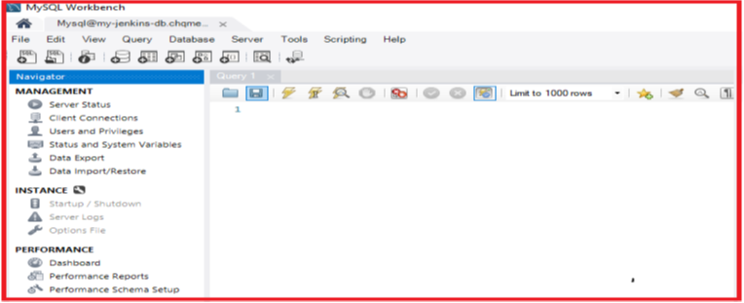
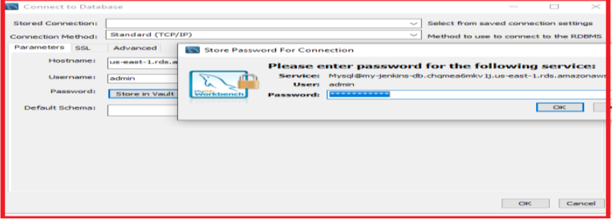
Connect database by copy the ENDPOINT and port of your database ,paste it on MYSQL workbench and the images are shown below.​
​

Slide 38


