Slide 1
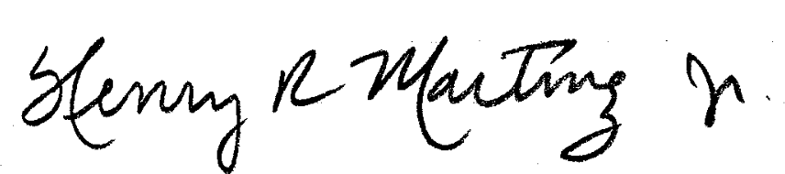
TO : PROGRAMMA CONSULTANTS TORRANCE, CA
DEAR MEL,
HERE’S A REAL NICE PIECE OF SOFTWARE CALLED MASTERMIND. IT DOES REQUIRE A BASIC, IT ONLY REQUIRES A SPHERE W/KBD AT F000/1 (OLD ONE) AND V3D (V3N) PROMS. IT WILL RESIDE AT 0300 → 059E WITH THE PROGRAM BEGINNING AT 0400, AT THIS STAGE, THE PROGRAM IS FAST, AND MAY EVEN APPEAR TO BE RUNNING THROUGH BASIC DUE TO THE “FANCY” PROMPTING AND MESSAGES.
I IMAGINE THE PROGRAM COULD SELL FOR $5 -> $10 DOLLARS – IT’S UP TO YOU GUYS I GUESS.
I REALLY DON’T WANT TO RECEIVE MONEY FOR MY EFFORT, AS I HAD A LOT OF FUN DOING IT, AND MY PHILOSPHY ABOUT SOFTWARE TENDS TO BE VERY LIBERAL; HOWEVER, I DIDN’T PUT IT IN THE NEWLETTER BECAUSE I SAW THIS AS AN OPPORTUNITY TO GET MORE SOFTWARE FOR MYSELF.
WHAT I WOULD LIKE TO DO IS HAVE YOU GO AHEAD AND SELL/DISTRIBUTE THIS PROGRAM, AND KEEP TRACK OF WHAT I “MAKE” AS FAR AS ROYALTIES. WHEN I ACCUMULATE ENOUGH MONEY ON THAT “ACCOUNT”, I’LL JUST BUY SOME SOFTWARE FROM YOU. I HOPE THIS IS AGREEABLE WITH YOU. IF YOU HAVE ANOTHER METHOD OR DON’T WANT TO DO IT THIS WAY THEN GO AHEAD AND WE’LL DO IT THE NORMAL WAY, I GET MY SOFTWARE EITHER WAY.
706 W, 212TH ST. THANKS,
TORRANCE, CA, 90502
(212) 320-2161
AFTER 7:00
P.S. FLOWCHARTS AND PROGRAM ANALYSIS (DESCRIPTION)
TO FOLLOW. (APPROX. 1 mo.)

Slide 2
6/23/77
MASTERMIND (V3D)(V3N)(V3A)
H. MARTINEZ
1
START
GENERAL
FLOWCHART
INITIALIZE
TEMPORARY
REGISTERS
DISPLAY HITS AND EXTRAS ON CRT
HOME CURSOR
CLEAR SCREEN
IS GUESS CORRECT ?
YES
PRINT WINNING MESSAGE
NO
OUTPUT HEADING MESSAGE
INCREMENT THE GUESS
COUNTER
GO TO PICK A NUMBER TO BE GUESSED
IS GUESS COUNTER = 12 ?
YES
PRINT LOSING MESSAGE
NO
PROMPT FOR GUESS
INPUT THE GUESS
ASK PLAYER IF HE WANTS TO PLAY AGAIN
TRANSFER THE GUESS FROM CRT RAM TO “GUESS” TMPS
PLAY AGAIN ?
NO
GO TO DEBUG
YES
TRANSFER THE DATA FROM ”VAULT” TO “CHECKBOX”
COMPARE “GUESS” TO “CHECKBOX”

Slide 3
6/23/77
MASTERMIND V3N
HENRY MARTINEZ
1 of 9
THIS MASTERMIND IS SIMILAR TO MILTON-BRADLEY’S MASTERMIND GAME *, AND TO THE BAGEL GAME THAT’S USUALLY FOUND IN BASIC.
IN THIS GAME, THE COMPUTER PICKS A 5 DIGIT NUMBER, WHEREIN THE DIGITS GO FROM 0 → 6.
THE OBJECT IS TO GUESS THE NUMBER IN 12 GUESSES
AFTER EACH GUESS, THE COMPUTER RESPONDS WITH THE NUMBER OF ‘HITS’ AND ‘EXTRAS’ YOU HAD.
HITS ARE THE NUMBER OF DIGITS IN YOUR GUESS THAT CORRESPOND EXACTLY TO THE NUMBER THE COMPUTER PICKED.
EXTRAS ARE THE NUMBER IN THE GUESS WHICH ARE IN THE COMPUTER’S “PICKED” NUMBER, BUT IN THE WRONG POSITION.
i.e
GUESS 3 4 0 6 1 HITS EXTRA
1 1
COMPUTER’s # 4 4 5 2 3
THE 4’S ARE A HIT, THE 3’S ARE EXTRAS
HOW TO PLAY:
I) LOAD CASSETTE NAME “MM” [4D, 4D]
@ 0300 → 59E
2) RUN AT LOCATION 0400.
3) THE COMPUTER WILL PUT A HEADING ON THE CRT AND TYPE:
ENTER GUESS >
YOU ARE REQUIRED TO INPUT A 5 DIGIT NUMBER FOLLOWED BY A “<“.
(next page) * (OR IS IT PARKER BROS. ?)

Slide 4
6/23/77
MASTERMIND V3N
HENRY MARTINEZ
2 of 9
UPON TYPING THE LESS THAN SIGN, THE COMPUTER WILL TYPE THE NUMBER OF HITS AND EXTRAS THAT WERE IN YOUR GUESS,
AND PROMPTS FOR NEXT GUESS.
>GUESS< HITS EXTRA
ENTER GUESS >XXXXX< X X
ENTER GUESS >
6) YOU HAVE 12 CHANCES IN WHICH TO GUESS THE NUMBER.
IF YOUR GUESS IS CORRECT, THE COMPUTER WILL SAY SO AND TELL YOU HOW MANY GUESSES IT TOOK.
IF YOU’RE NOT ABLE TO GUESS THE NUMBER IN 12 TRIES, YOU WILL BE TOLD WHAT THE NUMBER WAS.
7) AFTER THE GAME IS OVER YOU WILL BE ASKED IF YOU WANT TO PLAY AGAIN… IF SO, TYPE ANYTHING BESIDES AN “N” AND PLAY SOME MORE. TYPING N PUTS YOU INTO DEBUG.

Slide 5
MASTERMIND V3N
HENRY MARTINEZ
3 of 9
TEXT FOR PROMPTING, I/O REQUESTS 320 →300
TEMPORARY LOCATIONS:
ADDRESS DATA
0300 SPARE
301 1st DIGIT
302 2nd DIGIT
303 3rd DIGIT
304 4th DIGIT
305 5th DIGIT
306 1st DIGIT
307 2nd DIGIT
308 3rd DIGIT
309 4th DIGIT
30A 5th DIGIT
30B 1st DIGIT
30C 2nd DIGIT
30D 3rd DIGIT
30E 4th DIGIT
30F 5th DIGIT
310 HITCOUNTER
311 EXTRACOUNTER
312 GUESSCOUNTER
313 CURSOR POINTER TEMP.
314 CURSOR POINTER TEMP. 315 INDEX REGISTER TEMP.
316 INDEX REGISTER TEMP.
317 INDEX REGISTER TEMP.
318 INDEX REGISTER TEMP.
PROGRAM BEGINS AT: 0400
PROGRAM ENDS AT: 059E
BACKSPACE CHAR. AT: 047F
NUMBER PICKER SUBROUTINE PARAMETERS*:
1) LOWER BOUNDS: 042D
2) UPPER BOUNDS: 0453
* SEE TEXT 3) OFFSET : 0438, 0439
GUESS
CHECKBOX
THE NUMBER THE
COMPUTER PICKS IS
PLACED HERE FOR
THE COMPARE, IT IS
TRANSFERRED TO THE
BECAUSE THE COMPARISON
BETWEEN GUESS AND CHECKBOX IS
DESTRUCTIVE
VAULT

Slide 6
6/23/77
MASTERMIND (V3N)
HENRY MARTINEZ
4 of 9
PROGRAM SPECIFICS:
I THE INPUT FROM KEYBOARD DOES NOT USE THE SPHERE EDITOR, THEREFORE YOU CANNOT USE ANY OF THE CURSOR CONTROLS EXCEPT FOR THE BACKSPACE ← KEY ON THE CURSOR PAD.
TO CHANGE A GUESS BEFORE HITTING “<“, SIMPLY BACKSPACE TO
THE DIGIT TO BE CORRECTED RE-TYPE IT AND TYPE IN THE REST OF THE
NUMBER IN THE GUESS AGAIN UNTIL DONE (THIS’LL BECOME CLEARER AFTER LOADING THE PROGRAM AND RUNNING IT A FEW TIMES.
II MAKE SURE YOUR GUESS IS 5 DIGITS ONLY OTHERWISE THE HIT COUNTS AND EXTRA COUNTS WILL BE INCORRECT FOR THAT PARTICULAR GUESS.
III THE PICK A NUMBER ROUTINE FOR THE COMPUTER IS RATHER CLEVER I THINK, BUT SEEMS TO BEHAVE DIFFERENTLY IN DIFFERENT SYSTEMS (SOMETIMES THE RANDOM NUMBERS AREN’T VERY RANDOM). SO I’LL EXPLAIN HOW I GENERATE THE NUMBERS AND HOW TO “FIX” THE SUBROUTINE IF IT’S MISBEHAVING.
THE RANDOM NUMBER GENERATOR LOOKS AT THE KBD PIA FOR GARBAGE AT LOCATION F000. IT PUTS IT IN THE ACC A AND CHECKS TO SEE IF IT IS WITHIN A SPECIFIC RANGE (NOW SET TO 08 < # < 12). WHEN IT IS BETWEEN THOSE TWO LIMITS, THE PROGRAM ADDS 24₁₆ TO BRING THE NUMBER INTO THE ASCII RANGE OF 30 →36 (0-6).
WHEN THE NUMBER ISN’T WITHIN THE LIMITS, THE PROGRAM SIMPLY GOES AND FETCHES ANOTHER NUMBER AND CONTINUES UNTIL ITS FILLED 5 MEMORY LOCATIONS I CALL THE ‘VAULT’ WITH ASCII CHARACTERS.
(next page)

Slide 7
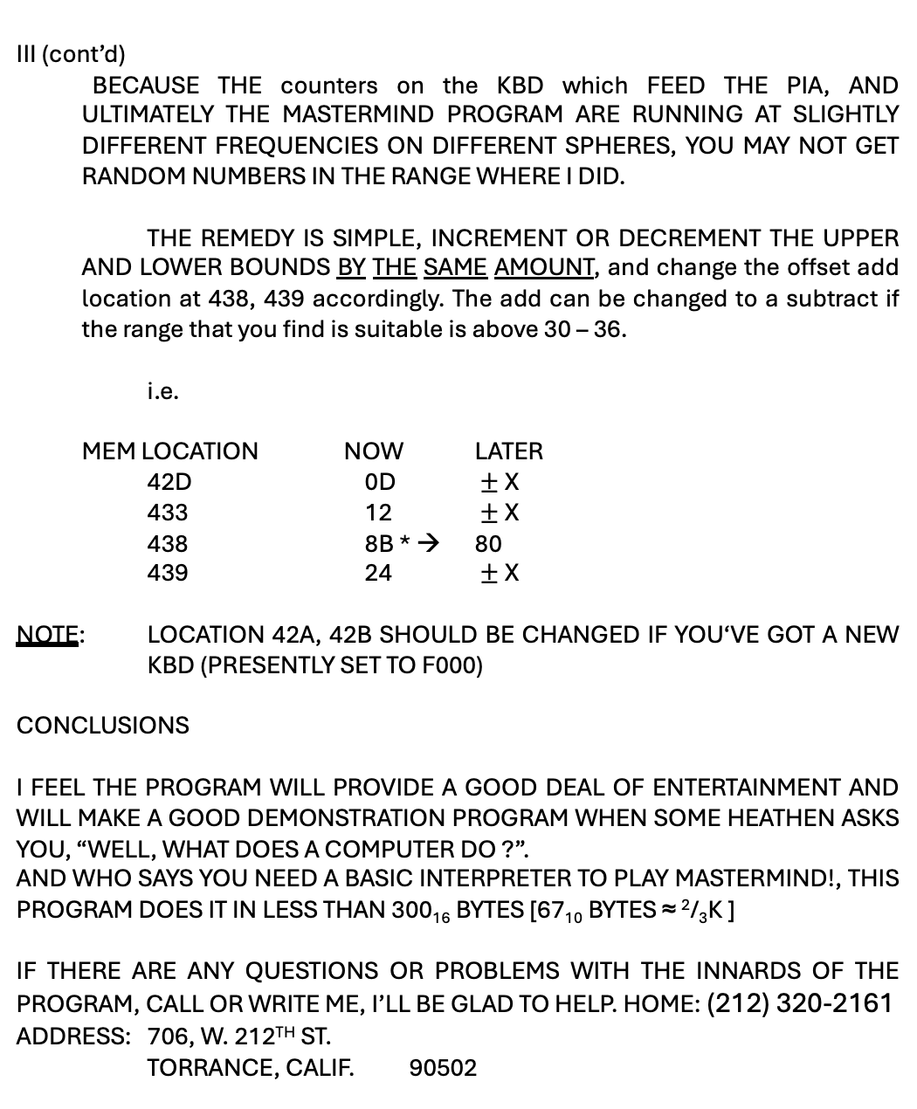
6/23/77
MASTERMIND (V3N)
HENRY MARTINEZ
5 of 9
III (cont’d)
BECAUSE THE counters on the KBD which FEED THE PIA, AND ULTIMATELY THE MASTERMIND PROGRAM ARE RUNNING AT SLIGHTLY DIFFERENT FREQUENCIES ON DIFFERENT SPHERES, YOU MAY NOT GET RANDOM NUMBERS IN THE RANGE WHERE I DID.
THE REMEDY IS SIMPLE, INCREMENT OR DECREMENT THE UPPER AND LOWER BOUNDS BY THE SAME AMOUNT, and change the offset add location at 438, 439 accordingly. The add can be changed to a subtract if the range that you find is suitable is above 30 – 36.
i.e.
MEM LOCATION NOW LATER
42D 0D $±$X
433 12 $±$X
438 8B * → 80
439 24 $±$X
NOTE: LOCATION 42A, 42B SHOULD BE CHANGED IF YOU‘VE GOT A NEW KBD (PRESENTLY SET TO F000)
CONCLUSIONS
I FEEL THE PROGRAM WILL PROVIDE A GOOD DEAL OF ENTERTAINMENT AND WILL MAKE A GOOD DEMONSTRATION PROGRAM WHEN SOME HEATHEN ASKS YOU, “WELL, WHAT DOES A COMPUTER DO ?”.
AND WHO SAYS YOU NEED A BASIC INTERPRETER TO PLAY MASTERMIND!, THIS PROGRAM DOES IT IN LESS THAN 300₁₆ BYTES [67₁₀ BYTES ≈ ²/₃K ]
IF THERE ARE ANY QUESTIONS OR PROBLEMS WITH THE INNARDS OF THE PROGRAM, CALL OR WRITE ME, I’LL BE GLAD TO HELP. HOME: (212) 320-2161
ADDRESS: 706, W. 212TH ST.
TORRANCE, CALIF. 90502

Slide 8
6 of 9
6/23/77
MASTERMIND TEXT
H. MARTINEZ
TEXT 1
= 0320
53 E 50 48
45 E 52 45
20 E 4D 41
53 E 54 45
52 E 4D 49
4E E 44 20
47 E 41 4D
45 E 20 20
28 E 56 33
41 E 29 0D
20 E 20 20
20 E 20 20
20 E 20 20
20 E 20 20
3E E 47 55
45 E 53 53
3C E 20 48
49 E 54 53
20 E 20 45
58 E 54 52
41 D 0D
= 0360
45 E 4E 54
45 E 52 20
47 E 55 45
53 E 53 20
3E
= 0370
20 E 4C 4F
53 E 45 2C
20 E 4E 55
4D E 42.45
2 E 20 57
41 E 53 3A
20
= 0390
59 E 4F 55
20 E 57 49
4E E 21 21
20 E 49 4E
20 E 20 47

Slide 9
7 of 9
6/23/77
MASTERMIND TEXT
H. MARTINEZ
TEXT 2
TEXT
55 E 45 53
53 E 45 53
= 03B0
54 E 4F 20
50 E 4C 41
59 E 20 41
47 E 41 49
4E E 20 54
59 E 50 45
20 E 59 20
45 E 4C 53
45 E 20 54
59 E 5 45
20 D 4E

