Slide 1

Game Design

Slide 2
Noughts and Crosses
Screen is 16 lines by 32 chars
Display board -
#
#
#
#
#
#
# # #
#
# # #
#
# # #
#
#
#
#
#
#
# # #
#
# # #
#
# # #
#
#
#
#
#
#
#
#
Have a flashing cursor that goes around each square and wraps
<enter> to place the piece.

Slide 3
(x,y)
(6,1) = 15
Offset = ((y*line_length) + x)
Store in SCREEN_BASE + offset
X
Screen_base = 0xE000
Screen end = 0xE1FF
****Assuming the CPU/2 Board and CRT/1 boards are standard setup

Slide 4

Project
Author
Date
0
Screen Layout Sheet
10
20
30
16
32
8
10
16

Slide 5
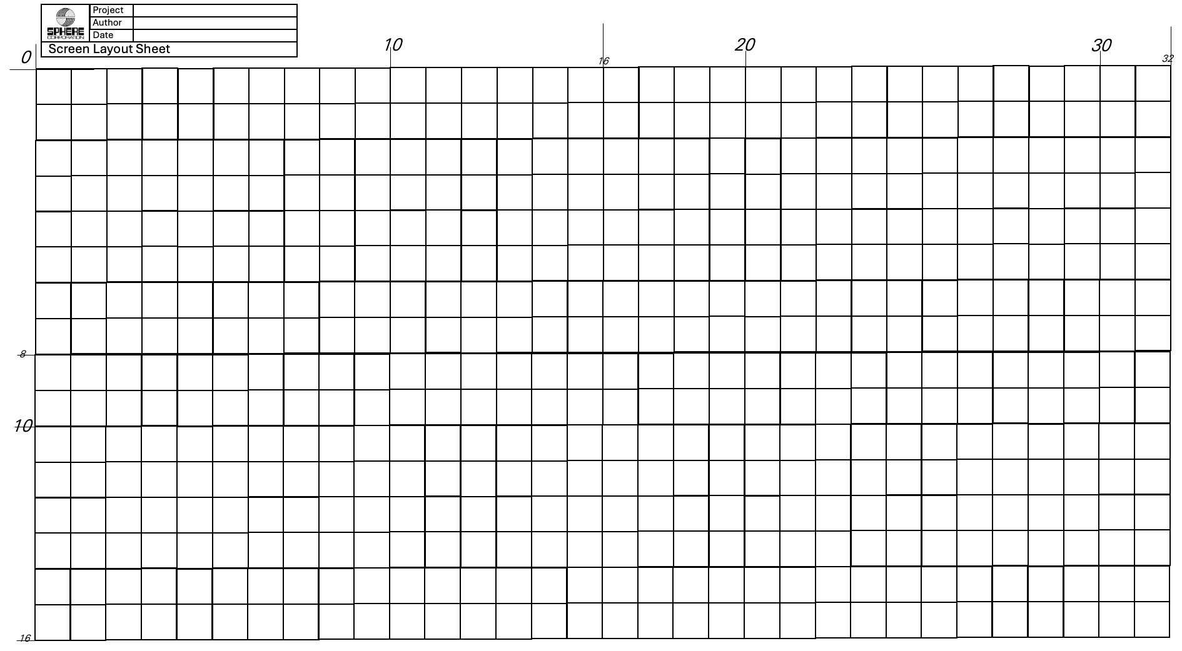
#
#
X
X
#
#
X
#
#
X
X
#
#
#
#
#
#
#
#
#
#
#
#
#
O
O
O
#
#
O
O
#
#
O
O
O
#
#
#
#
#
#
#
#
#
#
#
#
#
#
#
#
#

Slide 6
Project
Author
Date
0
Screen Layout Sheet
10
20
30
16
32
8
10
16

Slide 7
10,3 16,3 22,3
10,9 16,9 22,9
10,15 16,15 22,15
LDX #0
LDAA CURSX
LDAB CURSY
CMP #10
BEQ ROWS
CMPA #16
BEQ COL1
COL2 INX
COL1 INX
ROWS CMPB #3
BEQ ROW1
CMPB #9
BEQ ROW2
INX
ROW2 INX
ROW1 INX
STX POSIT
1 2 3
4 5 6
7 8 9

