Slide 1
AI Job Market Analysis 2025-2026
What 1,500 AI job postings tell us about salaries, demand and skills

Slide 2
What is this about?
We took a dataset of AI job postings and turned it into charts.
Goal: see what AI jobs actually pay, which roles are growing, and which skills keep showing up.
Before charting anything, the raw data had to be cleaned - a lot of it was inconsistent.
This presentation walks through the cleaning and what the charts show afterwards.

Slide 3
Where did we get the data?
Downloaded from Kaggle - a dataset of AI job market postings for 2025 and 2026.
1,500 rows and 25 columns of data.
Covers 25 roles (LLM Engineer, Prompt Engineer, MLOps Engineer...)
Each posting lists salary, required skills, location, experience level, demand score and more.
Jobs across 14 countries - about 3 in 4 offer remote or hybrid work.

Slide 4
Cleaning and preparing the data
288 salaries sat outside their posted min-max range - we widened the range so the salary fits inside it.
1,099 rows had years of experience that didn't match the experience level (e.g. 'Entry' with 8 years) - clipped them into the right band.
119 postings listed the same skill twice - kept only the first one.
Turned the flag columns into True/False, merged year + month into a posting_date, and gave ordered columns (Entry < Mid < Senior < Lead) so charts sort correctly.
Result: a clean table saved as ai_jobs_cleaned.csv, plus a long skills table for skill charts.

Slide 5
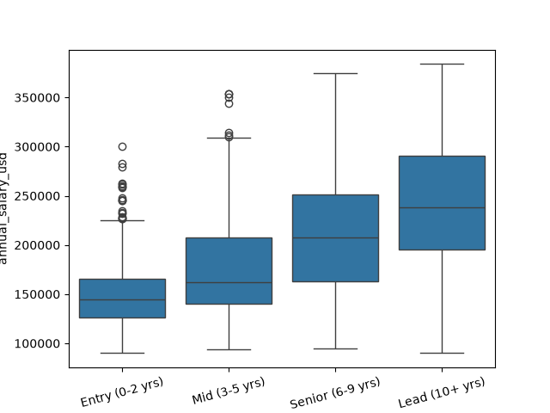
Does pay rise with experience?
Q: Do more senior roles actually pay more?
A: Yes, clearly. The median salary climbs at every step - around $145k for Entry, $162k for Mid, $208k for Senior and $238k for Lead. The whole box (the middle 50% of salaries) keeps moving up, so the trend is not caused by a few outliers. The biggest single jump is Mid to Senior, roughly +$46k or about 28% more.
Q: What does the spread tell us?
A: Every level still has a wide range, so a top-paid Mid engineer can out-earn a low-paid Senior. But the Entry and Lead boxes barely overlap at all - experience is one of the strongest salary drivers in this market.

Slide 6
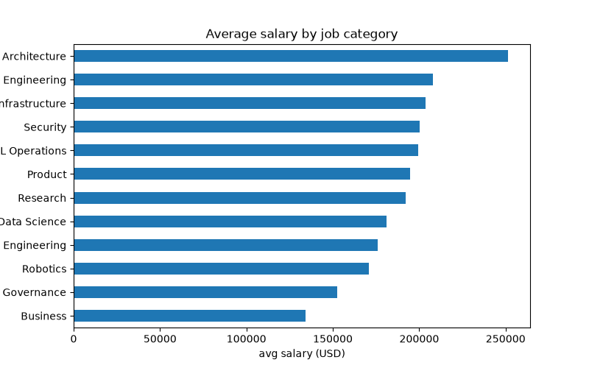
Which job category pays best?
Q: Which categories pay the most?
A: Architecture tops the list at about $252k average (roles like AI Solutions Architect). The technical core sits just behind - AI Engineering ~$208k, Infrastructure ~$204k, Security ~$200k and ML Operations ~$199k, all comfortably above $200k.
Q: And the lowest paying?
A: Business roles average ~$134k and Governance ~$153k. Still six-figure jobs, but close to half of what the top technical tracks pay. The pattern: roles that design and build systems out-earn roles that manage or analyse them.

Slide 7
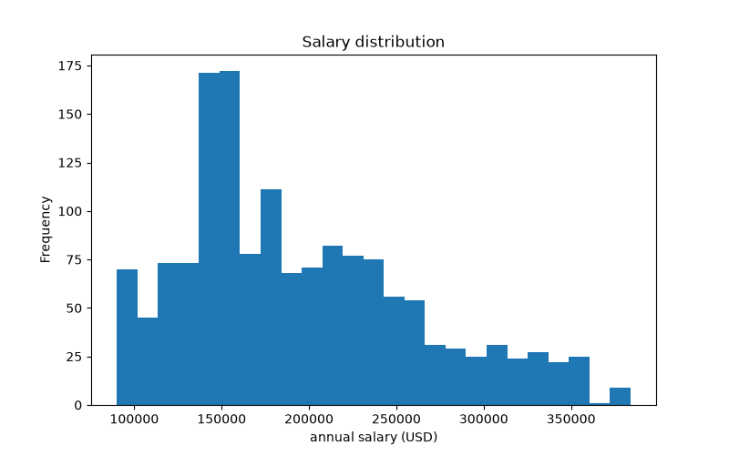
What does a typical AI job pay?
Q: Where do most salaries sit?
A: Salaries spread fairly evenly between $90k and $300k, but the bulk is in the middle - 57% of all postings pay between $100k and $200k. The median is $180k, and the middle 50% of offers fall between roughly $145k and $236k.
Q: How realistic is a $300k+ offer?
A: Possible but rare. The thin tail on the right is the Elite tier - mostly senior LLM and architecture roles at big tech companies. For most AI professionals the realistic band is $150-250k, not the headline numbers.

Slide 8
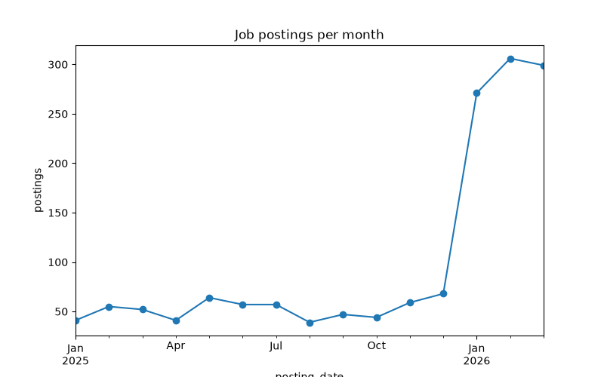
Is the AI job market growing?
Q: Growing or slowing down?
A: Growing. Monthly postings rise through the dataset and peak in early 2026 - January to March 2026 each saw roughly 270-300 new postings, the busiest stretch in the data. The 2025 months are clearly lighter and more uneven.
Q: What could explain the 2026 spike?
A: It lines up with companies moving AI from experiments into real products - LLM, agent and MLOps skills pull the postings up. Whatever the reason, the momentum is still increasing, not cooling off.

Slide 9
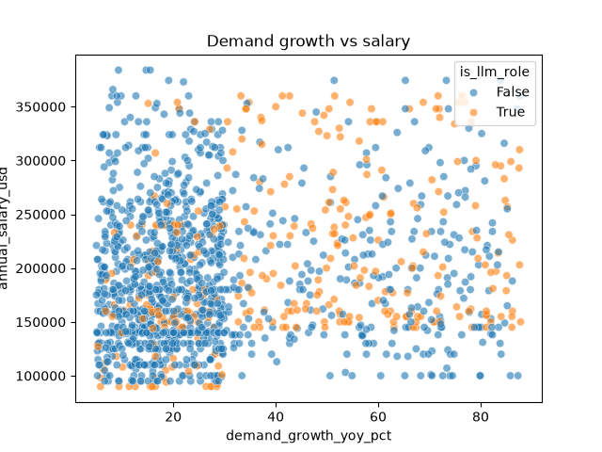
Does fast growth mean higher pay?
Q: Do the fastest growing roles pay the most?
A: Only slightly. The correlation between yearly demand growth and salary is about 0.14 - weak. You can find fast-growing roles at $120k and at $300k, so growth on its own does not predict a big paycheck.
Q: What do the LLM roles (colored points) show?
A: They appear at every salary level, but they bunch up on the right side of the chart - average demand growth of about 44% a year versus 28% for everything else. LLM skills are where the market is expanding fastest, even if that does not automatically mean the top salary.

Slide 10
So what did we learn?
Experience pays - median salary grows from ~$145k (Entry) to ~$238k (Lead).
Architecture and core AI engineering roles top the pay charts; business-side roles pay the least.
The market is still accelerating - postings peak in early 2026.
LLM roles are the growth engine (~44%/yr) even though fast growth alone does not guarantee the biggest paychecks.

