Slide 1

Hackfest 2021
Team : Sphinx
Team members:
Srajan Gupta, Jyoti Swaroop, Anshul Agrawal

Slide 2
Introduction
Robotics is a constantly evolving field in the modern world. With the advent of increase in research towards Artificial Intelligence and robotics, we can see much dynamic development in applications like Self driving cars, autonomous drone systems for defense research and delivery systems, medical robots to assist in surgical procedures, agricultural robots, robotic arms in assembly-line industries, etc.
With the advent of increase in COVID-19 in India, we are running short of supplies as well as manpower. A helping hand is definitely necessary in various processes at the hospitals. One such problem which we focus upon here is the disposal of the medical waste like PPE kits, face masks etc and also regular sanitisation of the various surfaces in and around the hospitals. We wish to deploy and exploit the Robotic work force and help the country in the current state of the COVID-19.

Slide 3
Problem Statement
To help curb the current COVID-19 crisis we propose to employ Autonomous Robots in regular tasks and utilise the man power effectively in other required areas. The Robot we propose to build would be able to autonomously navigate around the hospital environment, collect the medical waste from various parts of the hospital and dispose of them without human intervention thus preventing contact with infectious leftover PPE kits, face masks etc.
The robot apart from clearing the medical waste, would also be employed for regular sanitisation of areas and in and around the hospitals, so that patients who might be visiting for a COVID test or any other medical reason can be assured to certain extent of their safety to visit hospitals.
Additionally, employment of these robots in large COVID facilities like the DRDO facility in Delhi, COVID facility by RSS in Indore etc, would ensure the regular sanitisation of the surfaces and could potentially help in spread of the infection.

Slide 4
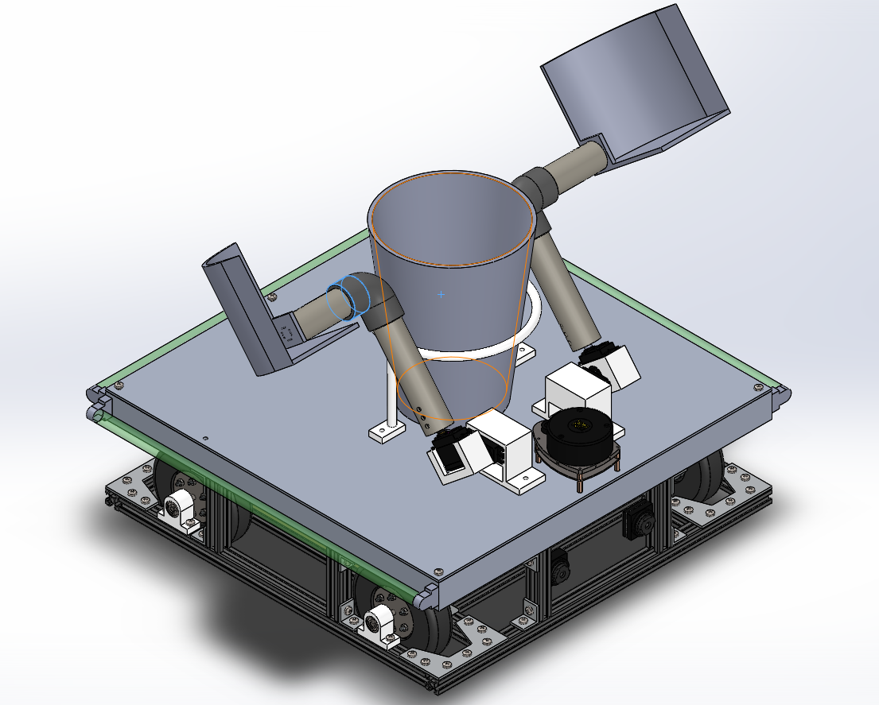
Mechanical Design

Slide 5
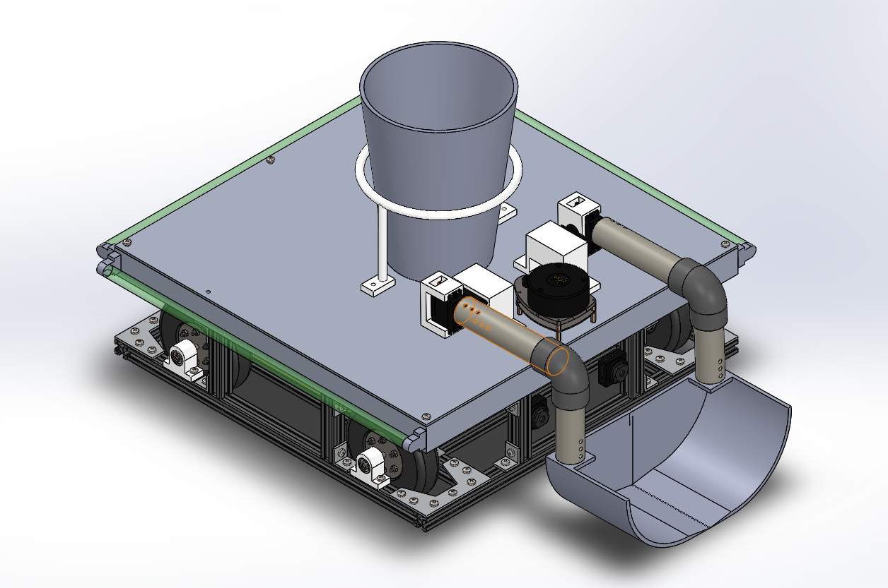
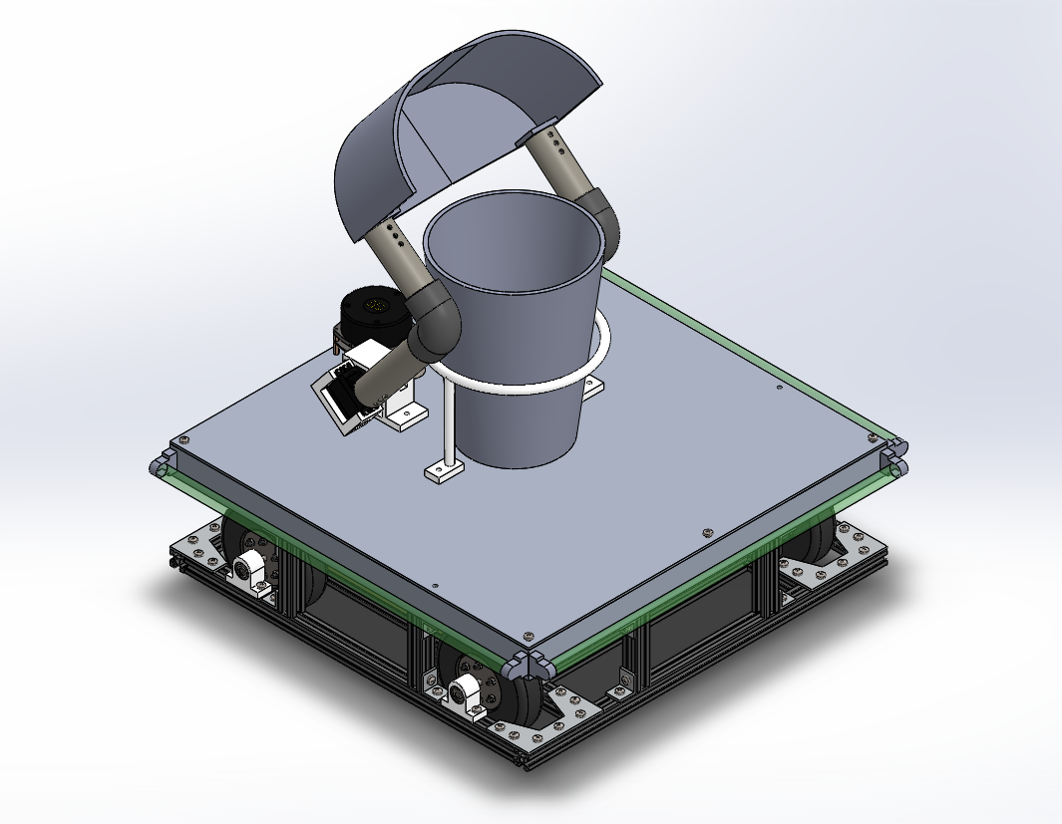
Trash Picking Mechanism

Slide 6



Softwares
The primary middleware being used is the Robot Operating System(ROS). It is a bridge between the hardware and software and helps in easy programming, debugging etc.
Simulation Software used for the Robot simulation is the Gazebo Simulation Environment a very well known and easy to use simulation software for Robotics Simulations.
For Object Detection and Trash Detection related tasks, we had employed the techniques of Computer Vision and the Tensorflow Framework was used for the same.
The language used for the entire code base is python.

Slide 7
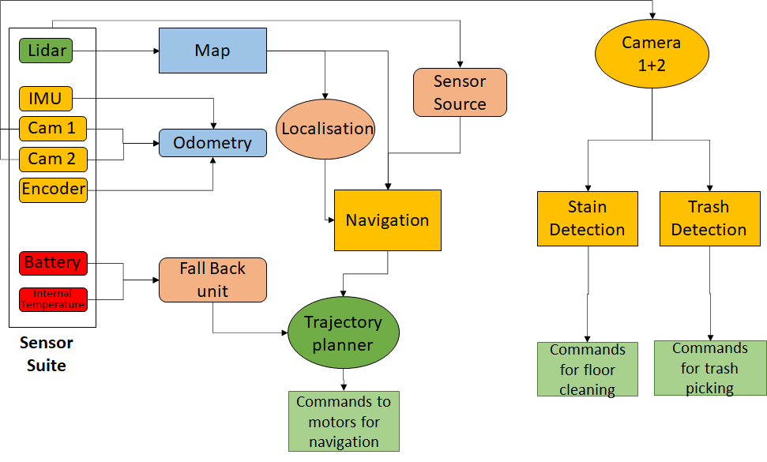
Workflow
In this section, the higher level software workflow is explained. This shows how the data flow occurs from the sensors to various modules and the processing that takes place.
For the Autonomous Navigation of the Robot in an Environment, at first it would need a map of the environment which can be pre built or made on the go. Cameras and LiDAR help in perceiving the surrounding environment,Odometry sources give an estimate on how far the robot has moved with respect to the initial point. Fusion of the above two with the help of Kalman Filters would help in getting the map.
Furthermore, the robot simultaneously localises it self in an environment, maps the area and decides its path to the given goal point also called navigation.

Slide 8
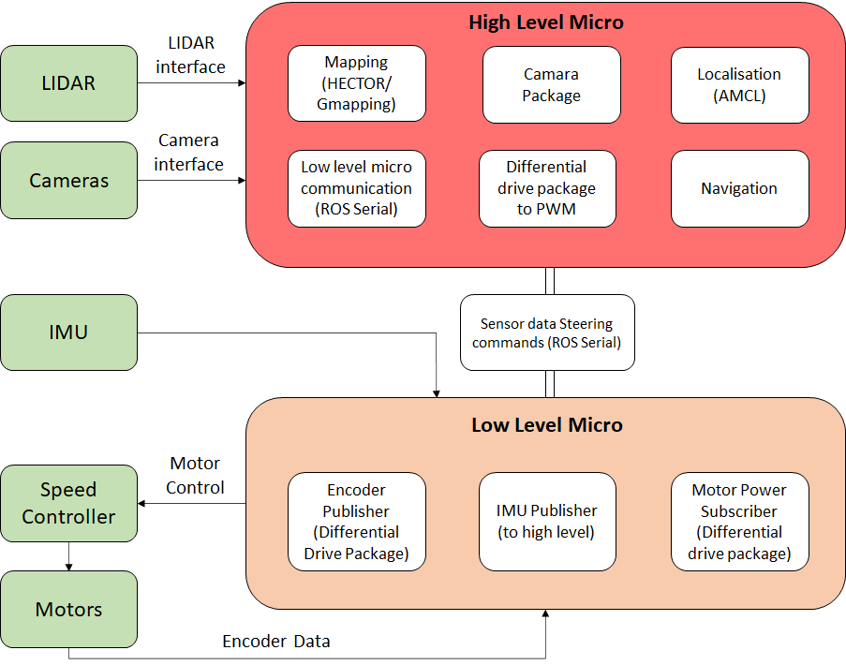
Hardware Control
One feature of the Robot Operating System(ROS) which has made it a widely used platform in the Robotics domain is the ease of Hardware Integration.
Inherently the ROS graph structure divides the higher level and lower level tasks into distinct nodes and hence the code of the particular code can be directly run on the separate higher level and lower hardwares respectively without any modification.
The Higher level hardware generally deals with tasks of processing like images,point clouds etc.
The Lower level hardware deals with the control of motors and actuators.
The control in our robot is as shown on the right.

Slide 9
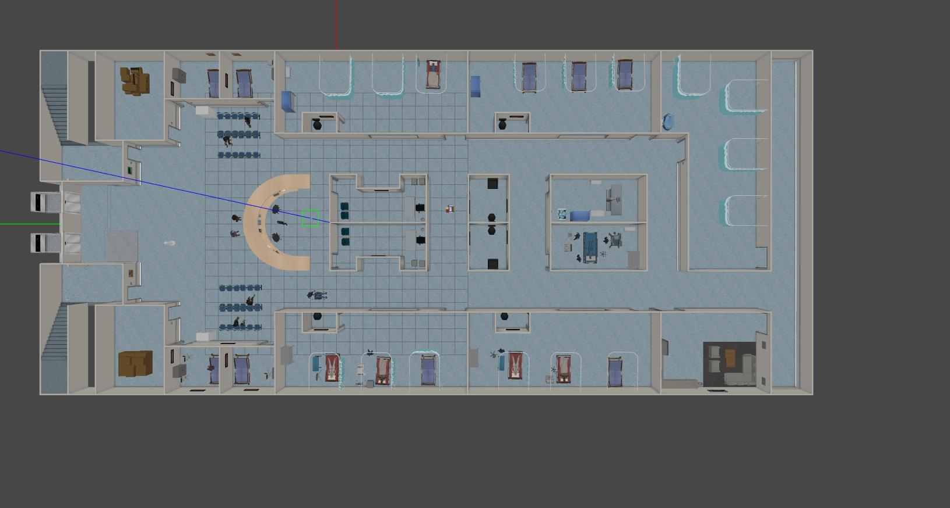
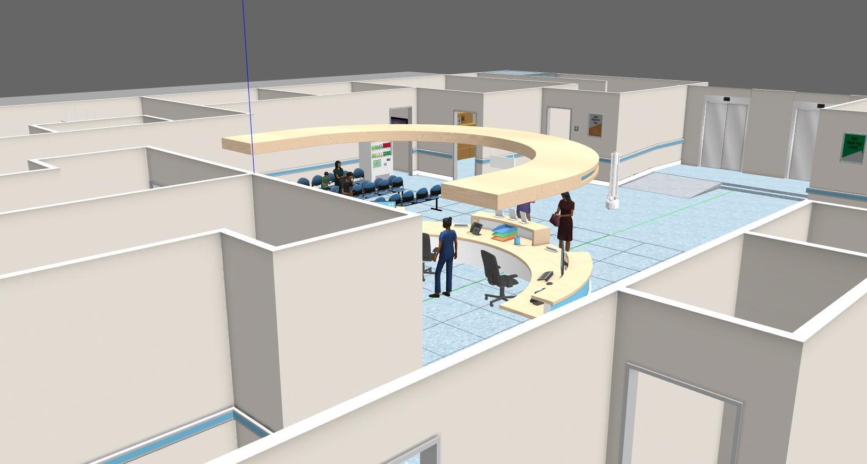
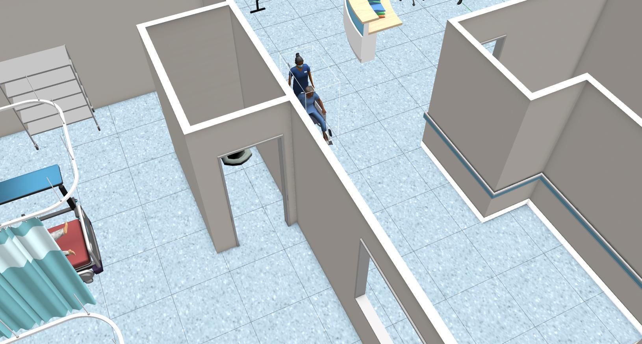
Hospital World
We had developed a Hospital environment using various components from the AWS RoboMaker simulation software.
The environment developed is a static one with various equipments of a hospital

Slide 10

Video Demonstration of Autonomous Navigation

Slide 11
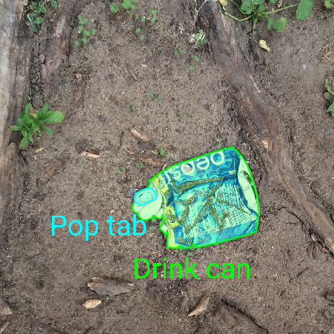
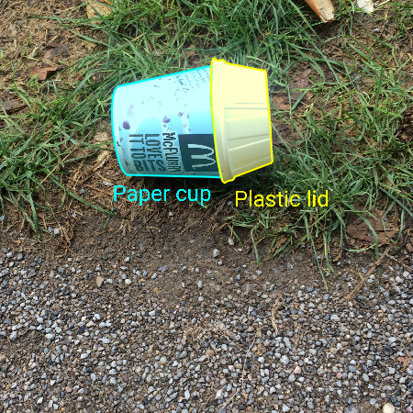
Perception
We have used real time instance segmentation of trash to the image of our surrounding area.
Firstly, a model is trained to detect the kind of trash present in the image and then the real time instance segmentation is done so that the robot can better understand the shape and size of the trash which will help it to pick the trash more easily.
With the help of kind of waste we are picking up, we can even implement the model to segregate the waste accordingly whether Biodegradable, Recyclable or Hazardous.

Slide 12
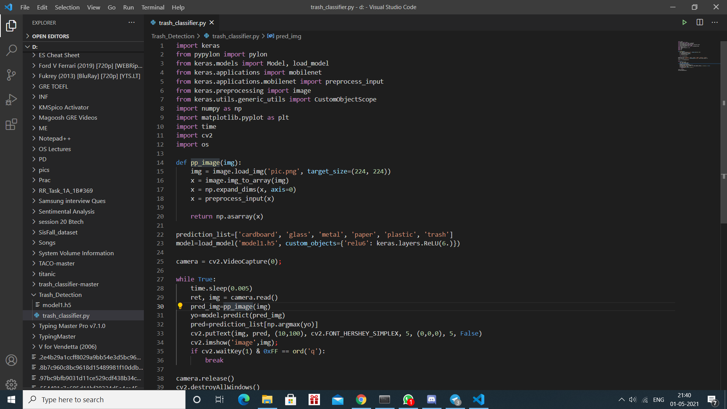
Code Snippet

Slide 13
Pseudo Code
classifier_list = [Plastic, Glass, Cardboard …………….]
camera = cv2.videocapture(0)
While True:
img = camera.read()
pd = model.predict(img)
print(classifier_list[pd])
segmented_img = Visualization(img)
imshow(segmented_img)
If cv2.waitkey(1) & 0xFF = ord(‘q’);
break
camera.release()
cv2.destroyAllWindows()

Slide 14
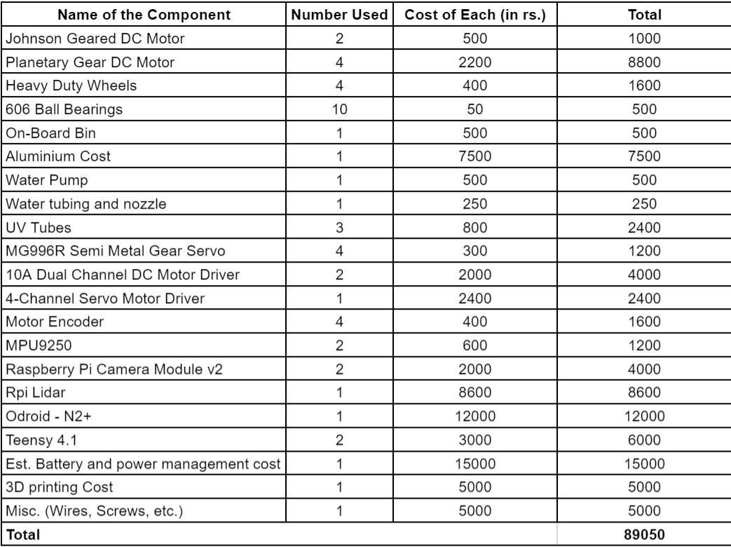
Approximate Costing

