Slide 1
Conversational Apps Integration
Voice Assistant
Team Cipher

Slide 2
Frontend
Tech-Stack : HTML, CSS, Javascript, Bootstrap
Meticulously designed for easy navigation.
Added informative points in a appealing way.
Designed in consonance with the customer needs.
Soothing colours .
Responsive Layouts.

Slide 3
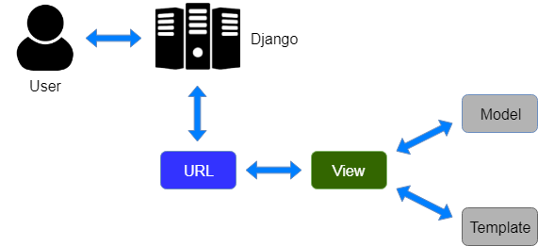
Backend
Tech Stack: Django, Python, AJAX,JS
Web Speech API
MVT(Model View Template)
AJAX for data transfer
Email
CSRF Token
Opening/Searching web browsers

Slide 4
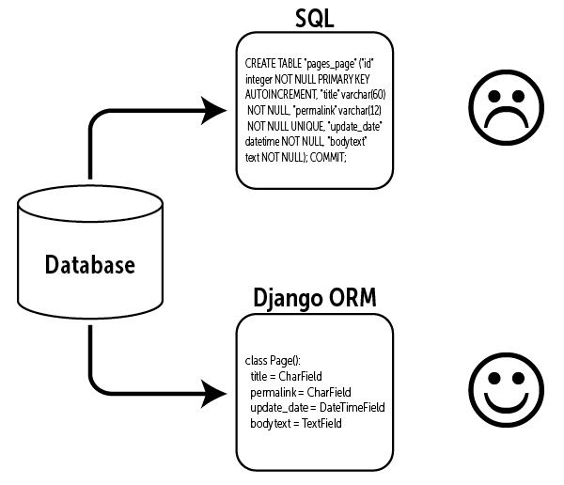
Backend
Tech Stack : Django, Python, PostgreSQL
ORM model
Registration for managers
Login for managers

Slide 5
Keyword-Algorithm
Efficiency of machine learning algorithms.
Regular expressions for text processing
Importance of predefined set of keywords
What tags are extracted
Action keywords and database keywords
Some important functions and flexibility
Modules
Callouts :
Deep learning approach if vast dataset is available.

Slide 6
Conversation Flow and Integration
Happy and Unhappy paths
Chatterbot and query datasets
Database and API calls
Voiceflow and Dialogflow
Google Assistant Integration
Secure login and anywhere access
Callouts:
Complete entity extraction is possible with Google Cloud account upgradation.

Slide 7
Contributions
Front end - Janani Vakkanti, Ansuya Mohapatra
Backend - Shibani Das, Ansuya Mohapatra
Algorithm - CVN ADITYA DATTA
Chatterbot - Janani Vakkanti, Vankineni Divya Sai Sindhuja
Google Assistant Integration - Vankineni Divya Sai Sindhuja

