Slide 1

Payment Processing Platform
James Mashiyane

Slide 2
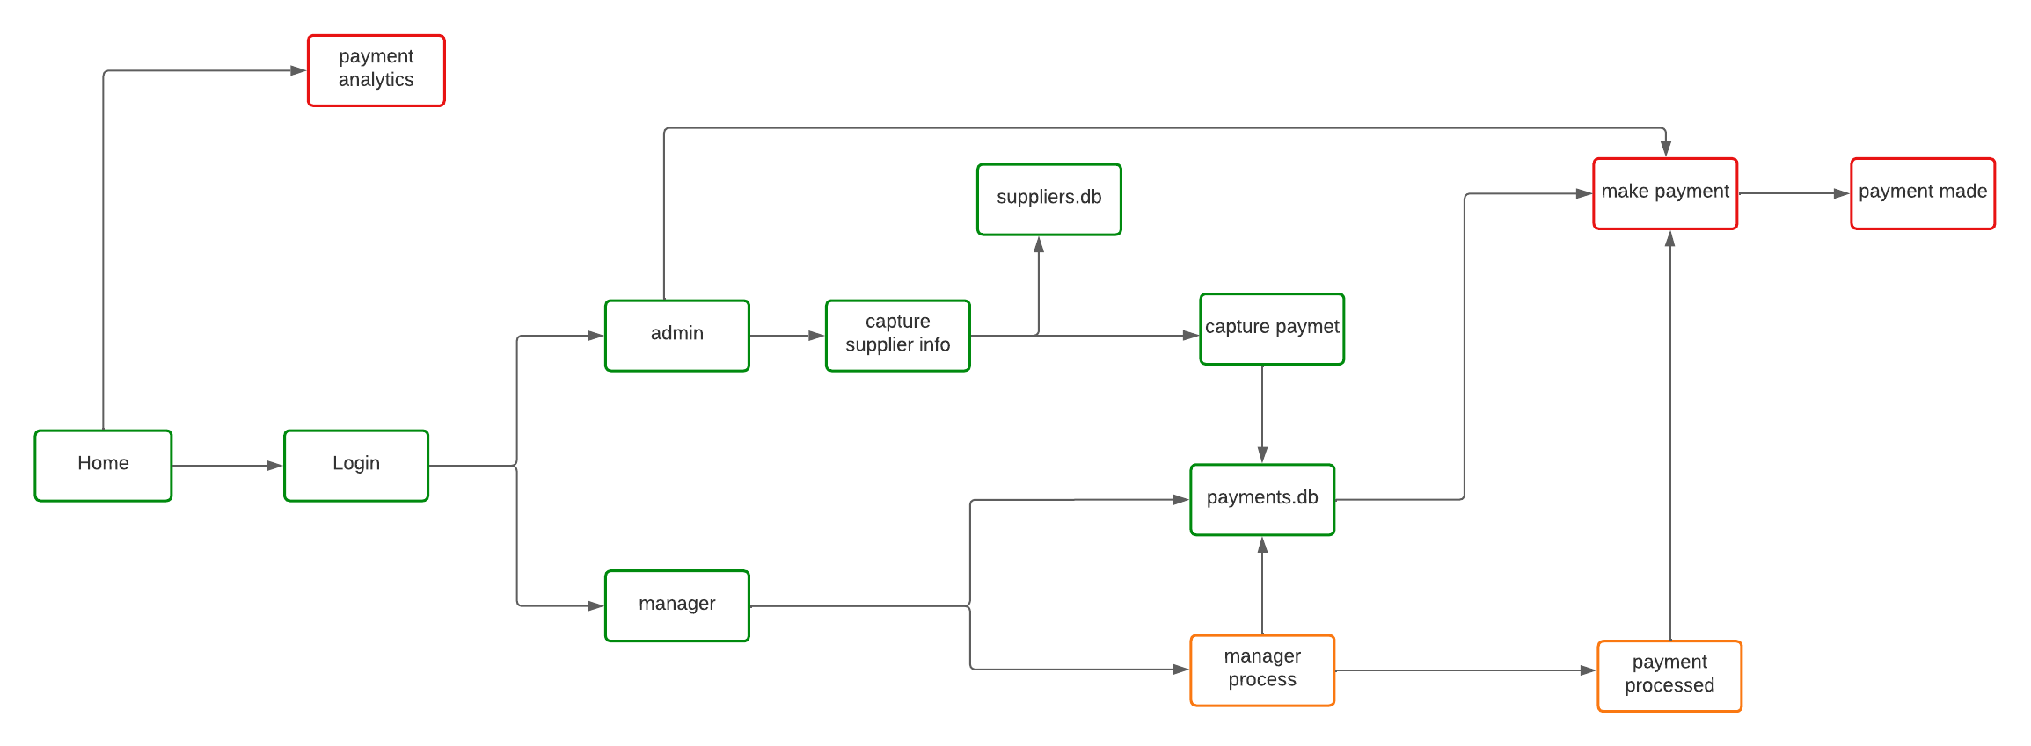
Payment Platform, python, SQL and flask

Slide 3
functions
Main.py(main flask application)
Suppliers.py(sql code to create the suppliers.db)
Payments.py(sql code to create the payments.db)
Templates(html folder with all flask app templates)
Static(css folder for styling)
Utils(i.e pdf_utils, math_utils, db_utils)

Slide 4
Main app functions
Home(home page)
Login(login as admin or as manager)
Dashboard(redirects according to the role)
Capture(if admin: capture supplier information and save on the suppliers.db)
Capture_payments(if admin: capture payment information and =save on payments.db)

Slide 5
Main app functions
Manager_dashboard(manager views, confirms and approves the payment status, save to payments.db)
Payment_confirmation(if manager: views confirmed status)
Track_payments(if user: checks the updated status of payment request from manager)
Process_payments(proceeds to make payment)

Slide 6
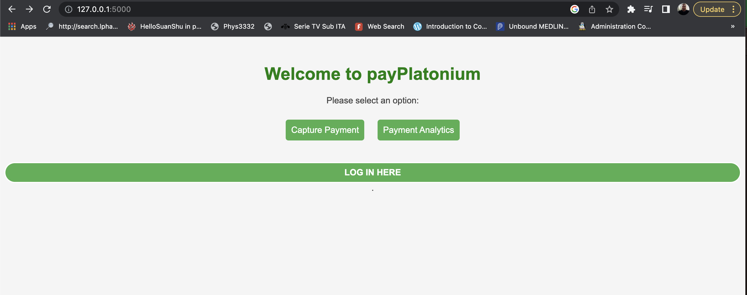
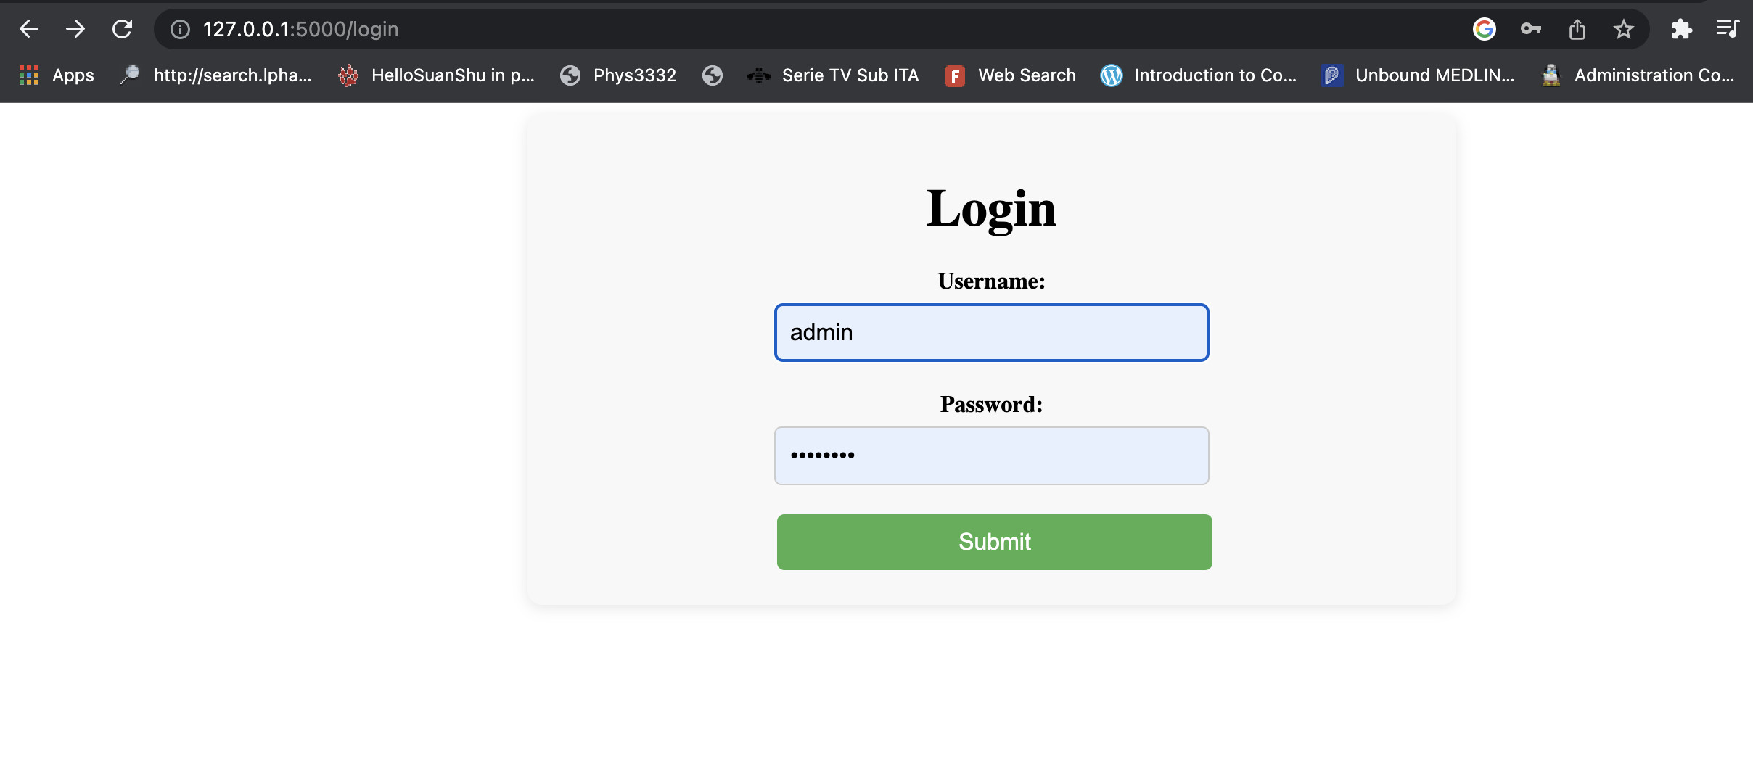
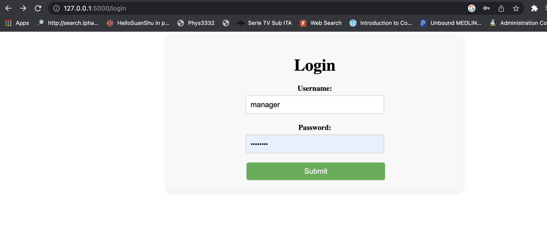
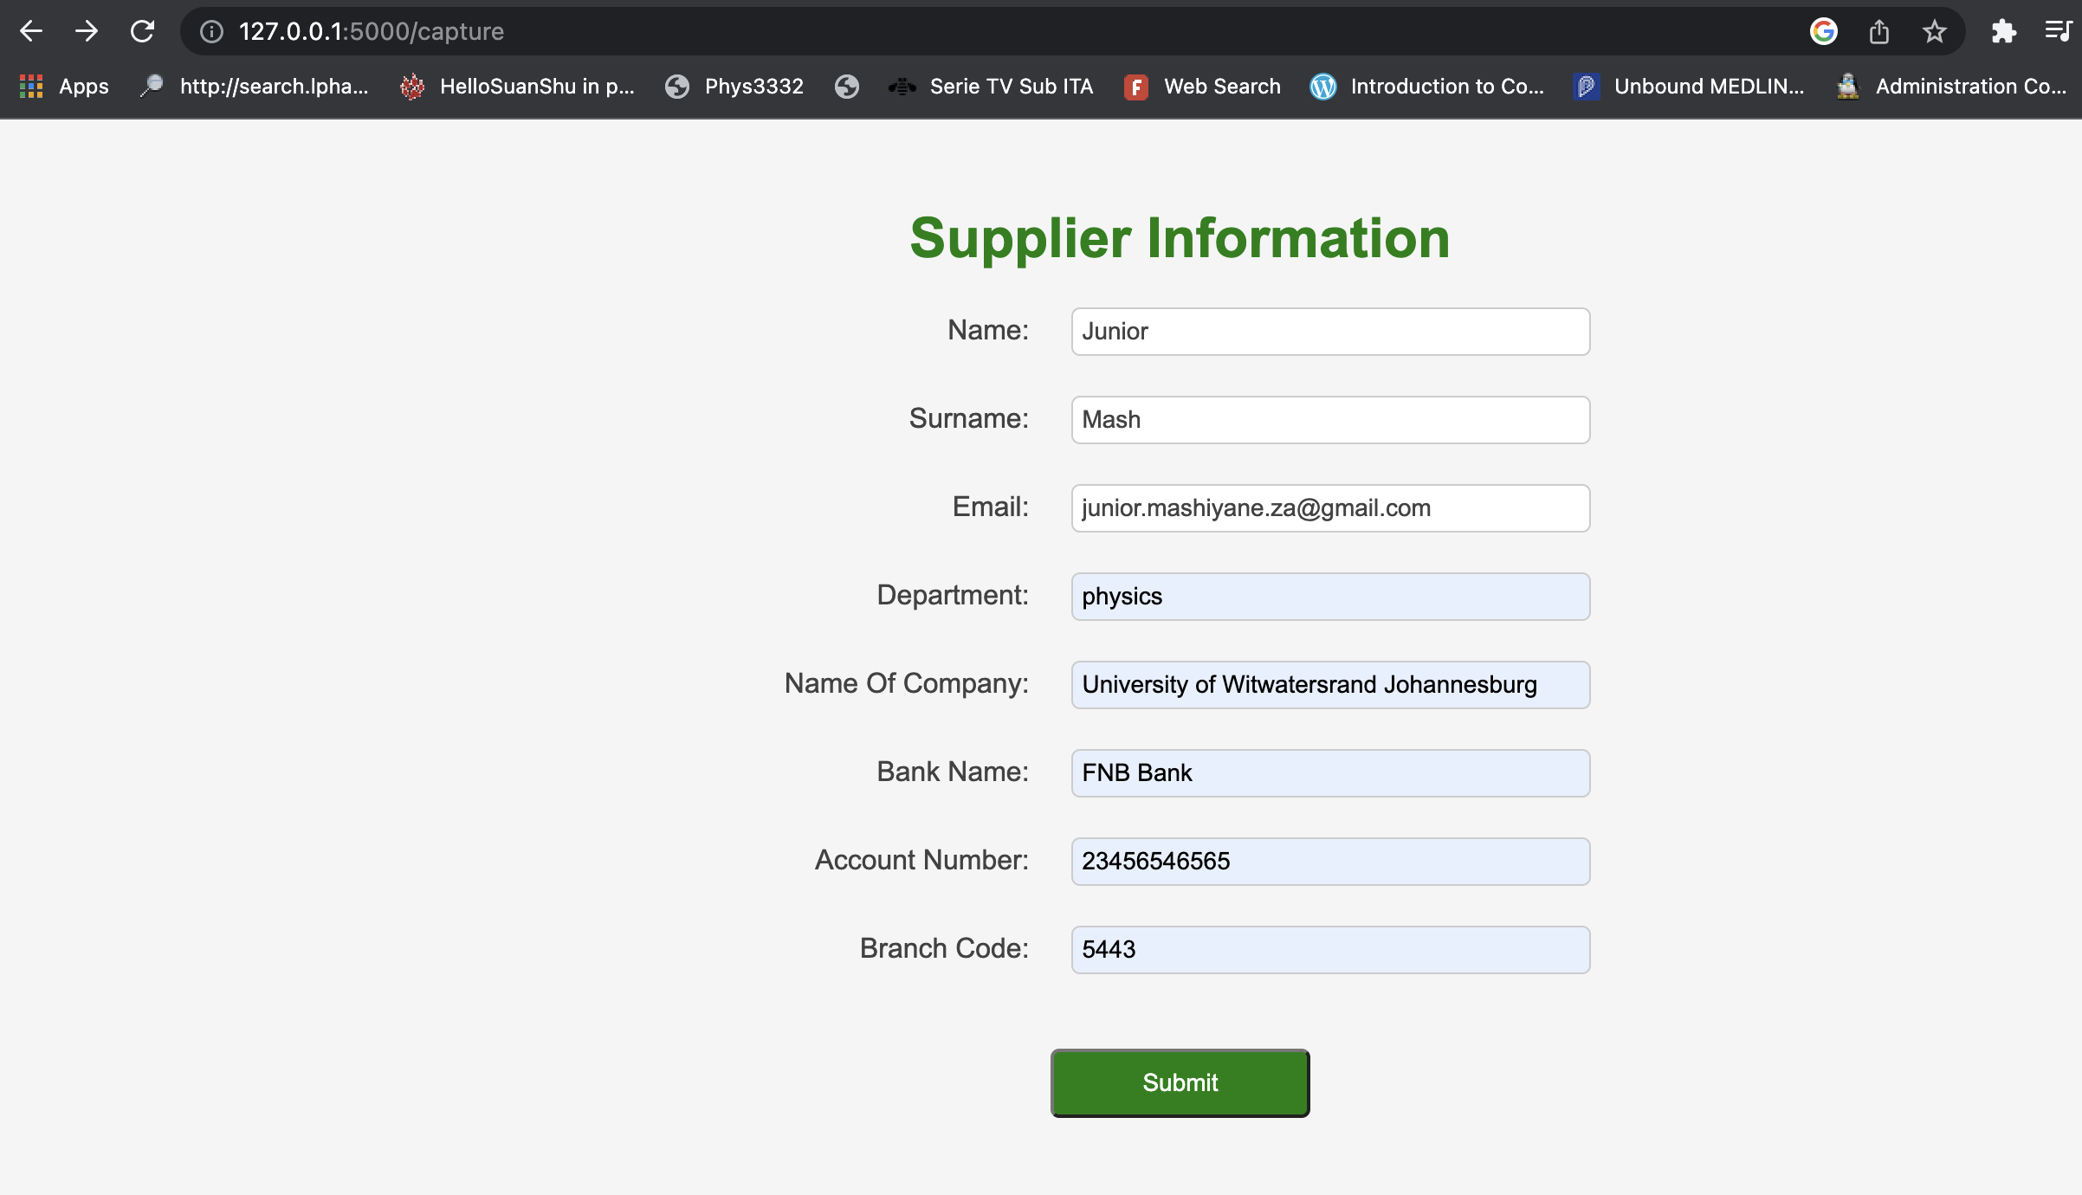
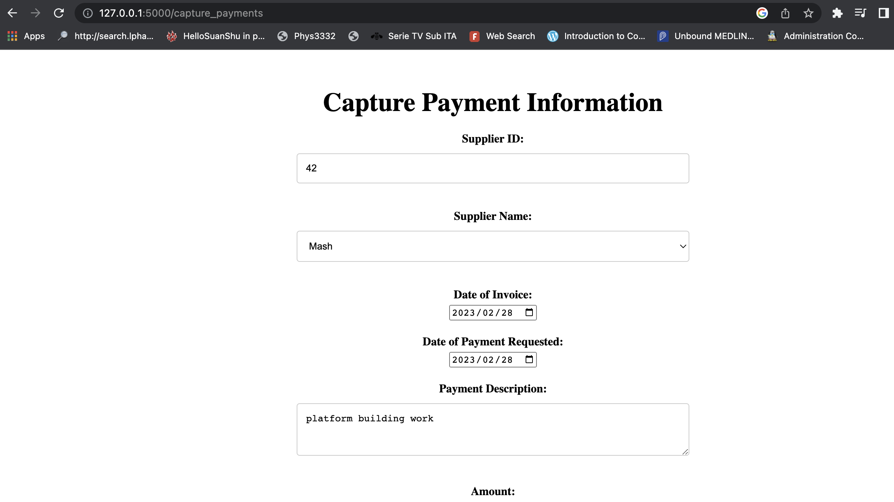
Application

