Slide 1
A Span-Based Model for Joint Overlapped and Discontinuous Named Entity Recognition ACL 2021
报告人：周沛

Slide 2
主要内容
提出新的span-based模型识别重叠和非连续实体
引入syntax information，调研对模型的影响程度

Slide 3
Preliminary
基本概念
Token：常指句中的Word
Span：从第 i 个Token到第 j 个Token组成的序列 (i ≤ j)
Jack and Mary are from New York .
(0, 0, PERSON), (2, 2, PERSON), (5, 6, LOCATION)

Slide 4
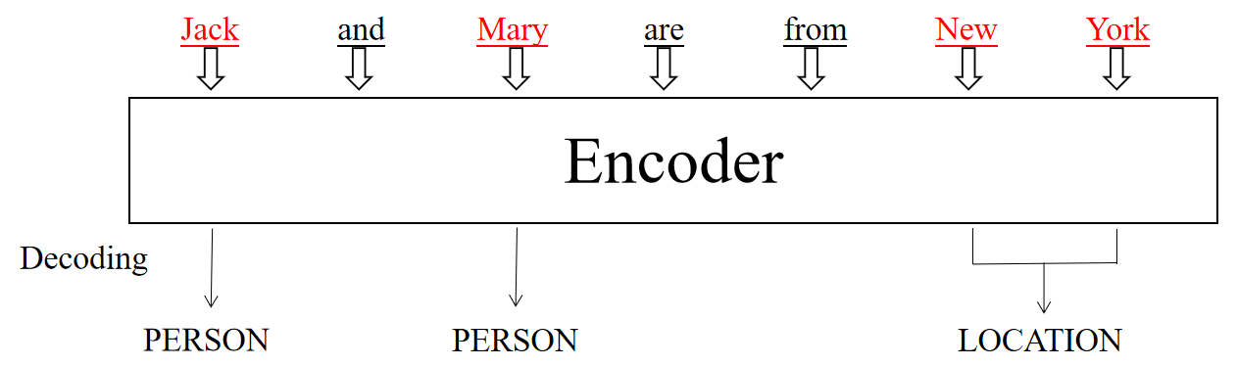
Preliminary
Named Entity Recognition (NER)
输入：Jack and Mary are from New York .
输出：(0, 0, PERSON), (2, 2, PERSON), (5, 6, LOCATION)
Span-Based Model

Slide 5
Preliminary
基本概念
overlapped entity：重叠实体
e.g.: At issue is the liability of a [[Pennsylvania]₁ radio station]₂
under the federal wiretap statute.
[The [Lincoln]₂ Memorial]₁
discontinuous entity：非连续实体
e.g.: The [mitral]₁ valve [leaflets]₁ are mildly [thickened]₁.
have much [[muscle]₁ pain]₂ and [fatigue]₁

Slide 6
Key Idea
枚举句子中所有可能的text spans
采用多分类策略确定entity fragment以及entity type
所有entity fragments两两进行relation classification:
①succession → discontinuous entity
②overlapping → overlapped entity
③other → other realtions or no relations
三种预定义关系

Slide 7
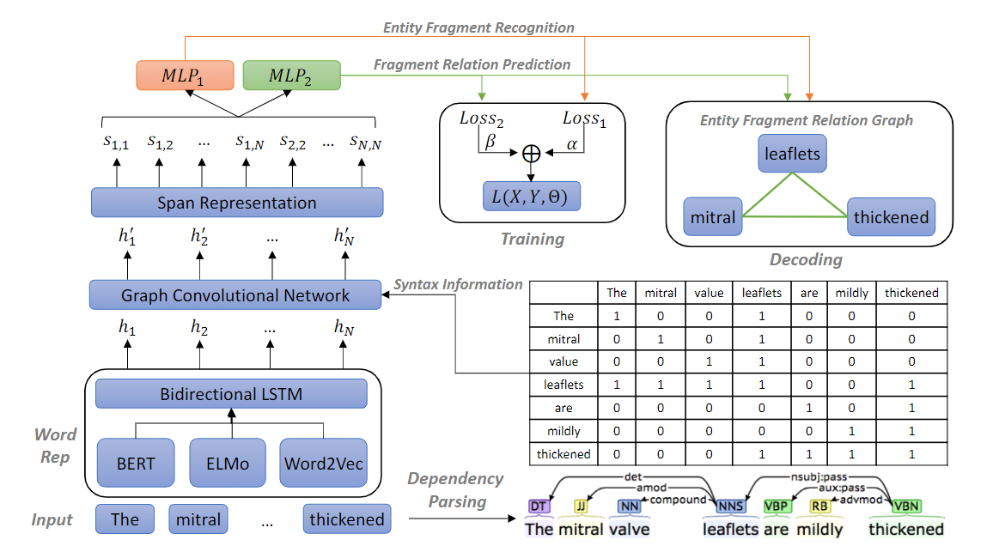
Model Architecture

Slide 8

Model Architecture
word representation
input sentence: x = {x₁, x₂, …, x_{N}}
matrix H = {h₁, h₂, …, h_{N}}
BERT在tokenizer时会将word分成word pieces，降低英文单词中时态的多样性
e.g.:fevers -> fever + ##s，论文选取开头的单词作为最终的单词表示
pretrained model

Slide 9
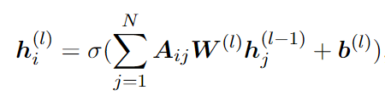

Model Architecture
graph convolutional network
GCN:
W^{(l)} , b^{(l)} : the weights and bias of the l-th layer
: adjacency matrix obtained from dependency graph

Slide 10
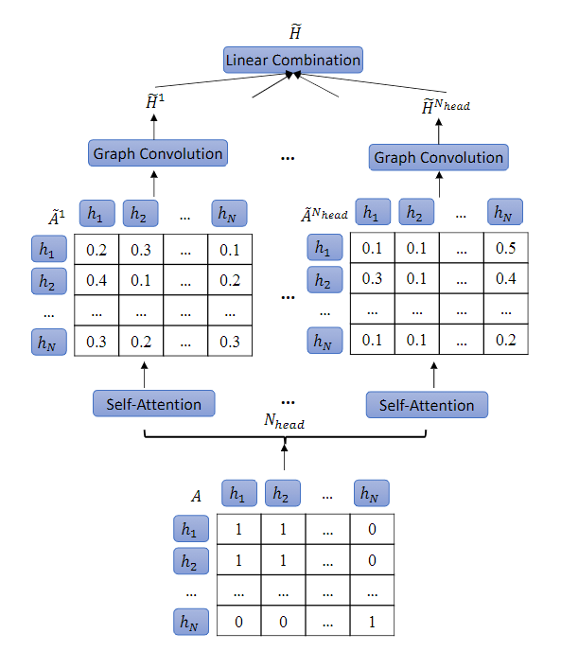
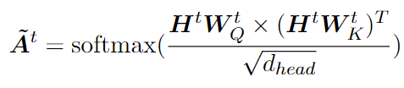



Model Architecture
graph convolutional network
论文中采用attention-guided GCN(AGGCN)
: updated adjacency for t-th head
W₁
_{将拼接后的向量重新映射回dh维}

Slide 11

Model Architecture
span representation
idea: span enumeration -> text spans
e.g.: The mitral valve leaflets are mildly thickened
spans: “The”, “The mitral”, “The mitral valve”, …,“mildly”, “mildly thickened”, “thickened”.
span(i, j) representation:
w：20-dimensional embedding represente span width

Slide 12

Model Architecture
decoding
①entity fragment recognition:
(1)span is an entity fragment?
(2)what is entity type?
p₁表示实体类型的概率
②fragment relation prediction
p₂表示三种关系的概率

Slide 13
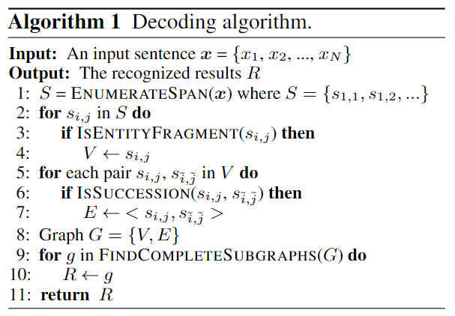
Model Architecture
decoding
line2-4: recognize entity fragments from text spans
line5-7: determine their relations
line8: an entity fragment relation graph
line9: find all subgraphs in which each node connect
any other node
line10: each subgraph compose an entity

Slide 14

Training
loss calculation
α and β are the weights to control the task importance
use BertAdam algorithm
learning rate: 5×10⁻⁵ finetune BERT 1×10⁻³ finetune other parts of model
early stop = 15

Slide 15
Summary
steps of model:
input一方面通过pre-train模型获取word rep，一方面通过dependency parsing获取句法信息；
GCN集合LSTM的输出和句法输入，得到syntax-enhanced的新的表达；
获取所有span表示；
通过两个MLP预测span是否为实体，以及实体之间是否有关系；
最后每个loss加上权重，为最终优化目标。

Slide 16
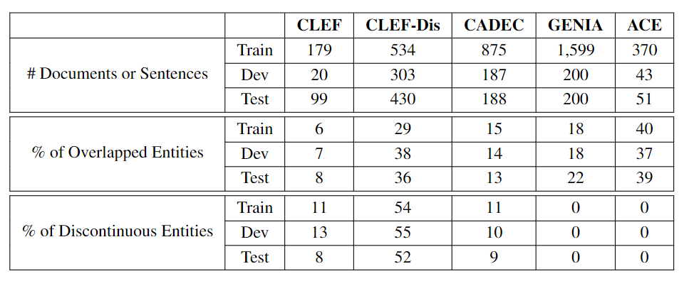
Dataset

Slide 17
Data
"sentences": [["The", "mitral", "valve", "leaflets", "are", "mildly", "thickened", "."]]
"ner": [[[1, 1, "Disease_Disorder"], [3, 3, "Disease_Disorder"], [6, 6, "Disease_Disorder"]]]
"relations": [[[1, 1, 3, 3, "Succession"], [1, 1, 6, 6, "Succession"], [3, 3, 1, 1, "Succession"], [3, 3, 6, 6, "Succession"], [6, 6, 1, 1, "Succession"], [6, 6, 3, 3, "Succession"]]]
"dep": [{"nodes": [[3], [3], [3], [0, 1, 2, 6], [6], [6], [3, 4, 5, 7], [6]]}]

Slide 18
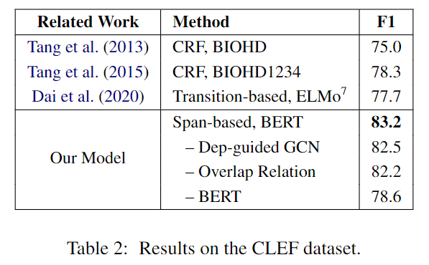
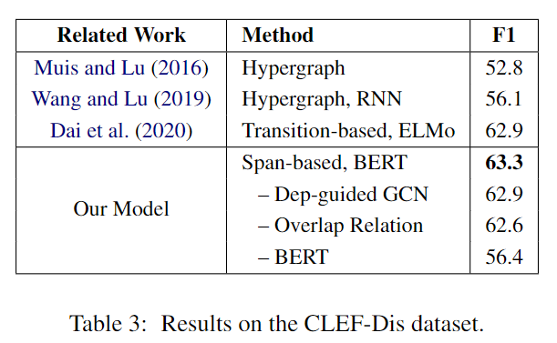
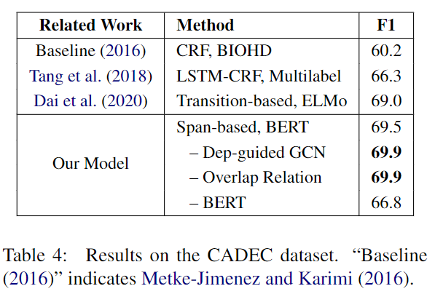
Experimental Results
the effect of AGGCN and the overlapping relation

Slide 19
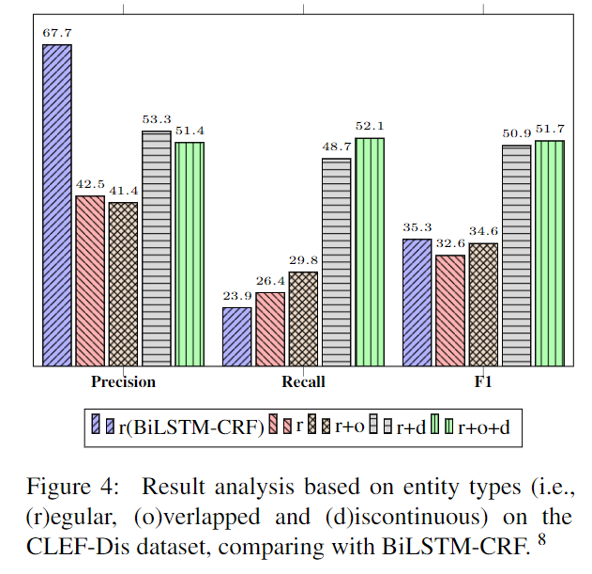
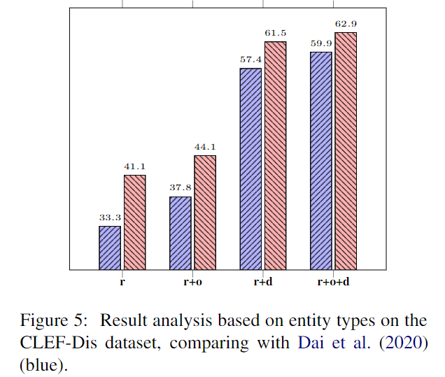
Experimental Results
influence performance of regular NER?
BiLSTM-CRF可以利用标签依赖提高P值，论文模型的R值更高

Slide 20
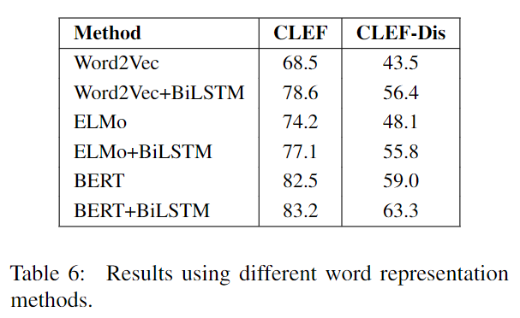
Experimental Results
different word representation layers
在CLEF and CLEF-Dis datasets中，BiLSTM的作用更加明显。
小型数据集更需要BiLSTM的帮助。

Slide 21
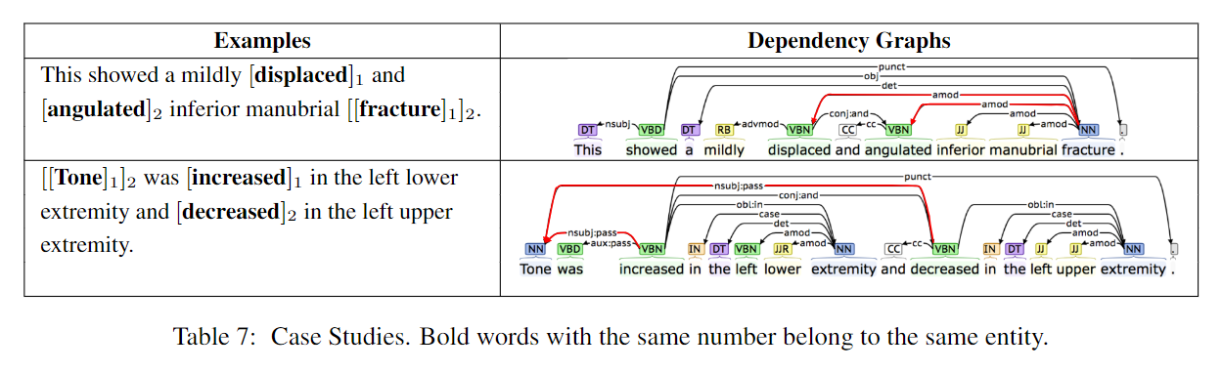
Experimental Results
how syntax information helps our model?
note: utilize Standford CoreNLP toolkit to perform dependency parsing
discontinuous entity可能在句子中相距较远，
但在dependency graphs中相距较近。

Slide 22
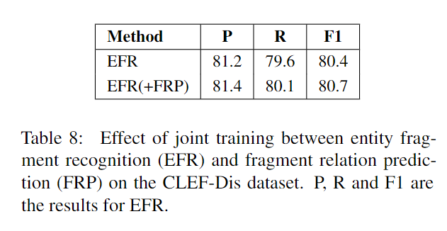
Experimental Results
effect of joint training
the interaction between EFR and FRP can benefit model

Slide 23
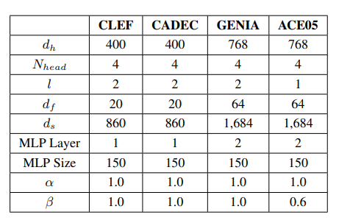
Experimental Results
hyperparameter settings

Slide 24
Conclusion
enumertate span的复杂度偏高，推理速度较慢。
好消息是：discontinuous entity不太可能出现在两个不同的句子中，因此在enumertate span的时候，只需要关注一个句子就可以了，句子越短效率越高。
论文为了验证某个方法的效果，设置了很多ablation experimrnt，论文的严谨值得我们学习。

Slide 25
E n d

