Slide 1
Event-event Relation Extraction
主讲人：任俊飞
时间：2021-11-24

Slide 2
Events are not isolated
◻ Coreference relations ◻ Temporal relations ◻ Parent-child relations ◻ Causal relations
◻ ...

Slide 3
ACL-21 is [held virtually] due to [the pandemic]. [Its] attendees are thus [giving remote presentations] of [their research].
[the pandemic] CAUSES [held virtually]
[held virtually] CAUSES [giving remote presentations]
[Its] REFERS to the conference being [held virtually] [giving remote presentations] is a SUBEVENT of [Its]
[held virtually] HAPPENS DURING [the pandemic] [their research] HAPPENS BEFORE [giving remote presentations]

Slide 4
[Its] REFERS to the conference being [held virtually]
Coreference relations
[held virtually] HAPPENS DURING [the pandemic] Temporal relations
[their research] HAPPENS BEFORE [giving remote presentations]
Parent-child relations [giving remote presentations] is a SUBEVENT of [Its]
[the pandemic] CAUSES [held virtually]
Causal relations
[held virtually] CAUSES [giving remote presentations]

Slide 5
Why？？？
These event-event relationships are important for understanding stories.
我们可以用同样的一组事件，但是事件对儿之间的关系不同，来描述不同的故事：
例：
1.小明一般晚饭后都会散步半小时
2.傍晚小明在街边一边散步一边寻找一家饭店来吃晚饭

Slide 6
问题定义1
问题定义2
输入：
1.一段长文本
2.多个事件的主要短语
任务：
抽取所有事件对儿之间的关系
输入：
1.一段长文本
任务：
联合抽取事件以及所有事件对儿之间的关系

Slide 7
特点1：事件相互关联
由于关系的传递性，事件是相互关联的
◻ Coreference: If A == B, B == C, then A == C.
◻ Temporality: If A before B, B before C, then A before C.
◻ Parent-child: If A contains B, B contains C, then A contains C.
◻ Causality: If A leads to B, B leads to C, then A leads to C

Slide 8
特点 2：不同类型的关系也相互关联
Causal relationship vs temporal relationship
一般情况下，原因事件是出现在结果事件之前
例：猪瘟导致猪肉价格上涨
原因事件：猪瘟
结果事件：猪肉价格上涨
猪瘟在猪肉价格上涨之前

Slide 9
特点 2：不同类型的关系也相互关联
Parent-child relationship vs temporal relationship
如果A是B的父级，则A的时间跨度必须包括B的时间跨度
例：2021自然灾害频繁发生严重危害了人民的生命财产安全，尤其是九月份的那场台风使得渔民也大受打击。
父事件：自然灾害
子事件：台风

Slide 10
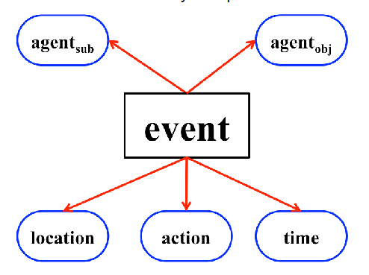
特点 3：事件本身是一个复杂的概念，有许多组成部分，可以有不同的模式
Event Detection and Co-reference with Minimal Supervision. Peng et al., 2016.

Slide 11
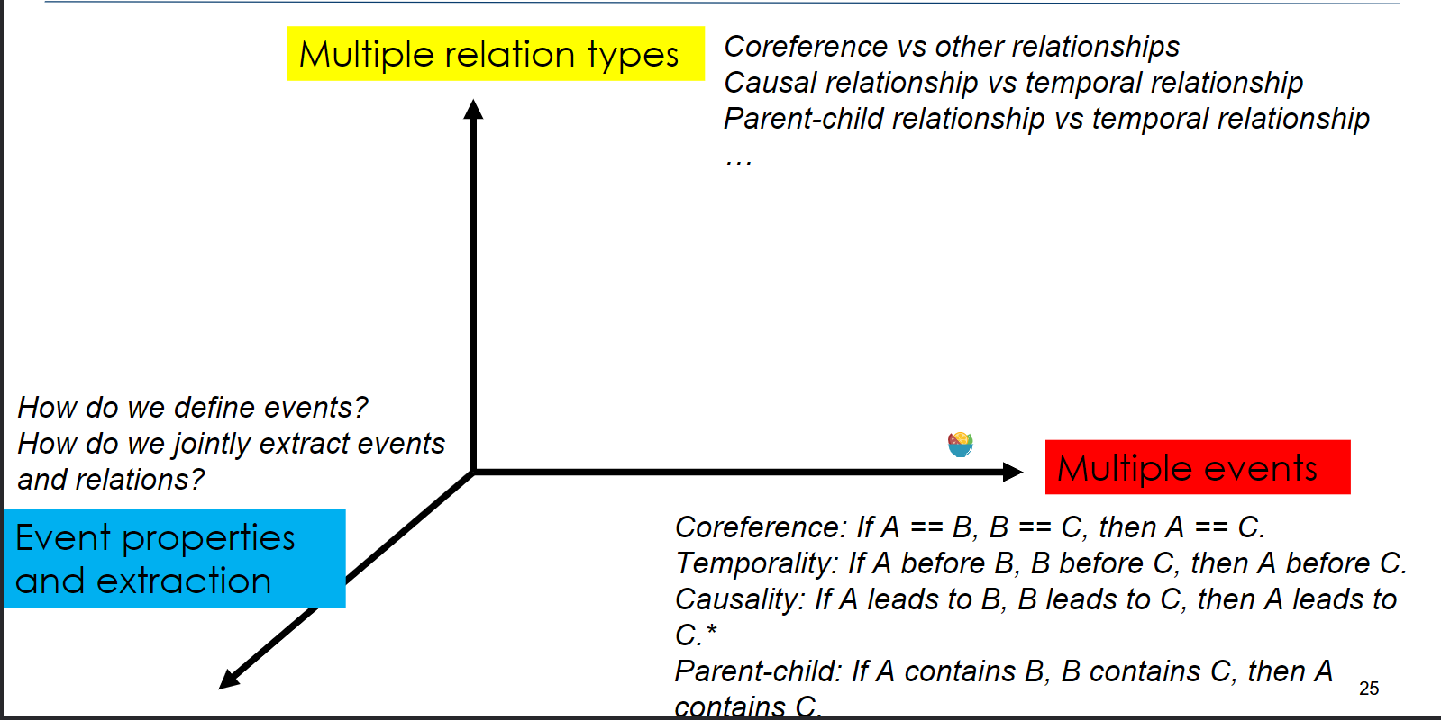

Slide 12
结合三个特点进行事件关系抽取的步骤
根据数据/任务定义结构
在推论或者学习中利用这种结构信息
学习潜在的语义信息

Slide 13
how do we train the model?
Existing methods: global inference with local learning
………tons of earth cascaded down a hillside, ripping two houses from their foundations. No one was hurt, but firefighters ordered the evacuation of nearby homes and said they'll monitor the shifting ground.

Slide 14
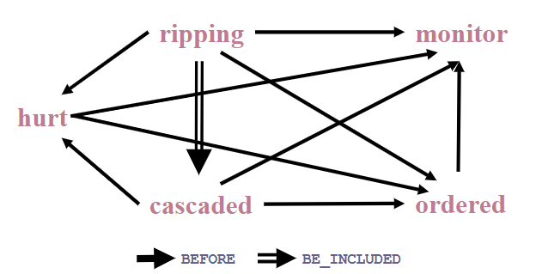
考虑时态关系结构
………tons of earth cascaded down a hillside, ripping two houses from their foundations. No one was hurt, but firefighters ordered the evacuation of nearby homes and said they'll monitor the shifting ground.
时态有序图：

Slide 15
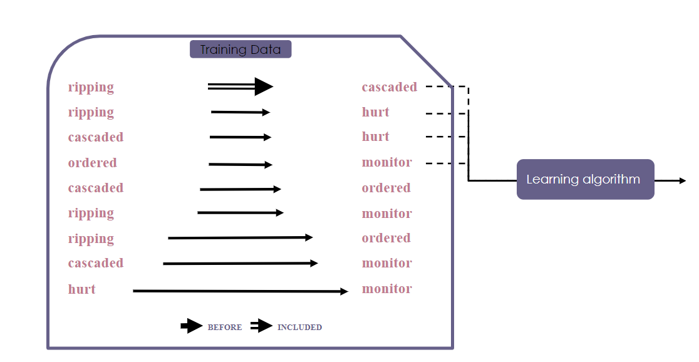
Local learning

Slide 16
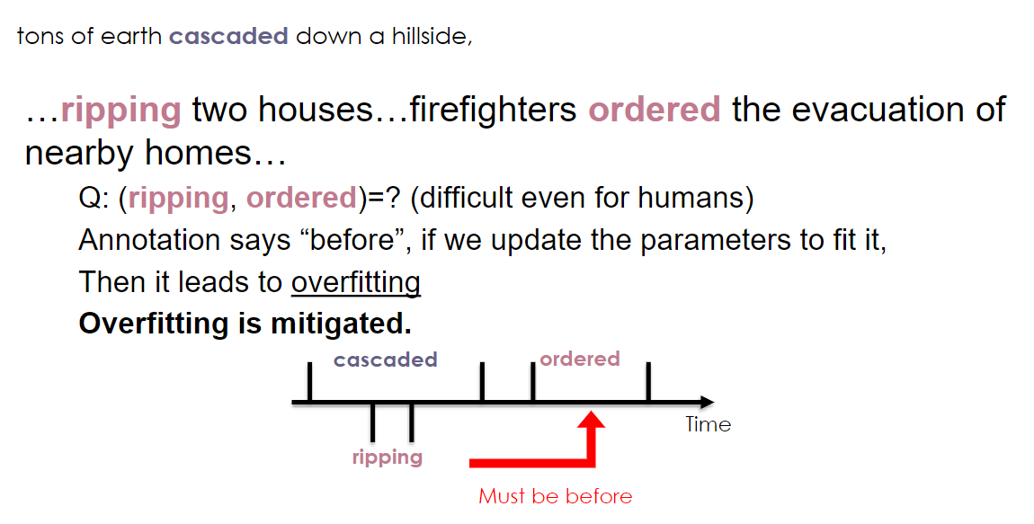
Local learning is not sufficient : Overfitting

Slide 17
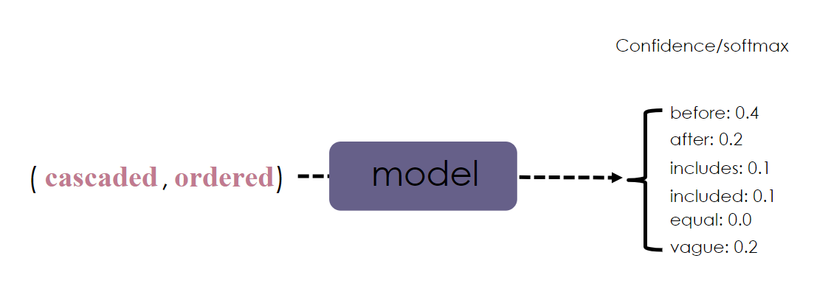
Local learning is not sufficient : Violation

Slide 18
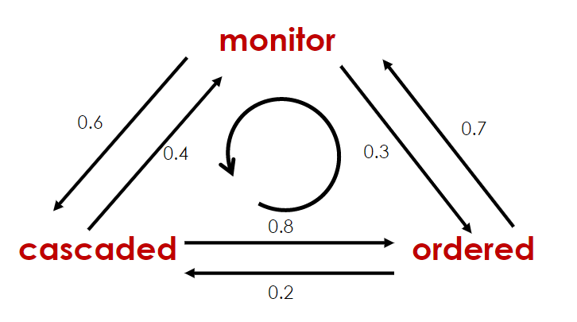
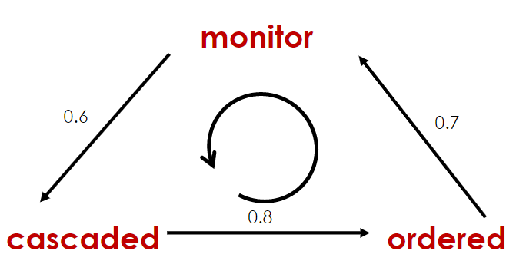
Local learning is not sufficient : Violation
（ cascaded ， ordered ）：before 0.8 after 0.2
（ cascaded ， monitor ）：before 0.4 after 0.6
（ monitor ， ordered ）：before 0.3 after 0.7

Slide 19
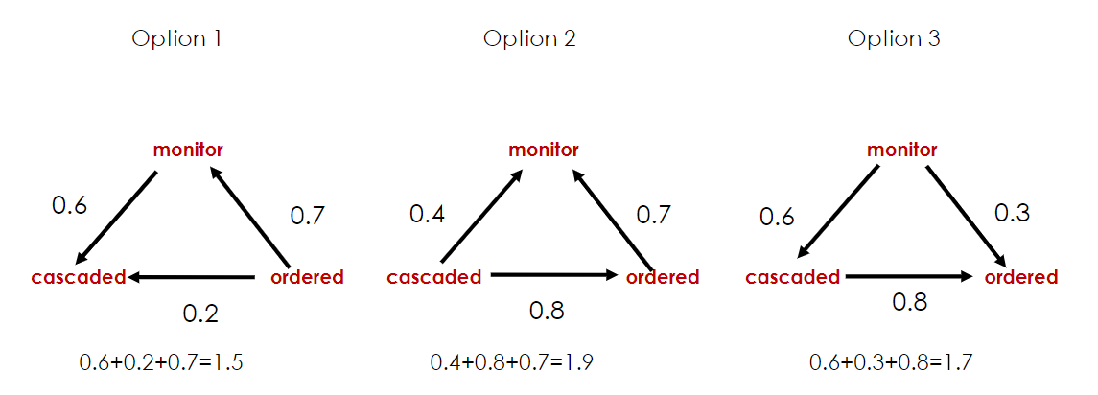
Global Inference
√
A Linear Programming Formulation for Global Inference in Natural Language Tasks. Roth & Yih, CoNLL2004

Slide 20
Global Inference via ILP
This “global inference” procedure is often formulated as an integer linear programming (ILP) problem
A Linear Programming Formulation for Global Inference in Natural Language Tasks. Roth & Yih, CoNLL2004.

Slide 21
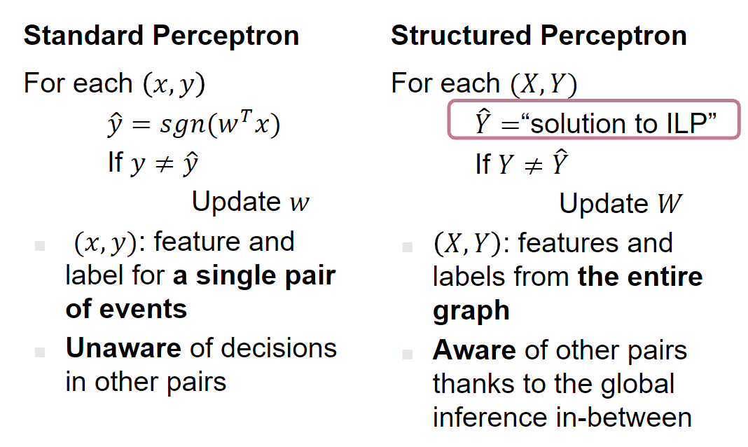
Contrast
Discriminative training methods for hidden markov models: Theory and experiments with perceptron algorithms. Collins, ACL2002

Slide 22
Joint Reasoning for Temporal and Causal Relations. Ning et al., ACL2018
Joint Constrained Learning for Event-Event Relation Extraction. Wang et al., EMNLP2020.

Slide 23
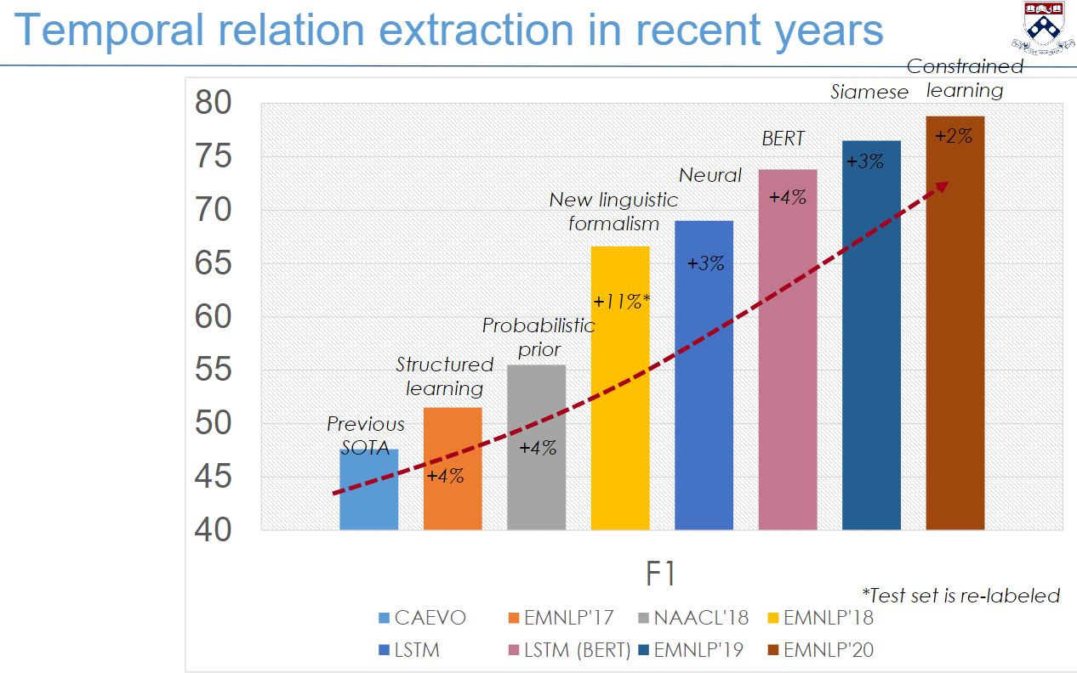

Slide 24
Summary
Events are not isolated.
Relations between events are important for story understanding.
Event relation extraction with Three characteristics:
◻ Events are inter-related due to the transitive property of relations ◻ Different types of relations are also inter-related ◻ Event itself is a complex concept
A key word in existing works is “JOINT”

Slide 25
