Slide 1
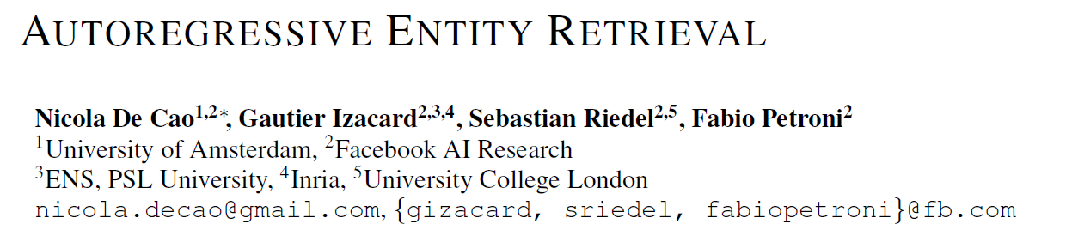
ICLR 2021
报告人：贾昊

Slide 2
主要内容
提出一个Seq2Seq模型，解决面向知识库的实体检索问题
Query
KG (Wikidata / Wikipedia)
Search
Superman saved Metropolis
……
Metropolis (comics)
……
Answer
Input
Output
Model (BART)
Train

Slide 3
问题
对给定的query，找到知识库中对应的实体
Query：Superman saved Metropolis.
Candidate：Metropolis (comics)，Metropolis (1927 film)
常见做法：
1、设计Heuristic Rules，从知识库中筛选实体，构造小规模Candidate Set
2、用模型对句子中的entity mention和Candidate Set中的entity进行encoding，计算Similarity Score

Slide 4
问题
简单的点积运算难以充分捕捉语义关联信息
Entity Embedding的存储开销大
Hard Negative Sample难以选择
对于信息量少的实体，难学到有意义的表示
Entity Mention
KB Entity
Contextual Representation
Contextual Representation
Similarity Score

Slide 5
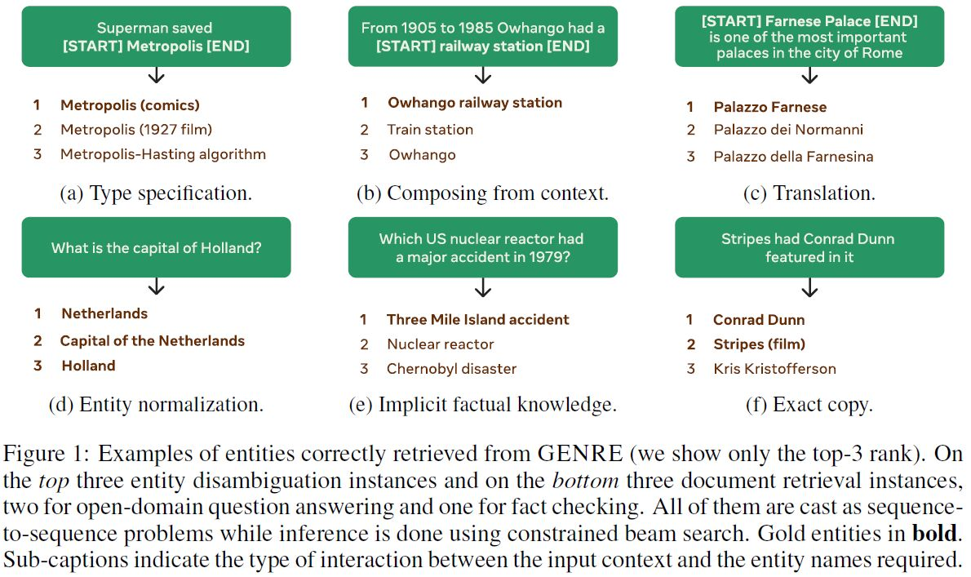
方法
将问题转化为Sequence to Sequence的形式

Slide 6
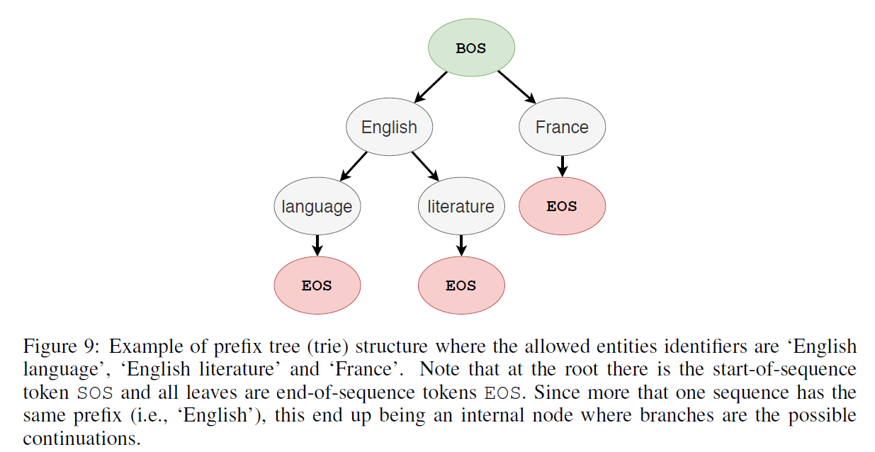
Constrained Beam Search
为保证解码结果为合法的实体，解码前构建一个Prefix Tree，用来限制解码空间
English language
English literature
France

Slide 7
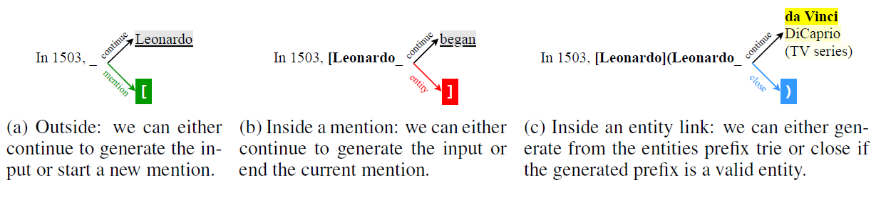
End-to-End Entity Linking
输入：In 1503, Leonardo began painting the Mona Lisa.
输出：In 1503, [Leonardo](Leonardo da Vinci) began painting the [Mona Lisa](Mona Lisa).

Slide 8
实验
Entity Disambiguation (ED)
Superman saved Metropolis → Metropolis (comics) or Metropolis (film)
End-to-End Entity Linking (EL)
Superman saved Metropolis → < Metropolis, Metropolis (comics) >
Page-level Document Retrieval (DR)
Who saved Metropolis ? → Superman

Slide 9
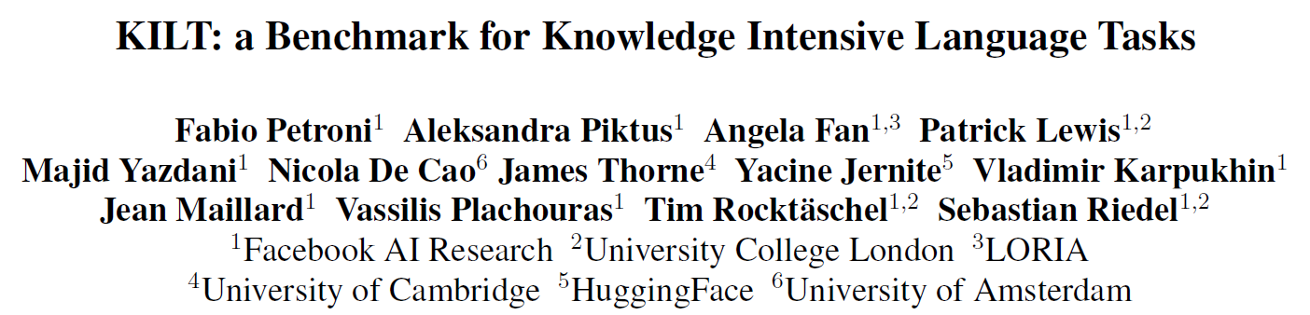
KILT
NAACL 2021

Slide 10
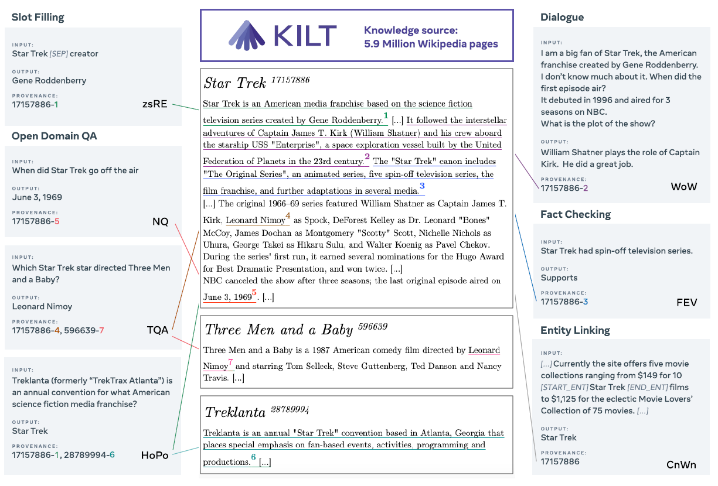
KILT

Slide 11
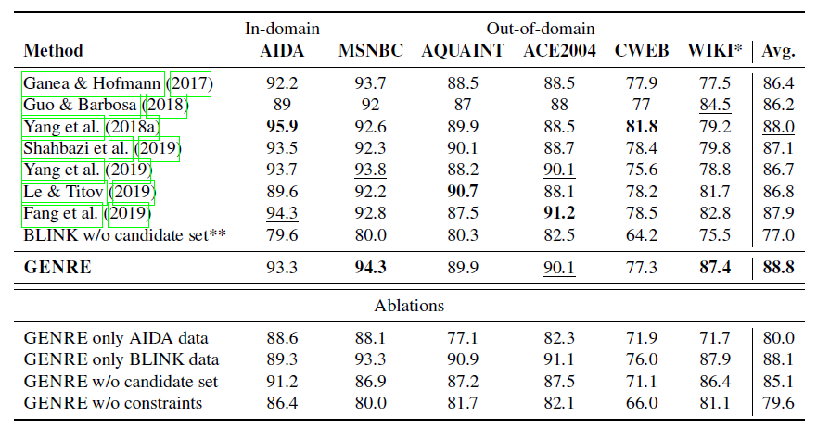
实验结果
Entity Disambiguation (ED)

Slide 12
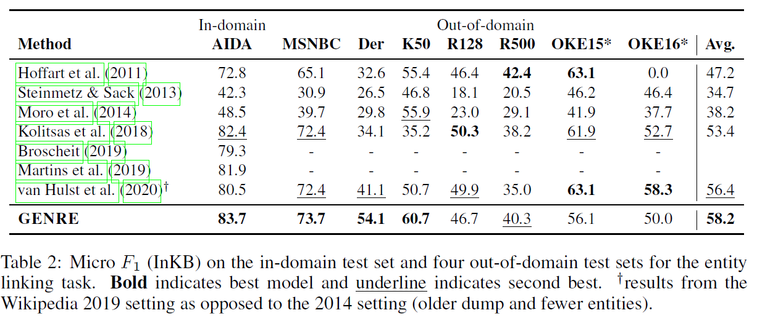
实验结果
End-to-End Entity Linking (EL)
GERBIL - Benchmarking Named Entity Recognition and Linking Consistency. (Röder er al. Semantic Web, 2018)

Slide 13
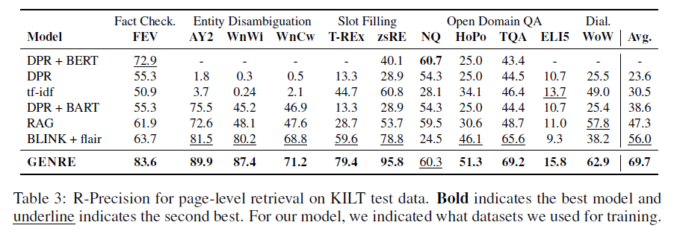
实验结果
Page-level Document Retrieval (DR)

Slide 14
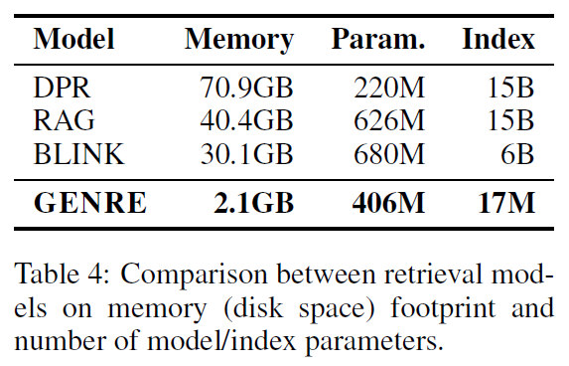
实验结果
存储空间对比

Slide 15
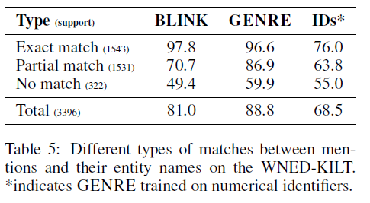
实验结果
Entity Name or ID ?

Slide 16
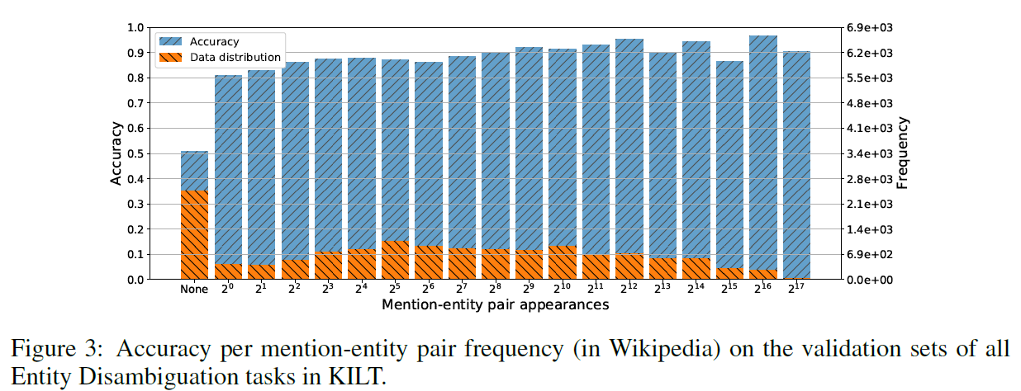
实验结果
Mention-Entity Pair Frequency

Slide 17
实验结果
Cold Start
人工挑选50个比较新的Wikipedia实体，进行ED实验
Match? | Accuracy
Exact Match | 19/19 = 100%
Others | 14/31 = 45.2%

