Slide 1
Group 32 Presentation
(algorithms and data structures)

Slide 2
Introduction
This Event Planner scenario is based on a university committee for a student society aiming to run events across the weekend.
Aim: best combination of events leading to the highest enjoyment level
Key considerations: time constraint
Optimisation objectives:
Behaviour comparison between exponential and polynomial growth
Behaviour comparison of algorithms with increasing input size, numbers
Notes:
This Event Planner scenario is based on a university committee fora student society aiming to run events across the weekend. The main aim is to come up with the best combination of events, where each event is unique, to provide the greatest enjoyment level while considering a time . The optimisation objectives involve observing the behaviour between an exponential growth (brute force) and a polynomial growth (dynamic). Finally, the coursework aims to observe the behaviour of the 2 implemented algorithms with growing input numbers.

Slide 3
Brute-Force
Start timer
Read input file and store the necessary information as variables
Create a list containing: name, time required, monetary cost and enjoyment value for each evet
Compute the sum of: time required, monetary cost and enjoyment value for the first subset of events
If the most recent subset of events fits within the constraints and results in the greatest enjoyment value so far, it is set as the best subset of events
Check timer
If the timer reads greater than 10 minutes or no more subsets exist, then the best subset so far is used

Slide 4
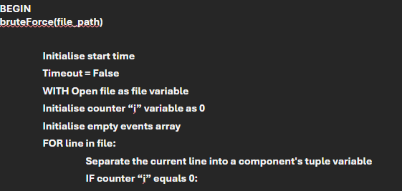
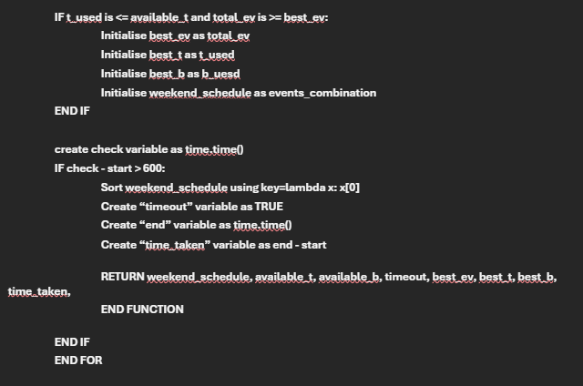
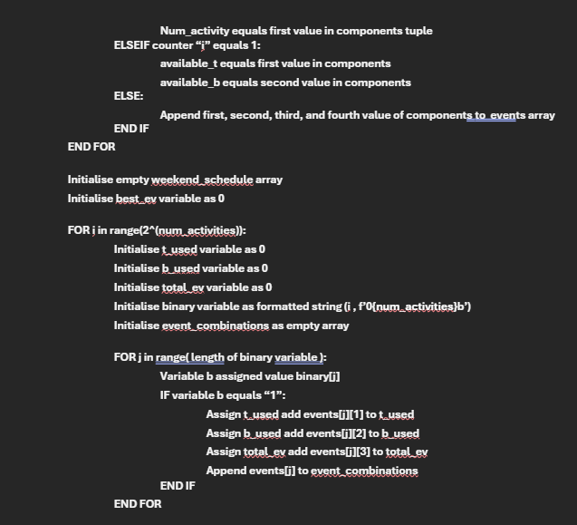
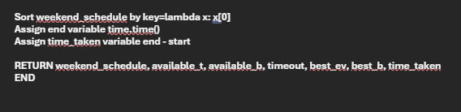
Brute-Force pseudocode

Slide 5
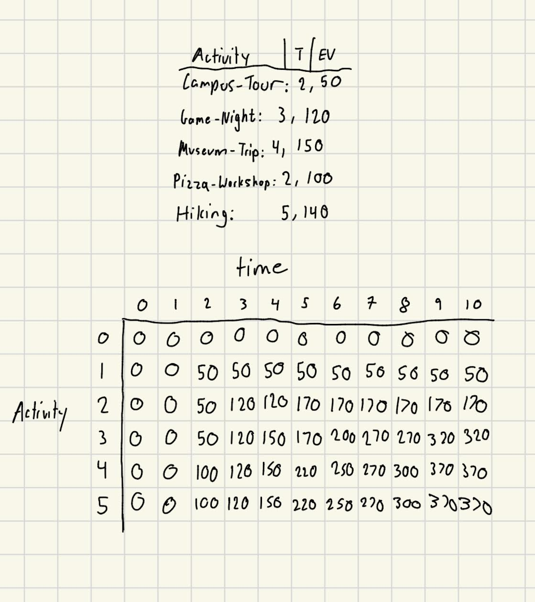
Dynamic Programming
an optimization approach that transforms a complex problem into a sequence of simpler problems
When creating an event planner with only one constraint, the 0/1 knapsack method can be used.
The idea is to use recursion on all possible combinations to find the most optimal weight
Notes:
To find the item. Start at the top 370 --> 370 at 4 then subtract the 50from the pizza workshop end up at 270. Go up once.
Then you know that Museum Trip is in the Activity list

Slide 6
Notes:
To find the item. Start at the top 370 --> 370 at 4 then subtract the 50from the pizza workshop end up at 270. Go up once.
Then you know that Museum Trip is in the Activity list

Slide 7
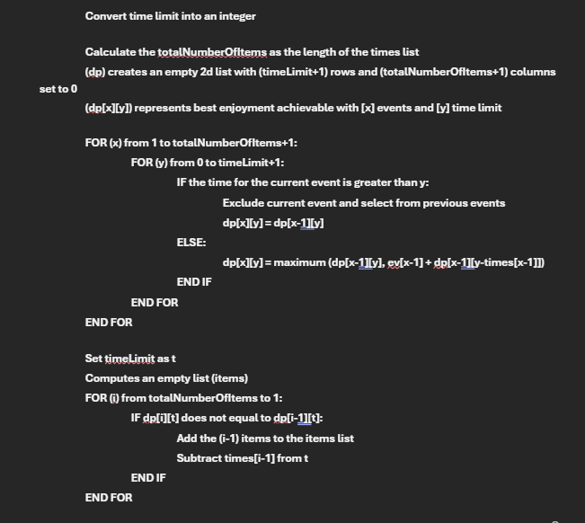
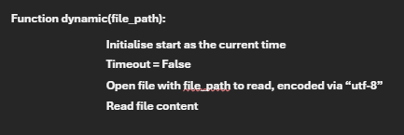
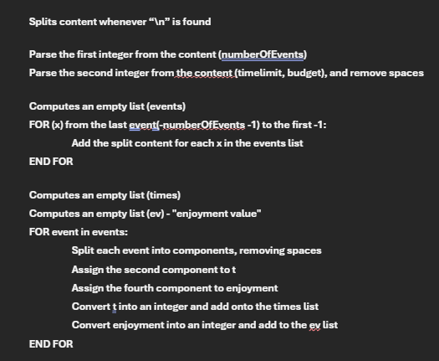
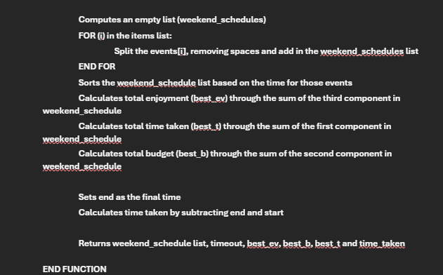
Dynamic Programming Pseudocode

Slide 8
Greedy-Heuristic
Aims to find an approximation of the optimal solution with minimal complexity
Calculates the ratio between Enjoyment value and time for each event
Ranks the ratios in descending order
Might not always provide the optimal solution, but is usually more time efficient than both other algorithms
However, the minimal running time difference compared to Dynamic means it is usually better to use dynamic over this algorithm

Slide 9
Differences
Brute Force | Dynamic Programming
Tries every combination O notation: O(n^2) Easier than dynamic programming to implement Uses a recursion stack so little memory needed | Stores and reuses results O notation: O(N * W) Harder to implement than brute force Requires more memory to store arrays

Slide 10
Speed Comparisons
Names | Small (5) | Medium (12) | Large (25) | 10 | 100 | 200 | 500 | 1000
Brute Force | 0.0002546 | 0.0076554 | 104.40063 | 0.0051146 | >10 minutes | >10 minutes | >10 minutes | >10 minutes
Dynamic | 0.0005921 | 0.0006447 | 0.0010561 | 0.0004031 | 0.0029379 | 0.0078861 | 0.0221453 | 0.0335866
Greedy Heuristic | 0.0004611 | 0.0005771 | 0.0003365 | 0.0004771 | 0.0008159 | 0.0006310 | 0.0012747 | 0.0023850
Key observations:
Brute Force demonstrates a superior performance compared to Dynamic for small input sizes
However, Dynamic illustrates a far superior performance than Brute Force for increasing input sizes
Greedy Heuristic ratio approximates more efficiently for increasing input sizes
Notes:
average time taken to execute each input over100 iterations, except brute force large (5 iterations)
Talk about specific examples across the different algorithms during the presentations: e.g, point out a faster reading time for small (5) in brute force but a far superior reading time for (1000) in dynamic

Slide 11
Live Demonstration

Slide 12
Any
Questions?

