Slide 1



Implementing Machine Learning Algorithims for Decision Support in Organizations
Seminar presented by:
Uzoma Uzosike
16-05110171-002
Department :
Business Information Management
Supervisor:
Asst. Prof EVRİM ERSİN KANGAL

Slide 2

What is Machine Learning?
Machine Learning is a method of data analysis that automates analytical model building by using algorithims that iteratively learn from data
Machine Learning Proccess (Mitchell 1997)
Learn from past experiences
Improve the performances of intelligent programs
Definitions (Mitchell 1997)
A computer program is said to learn from experience E with respect to some class of tasks T and performance measure P, if its performance at the tasks improves with the experiences

Slide 3
EXAMPLE : DISEASE DIAGNOSIS
Database of medical records
Patient 1’s data Absence
Patient 2’s data Presence
… …
Training
Disease classifier
New Patient’s Data
Prescence or Absence

Slide 4
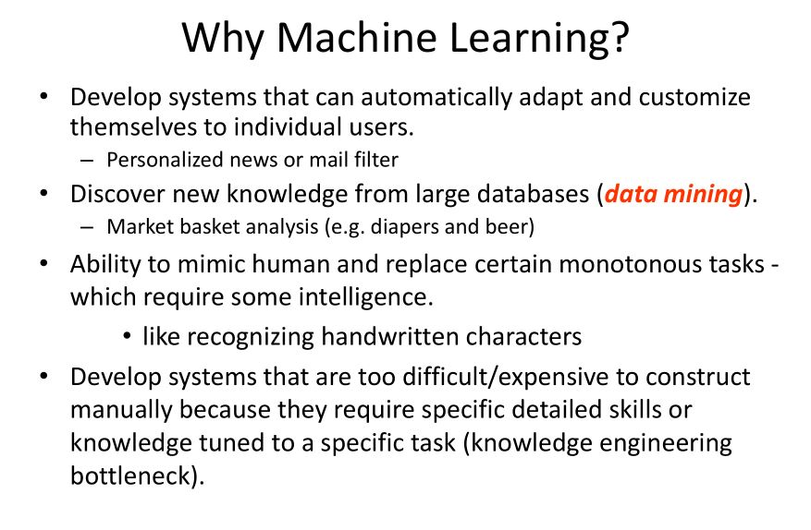

Slide 5
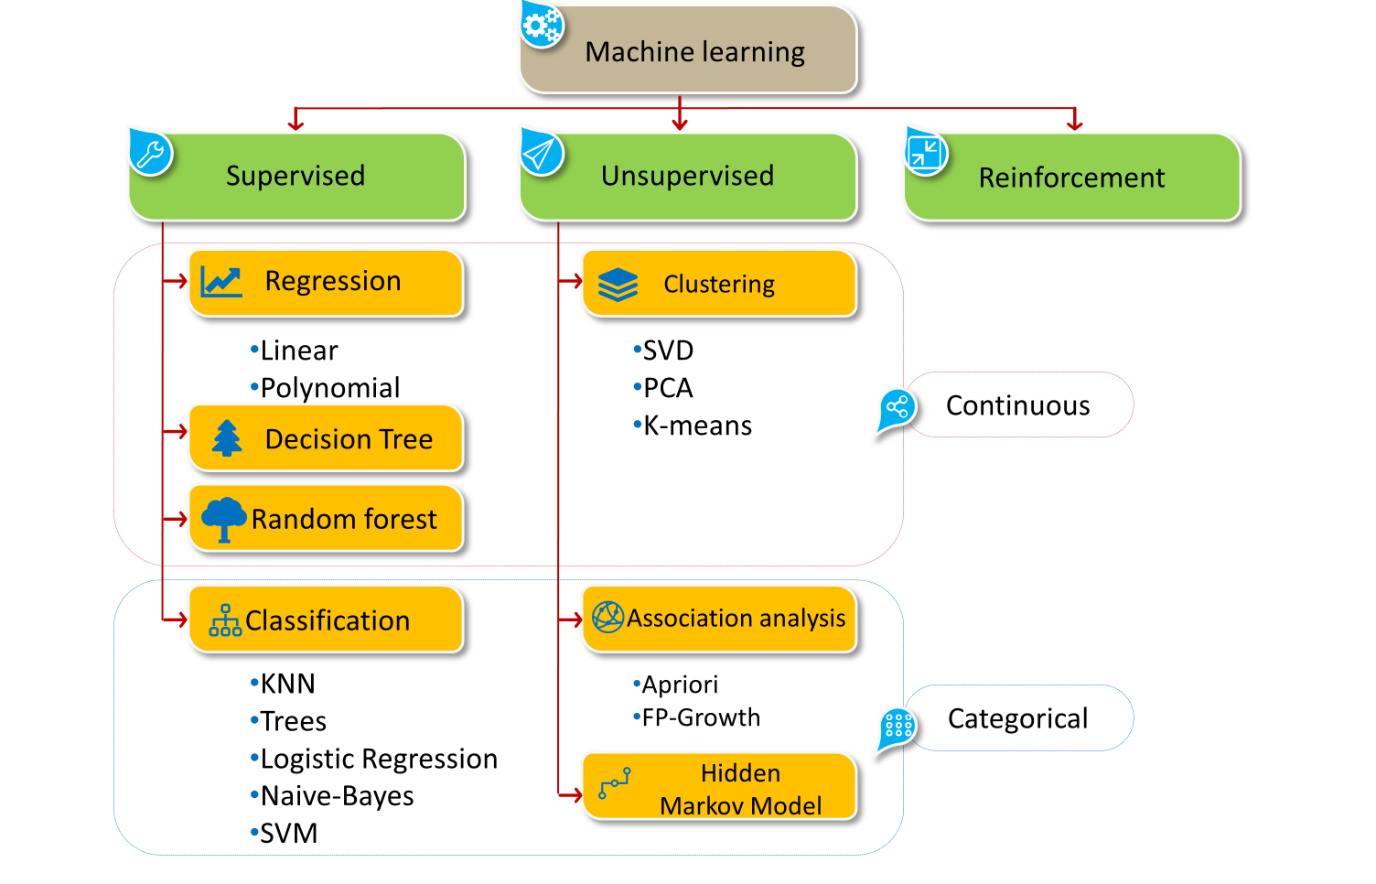
Branches of Machine-Learning

Slide 6
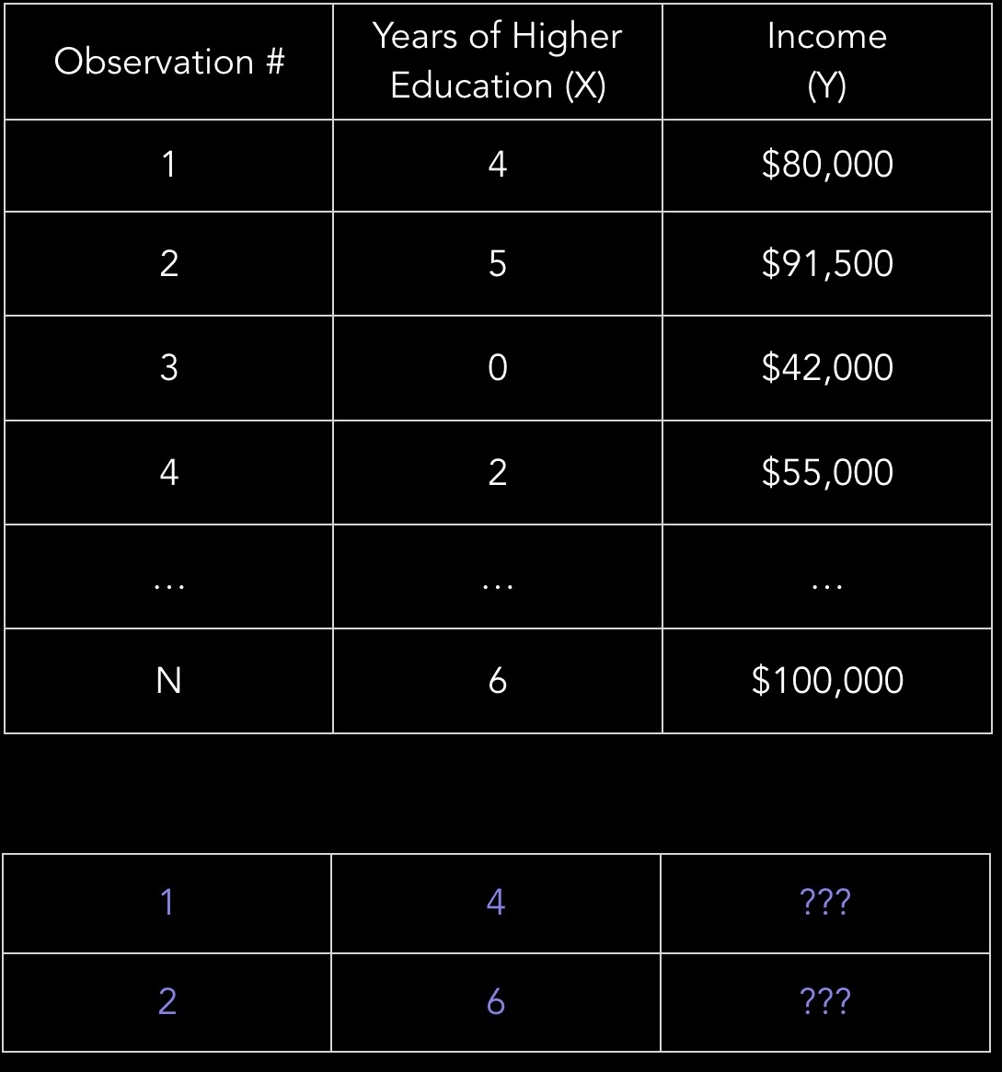
Supervised Learning
Supervised learning is the machine learning task of learning a function that maps an input to an output based on example input-output pairs. It infers a function from labeled training data consisting of a set of training examples.
In supervised learning, each example is a pair consisting of an input object (typically a vector) and a desired output value.
The output value is also called the supervisory signal.
A supervised learning algorithm analyzes the training data and produces an inferred function, which can be used for mapping new examples.

Slide 7
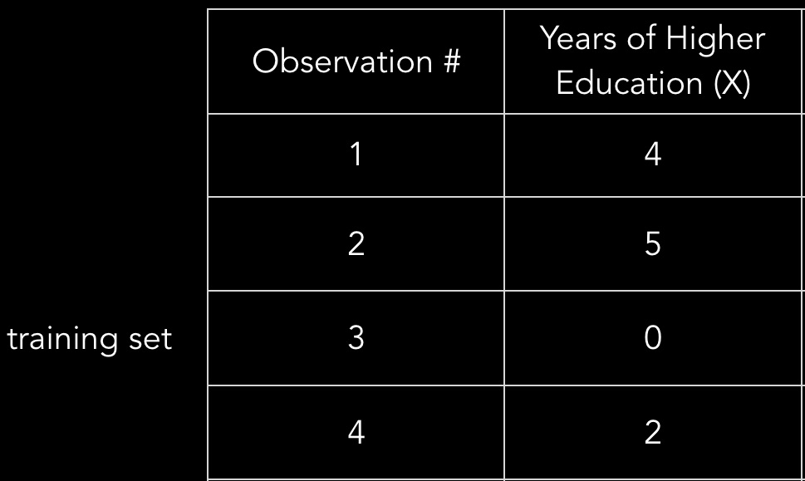
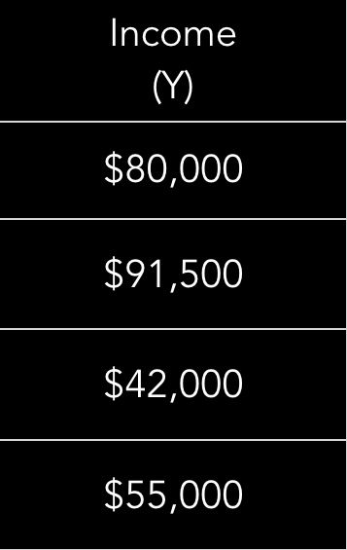

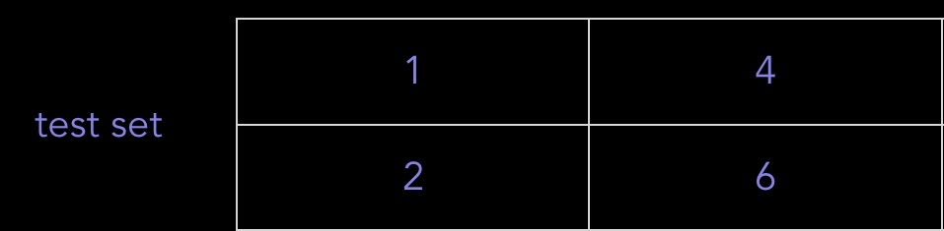

Supervised Learning Proccess
Observation | Years of Higher Education (X)
1 | 5
2 | 0
3 | 4
Learning Algorithm
New Data
Linear Regression
Logistic Regression
kNN
Decision Tree
Random Forest
SVM
$ 80,000
$87,000

Slide 8
Unsupervised Learning
Unsupervised learning is concerned with proccessing unlabeled data or data of unknown structure. Using unsupervised learning techniques, we are able to explore the structure of our data to extract meaningful information without the guidance of a known outcome variable or reward function (Raschka & Olson, 2016 p6).
Unsupervised learning is a type of machine learning algorithm used to draw inferences from datasets consisting of input data without labeled responses.
The most common unsupervised learning method is cluster analysis, which is used for exploratory data analysis to find hidden patterns or grouping in data.
Clustering” is the process of grouping similar entities together. The goal of this unsupervised machine learning technique is to find similarities in the data point and group similar data points together.

Slide 9
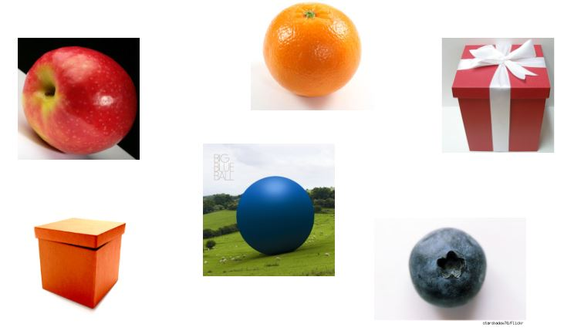

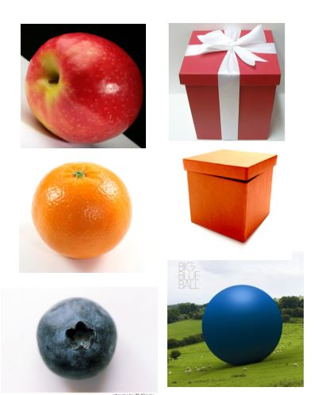
Unsupervised Learning
Learning Algorithm
Clustering
K-means
PCA
Association Analysis
FP-Growth

Slide 10
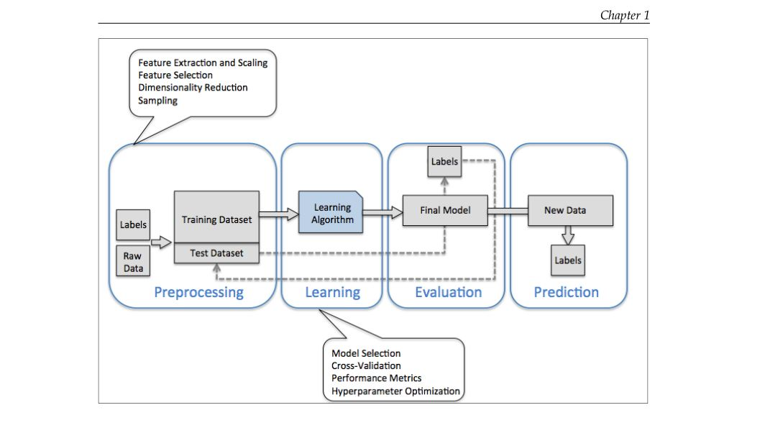
MACHINE LEARNING PROCCESS
Data Pre-Proccessing
Learning
Evaluation
Prediction

Slide 11
1. Data Pre-Proccessing
Data pre-processing is a data mining technique that involves transforming data into an format that is understandable. Often in reality, Data is always inconsistent and lacking in certain characteristics or trends. To this end, real world data is likely to contain numerous errors.(Techopedia 2014)
Therefore, Data preprocessing is a proven method of resolving issues associated with data inconsistency. Data preprocessing is a prerequsite step which prepares raw data for further processing in a format for meaningful usage.
Raw data rarely comes in the form and shape that is necessary for the optimal performance of a learning algorithm. Thus, the preprocessing of the data is one of the most crucial steps in any machine learning application (Sebastian 2016, p 11)

Slide 12
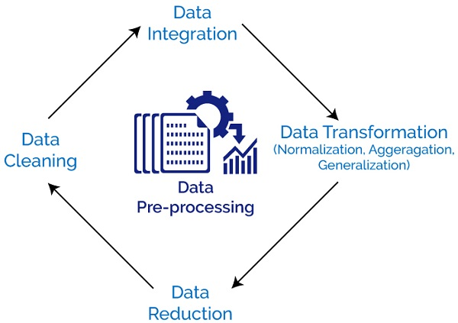
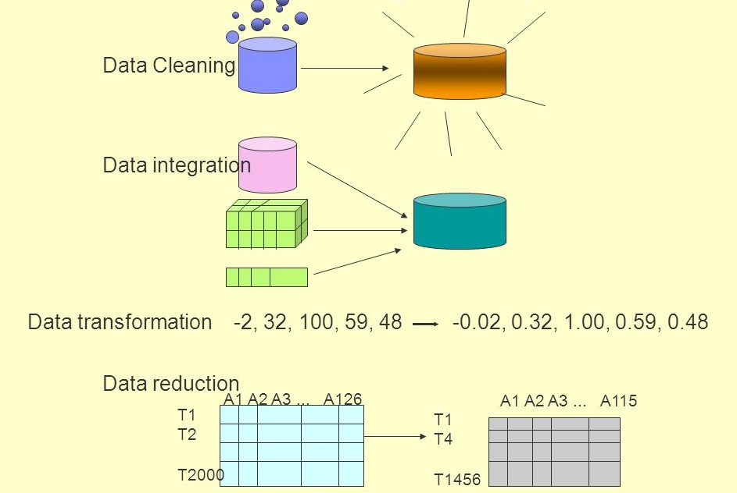
Forms of Data Preproccessing
Data Cleaning - Data cleaning is a form of data pre-processing that involves identifiyiny and filling in missing values, smoothing noisy data, identifying or removing outliers, and resolving inconsistencies.

Slide 13
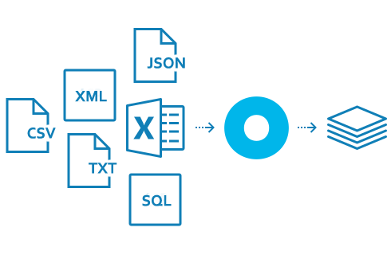
Data integration -
Integration of multiple databases, data cubes, or files into a unified readable format.
Data Transformations -
According to Osborne (2002), Data transformations are the application of a mathematical modification to a variable. Forms of data transformation are as follows:
Normalization – Scaling attributes and values of the data set to fall within a specified range using mean and standard deviation.
Aggregation –
Generalization
Attribute Construction – This is done by creating new attributes inferred by already existing attributes.

Slide 14
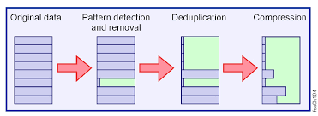
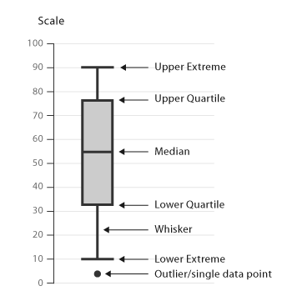
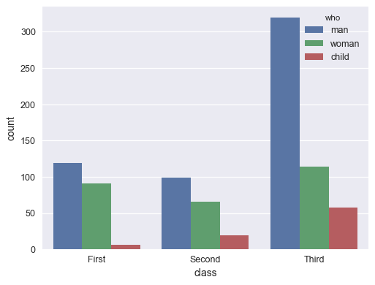
Data Reduction –
Data reduction is the transformation of numerical or alphabetical digital information derived empirically or experimentally into a corrected, ordered, and simplified form. The basic concept is the reduction of multitudinous amounts of data down to the meaningful parts.
Data visualization -
Data visualization is the presentation of data in a pictorial or graphical format.
Data visualization enables decision makers to see analytics presented visually to enable them understand difficult concepts or identify new patterns.

Slide 15
2. Logistic Regression
Logistic regression is a classification algorithm used to assign observations to a discrete set of classes. Unlike linear regression which outputs continuous number values, logistic regression transforms its output using the logistic sigmoid function to return a probability value which can then be mapped to two or more discrete classes.(ML Cheatsheet, 2017)
Types of Logistic Regression:
Binary (Pass/Fail)
Multi (Cats, Dogs, Sheep)
Ordinal (Low, Medium, High

Slide 16
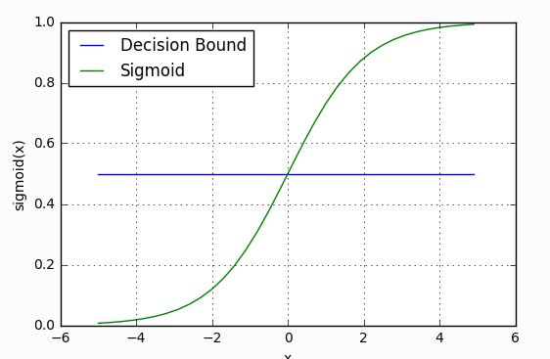
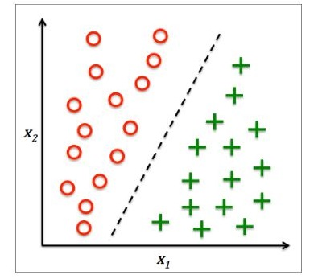

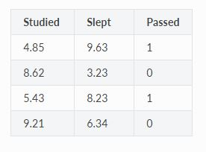

Sigmond Function
S(z) = output between 0 and 1 (probability estimate)
z= input to the function
e= base of natural log
Studied : Number of hours for Study
Slept : Number of hours for sleep
Target Attribute :
= Passed
0 = Failed
Decision bound

Slide 17
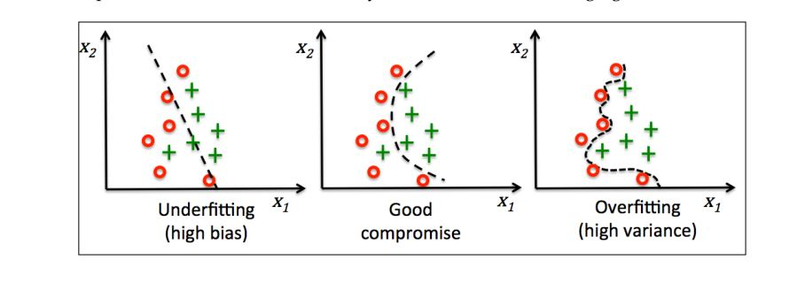
Tackling Overfitting and Underfitting problems
Overfitting is a common problem in machine learning, where a model performs well on training data but does not generalize well to unseen data (test data). If a model suffers from overfitting, we also say that the model has a high variance, which can be caused by having too many parameters that lead to a model that is too complex given the underlying data.
Underfitting also known as high bias, means that our model is not complex enough to capture the pattern in the training data well and therefore also suffers from low performance on unseen data (Raschka & Olson, 2016 p6).
Tackling overfitting via regularization (Raschka & Olson, 2016 p65).

Slide 18
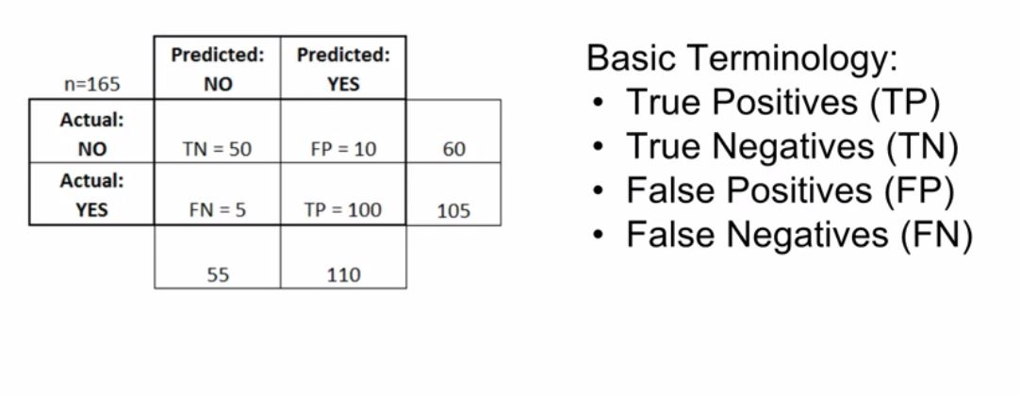
Model Evaluation – Confusion Matrix
The confusion matrix is a tabular report used to show the performance of a classification model on a set of test data for which the true target values are known.
A confusion matrix contains information about actual and predicted classifications done by a classification system. Performance of such systems is commonly evaluated using the data in the matrix (Kohavi and Provost, 1998) .
Accuracy: Overall, how often is the classifier correct?
(TP+TN)/total = (100+50)/165 = 0.91
Misclassification Rate: Overall, how often is it wrong?
(FP+FN)/total = (10+5)/165 = 0.09
True Positive Rate: When it's actually yes, how often does it predict yes?
TP/actual yes = 100/105 = 0.95
also known as "Sensitivity" or "Recall"
False Positive Rate: When it's actually no, how often does it predict yes?
FP/actual no = 10/60 = 0.17
Specificity: When it's actually no, how often does it predict no?
TN/actual no = 50/60 = 0.83
equivalent to 1 minus False Positive Rate
Precision: When it predicts yes, how often is it correct?
TP/predicted yes = 100/110 = 0.91

Slide 19
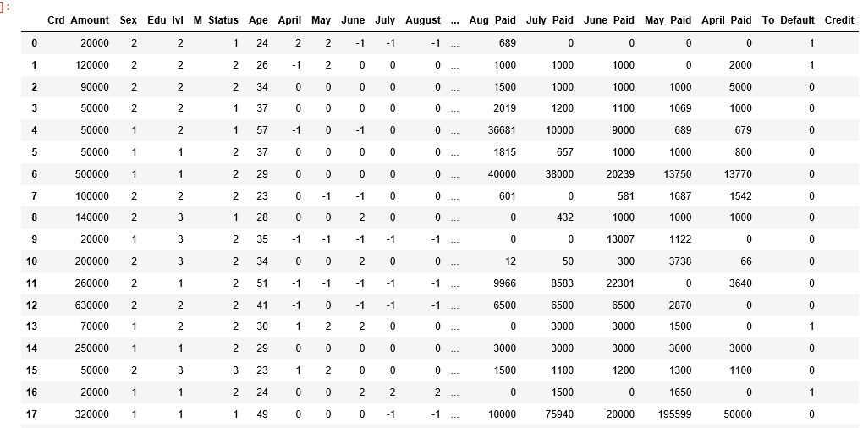
Sample Dataset : Default Payments of Credit Card Clients Dataset in Taiwan from 2005
LIMIT_BAL: Amount of given credit in NT dollars (includes individual and family/supplementary credit)
SEX: Gender (1=male, 2=female)
EDUCATION: (1=graduate school, 2=university, 3=high school, 4=others, 5=unknown, 6=unknown)
MARRIAGE: Marital status (1=married, 2=single, 3=others)
AGE: Age in years
PAY_0: Repayment status in September, 2005 (-1=pay duly, 1=payment delay for one month, 2=payment delay for two months, ... 8=payment delay for eight months, 9=payment delay for nine months and above)
To_Default: Default payment (1=yes, 0=n

Slide 20
References
Baştanlar, Y., & Özuysal, M. (2014). Introduction to machine learning. In miRNomics: MicroRNA Biology and Computational Analysis (pp. 105-128). Humana Press, Totowa, NJ.
Donalek, C. (2011). Supervised and Unsupervised learning. In Astronomy Colloquia. USA.
https://www.techopedia.com/definition/14650/data-preprocessing
James, G., Witten, D., Hastie, T., & Tibshirani, R. (2013). An introduction to statistical learning (Vol. 112). New York: springer.
Jason Osborne 2002
Lichman, M. (2013). UCI Machine Learning Repository [http://archive.ics.uci.edu/ml]. Irvine, CA: University of California, School of Information and Computer Science.
Raschka, S., & Olson, R. S. (2016). Python machine learning: Unlock deeper insights into machine learning with this vital guide to cutting-edge predictive analytics. Birmingham: Packt Publishing.
Pearce, J., & Ferrier, S. (2000). Evaluating the predictive performance of habitat models developed using logistic regression. Ecological modelling, 133(3), 225-245.
Python for Data Science and Machine Learning Bootcamp
https://www.udemy.com/python-for-data-science-and-machine-learning-bootcamp/learn/v4/t/lecture/5733414?start=0

