Slide 1

Customer management application system
LAZARDO

Slide 2

Story of lazardo
Lazardo is a reptile who love to purchase an item but one day lazardo fell in the ground he notice his account been leaked and the money is gone.
The anger of lazardo he lurk to a school and go inside an IT room where he watch from celling while professor teaching a student .
After 4 years of observation lazardo created a CMASystem and its called LAZARDO on where all of the user will be secured.

Slide 3
Lazardo provide
Security
Satisfaction
Responsive web site
Accessibilitiy
Option
Affordable product price meet customer wallet size

Slide 4
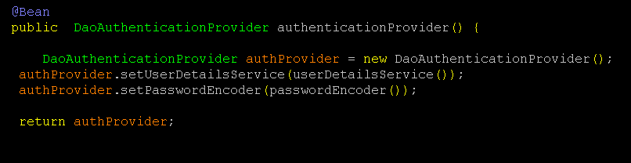
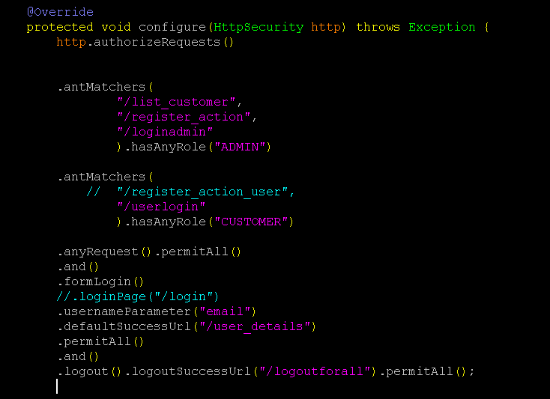
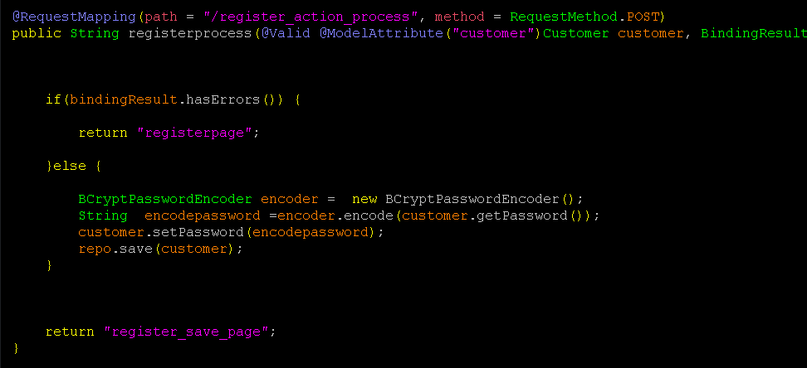
Spring Security
Every url of admin and customer are need to be authorize by its Role.
If the customer try to login in customer will be not authorized same goes to admin.
Password are encrypted for customer and admin.
Password encryption is safe from anonymous hacker.

Slide 5
User access
Admin – 1
Delete customer and other admin account
Update customer and admin information and role
Create customer and admin information and role
Customer – 2
Register their information
View their own information

Slide 6
Frontend
Spring Web
Thymeleaf – to support my web development and security
JavaScript – Support html action
HTML - body
CSS – to style html

Slide 7
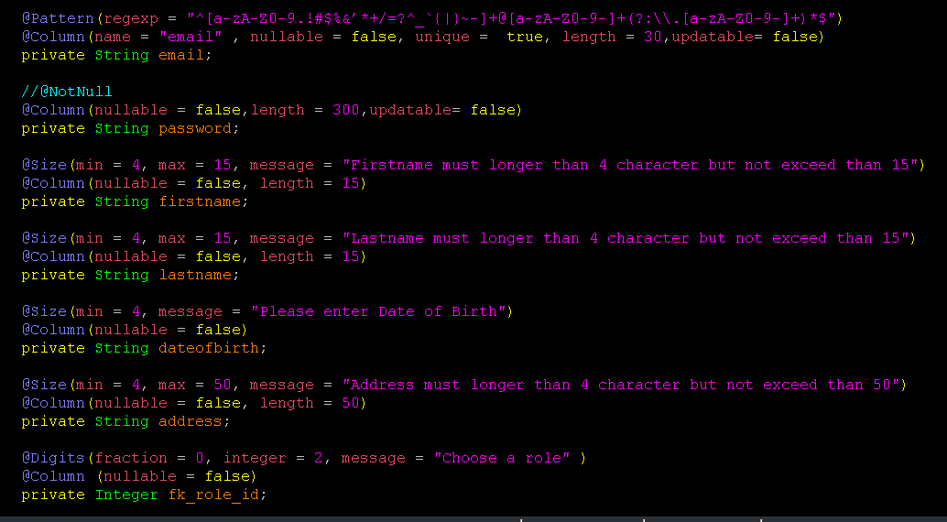
Validation
Spring Validator
Hibernate Validator
This Validator is from backend and control the backend which validate the customer register module and admin create module

Slide 8
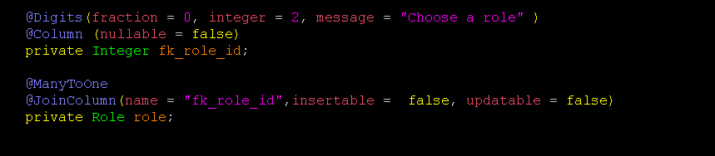
Role many to one
Customer and admin

Slide 9
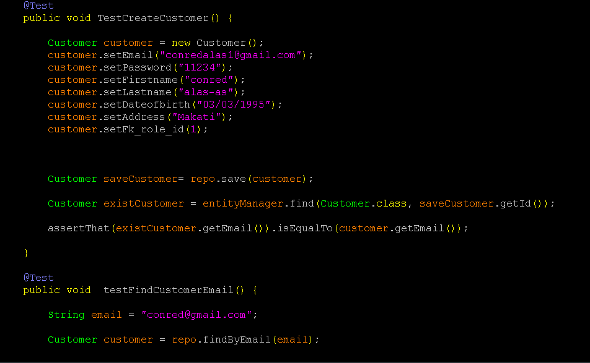
Testing test in database connection and email duplicate

Slide 10
Use in development
IDE – Eclipse and VScode
JAVA 8
Postgres JDBC
PostgreSQL
Spring Data JPA
Spring Security
Thymeleaf

Slide 11
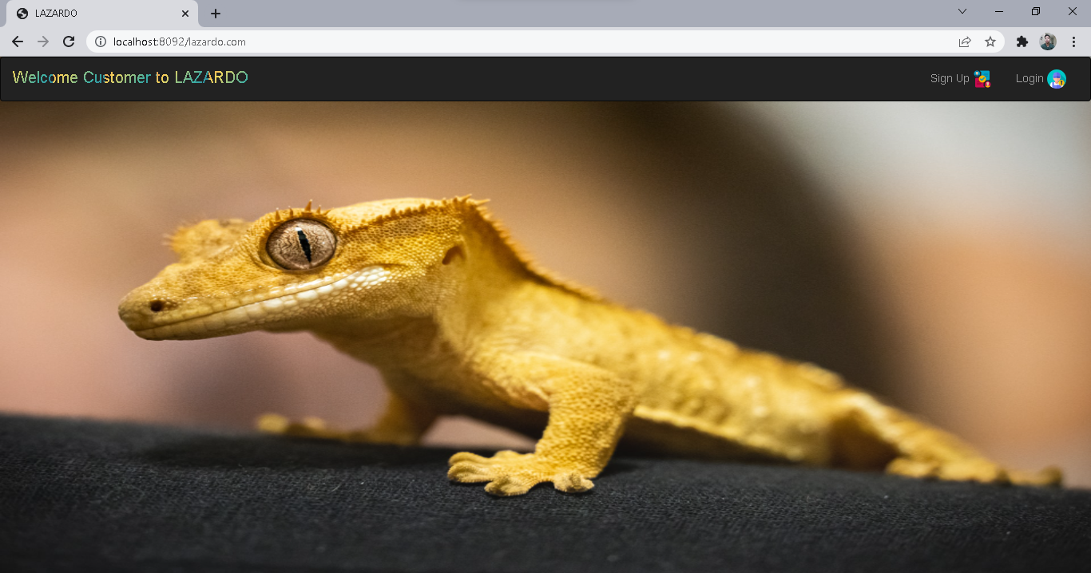
customer interface

Slide 12
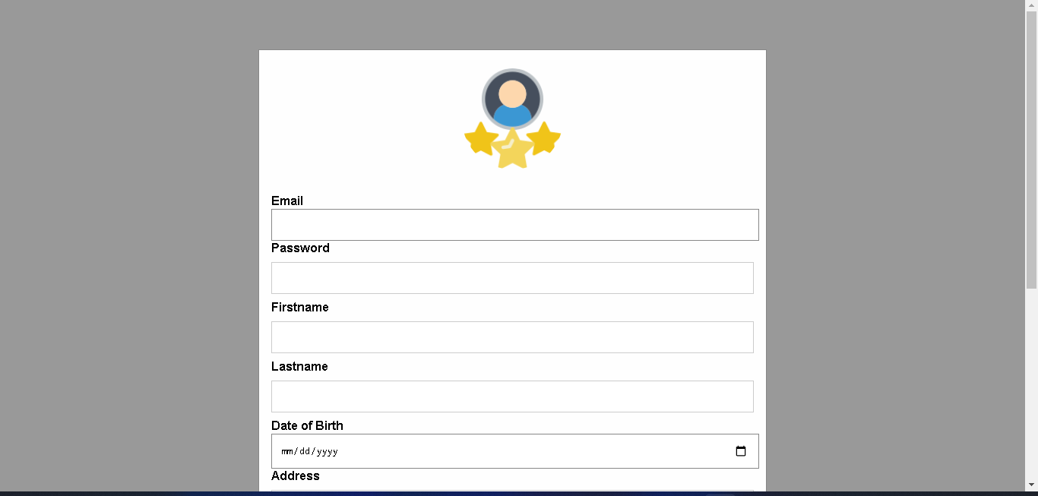
Customer registration

Slide 13
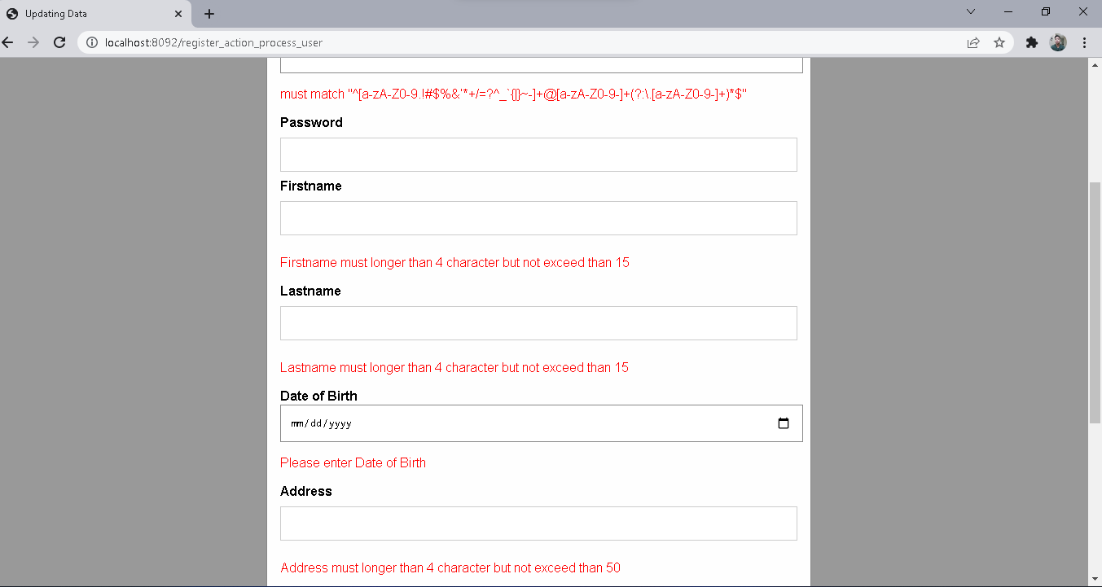
Spring & hibernate Validator for customer regisTRATION

Slide 14
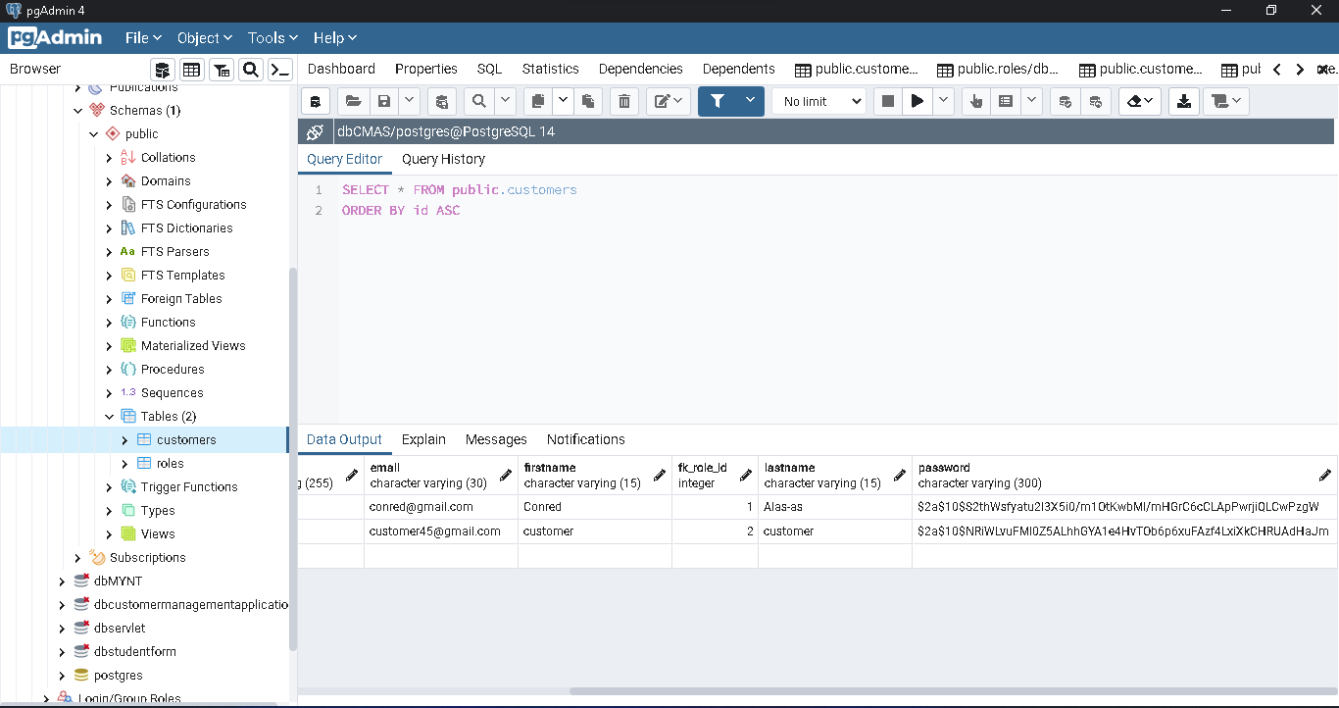
BCryptPasswordEncoder

Slide 15
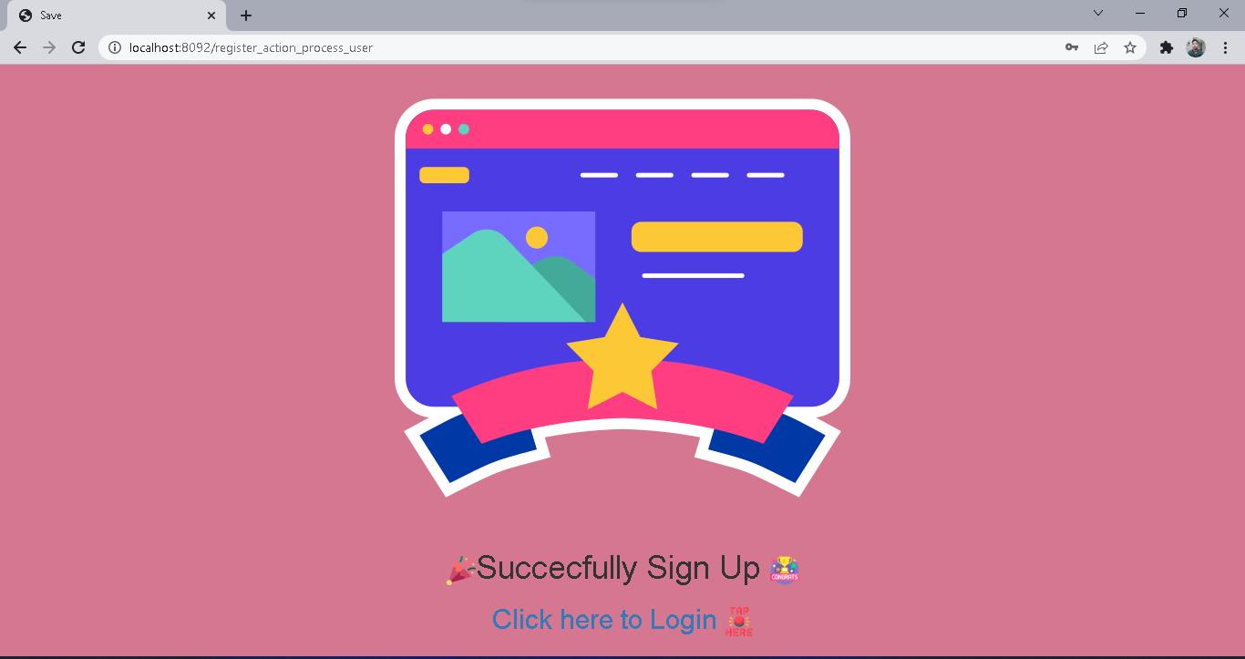
After Successfully login

Slide 16
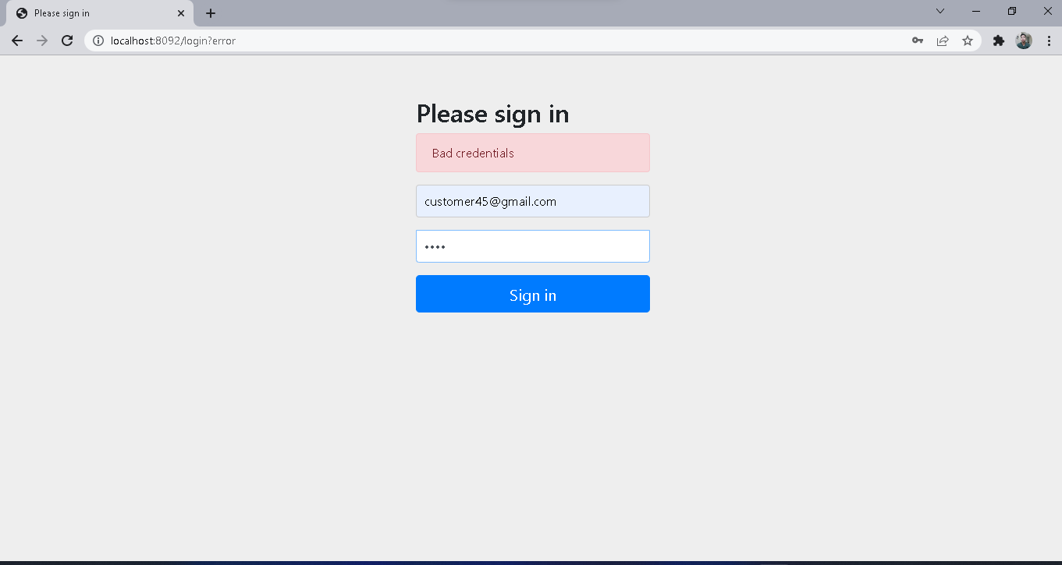
Customer role only can login in customer interface

Slide 17
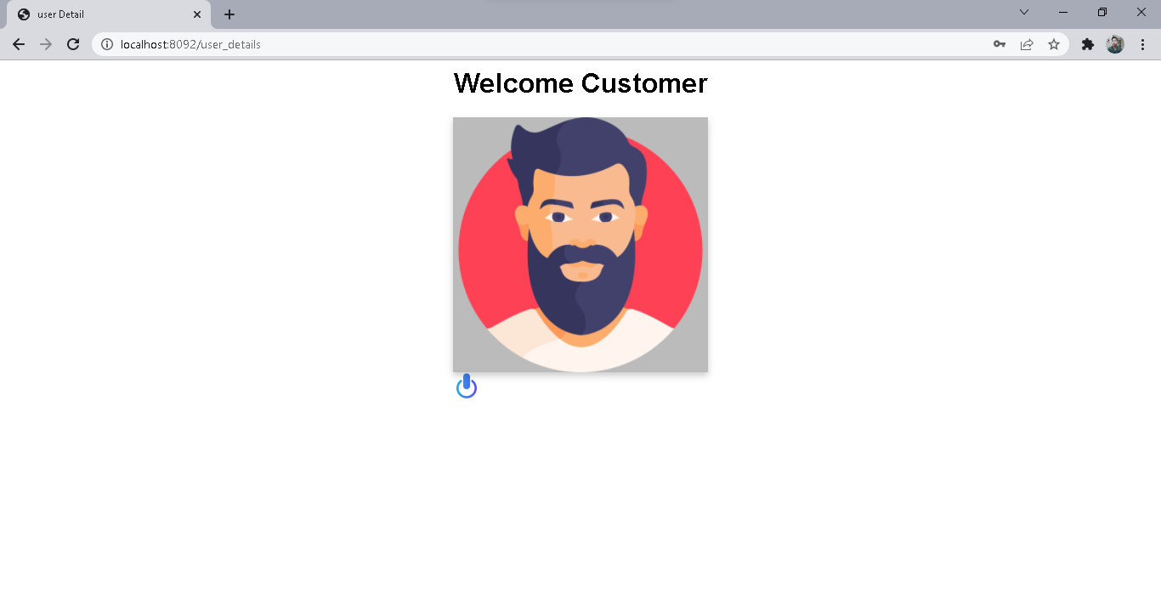
Customer detail click to show detail

Slide 18
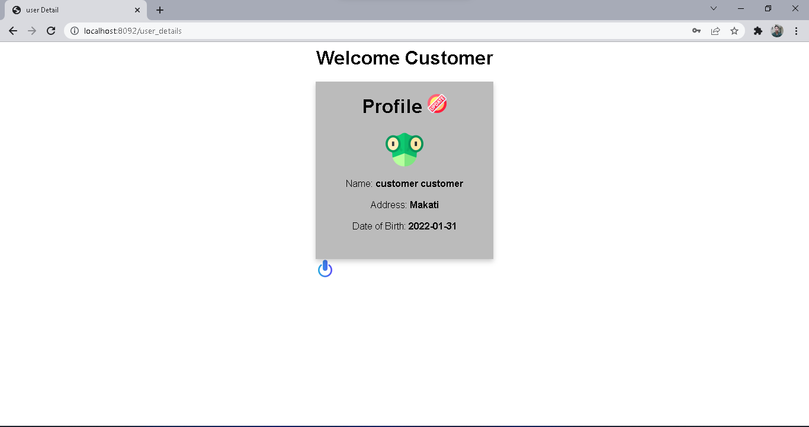
After click

Slide 19
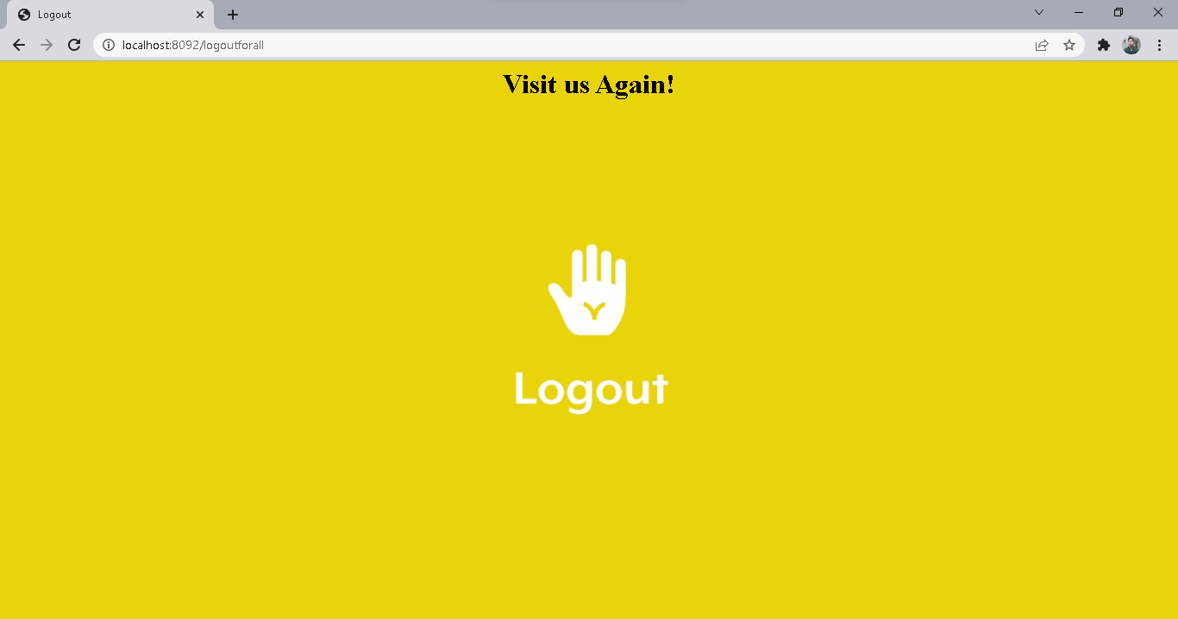
logout

Slide 20
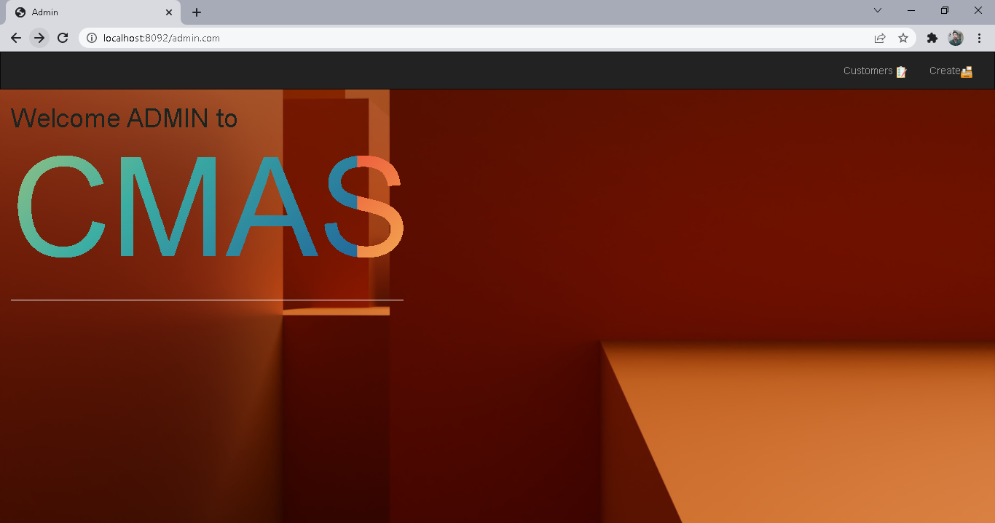
Admin interface

Slide 21
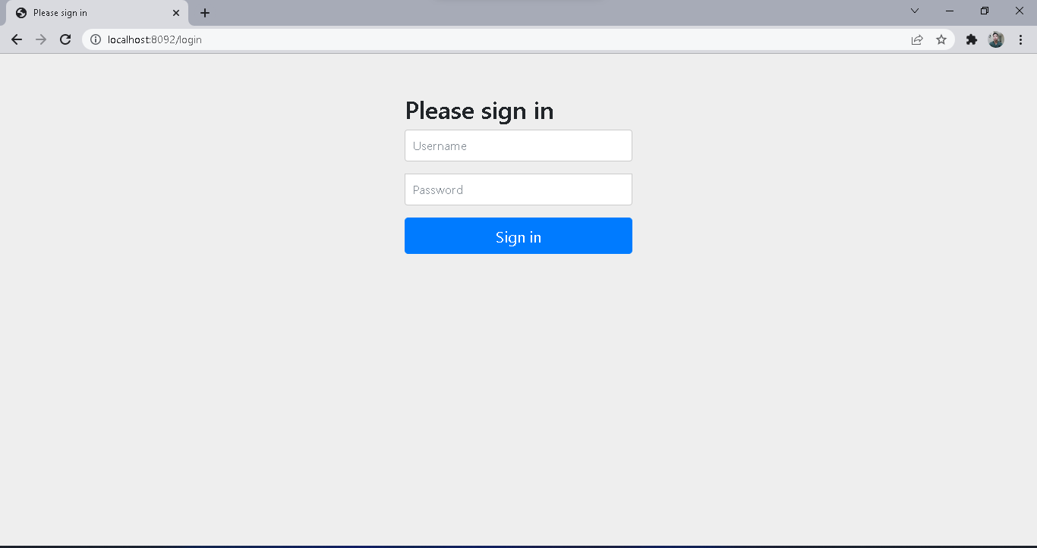
Restricted access for customer list and creation must have admin role

Slide 22
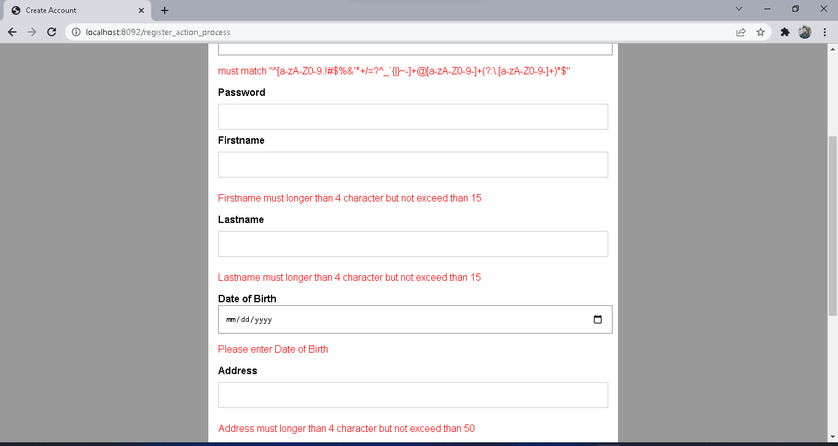
Create account for customer or admin and spring/hibernate validator

Slide 23
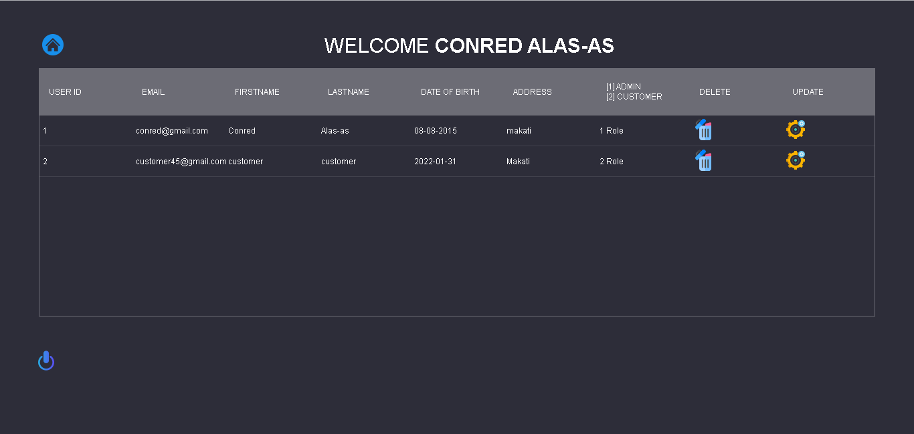
List of customer and admin with delete and update with spring validator

Slide 24
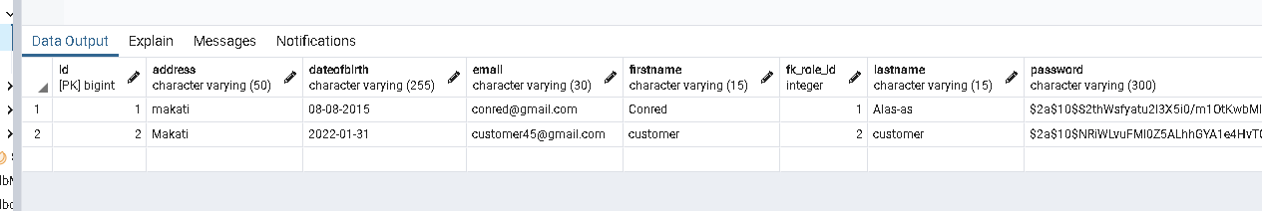
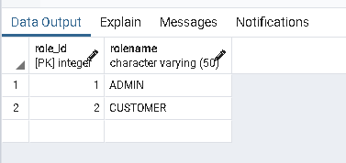
Many to one mapping role admin & customer

