Slide 1

P-357- BANKRUPTCY PREVENTION
Presented By G-3:
Ms. Vaishali Ravi Mukharjee
Mr. Yash Kumar Roy
Ms. Shrusti Suresh Kardile
Mr. Rachakonda Saket Rao
Ms. Gudicint Hari Priya
Mr. Prasanth Junnada
Mrs. Neha Bhatia

Slide 2
CONTENTS
Business Objective
Introductions
Project Architecture
Data Details
Visualization and EDA
Modelling Building
Evaluation
Deployment

Slide 3
ACKNOWLEDGEMENT
We would like to express our deepest gratitude to Ms. Bhanupriya Katrapally for their invaluable patience and feedback. Thank you for entrusting us with this opportunity.
We could not have undertaken this journey without your guidance and expertise.

Slide 4
BUSINESS OBJECTIVE
This is a classification project, since the variable to predict is binary (bankruptcy or non-bankruptcy). The goal here is to model the probability that a business goes bankrupt from different features.
The data file contains 7 features about 250 companies
The data set includes the following variables:
industrial_risk: 0=low risk, 0.5=medium risk, 1=high risk.
management_risk: 0=low risk, 0.5=medium risk, 1=high risk.
financial flexibility: 0=low flexibility, 0.5=medium flexibility, 1=high flexibility.
credibility: 0=low credibility, 0.5=medium credibility, 1=high credibility.
competitiveness: 0=low competitiveness, 0.5=medium competitiveness, 1=high competitiveness.
operating_risk: 0=low risk, 0.5=medium risk, 1=high risk.
class: bankruptcy, non-bankruptcy (target variable).

Slide 5
INTRODUCTION
The primary objective of this project is to build a predictive model that can effectively classify companies as either bankrupt or non-bankrupt based on historical financial data and other relevant features. By employing state-of-the-art data science methodologies, we aim to develop a model that not only achieves high accuracy but also provides valuable insights into the underlying factors contributing to bankruptcy risk.

Slide 6
PROJECT ARCHITECTURE/ PROJECT FLOW
Business Understanding
Model Deployment
Data Collection
Model Evolution
Data Preparation
Visualization
Exploratory Data Analysis

Slide 7
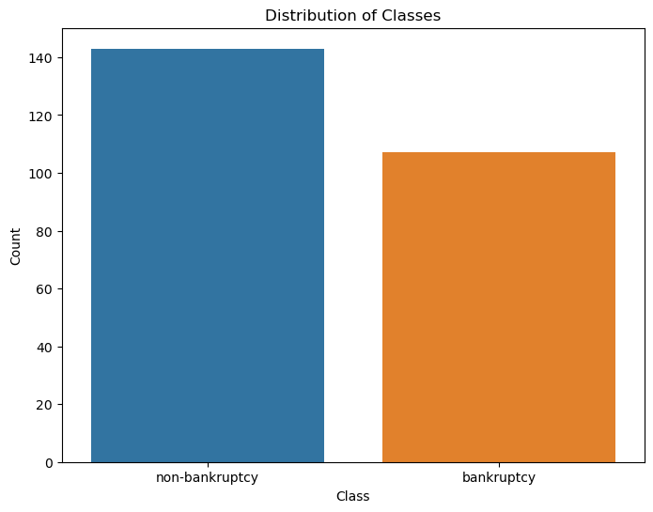
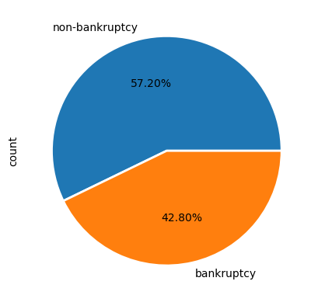
DATASET and VISUALIZATION
Observation :-
There are 143 instances labeled as 'non-bankruptcy' and 107 instances labeled as 'bankruptcy’.
The dataset seems to be somewhat balanced, but there is a slight class imbalance with more non-bankruptcy instances.

Slide 8
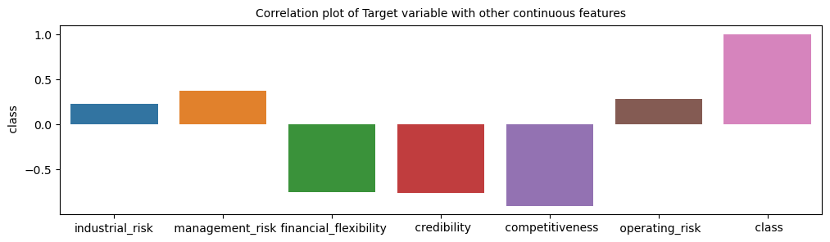
Observation :-
Correlation plot of class variable with other continuous features. We can see Financial Flexibility, Credibility and Competitiveness has negative correlated to the class other are having positive correlation with the class variable.

Slide 9
MODEL BUILDING
We have split the whole data into training and test set in the ratio of 80% to training set and 20% to test set.
Name | Accuracy | Precision | Recall | F1-Score | AUC
Logistic Regression | 100 | 100 | 100 | 100 | 100
KNN | 100 | 100 | 100 | 100 | 100
SVM | 100 | 100 | 100 | 100 | 100
Decision Tree | 100 | 100 | 100 | 100 | 100
Random Forest | 100 | 100 | 100 | 100 | 100
Naïve Bayes | 98 | 100 | 94.74 | 97.30 | 97.37
Note:
All values are in percent

Slide 10
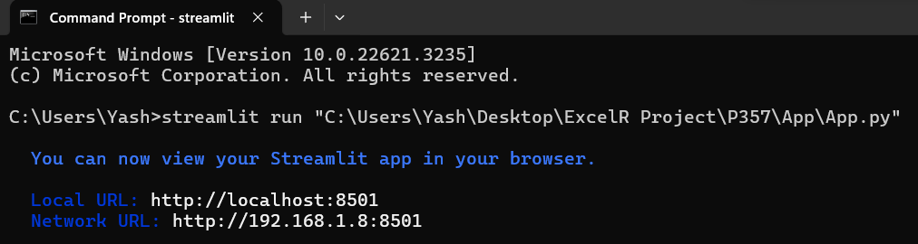
DEPLOYMENT

Slide 11
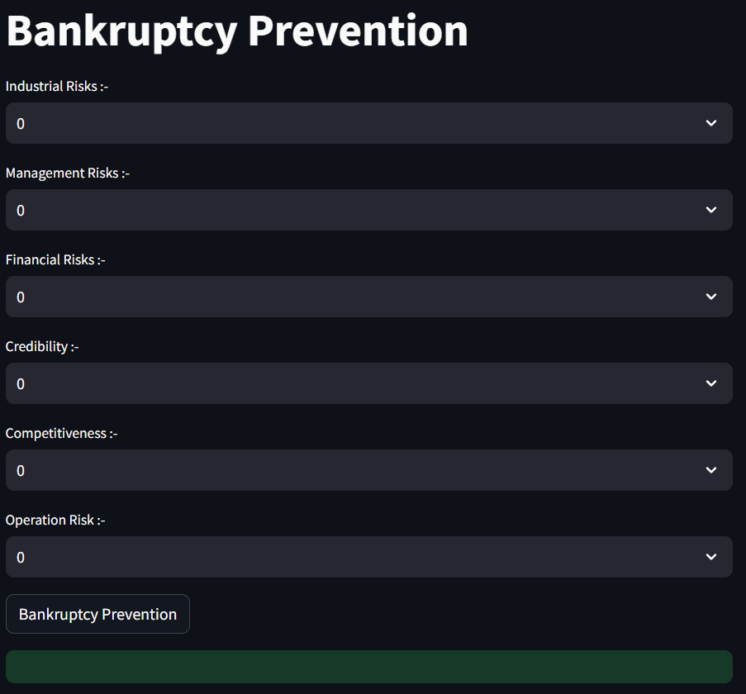
Sample Page:

Slide 12
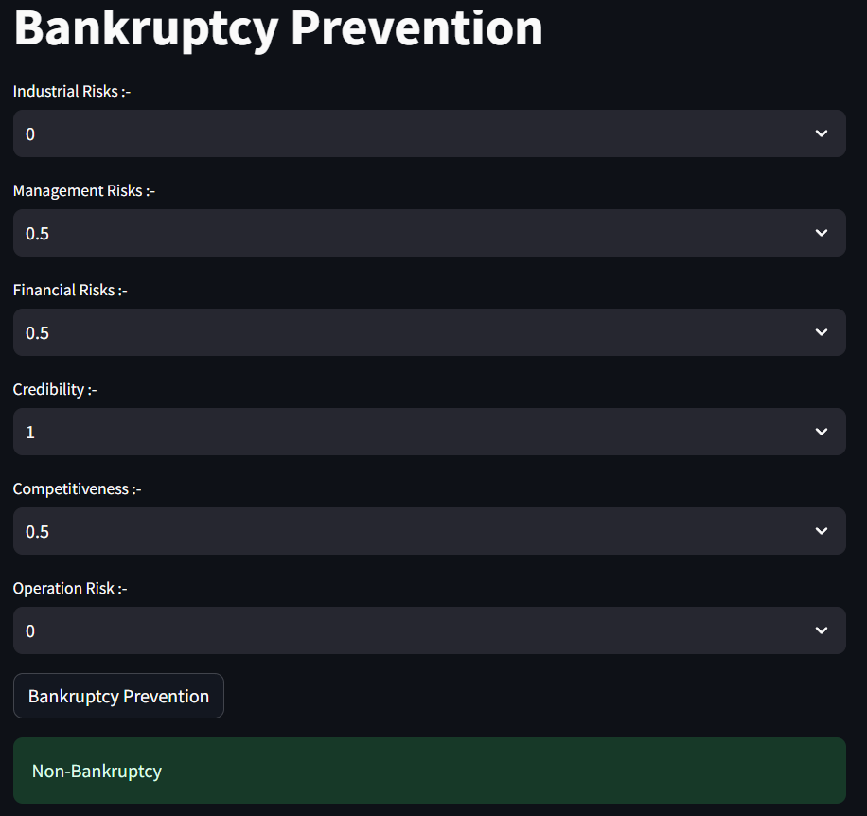
With some input:

