Slide 1

P375-Medical Cost Charges Prediction
PRESENTED BY G-1:
MS. VAISHALI RAVI MUKHARJEE
MR. YASH KUMAR ROY
MS. SHRUSTI SURESH KARDILE
MS. SWATHI MANOHARAN
MS. MAYURI DILIP JAGTAP
MR. KAIF SHANAWARALI QUADRI
MR. SOHEL SALIM SAYYED

Slide 2
CONTENTS
Business Objective
Introductions
Project Architecture
Data Details
Visualization and EDA
Model Building
Evaluation
Deployment

Slide 3
ACKNOWLEDGEMENT
We would like to express our deepest gratitude to Mr. Adwaith for their invaluable patience and feedback. Thank you for entrusting us with this opportunity. We could not have undertaken this journey without your guidance and expertise.

Slide 4
BUSINESS OBJECTIVE
The goal here is to develop a predictive model to estimate the medical insurance costs for individuals based on various parameters including age, sex, BMI, children, smoking status, and residential region.
The data set includes the following variables:
AGE: age of primary beneficiary
SEX: insurance contractor gender, female, male
BMI: Body mass index, providing an understanding of body, weights that are relatively high or low relative to height, objective index of body weight (kg / m ^ 2) using the ratio of height to weight, ideally 18.5 to 24.9
CHILDREN: Number of children covered by health insurance / Number of dependents
SMOKER: Smoking
REGION: the beneficiary's residential area in the US, northeast, southeast, southwest, northwest.
CHARGES: Individual medical costs billed by health insurance

Slide 5
INTRODUCTION
This project focuses on predicting medical health insurance costs using various regression models. The goal is to create a model that can accurately estimate the insurance costs for individuals based on their attributes.

Slide 6
PROJECT ARCHITECTURE/ PROJECT FLOW
Business Understanding
Model Deployment
Data Collection
Model Evolution
Data Preparation
Visualization
Exploratory Data Analysis

Slide 7
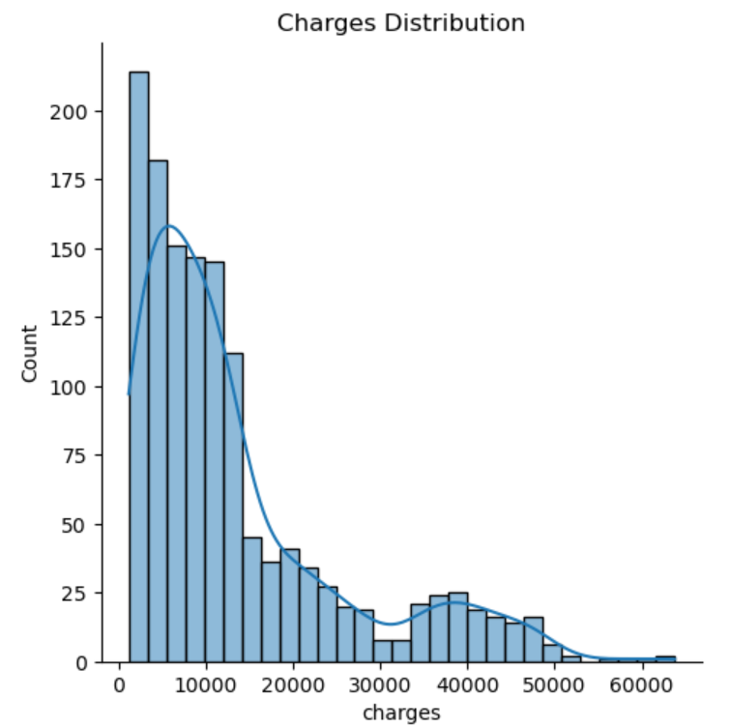
DATASET and VISUALIZATION
OBSERVATONS:
The given graph shows count of charges in the given data. The graph is right skewed.

Slide 8
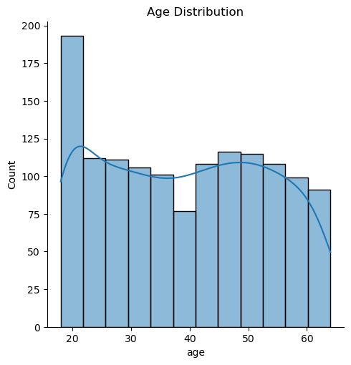
OBSERVATIONS:
Age range is between 18 and 64

Slide 9
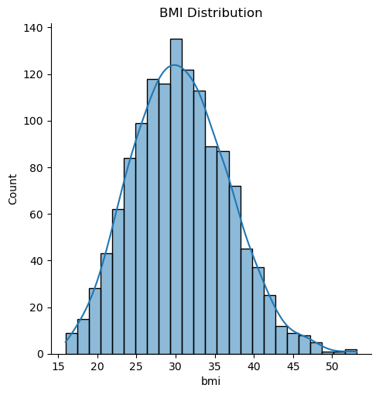
OBSERVATIONS:
BMI is Normally Distributed and we have maximum number of customer around age 30

Slide 10
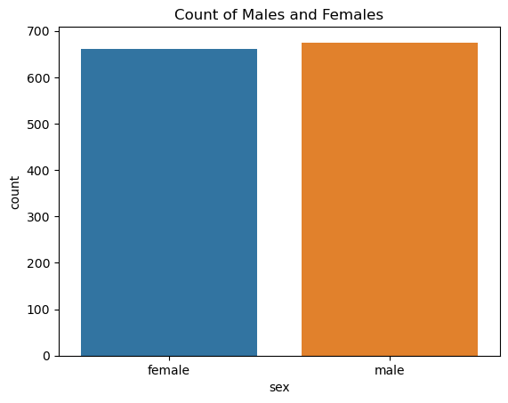
OBSERVATIONS:
There are 675 males and 662 females. That is the ratio of sex seems balanced in the data

Slide 11
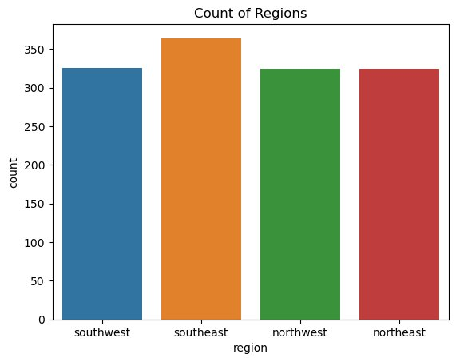
OBSERVATION:
There are 364 regions labeled as southeast 325 labeled as southwest 324 labeled as northwest 324 labeled as northeast

Slide 12
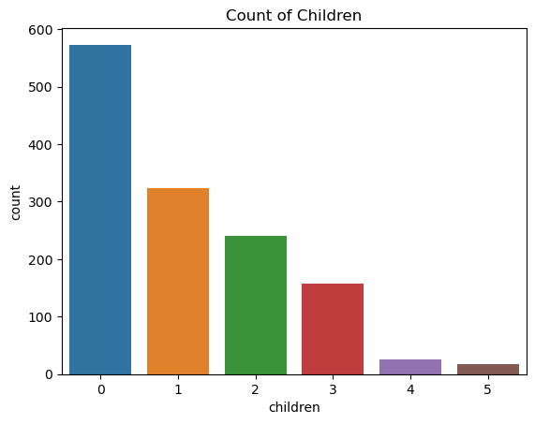
OBSERVATIONS:
We have more customer with zero children

Slide 13
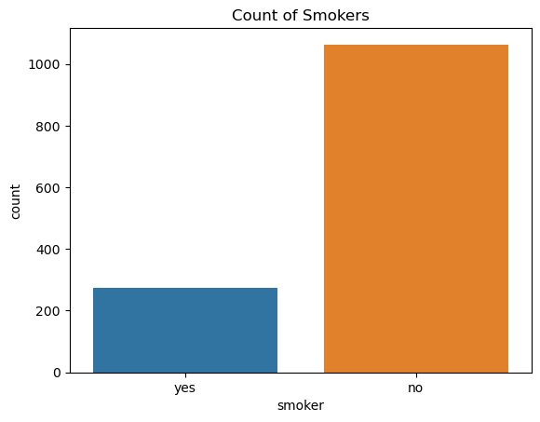
OBSERVATIONS:
There are 1063 people labeled as non-smoker and 274 as smoker

Slide 14
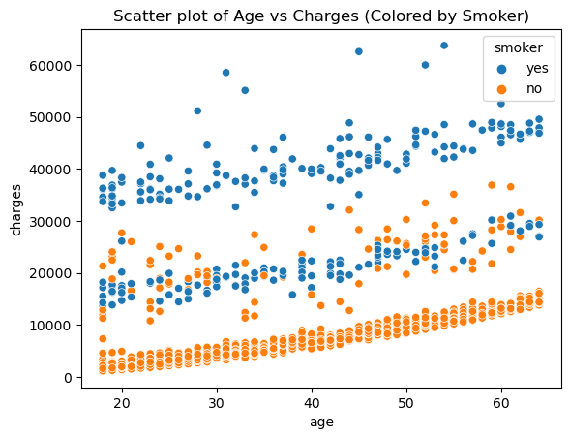
OBSERVATIONS:
The plot shows there is highly correlation between smoker and the chargers.

Slide 15
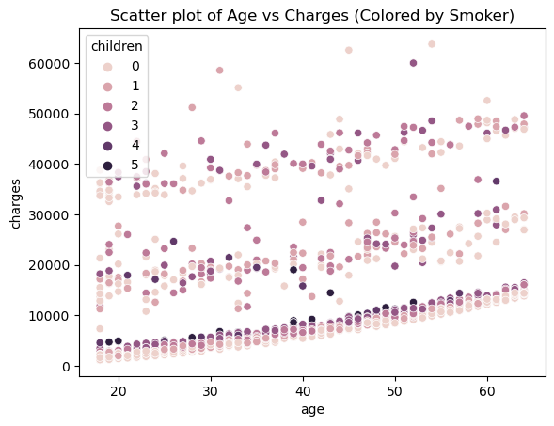
OBSERVATIONS:
This suggest that there is no such correlation between number of children and the charges.

Slide 16
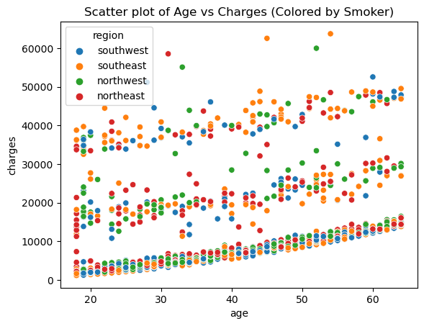
OBSERVATIONS:
Scatter plot suggests no such correlation between age and charges colored by region

Slide 17
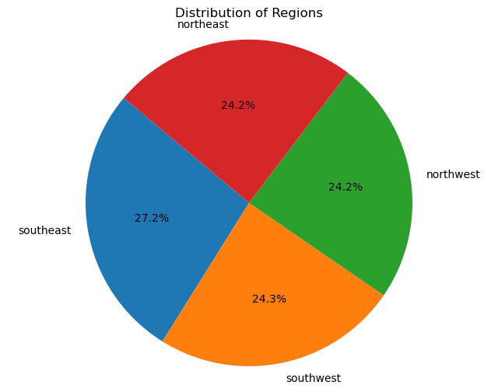
OBSERVATIONS:
From regions 24.2% regions are northeast,24.2% are northwest,27.2% are southeast, 24.3% are southwest

Slide 18
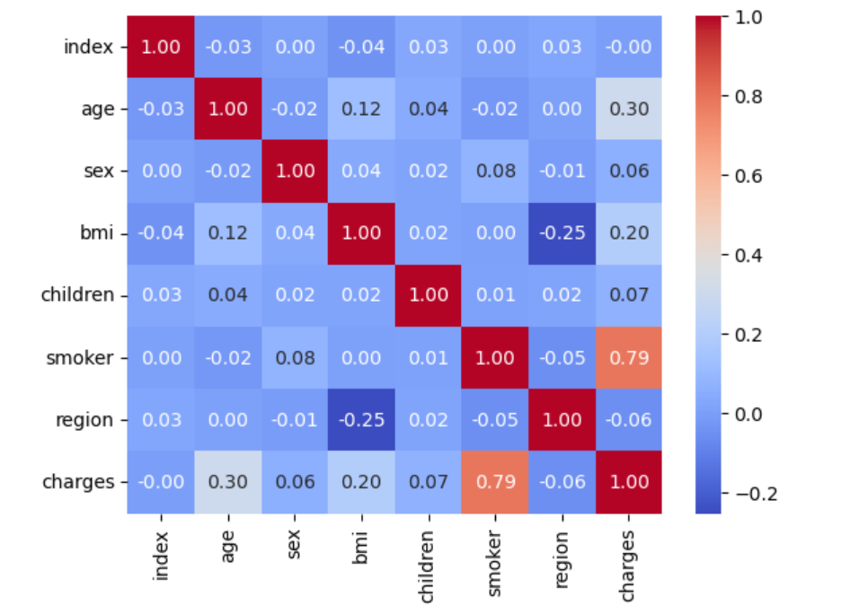
OBSERVATIONS:
There is a strong correlation between charges and smoker. There is also a weak positive correlation between charge and age, as well as BMI.

Slide 19
MODEL BUILDING
We have split the whole data into training and test set in the ratio of 80% to training set and 20% to test set. And here is the evaluation metrics of different model.
 | Model | MSE | MAE | R-squared
0 | Linear Regression | 3.363521e+07 | 4.186509e+03 | 7.833463e-01
1 | SGD Regression | 5.913156e+19 | 7.591024e+09 | -3.808827e+11
2 | XGBoost | 2.326124e+07 | 2.791833e+03 | 8.501679e-01
3 | LightGBM | 2.066709e+07 | 2.595572e+03 | 8.668775e-01

Slide 20
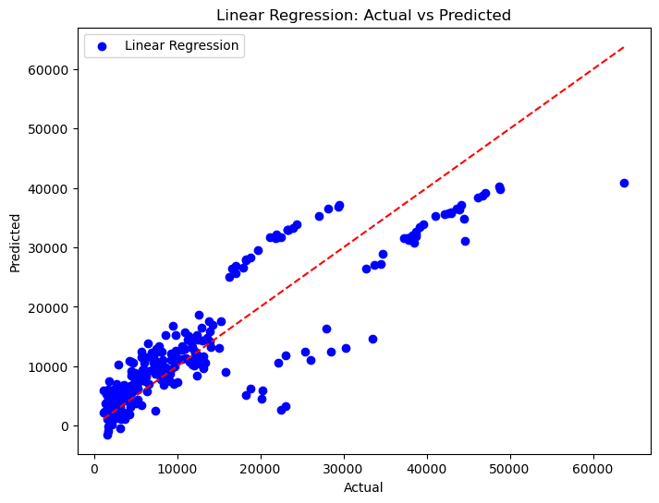

Slide 21
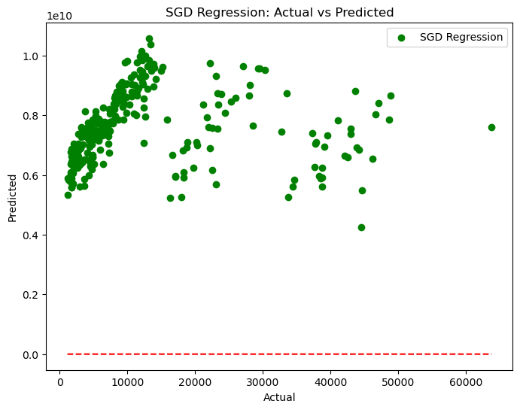

Slide 22
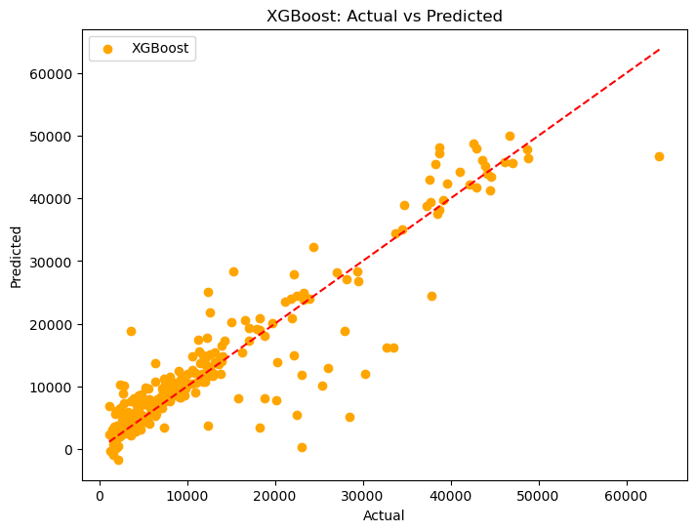
Final Model:

Slide 23
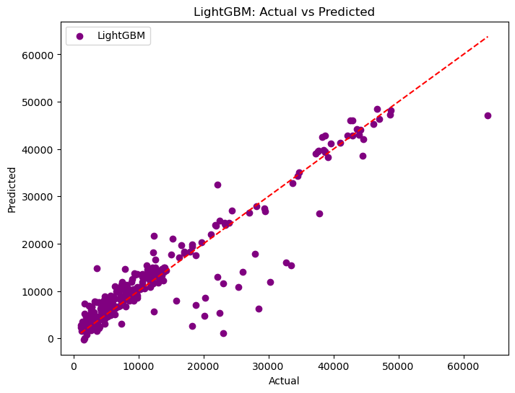

Slide 24
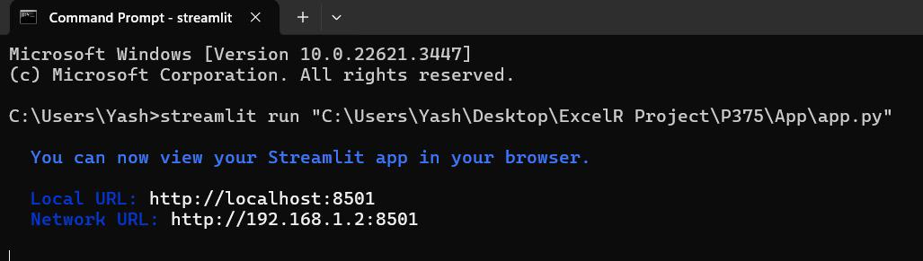
DEPLOYMENT
Running by CMD:

Slide 25
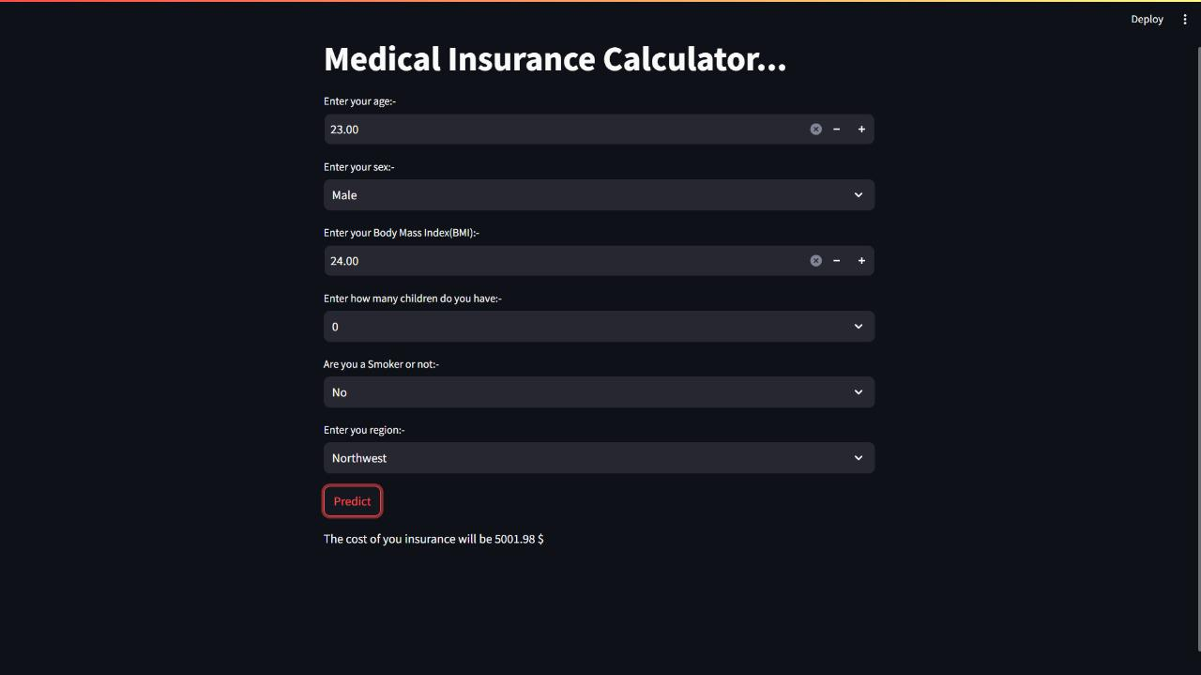
Sample Page:

Slide 26
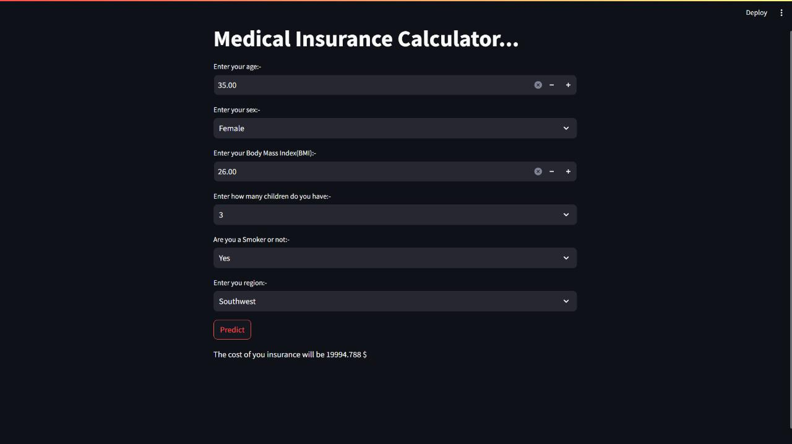

Slide 27
THANK YOU

