Slide 1
Mood Prediction
Predicting Her Mood: A Machine Learning Approach to Understanding Emotions

Slide 2
OBJECTIVE
To develop a Regression based ML model that predicts mood scores based on behavioural and contextual factors.

Slide 3
OVERVIEW
Built an end-to-end process from synthetic dataset generation to model deployment.
Focused on real-life inspired features: sleep, affection, arguments, self-care, cycle phase, etc.
Deployed using a Streamlit app for user-friendly interaction.

Slide 4
DATA
To simulate real-world emotional data, a synthetic dataset with 1,000 entries was generated using a combination of domain logic, probability, and behavioral weighting. The dataset includes 10 features — such as sleep hours, arguments, expressions of love, and self-care — that influence a calculated mood score ranging from 1 to 10. We designed the data with realistic distributions, mapped ordinal categories to numeric mood influence, and applied custom weights to simulate human mood variability. A small proportion (<3%) of missing data was injected to reflect imperfect data collection, enhancing realism. This thoughtfully crafted dataset enabled us to build a regression model that feels both playful and insightful — striking a balance between fun and data science integrity.

Slide 5
LOGIC OF MOOD SCORE FORMULA
A realistic mood score (from 1 to 10) was simulated based on lifestyle, emotional, and environmental factors. Since mood is complex and subjective, a weighted sum of influential features, with some randomness added was used.
The weights are manually assigned based on common-sense — not based on real data, but crafted to make the synthetic data feel realistic and logically consistent.
Weights reflect how strongly we assume each factor affects mood. For example, love expression (1.2) is assumed to have a stronger emotional impact than eating favorite food (0.5).
Added random noise to simulate unpredictable emotional shifts — e.g., even if everything goes right, one might still feel down, and vice versa. This mimics real-world emotional complexity.

Slide 6
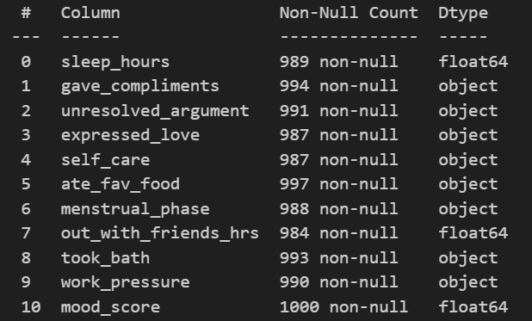
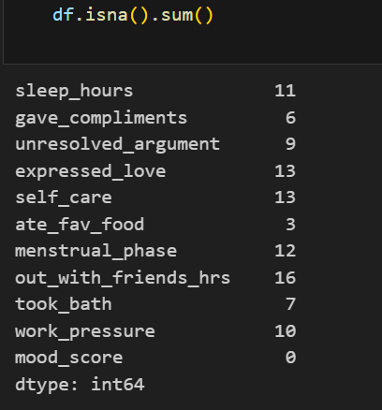
MODELLING AND TRAINING
Preprocessing Steps:
Missing Value Handling: Randomly introduced <1% missing data to simulate real-world conditions and tested with imputation strategies. Numerical features were imputed with the mean and Categorical features were filled using mode.

Slide 7
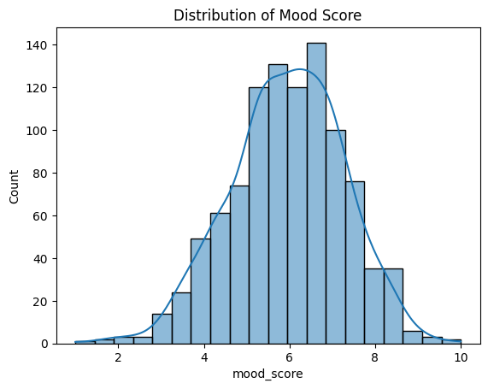
Distribution of target feature - The distribution was visualized using Seaborn.
The distribution is approximately normal (bell-shaped), which indicates that most of the mood scores are centered around the mean (around 6 to 7). This suggests that the dataset is well-balanced and the mood scoring logic is not biased.

Slide 8
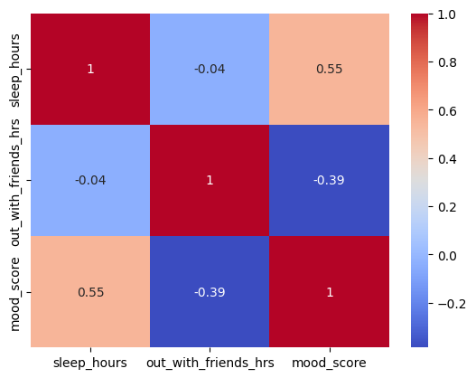
Correlation analysis
The correlation analysis revealed that adequate sleep improves mood, while increased time spent away from the partner tends to lower it — highlighting the emotional and physical well-being influences on mood.

Slide 9
Ordinal Encoding (for categories with order):
Features like: unresolved_argument → ‘none’ < ‘mild’ < ‘serious’ ,work_pressure → ‘no’ < ‘minor’ < ‘major’, menstrual_phase → ordered from ‘unknown’ to ‘PMS phase’. These were mapped to increasing integers (0, 1, 2...) to preserve their logical ranking.
Binary Encoding (for yes/no type):
Features like: gave_compliments, expressed_love, etc. were mapped as: yes’ → 1, ‘no’ → 0.
Used StandardScaler to normalize.
Model Chosen:
Linear Regression – selected for interpretability, and effectiveness in continuous score prediction (Mood Score from 1 to 10).
Evaluation Metric:
Used Mean Absolute Error (MAE) and R² Score to validate accuracy and reliability.

Slide 10
INTERPRETATION
MAE of 0.36 indicates that, on average, the model’s predicted mood score deviates by only +/-0.36 points fom the actual mood score. This small error shows that the model is highly accurate and consistent in capturing mood patterns based on the input features.
R² score of 0.87 indicates the model explains 87% of the variability in mood score — a strong fit for a linear regression. The model understands the mood dynamics with high reliability and leaves only 13% to randomness or unexplained.
Note: These values are based on a synthetic dataset, which was well-designed to reflect mood behavior. Real-world data may have more noise.

Slide 11
Model deployment with Streamlit
After training the model, with the help of Streamlit, an interactive web app was developed which made it easy and fun for anyone to use.
It lets users answer relationship-inspired questions.
Predicts the girlfriend’s mood instantly.
Shares a fun message tailored to the mood.

Slide 12
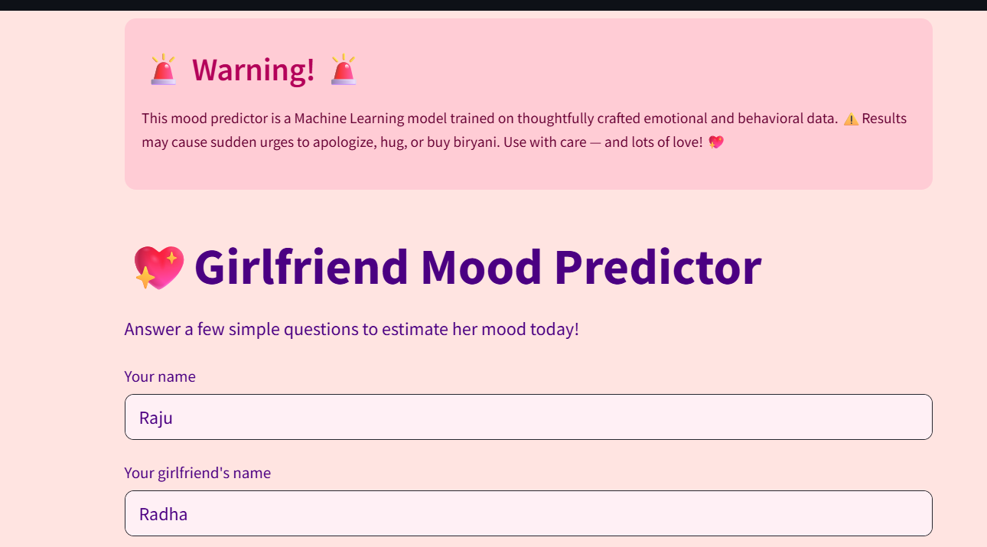

Slide 13
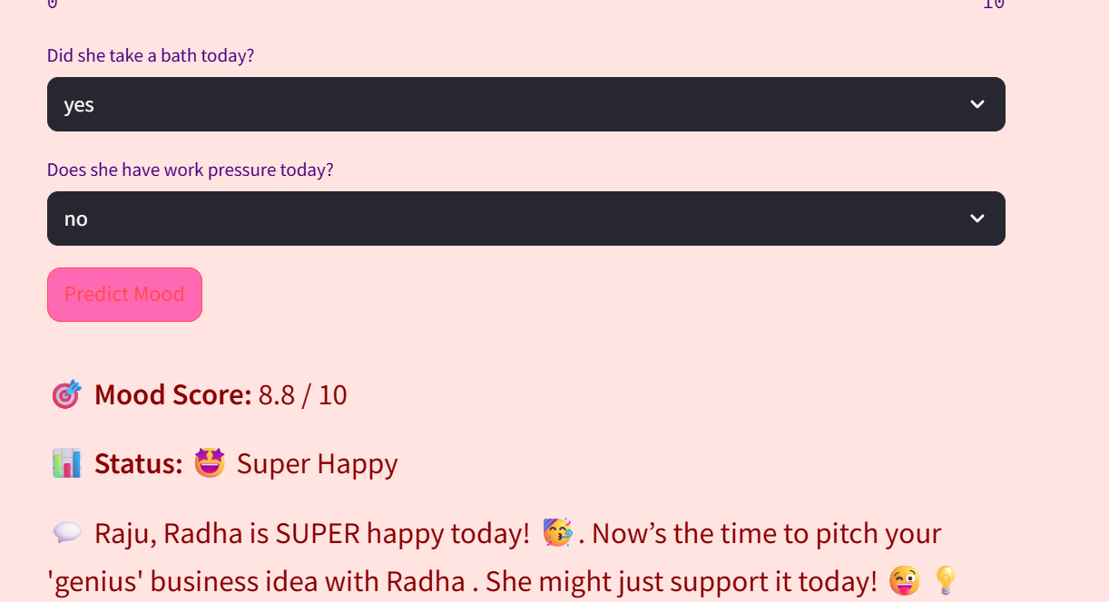

Slide 14
THANK YOU

