Slide 1
Does seasonality help forecast fashion search interest?
LSTM vs seasonal naive | Google Trends | India and France | 2016–2026
Bedaanntica Paul
Fashion attention is seasonal and local
Search data is a timely, cheap signal
LSTMs are popular, but is extra seasonal input needed?
Festivals, weather and retail calendars shape what people look for in India and in France.
Google Trends indices are used to nowcast demand-related activity (Choi & Varian, 2012).
Neural nets are not automatically better than simple benchmarks (Hewamalage et al., 2021).
Data are independently normalized search-interest indices, not sales. Refs: Choi & Varian, Econ. Record 88(s1), 2012; Hewamalage et al., Int. J. Forecasting 37(1), 2021.
Notes:
Motivation: fashion interest is seasonal and market-specific. Google Trends gives a cheap timely signal, but it is a normalized index, not sales. LSTMs are widely used for forecasting; we ask whether they need explicit seasonal features.

Slide 2
Research gap and objectives
Gap
Do LSTMs beat a seasonal naive benchmark?
1
Few controlled comparisons of seasonality-aware vs standard LSTMs on search-interest series from an Indian and a European market (within the sources we reviewed).
Naive benchmarks and data limits are often under-reported.
Do sine/cosine month features improve a standard LSTM?
2
Do conclusions differ between India and France?
3
Notes:
The gap is a controlled comparison of seasonal and non-seasonal LSTMs on two markets. Three questions: does LSTM beat seasonal naive, do month features help, and do conclusions differ by country.

Slide 3
Dataset and methodology
Google Trends, monthly, Jan 2016 – Sep 2026
4 keywords: streetwear, oversized clothing, sustainable fashion, traditional clothing
2 countries: India, France = 8 series
129 months each; 0 missing, 0 duplicates, gap-free
Data caveats
Index (peak = 100 per series), not volume or sales; series normalized independently
All 8 series hit 100 in Feb 2026 (unexplained); reported with and without
France oversized: 98% zeros
Chronological split per series (identical test months for all models)
Train 90 mo. (2016-01 to 2023-06)
Val 19
Test 20 mo.
Leakage control: scaler fitted on training data only; backward-looking 12-month windows; validation used only for early stopping; one-step walk-forward test (Feb 2025 – Sep 2026).
Notes:
Eight series, 129 months each, clean by basic checks. Important caveats: normalized index, and an unexplained simultaneous peak in Feb 2026 inside the test window, so we report results with and without it. Scaler fit on training only; test is walk-forward one step ahead.

Slide 4
Models and experimental setup
Seasonal naive
Standard LSTM
Seasonality-aware LSTM
Forecast = value 12 months earlier.
12 lagged values in; LSTM(50) → Dense(1).
Same network plus month encoding of the target month.
y(t) = y(t−12)
input: 12 × 1 feature
input: 12 × 3 (value, sin, cos)
Setup
Adam, MSE loss, batch 16, up to 100 epochs, early stopping (patience 10); no tuning
5 seeds per LSTM (42–46), forecasts averaged; seed variability reported
Metrics: MAE and RMSE per country and keyword; sensitivity excluding Feb 2026
Notes:
Three models. Seasonal naive copies last year. The two LSTMs share architecture; the seasonality-aware version also receives sine and cosine of the month being predicted. Five seeds each, no tuning. All use identical test months and one-step walk-forward.

Slide 5
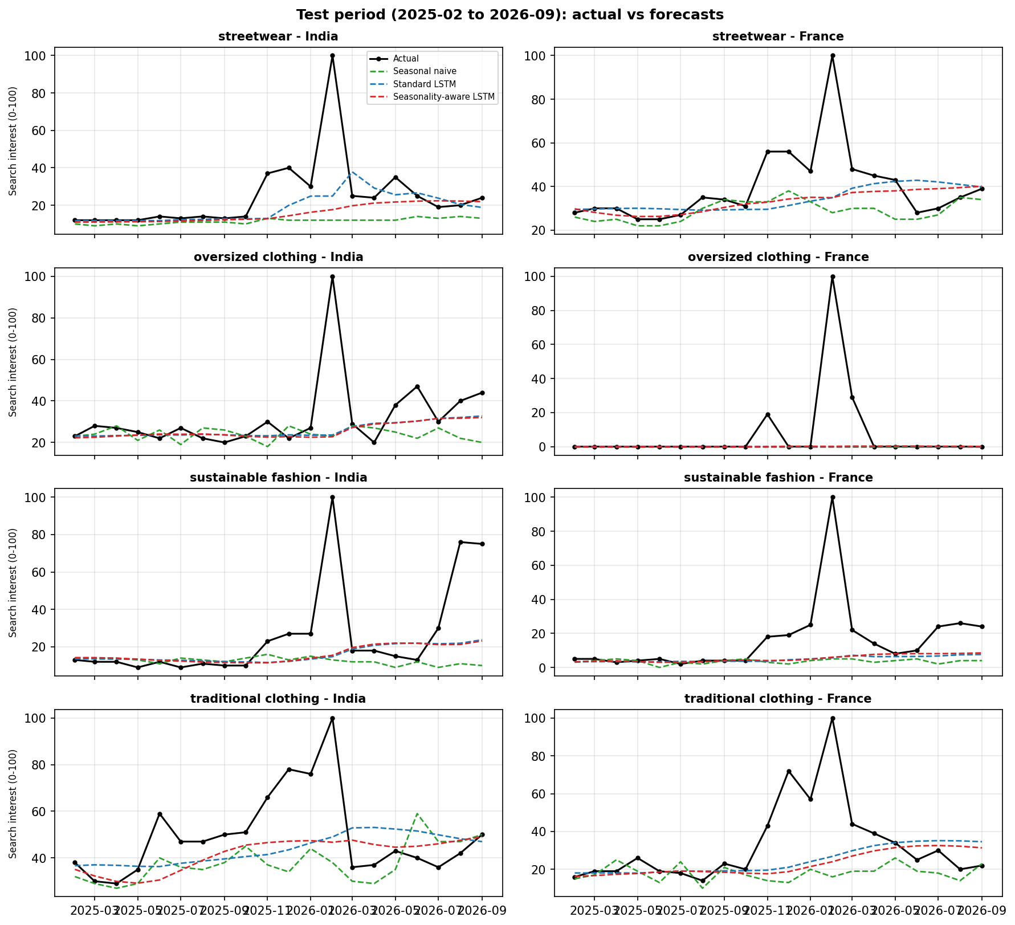
Results and discussion
Both LSTMs beat seasonal naive in 7 of 8 series.
Seasonal features: 10.80 vs 11.00 MAE, within seed noise (~0.5); better in only 3 of 8 series.
Persistence MAE 11.45: LSTM gain is largely level adaptation; the Feb 2026 spike dominates errors.
Test 2025-02 to 2026-09. Series won (MAE): standard 4, seasonal 3, naive 1
Notes:
Mean MAE: naive 12.82, standard LSTM 11.00, seasonality-aware LSTM 10.80. Excluding Feb 2026: 9.12, 7.50, 7.20. Both LSTMs beat naive in seven of eight series. The seasonal-feature advantage is about 0.2, below seed-to-seed noise, and mixed across series, so we do not claim a reliable benefit. Persistence is a diagnostic outside the three models.

Slide 6
Conclusion and future scope
What we found
Future scope
LSTMs lower average error than seasonal naive (about 14–16% MAE)
Sine/cosine month features: no reliable gain over a standard LSTM
India vs France: descriptive only (8 series, independent normalization)
Unexplained Feb 2026 peak limits generality
Re-collect data; investigate 2025–26 anomalies
Add persistence, ETS, SARIMA baselines
Rolling-origin and multi-step evaluation
Pooled LSTM across series; more keywords, Hindi/French queries
Statistical testing on larger sets
Notes:
Takeaway: LSTMs beat seasonal naive on average, but explicit month features did not give a reliable improvement over a standard LSTM in these data. Future work: better data, more baselines, rolling evaluation, pooled models, and statistical tests.

