Slide 1
Supporting Drum Learning/Playing through the use of Haptic Wearables
Simon Pfeifer

Slide 2
Contents
Motivation
Studies
  Haptic Guidance System
  Haptic Drum Kit
  Haptic Bracelets
  Vibrotactile Vest
Conclusion

Slide 3
Motivation
Drum learning is a heavy task and takes a lot of time
  Taking lessons
  Spending many hours practicing
First outputs are not pleasant for the ear and lead to giving up
How to improve the learners experience?
Is there a faster and more motivating way of learning?

Slide 4
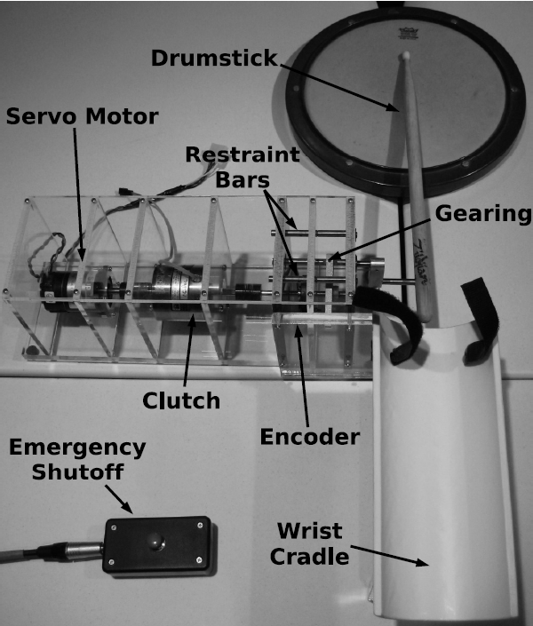
The Haptic Guidance System[1]
Haptic guidance
  Timing
  Strike Velocitiy
Replay possible
Wrist position secured
Safety measures
  Restraint bars
  Emergency shutoff

Slide 5
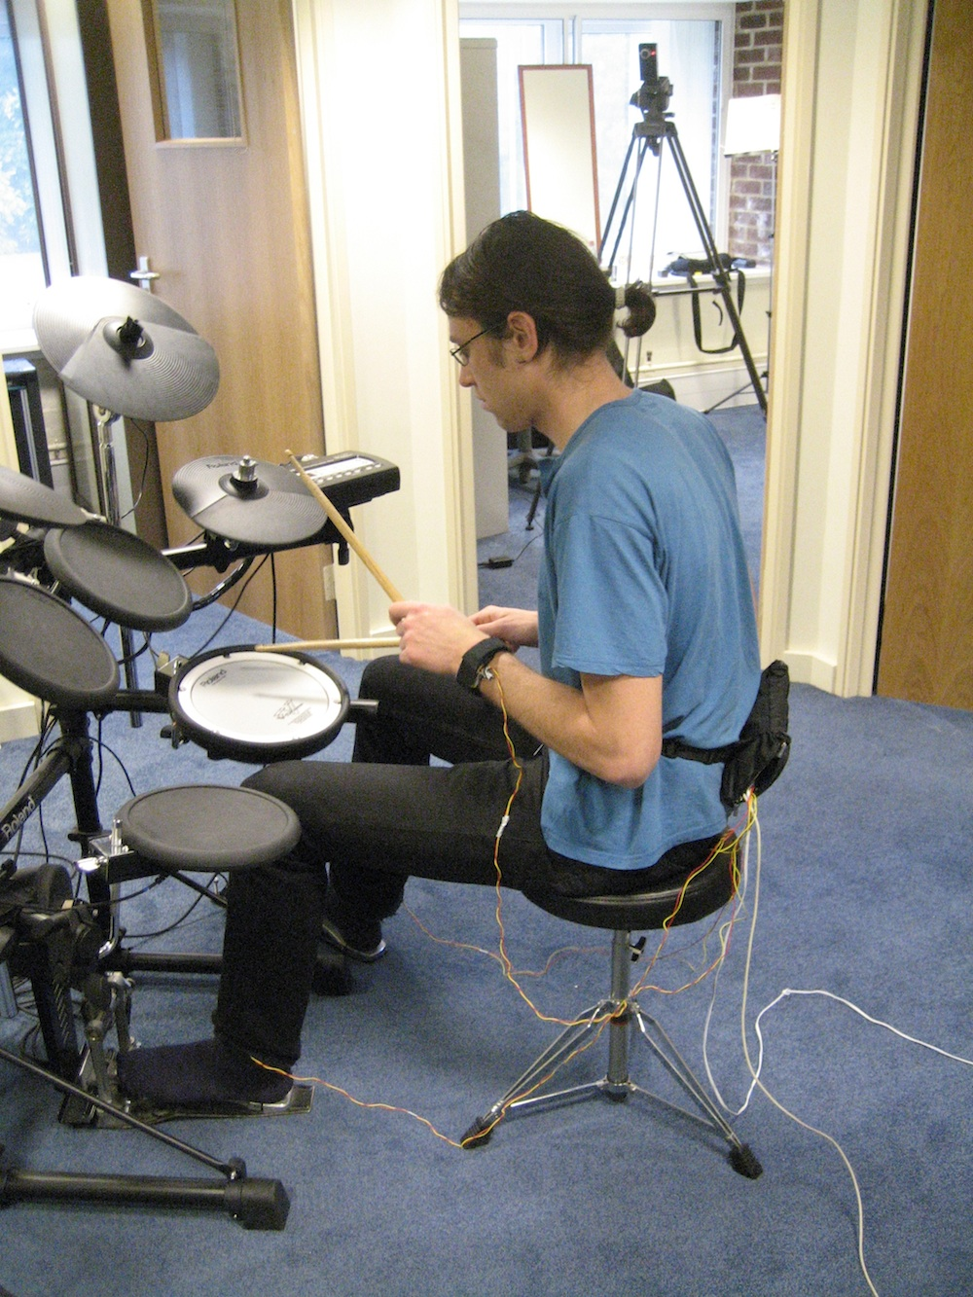
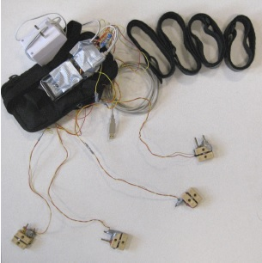
The Haptic Drum Kit[2]
Vibrotactiles attached to each limb
Multi-limb coordination
Polyphonic rhythms
Comparing audio and haptic learning
Haptic masking
  Movements overriding vibrations
  Time between signals

Slide 6
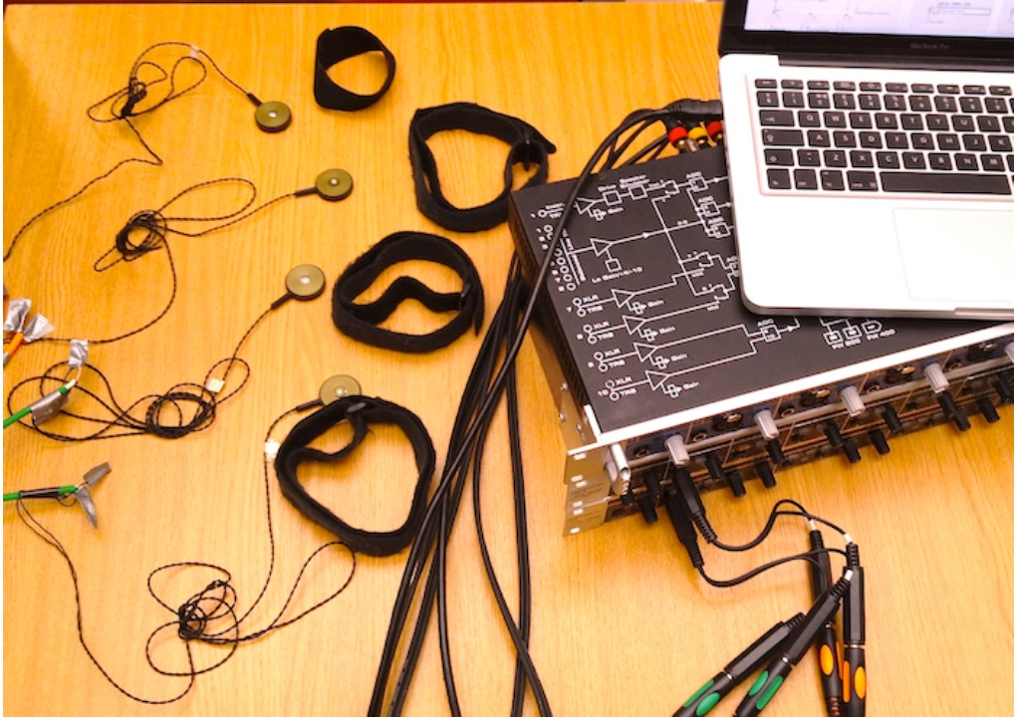
Haptic iPod[3] / The Haptic Bracelets[4]
Modified version of Haptic Drum Kit
Passive Learning
Mobile prototype (future: with audio)
Multi-limb coordination
Problems: Repetetiveness and locating start and end points

Slide 7
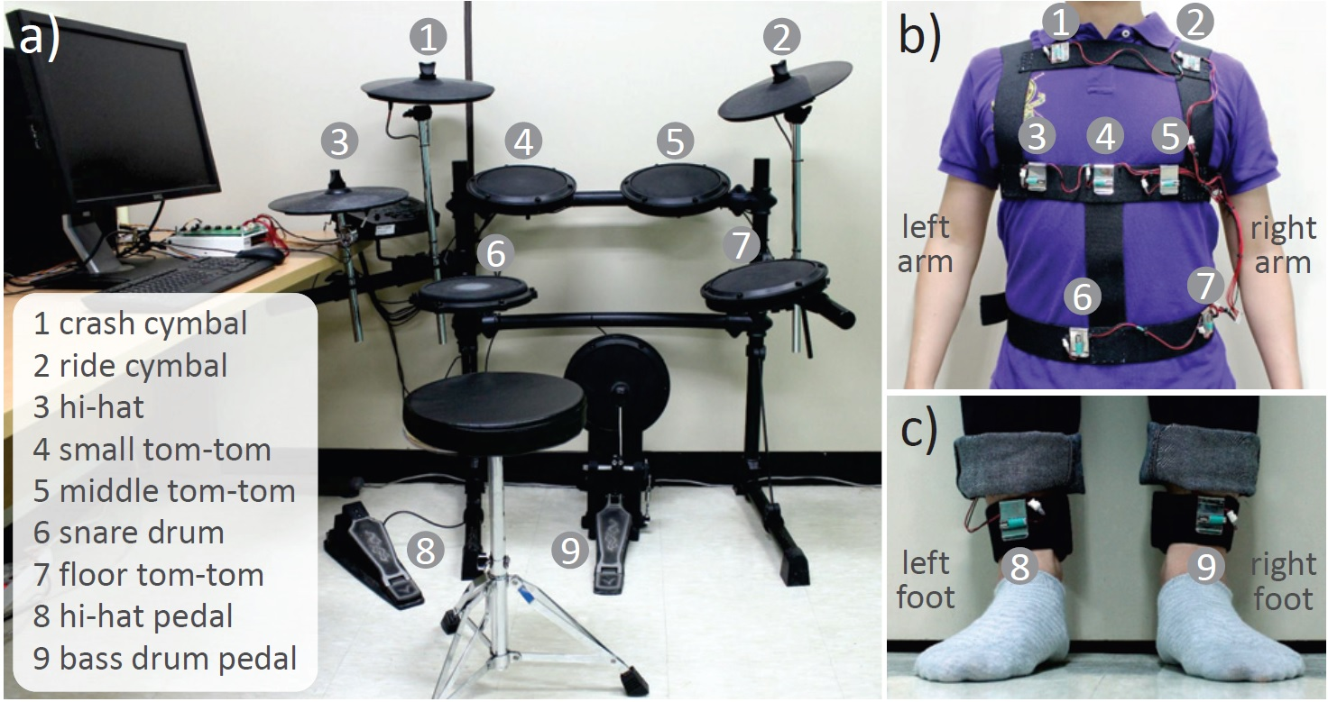
Vibrotactile Vest and ankle bands[5]
Vibrotactile guidance
  Drum targeting
  Striking strength
Only single vibrotactile cue at a time
95% accuracy with 9 targets and 2 striking strengths
Dense tactor placement increases identification time

Slide 8
Conclusion
Haptic guidance on its own is not enough for covering every aspect of drum learning/playing
Combination with audio guidance leads to a better learning experience and faster results
Not useful for very fast and complex rhythms because of haptic masking (only as metronome)
Further studies to combine drum targeting and multi-limb coordination

Slide 9
References
1. Grindlay, G.: Haptic guidance benets musical motor learning. In: 2008 Symposium
on Haptic Interfaces for Virtual Environment and Teleoperator Systems. pp. 397{
404 (March 2008)
2. Holland, S., Bouwer, A.J., Dalgelish, M., Hurtig, T.M.: Feeling the beat where it
counts: Fostering multi-limb rhythm skills with the haptic drum kit. In: Proceedings
of the Fourth International Conference on Tangible, Embedded, and Embodied
Interaction. p. 21{28. TEI '10, Association for Computing Machinery, New York,
NY, USA (2010), https://doi.org/10.1145/1709886.1709892
3. Bouwer, A., Dalgleish, M., Holland, S., et al.: The haptic ipod: passive learning
of multi-limb rhythm skills. In: Workshop `When Words Fail: What Can Music
Interaction Tell Us About HCI (2011)
4. Bouwer, A., Holland, S., Dalgleish, M.: The haptic bracelets: learning multi-limb
rhythm skills from haptic stimuli while reading. In: Music and human-computer
interaction, pp. 101{122. Springer (2013)
5. Lee, I., Choi, S.: Vibrotactile guidance for drumming learning: Method and perceptual
assessment. In: 2014 IEEE Haptics Symposium (HAPTICS). pp. 147{152 (Feb
2014)

