Slide 1
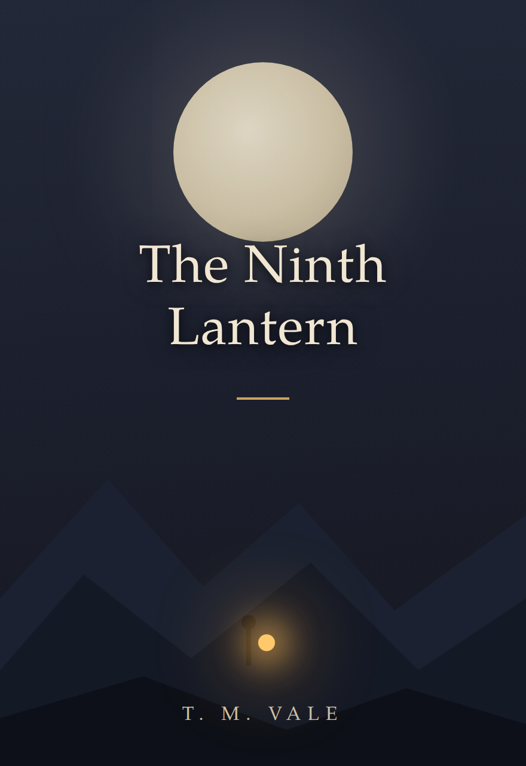
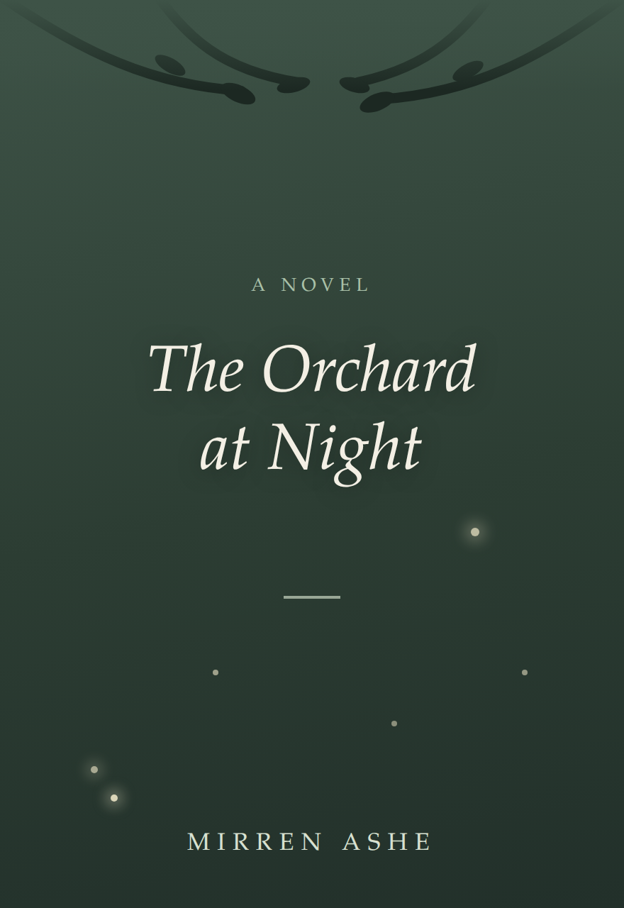
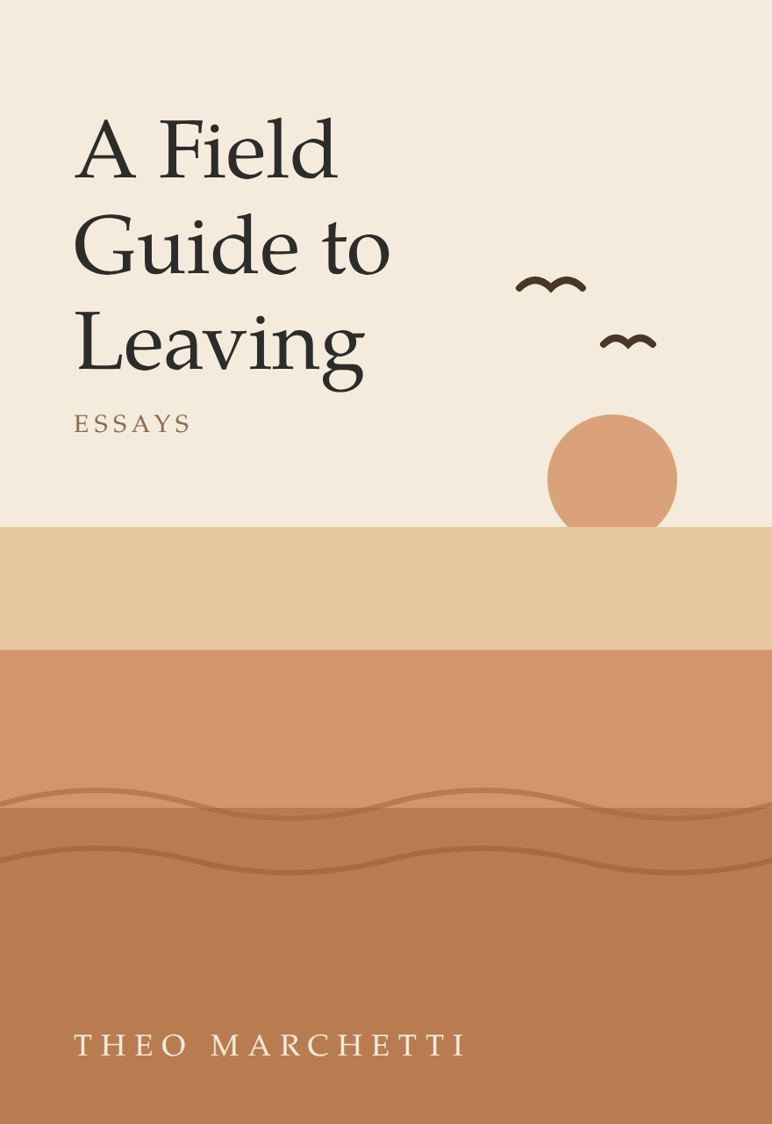
A
AuthorsLab
The future of publishing
still begins with a human being.
An environment for human creativity, intelligent collaboration and the development of books.
AUTHORSLAB · A SPIKE ISLAND STUDIOS COMPANY · SEPTEMBER 2026
Notes:
Open on the thesis. The books on the right are illustrative covers made in the AuthorsLab design language.

Slide 2
Writing a book is a creative act. Building a book is a process.
D
E
D
P
M
DEVELOPMENT
EDITORIAL
DESIGN
PUBLISHING
MARKETING
Finding and shaping the story.
Making the manuscript work.
Turning the manuscript into a book.
Getting it into the world.
Finding its readers.
WE STARTED WITH A SIMPLE QUESTION
Could technology make more of this expertise accessible to authors — without taking authorship away from them?
Notes:
The five-stage frame mirrors the product roster shown later — same colours, same order.

Slide 3
The question isn’t whether AI belongs in creativity.
It’s what role we give it.
HUMAN
AI
Intention
Experience
Imagination
Voice
Judgement
Authorship
Exploration
Research
Analysis
Memory
Iteration
Possibility
The interesting space is between the two.
Notes:
Carbon and Silicon — the manifesto's frame, spoken plainly.

Slide 4
The words aren’t the thought.
Writing is a medium of self-expression — a way of finding words capable of giving form to something that exists before the words.
The author brings the thought, experience, imagination and voice. AI helps explore the distance between what the author means and what they have written.
“Is this where your story truly begins?”
The author remains the author.
Alex · First read
Notes:
The manifesto beat. The margin note previews what the product feels like before the demo.

Slide 5
AI architecture matters.
Different problems require different relationships with AI.
LEGAL — CLARENCE
CREATIVE — AUTHORSLAB
Determinism
Reliability
Provenance
Control
Exploration
Ambiguity
Iteration
Possibility
Our experience building Clarence taught us to ask a more useful question:
Where should AI be used — and where should the human remain in control?
Notes:
Credibility beat: Clarence (legal AI) proves we know where determinism matters — and where it doesn't.

Slide 6
From idea to book.
A named editor at every stage of the journey.
W
A
S
J
T
M
R
Wright
Alex
Sam
Jordan
Taylor
Morgan
Riley
Begin from a blank page
Developmental editor
Line editor
Copy editor
Design
Publishing
Marketing
Think · Explore · Research · Develop
An environment designed around the lifecycle of a book — not simply a text-generation tool.
LIVE DEMO →
Notes:
Pivot to the live product here. Editing studio (Alex, Sam, Jordan) is live today; Wright, Design, Publishing and Marketing are staged releases — say it plainly if asked.

Slide 7
One platform. Two perspectives.
The same architecture can serve the author and the publisher.
THE AUTHOR
THE PUBLISHER
Private — the author’s space, always
Shared by invitation — never inside the writing
Ideas, research and brainstorming
Draft development with Wright
Editorial collaboration — Alex, Sam, Jordan
A creative companion that remembers the book
Multiple authors, multiple projects
Editorial workflow and project visibility
Design, publishing and marketing pipeline
A window the author opens — and can close
One architecture. Different perspectives.
Notes:
The Blair/Klein slide. Sacred vs shared-by-invitation is the trust story: the publisher sees the pipeline, never the writing, unless invited.

Slide 8
A book is not necessarily the end of the story.
IDEA
→
MANUSCRIPT
→
BOOK
→
AUDIO
→
SCREEN
→
RIGHTS
What happens when the environment around the author becomes connected to the wider life of the story?
AuthorsLab is beginning to explore that wider journey.
A
authorslab.ai
Notes:
Close on the rights journey — the Blair Partnership's home ground. Leave the question open; it is the conversation starter.

