Slide 1
ECE 464: Senior Design 2
IDR 3.0
Team Lead: Steven Wang

Slide 2
Deliverables 3
Design 2 Test
Results
Scale up
Project Design timeline
Purchase Parts
BMS
Batteries
Speed Controller

Slide 3
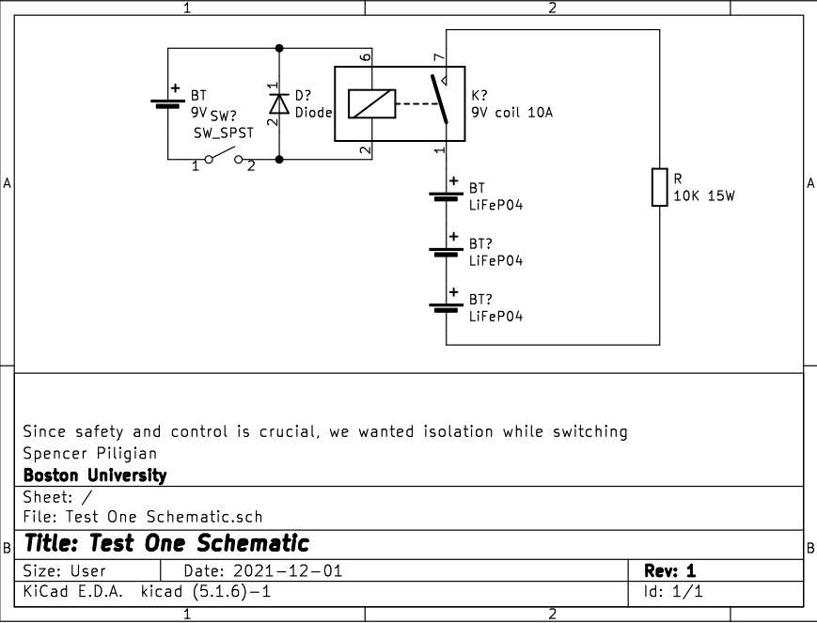
Test 2 Schematic

Slide 4
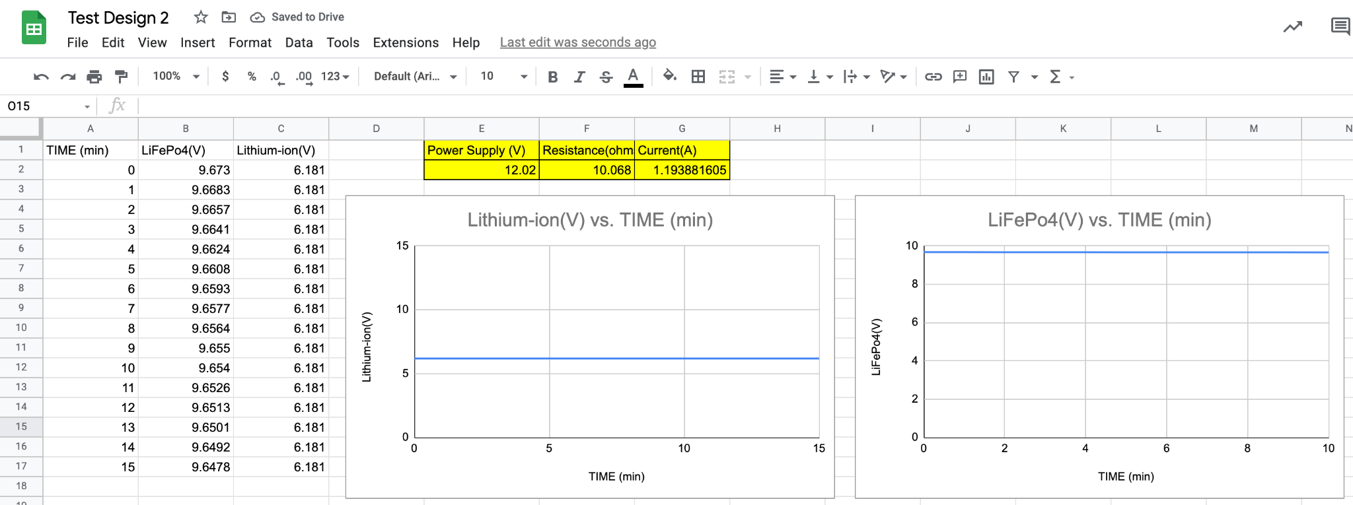
Test 2 Results

Slide 5
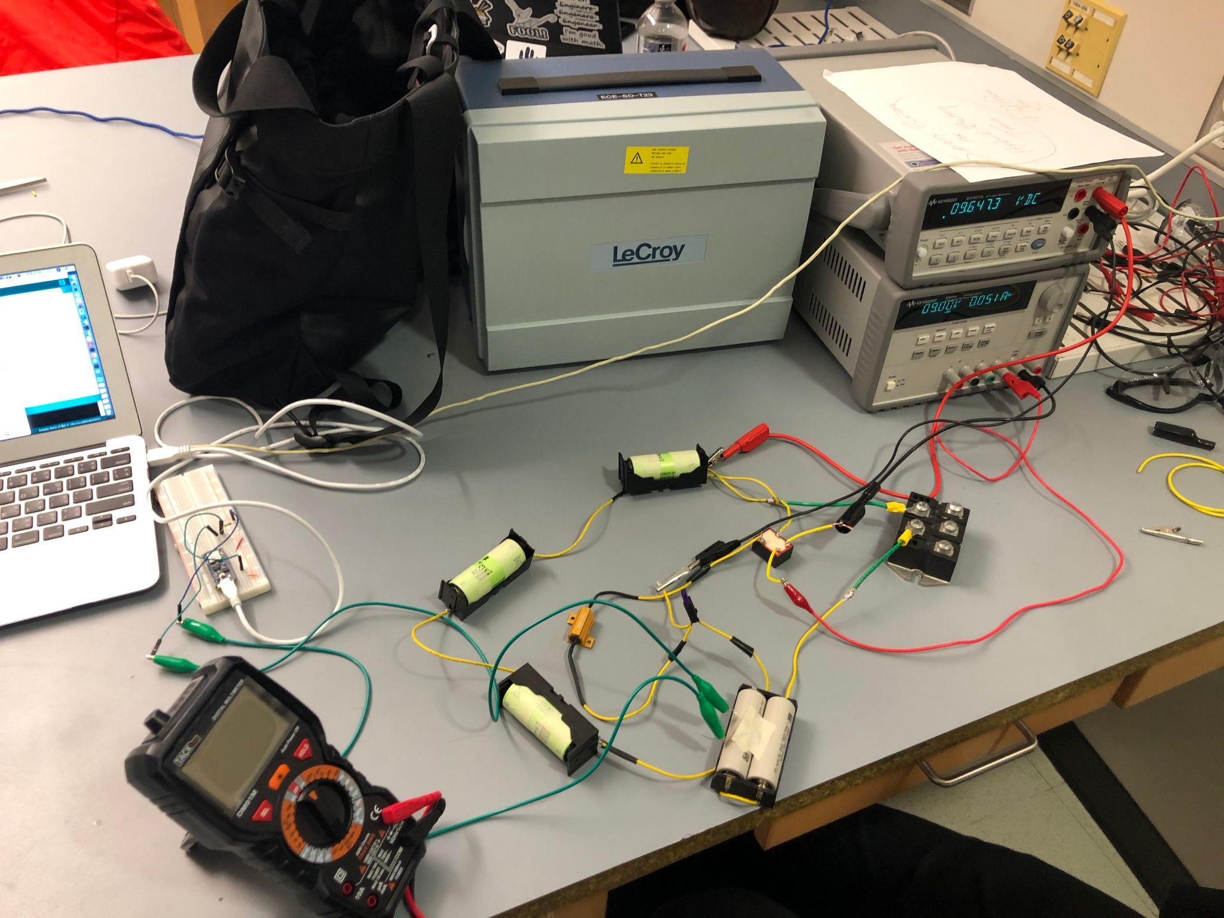
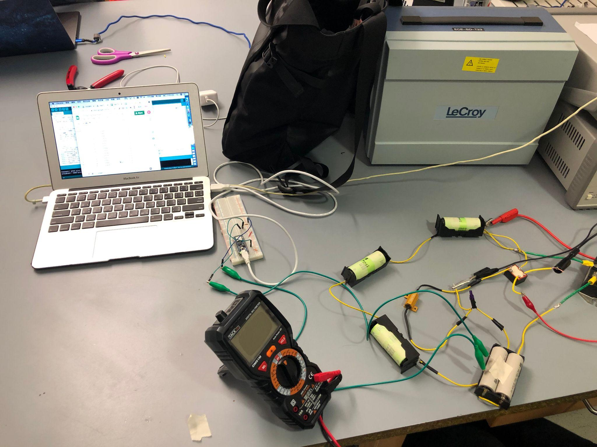

Slide 6
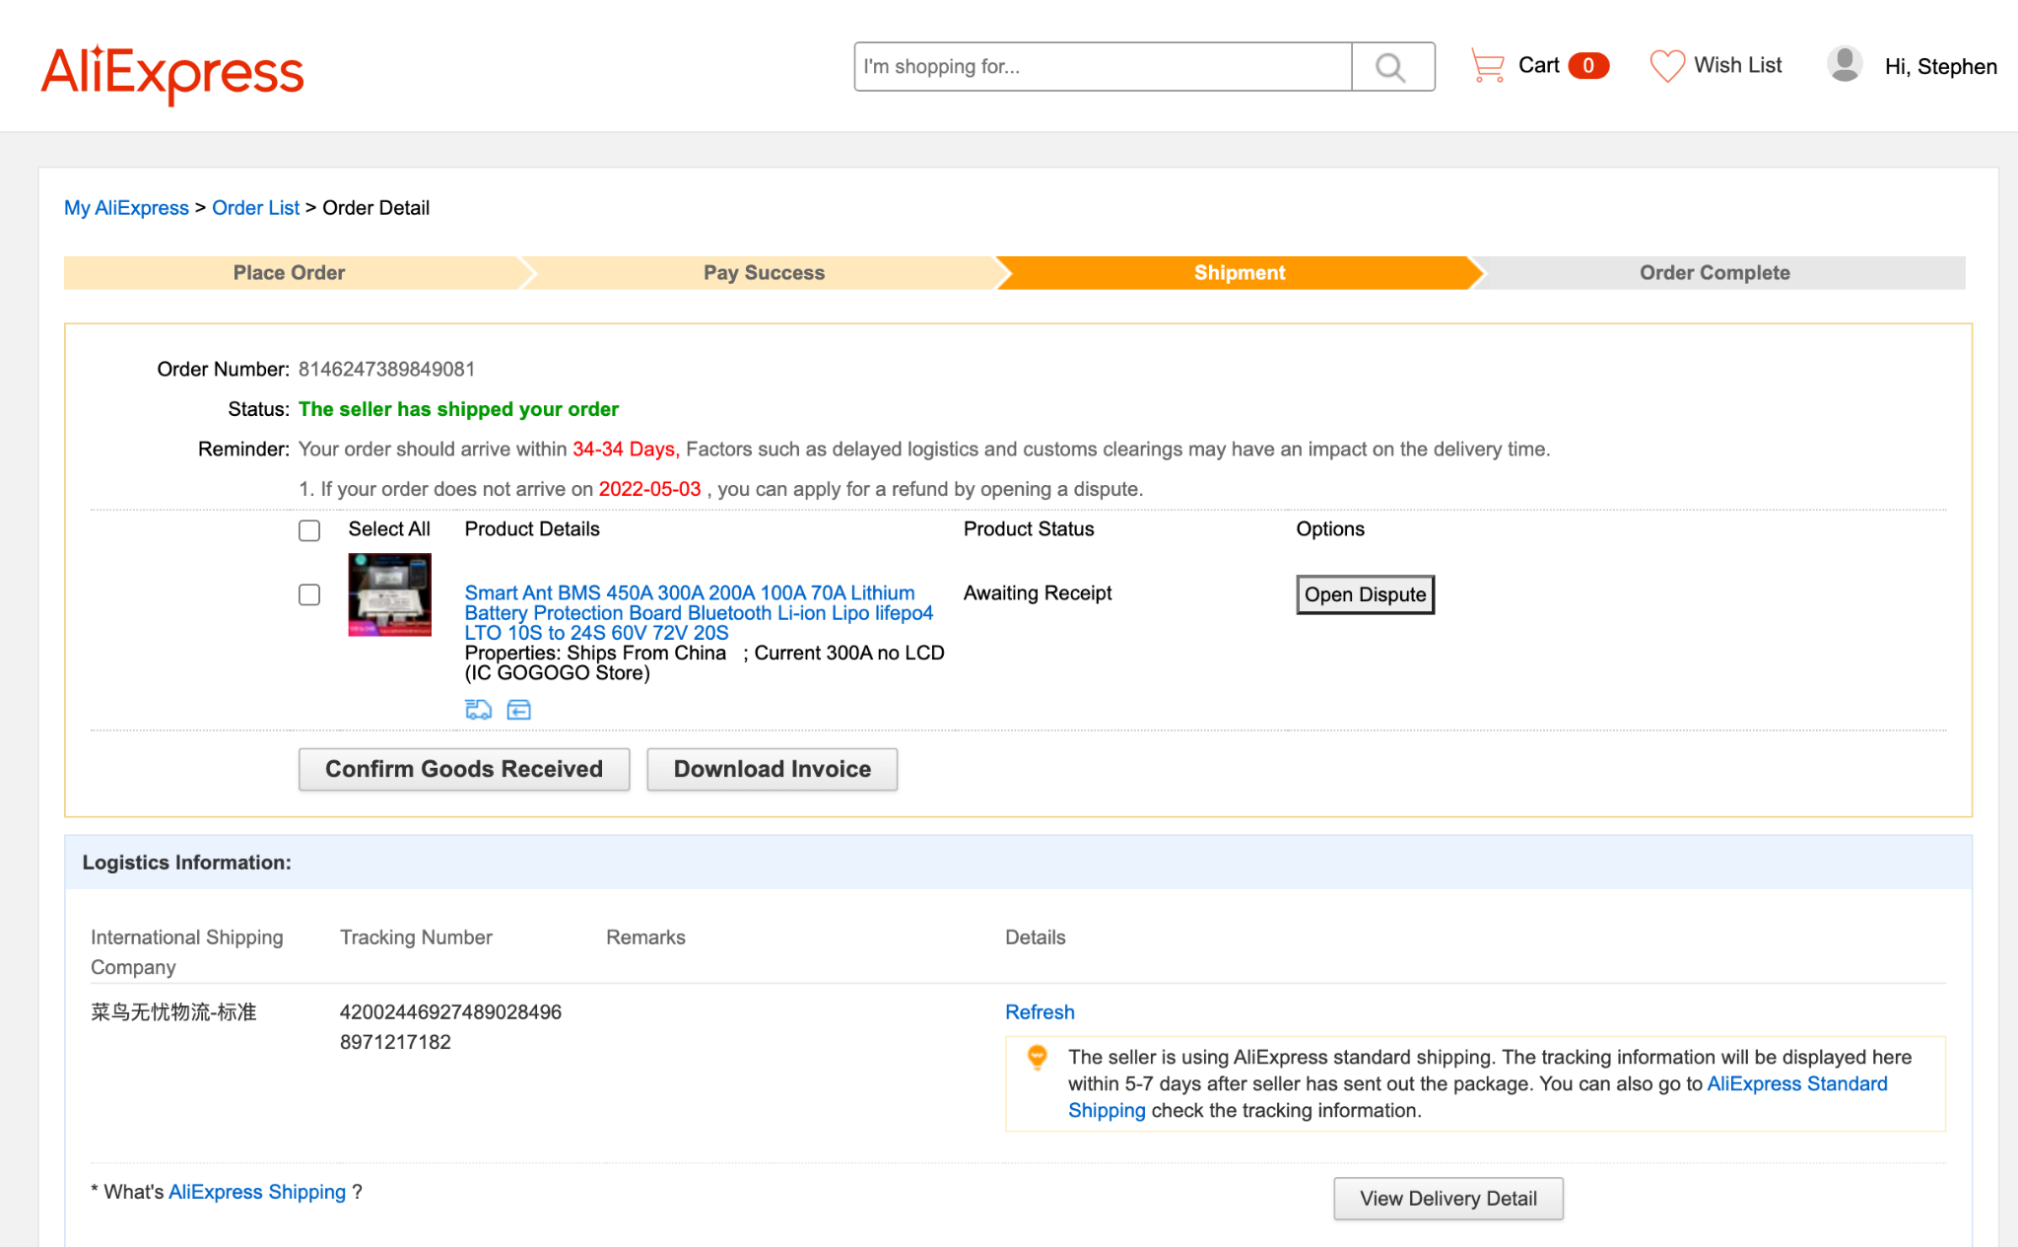
Purchase
Item | Amount | Cost
LiFePo4 | 48 | 65.09
Li-ion | 2 | 28.54
Battery holder | 1 | 14.44
Flipsky Speed Controller | 2 | 300
24S LiFePo4 BMS | 1 | 99.89
Total | 207.96

Slide 7
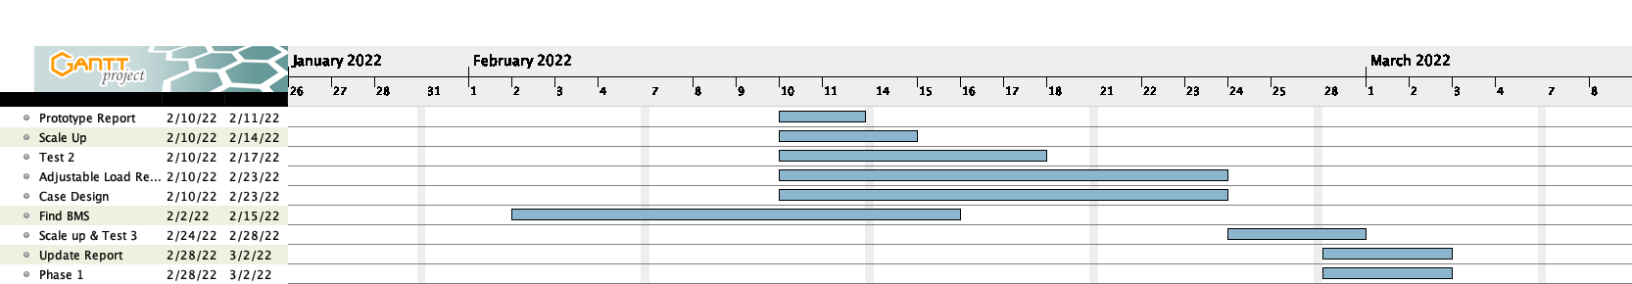
Timeline

Slide 8
Extra previous IDR

Slide 9
Deliverables 1
Test 1 Design
FMEA
Design Correction
Test design timeline
BOM
Purchase Parts

Slide 10
Deliverables 2
Design 1 Test
Results
Test design timeline
BOM
Purchase Parts
BMS
Batteries
Power Supplies

Slide 11
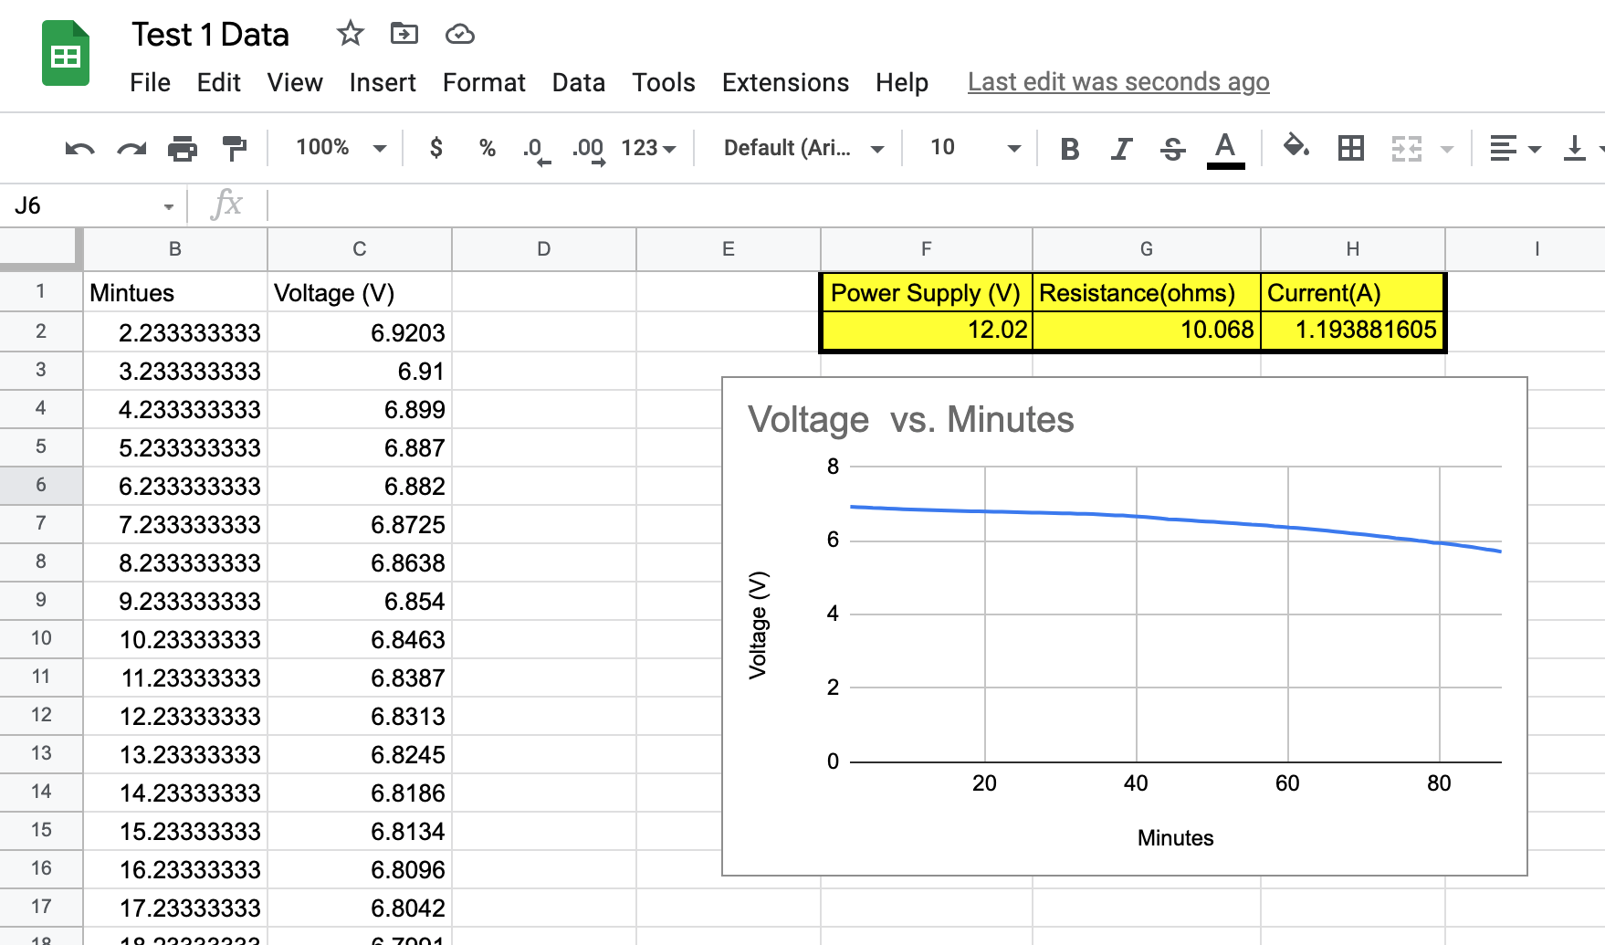
Test 1 Results
88 Data points
1 hr 30 mins

Slide 12
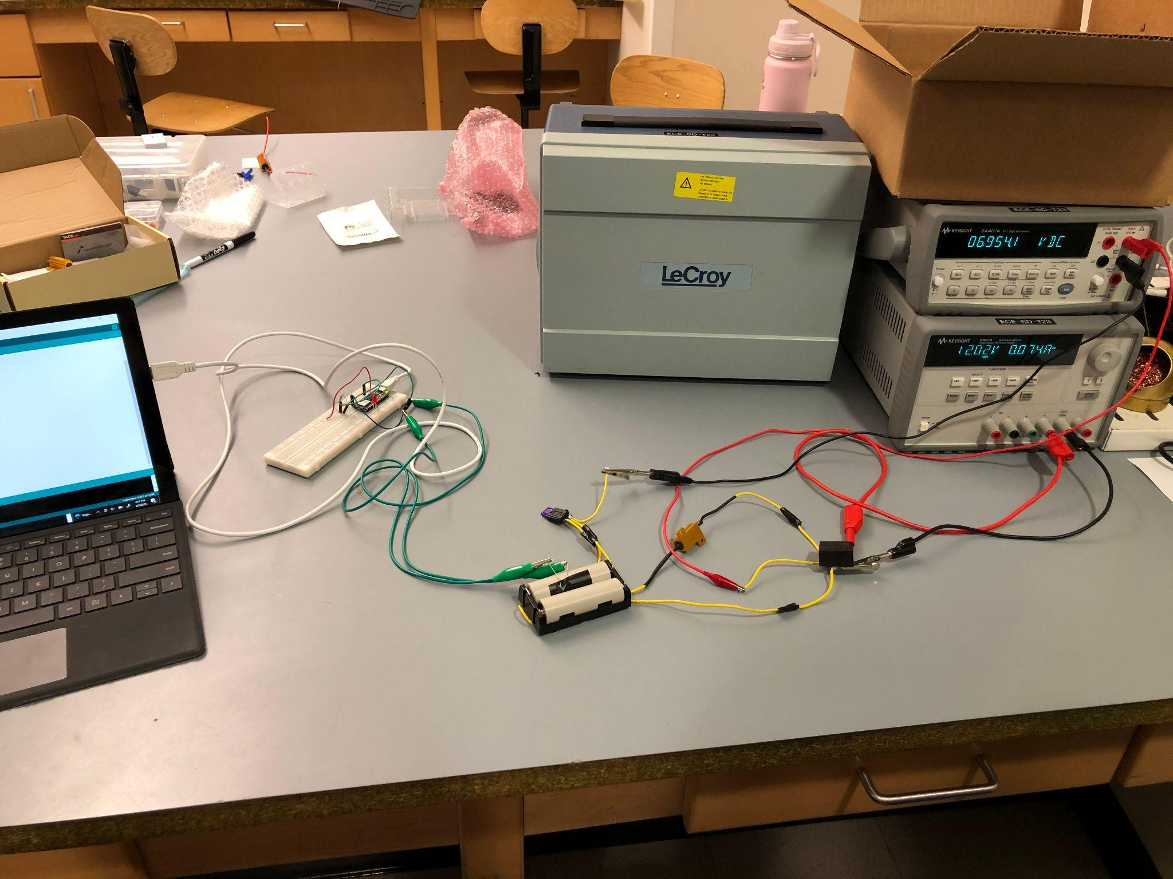
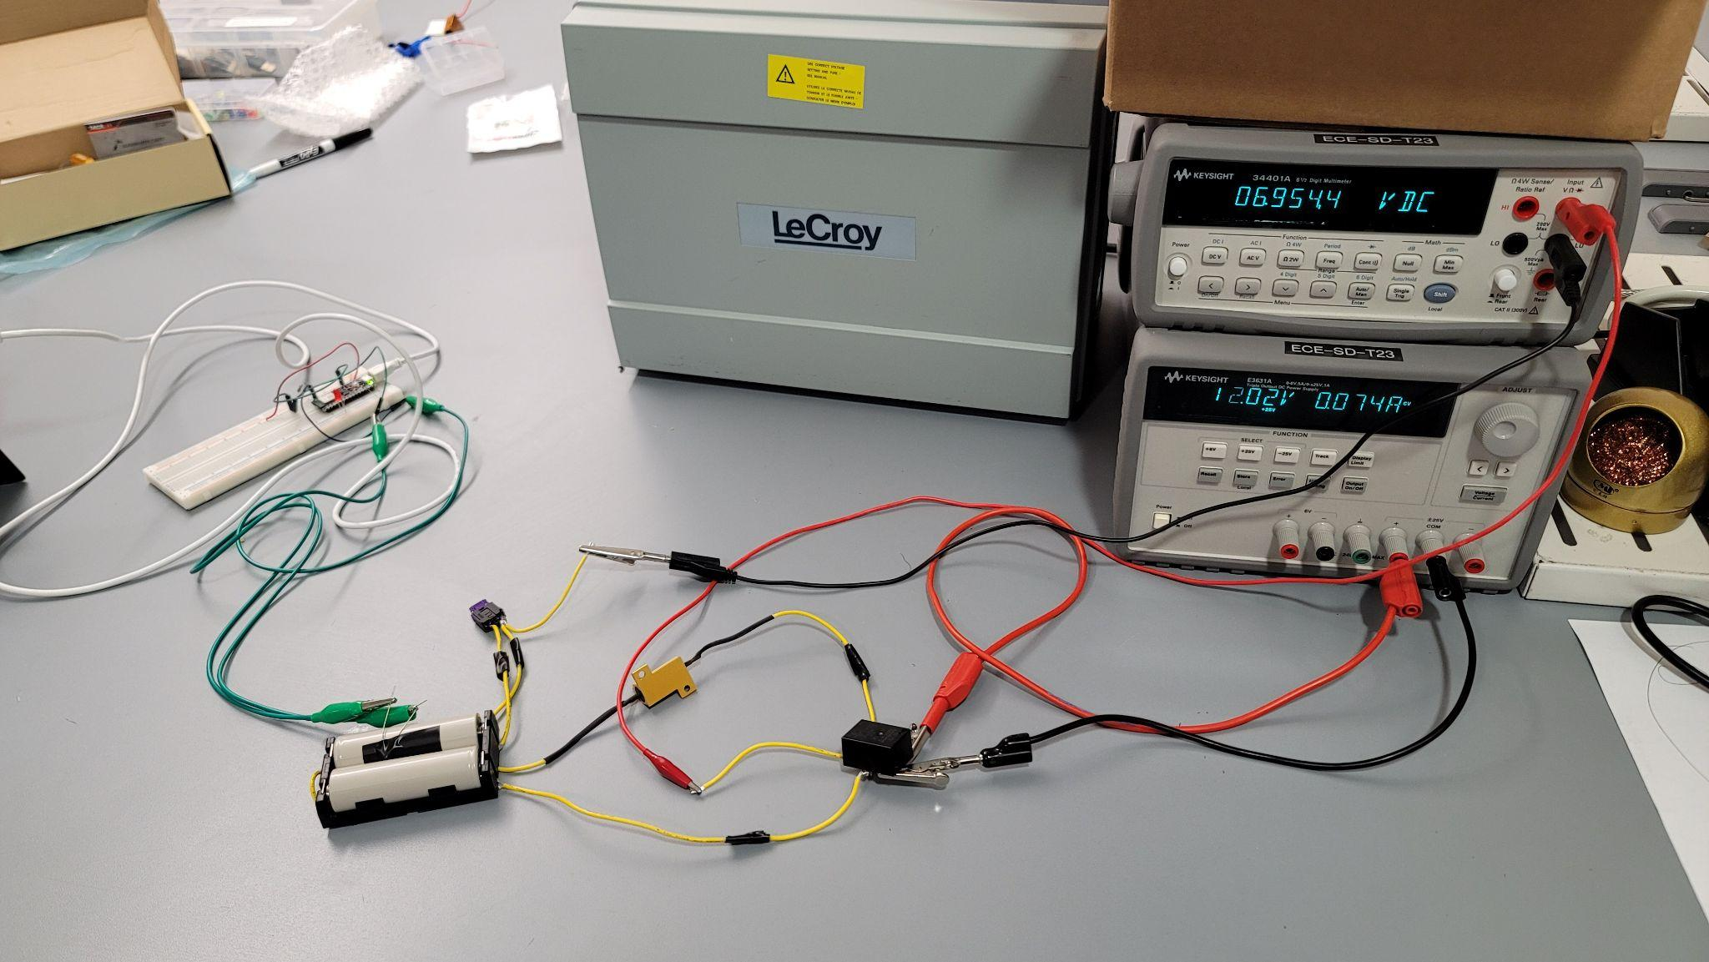

Slide 13
Objectives 2.10 - 2.17
Scale up
Design 2
Design 2 Test
Others:
Adjustable load
Battery
BMS
Case design

Slide 14
FMEA
Failures | Severity | Occurrence | Detection | RPN | Correction
Short in Ckt | 9 | 3 | 1 | 27 | Fuse Relay
Overloading wires | 8 | 1 | 5 | 40 | Good wire ratings
Bad battery connection | 4 | 7 | 1 | 28 | Reliable battery holder Good terminals
Overheating | 6 | 4 | 1 | 24 | Live temp. sensor
Switch failure | 2 | 1 | 1 | 2 | N/A
Environmental | 3 | 1 | 1 | 3 | N/A

Slide 15
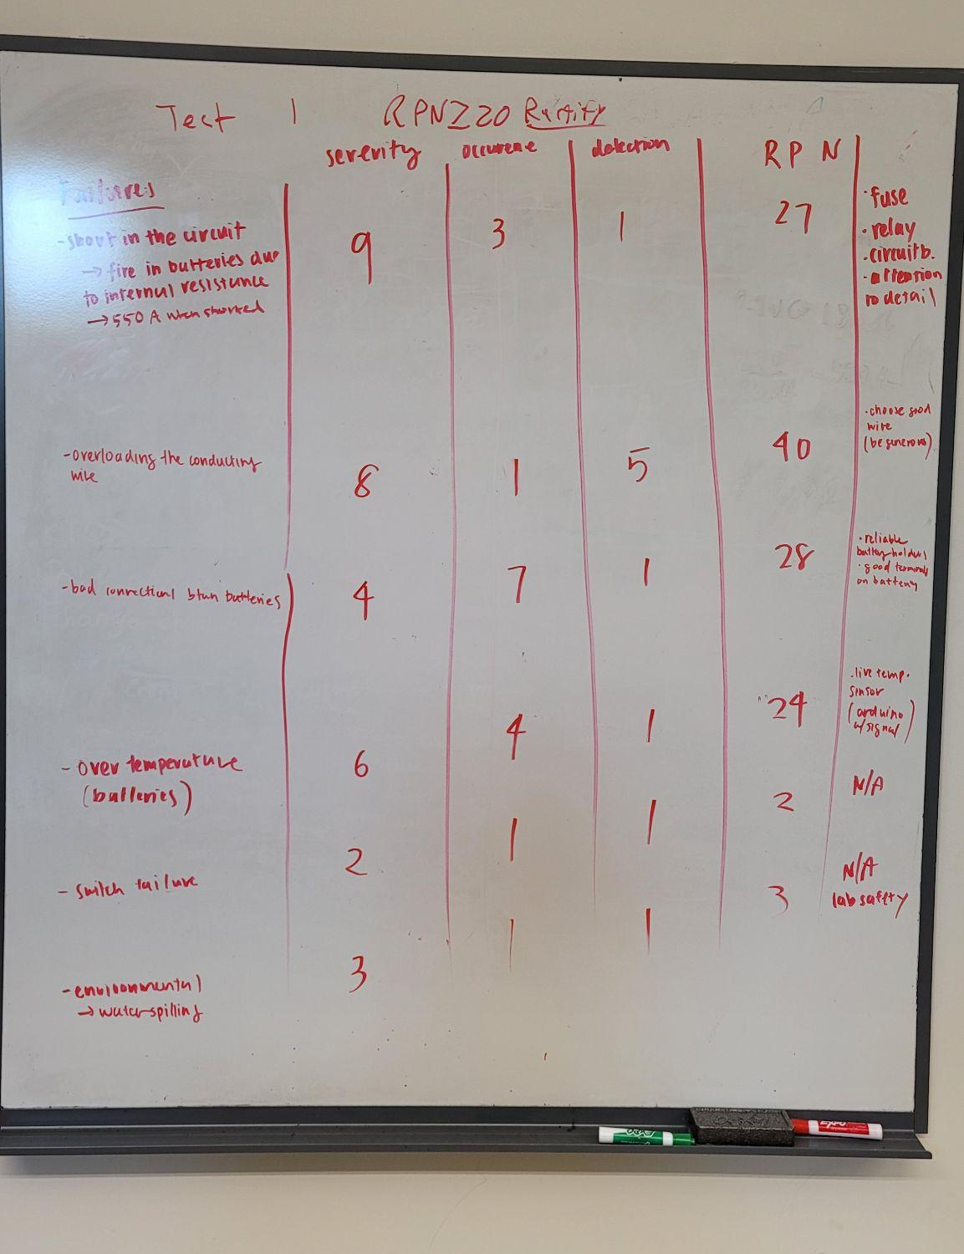

Slide 16
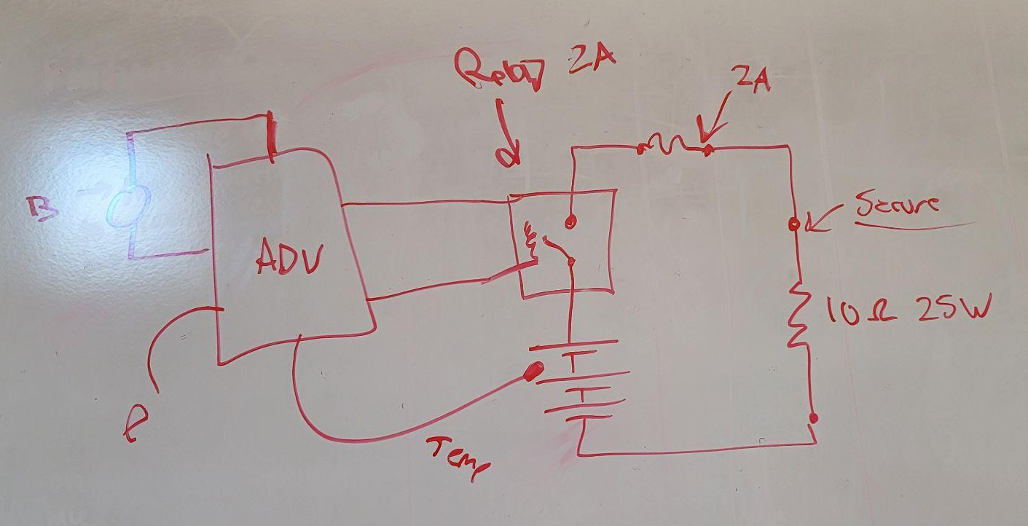
FMEA Design Correction

Slide 17
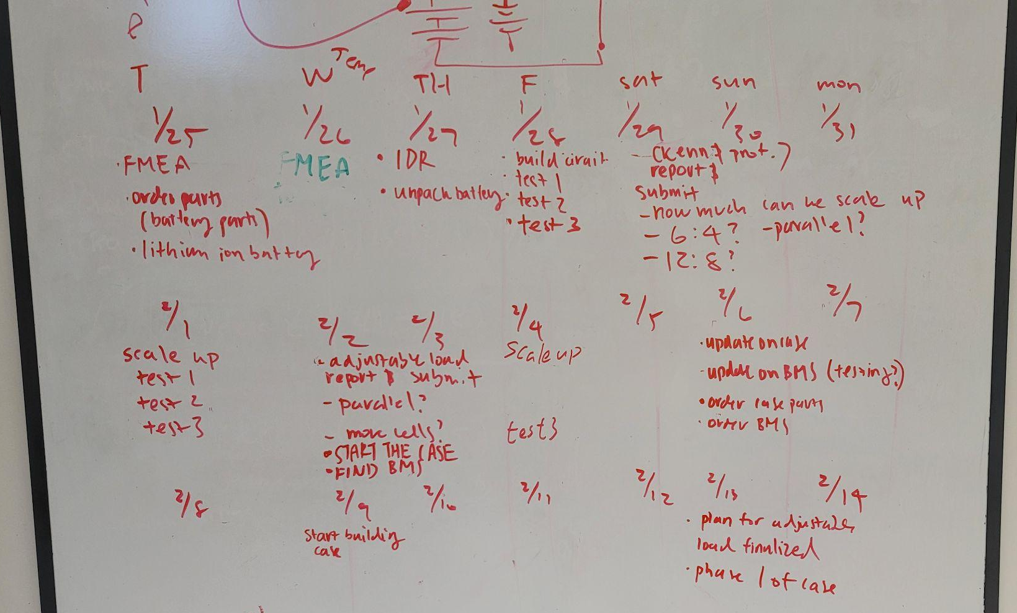

Slide 18
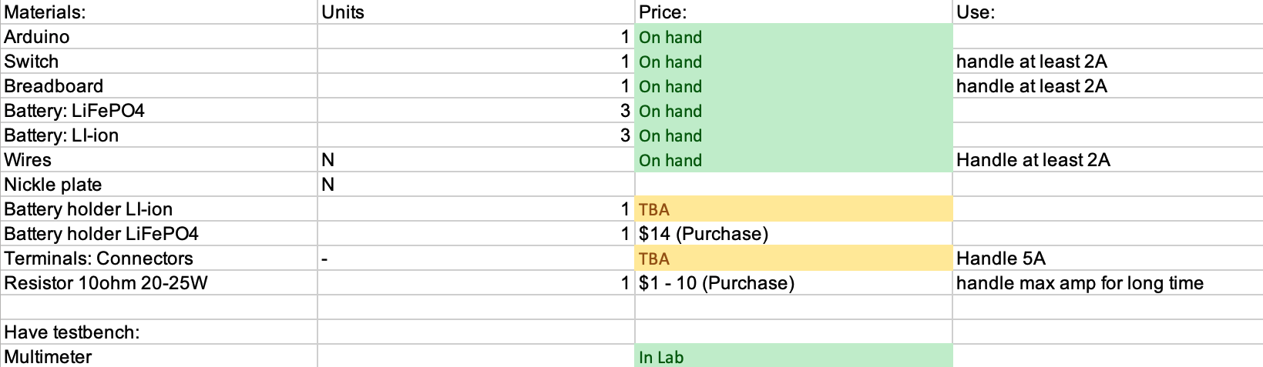
Bill of Materials (Test 1)

