Slide 1
Deep Learning
MSc in Artificial Intelligence
Spilios Dellis

Slide 2
Scope and method
Scope
Recognition of bird sound on audio recording
Database
Ten second audio recording in wav format
15690 audio recording
51 % contain bird sound
Variety of background noises

Slide 3
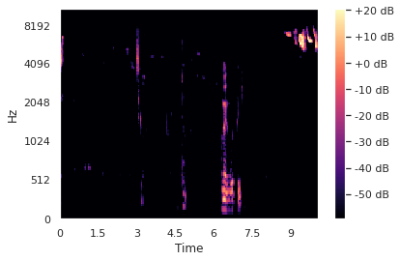
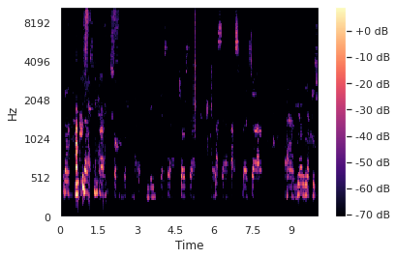
Method-Features
MEL Spectrograms

Slide 4
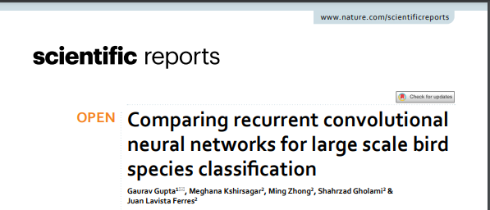
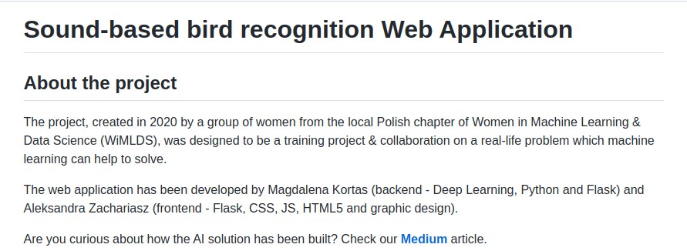
Method-Models
Deep learning models
Two different architectures were employed
Multilayer CNN model
RESNet50 based model

Slide 5
Method-Models
CNN based model
23 Convolution layers followed by batch normalization layers
Max pooling layer every two-three layers
Nodes - [64, 64, MP, 128, 128, 128, MP, 256, 256, 256, MP, 256, 256, 256, MP, 256, 256, 256, MP, 256, 256, 256, MP, 512, 512, 512, MP, 512, 512, 512, MP]
Flatten - Dense - Dropout - Dense layers are following
Total parameters: 20463310
Trainable parameters: 20449992

Slide 6
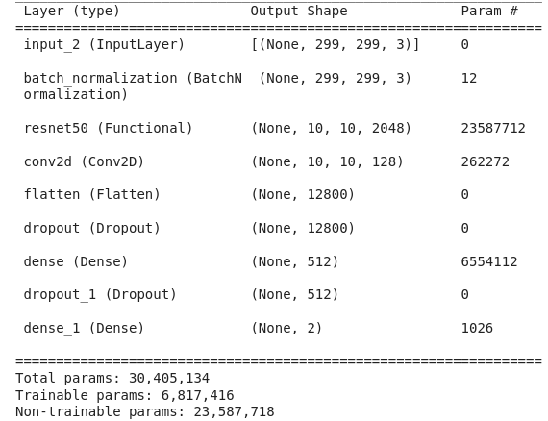
Method-Models
RESNet50 based model
Total parameters: 30405134
Trainable parameters: 6817416

Slide 7
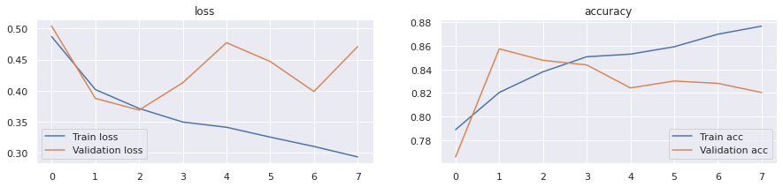
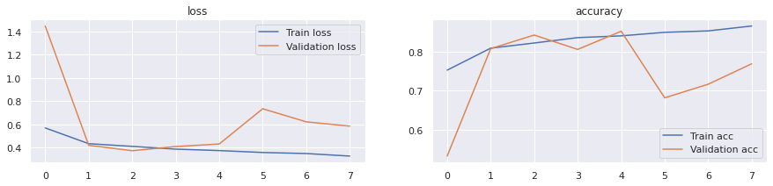
Method-Models
RESNET50 based model
RESNET50 based model
RESNET50 based model
CNN based model

Slide 8
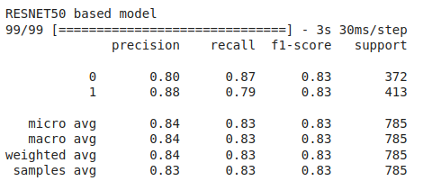
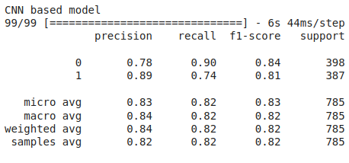
Method-Models
Results
CNN based model achieves slightly better precision and recall for both classes compared to the RESNet50 based model. An additional RNN layer on top of the CNN would probably result in even better performance.

