Slide 1
Project on “Machine Learning”
MSc in Artificial Intelligent
Spilios Dellis

Slide 2
Outline
Introduction
Data presentation and problem determination
Program workflow
Features extraction
Features preprocessing
Machine learning algorithms comparison
Features comparison
Best features and machine learning combination

Slide 3
Data
Data description
Field audio recordings of 10 s duration from around the world (FreeSound project)
Some contains bird sound
Labeling by the Machine Listening Lab of the Queens Mary University of London
More than 7000 audio recording (25 % of them contains bird sound)
Detect audio recording contains bird sound
Classification problem

Slide 4
Workflow
Features Extraction
+
Preprocessing
Comparison of different algorithm
Determine best algorithm
Evaluate best algorithm

Slide 5
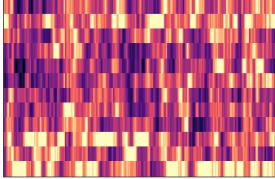
Features. Extraction
Extraction
Prepare chromagrams for each audio recording using constant-Q method and waveform methods.
Use chromograms as images and extract features using a CNN pretrained model (VGG16)
VGG16
[1X4096]

Slide 6
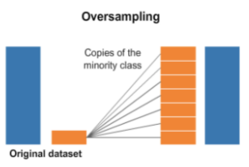
Features. Preprocessing
Resampling

Slide 7
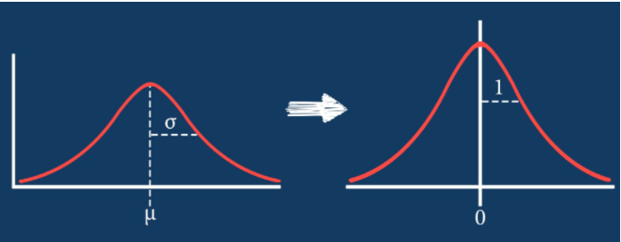
Features. Preprocessing
Resampling
Standardization

Slide 8
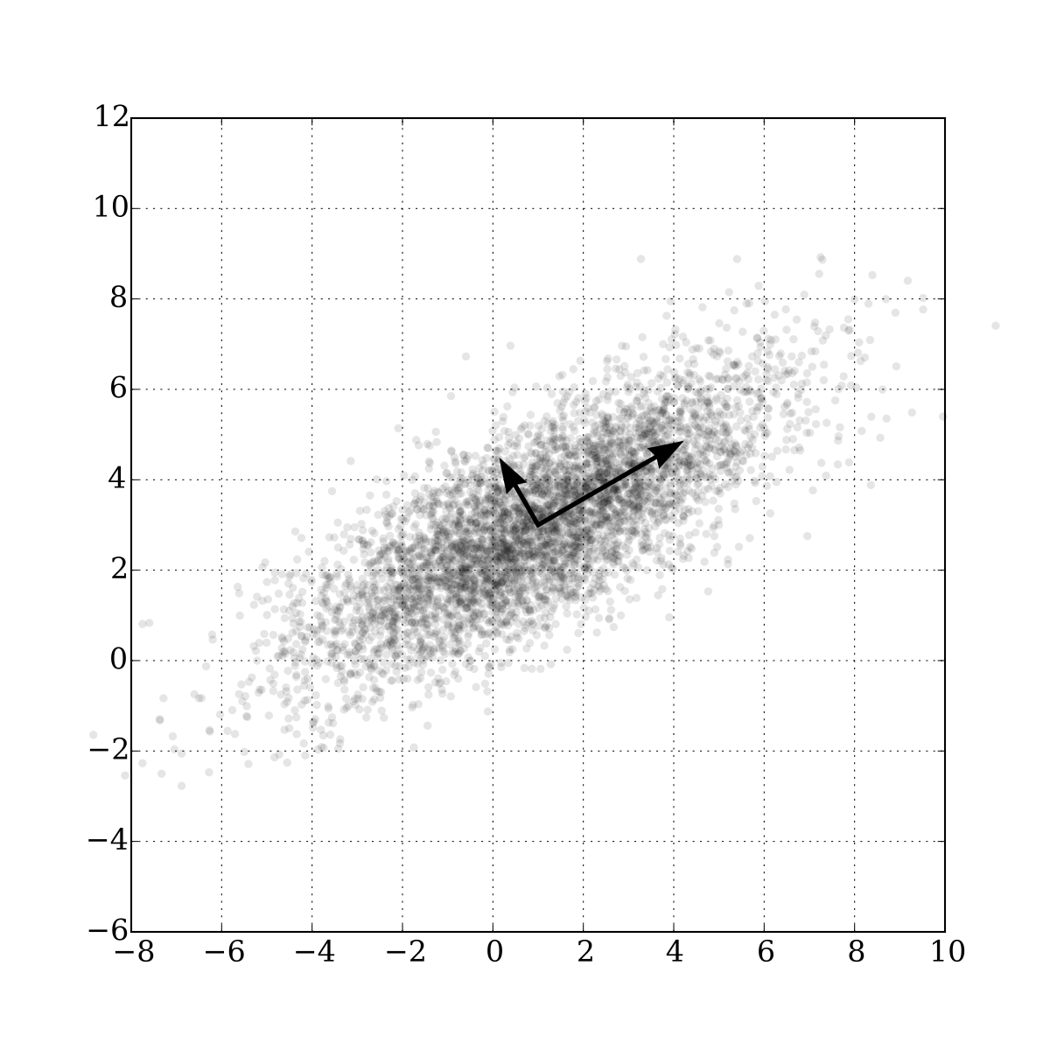
Features. Preprocessing
Resampling
Standardization
PCA

Slide 9
ML algorithms comparison
10 % of the original data kept as validation dataset.
Rest used for model training with a 2/8 ratio between test and training datasets.
The used algorithms are
Support vector classification
Logistic regression
Gaussian naïve Bayes
Decision tree classification
K nearest neighbours
ROC curves used for comparison
Best algorithm derived for each type of features

Slide 10
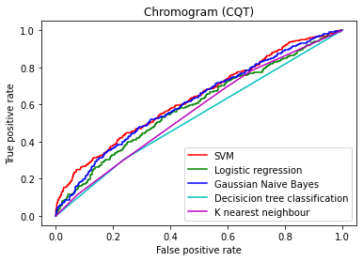
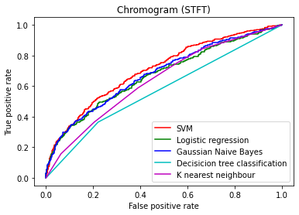
Determine best algorithm in respect to features’ type
 | CQT | STFT
SVM | 0.63 | 0.71
Logistic regression | 0.59 | 0.67
Gaussian Naïve Bayes | 0.61 | 0.68
Decision tree classification | 0.53 | 0.57
K nearest neighbors | 0.56 | 0.64

Slide 11
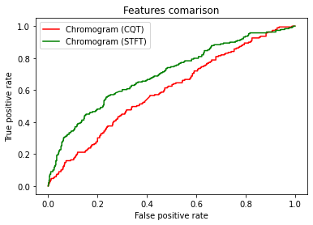
Comparison between features
0.7
0.6
Best combination
Features extracted from chromograms using waveform + SVM

