Slide 1
Machine learning in Multimedia Data
MSc in Artificial Intelligence
Spilios Dellis

Slide 2
Scope and method
Scope
Develop a method that can detect the most relevant music track from a list compared to a given music track
Database
Music tracks from the Free Music Archive database
106574 tracks from 16314 artists and 14854 albums
.mp3 files of the tracks
.csv files with track information, metadata, and features

Slide 3
Method-Description
Model
Feature extraction from the tracks of the list
Feature Standarization and dimensionality reduction (PCA)
Tracks separation in clusters
Track suggestion
Feature Standarization and dimensionality reduction (PCA)
Class prediction
Distance Calculation
Track feature extraction

Slide 4
Method-Features extraction
Common spectroscopy features were used (librosa library)
Features
Chroma features extracted by STFT and constant-Q
Chroma variant
Mel-frequency cepstral coefficients
Root-mean-square (RMS)
Spectral centroid
Spectral bandwidth
Tonal centroid features
zero-crossing rate
Features was compute for 2048 frames window (512 frames hopping) for each track and then the min, median, max, mean, skew, and kurtosis of the feature over the track was used

Slide 5
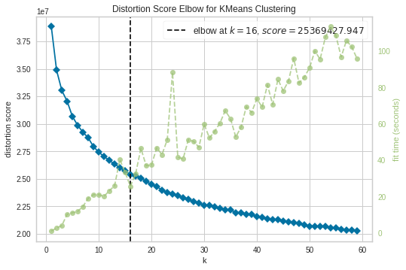
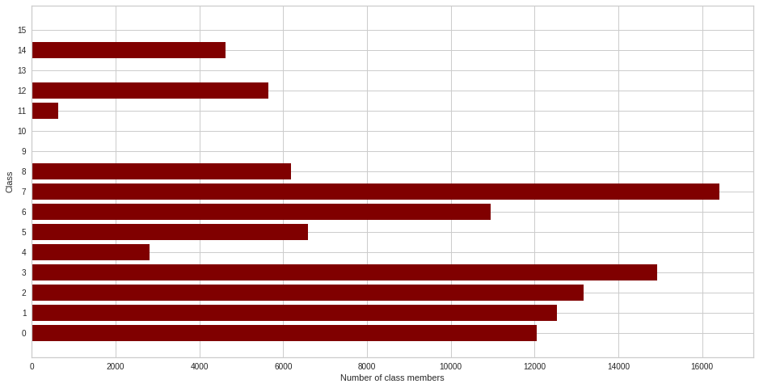
Method-Clustering
The optimum number of cluster was investigated using the elbow method and the distortions.

Slide 6
Method-Track suggestion
For the suggestion of the most relevant track:
The same features as for the tracks of the list are calculated
The features are standardized and transformed based on the standardization and transformation of the list tracks
The track is classified
The Euclidean distance between the under investigation track and the tracks of the same class is calculated
The track of lower distance is suggested

