Slide 1
An Alternative Interpretation of Apparent Failures to Learn From Failure
Stephen A. Spiller
ACR, September 28, 2024
Preprint, data, materials, and code at www.StephenASpiller.com

Slide 2
Roadmap
The Original Finding
The Script Task
My Argument
A Descriptive Model
A Placebo Replication
Implications and Takeaways

Slide 3
The Original Finding
People learn less from failure than from success
Why?
Experiencing failure threatens one’s ego
Ego-threat causes people to “tune out” and not learn
Finding has been replicated by multiple research teams
Finding is impactful, per citations and practitioner-oriented articles
Eskreis-Winkler & Fishbach, 2019, PsycSci; Keith et al., 2022, JEP:G; Gok & Fyfe, 2024, JEP:G

Slide 4
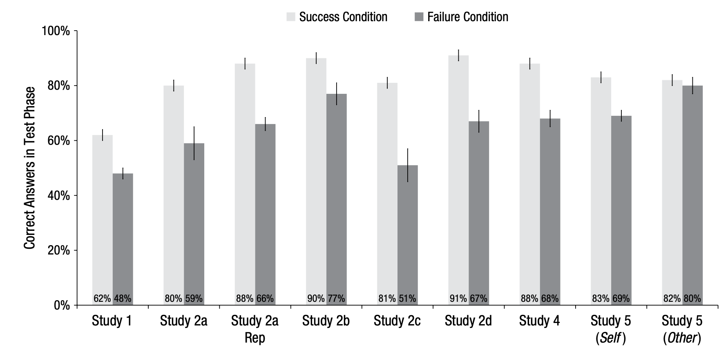
The Original Finding
Eskreis-Winkler & Fishbach, 2019, Psychological Science

Slide 5
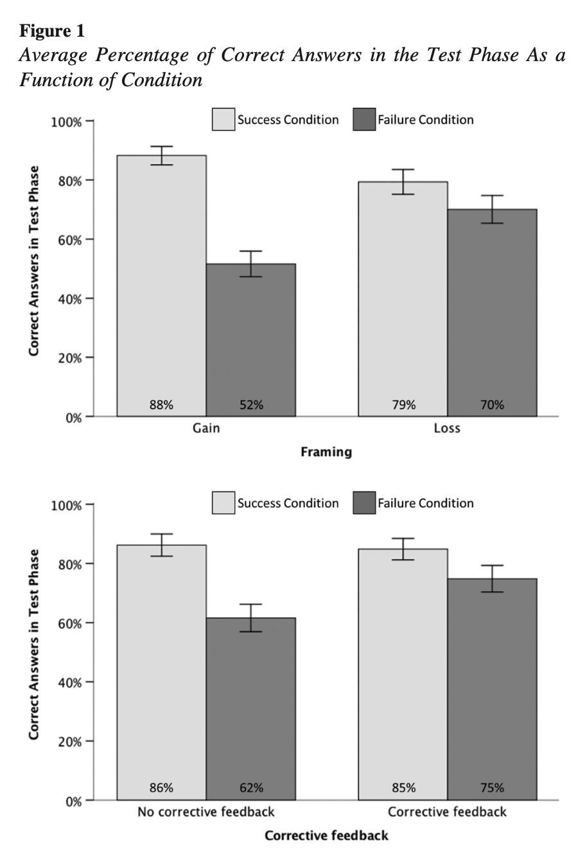
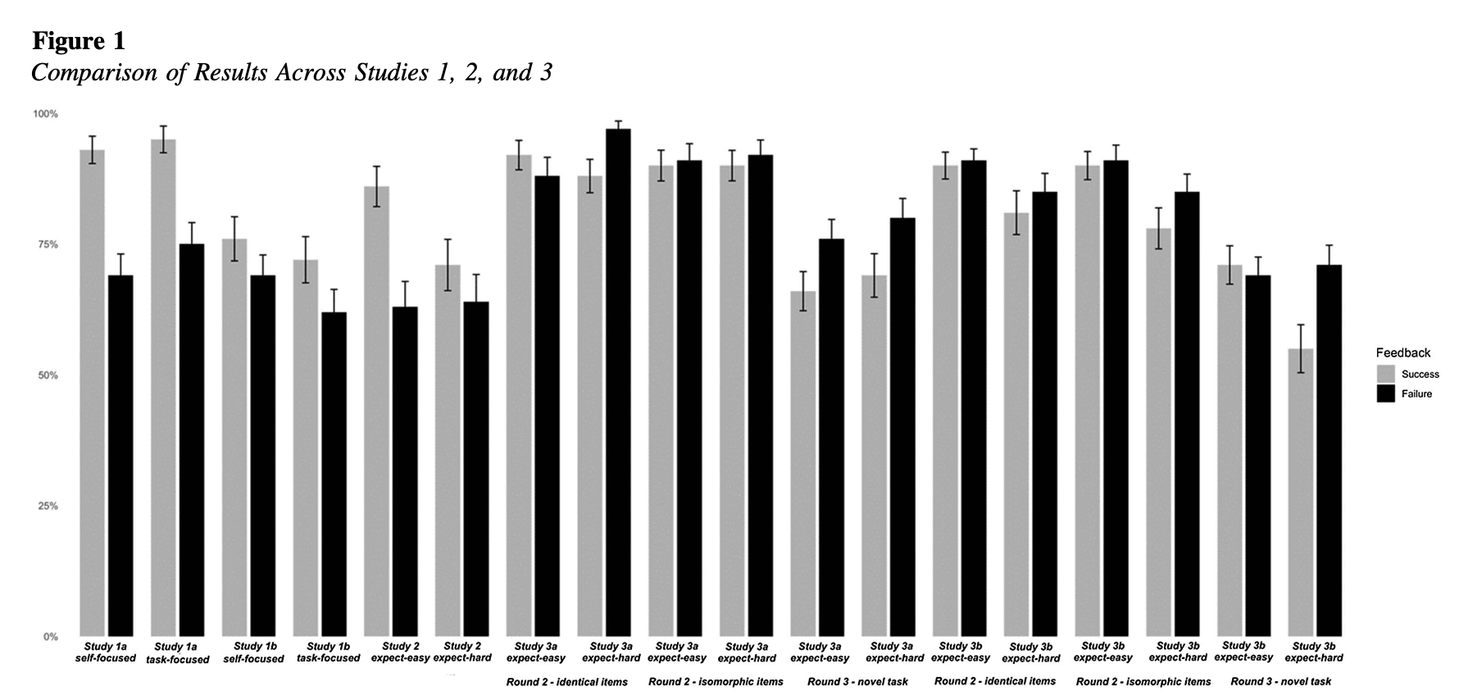
(Replications of) The Original Finding
Gok & Fyfe, 2024, JEP:G
Keith et al., 2022, JEP:G

Slide 6
The Script Task
Round 1
Round 2
Q1. Which of the following characters in an ancient script represents an animal?
ᛚ ᛖ
Q2. Which of the following characters in an ancient script represents a person?
ᛇ ᚾ
Q3. Which of the following characters in an ancient script represents a bird?
ᛗ ᛉ
Q1. Which of the following characters represents a non-living, stationary object?
ᛚ ᛖ
Q2. Which of the following characters represents a non-living, stationary object?
ᛇ ᚾ
Q3. Which of the following characters represents a non-living, stationary object?
ᛗ ᛉ

Slide 7
The Script Task
Success Condition
Failure Condition
Round 1: Which of the following characters in an ancient script represents a bird?
ᛗ ᛉ
Round 2: Which of the following characters represents a non-living, stationary object?
ᛗ ᛉ
Round 1: Which of the following characters in an ancient script represents a bird?
ᛗ ᛉ
Round 2: Which of the following characters represents a non-living, stationary object?
ᛗ ᛉ
✓
✓
✓
X
Correct!
Correct!
Incorrect!
✓
✓

Slide 8
The Script Task
Success Condition
Failure Condition
Round 1: Which of the following characters in an ancient script represents a bird?
ᛗ ᛉ
Round 2: Which of the following characters represents a non-living, stationary object?
ᛗ ᛉ
In the Success condition, internally-consistent Round 2 answers are correct
Round 1: Which of the following characters in an ancient script represents a bird?
ᛗ ᛉ
Round 2: Which of the following characters represents a non-living, stationary object?
ᛗ ᛉ
In the Failure condition, internally- consistent Round 2 answers are incorrect
✓
✓
X
Correct!
Incorrect!
✓
X
✓

Slide 9
My Argument
A stable response tendency (i.e., consistent responding) leads to higher performance following success than failure
As a consequence:
The evidence is consistent with equal learning from failure
Retroactive condition assignment replicates the finding
Different stimuli can reverse the apparent effect
Reversing or randomizing condition labels recovers the effect

Slide 10
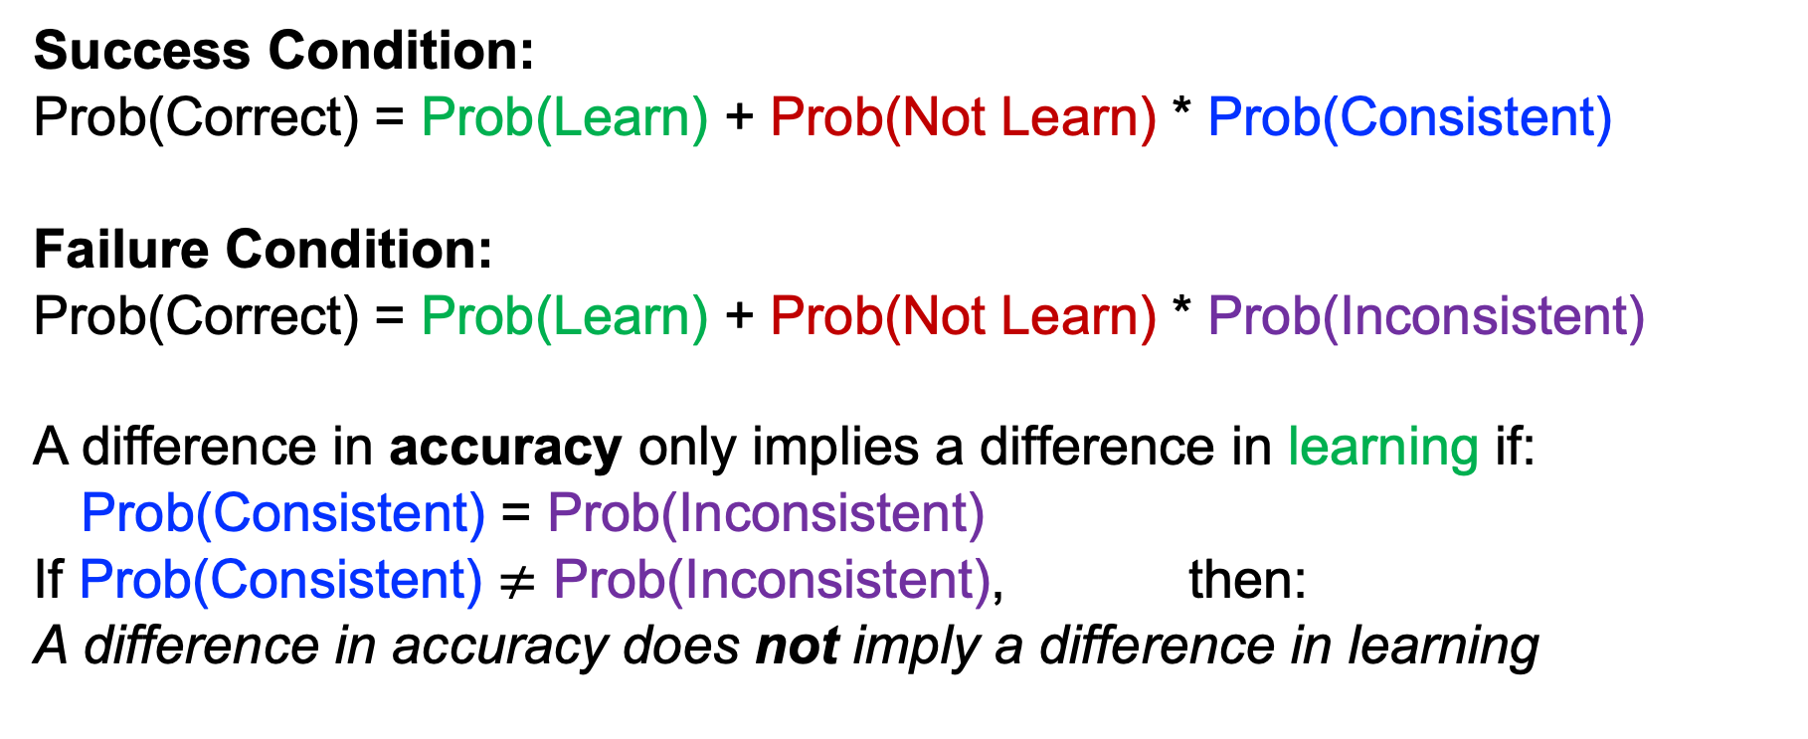
A Mathematical Model (Without Much Math*)
Success Condition:
Prob(Correct) = Prob(Learn) + Prob(Not Learn) * Prob(Consistent)
Failure Condition:
Prob(Correct) = Prob(Learn) + Prob(Not Learn) * Prob(Inconsistent)
A difference in accuracy only implies a difference in learning if:
Prob(Consistent) = Prob(Inconsistent)
If Prob(Consistent) $≠$ Prob(Inconsistent), then:
A difference in accuracy does not imply a difference in learning
*see preprint for math

Slide 11
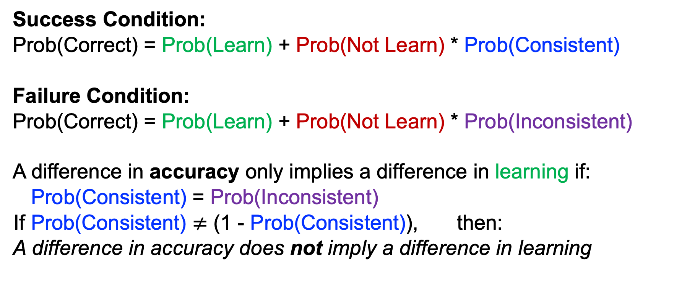
A Mathematical Model (Without Much Math*)
Success Condition:
Prob(Correct) = Prob(Learn) + Prob(Not Learn) * Prob(Consistent)
Failure Condition:
Prob(Correct) = Prob(Learn) + Prob(Not Learn) * Prob(Inconsistent)
A difference in accuracy only implies a difference in learning if:
Prob(Consistent) = Prob(Inconsistent)
If Prob(Consistent) $≠$ (1 - Prob(Consistent)), then:
A difference in accuracy does not imply a difference in learning
*see preprint for math

Slide 12
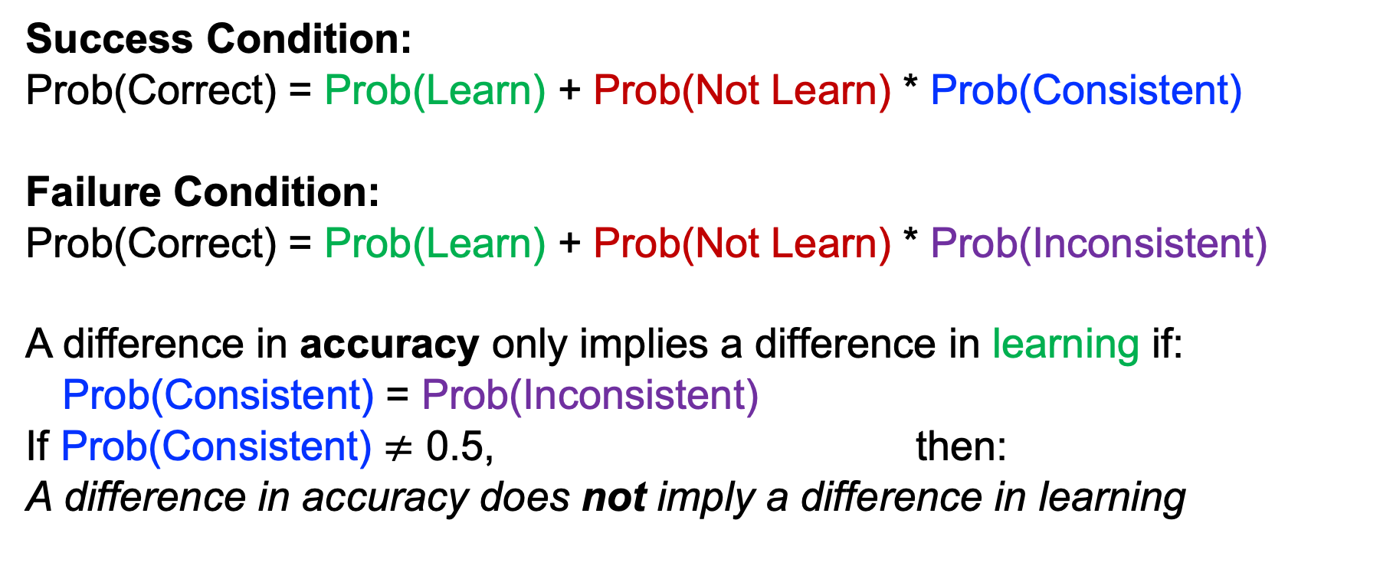
A Mathematical Model (Without Much Math*)
Success Condition:
Prob(Correct) = Prob(Learn) + Prob(Not Learn) * Prob(Consistent)
Failure Condition:
Prob(Correct) = Prob(Learn) + Prob(Not Learn) * Prob(Inconsistent)
A difference in accuracy only implies a difference in learning if:
Prob(Consistent) = Prob(Inconsistent)
If Prob(Consistent) $≠$ 0.5, then:
A difference in accuracy does not imply a difference in learning
*see preprint for math

Slide 13
Original Interpretation
Alternative Interpretation
Learn about half the time on average
Learn 20% less after failure
Answer randomly when don’t learn
Success: 85% accuracy
Failure: 65% accuracy
Learn about half the time on average
Learn equally well after failure
Answer consistently when don’t learn
Success: 85% accuracy
Failure: 65% accuracy

Slide 14
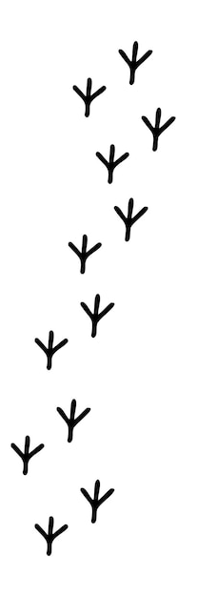
Why Might Participants Answer Consistently?
Based on partially stable preexisting beliefs
Participants may rely on prior knowledge in both Rounds
Q3: Which of the following characters in an ancient script represents a bird?
ᛗ ᛉ
Participants may align beliefs through answering Round 1, and/or
Participants may recall Round 1 in order to answer Round 2
Based on beliefs constructed through measurement
There is evidence both types of consistency may arise*
*see posttest in preprint

Slide 15
Experiment: A Placebo Replication
N = 395 participants after removing 6 with missing data
Replication of the original paradigm (Study 2a), except:
There is no feedback, and
Condition is assigned after participants finish the study.

Slide 16
Experiment: A Placebo Replication
Round 1: Which of the following characters in an ancient script represents a bird?
ᛗ ᛉ
Round 2: Which of the following characters represents a non-living, stationary object?
ᛗ ᛉ
At end of the study, assigned to condition

Slide 17
Experiment: A Placebo Replication
Success Condition
Failure Condition
Round 1: Which of the following characters in an ancient script represents a bird?
ᛗ ᛉ
Round 2: Which of the following characters represents a non-living, stationary object?
ᛗ ᛉ
Round 1: Which of the following characters in an ancient script represents a bird?
ᛗ ᛉ
Round 2: Which of the following characters represents a non-living, stationary object?
ᛗ ᛉ
✓
✓
X
Correct!
Incorrect!
✓
X
Score: 100%
Score: 0%

Slide 18
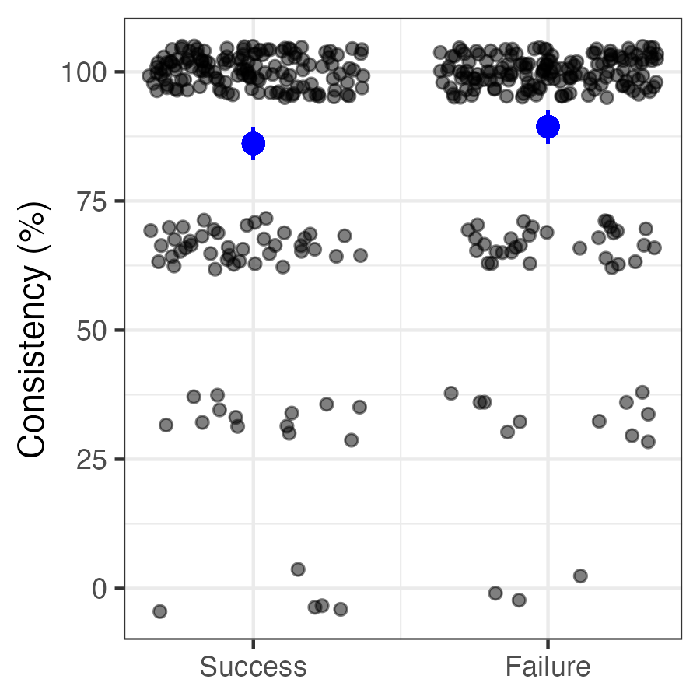
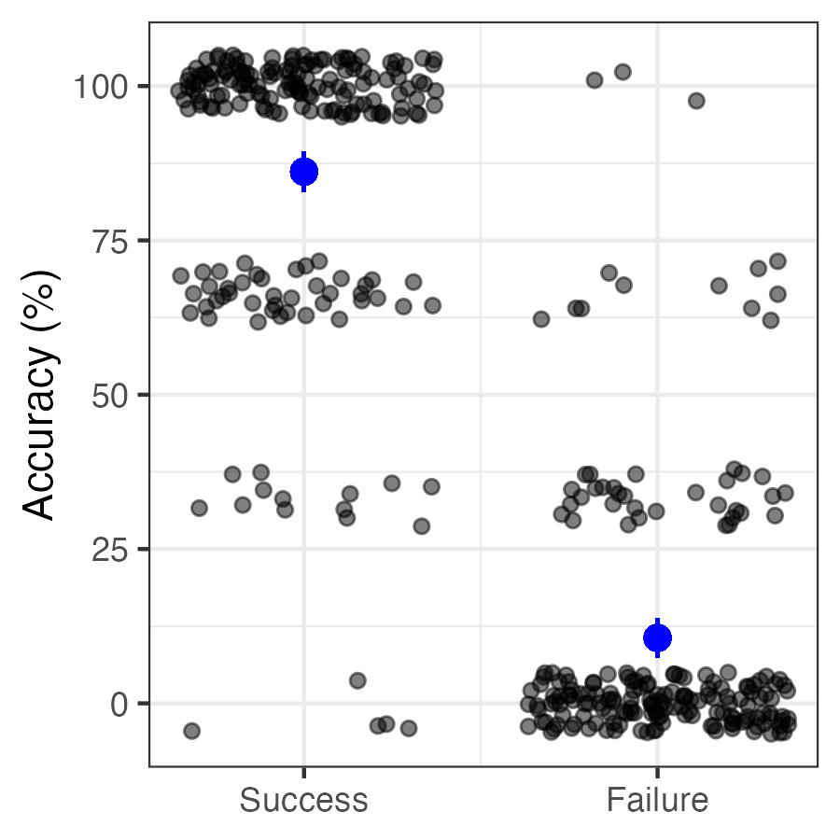
Experiment Results
t(393) = 1.41, p = .158
t(393) = 32.65, p < .001
86%
89%
86%
11%
Error bars represent 95% confidence intervals

Slide 19
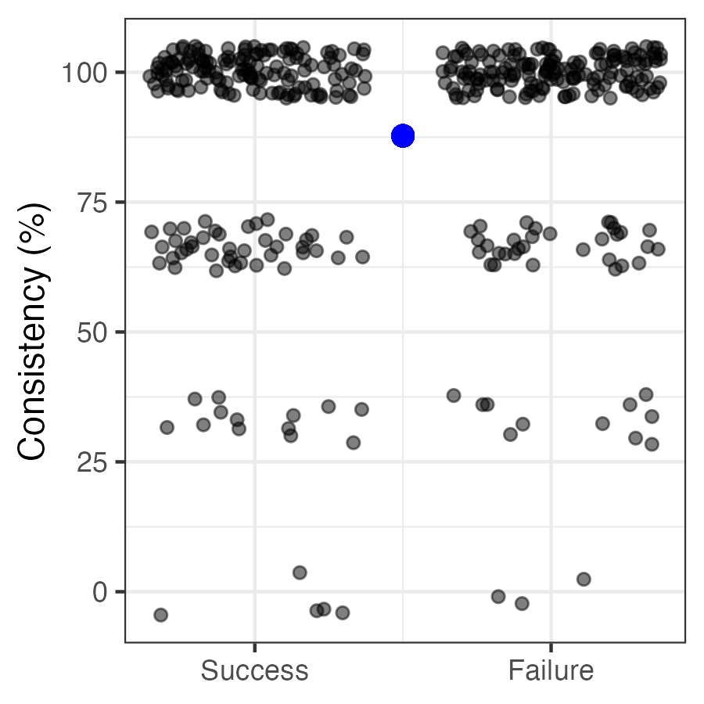
Experiment Results
Mean of means vs. 50%:
t(393) = 32.65, p < .001
Comparing conditions:
t(393) = 32.65, p < .001
Error bars represent 95% confidence intervals
See Abelson 1995; Brauer & Judd 2000; Shaffer 1977

Slide 20
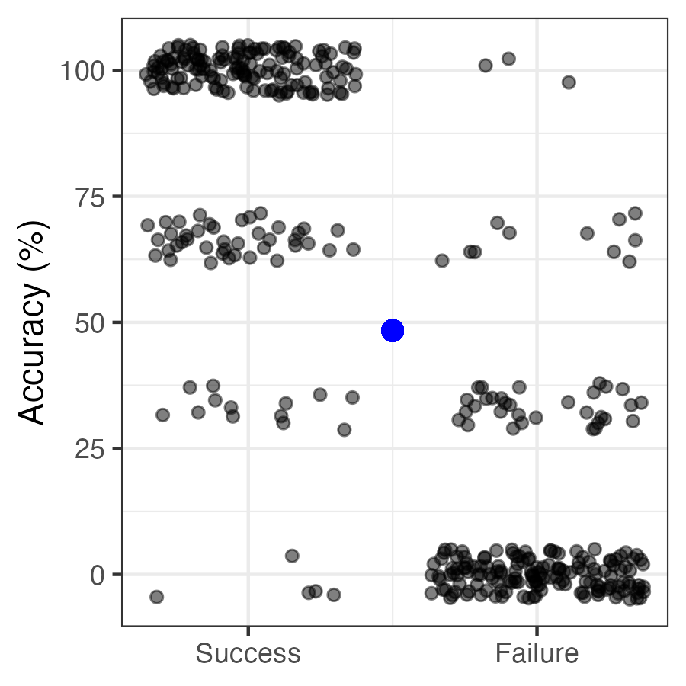
Experiment Results
Comparing conditions:
t(393) = 1.41, p = .158
Mean of means vs. 50%:
t(393) = 1.41, p = .158
Error bars represent 95% confidence intervals
See Abelson 1995; Brauer & Judd 2000; Shaffer 1977

Slide 21
Additional Findings
This alternative can account for each of the original findings
Careful stimulus selection can generate systematic inconsistency across rounds
With such stimuli, performance is better after failure than success, reversing the effect (Experiment S1)

Slide 22
Experiment S1 Example
Success Condition
Failure Condition
Round 1: Which of the following characters in an ancient script represents a torch?
ᛗ ᛉ
Round 2: Which of the following characters represents a scarecrow?
ᛗ ᛉ
In the Success condition, internally-consistent Round 2 answers are correct… but people tend to answer inconsistently
Round 1: Which of the following characters in an ancient script represents a torch?
ᛗ ᛉ
Round 2: Which of the following characters represents a scarecrow?
ᛗ ᛉ
In the Failure condition, internally-consistent Round 2 answers are again incorrect… but people tend to answer inconsistently
✓
✓
X
Correct!
Incorrect!
✓
X
✓

Slide 23
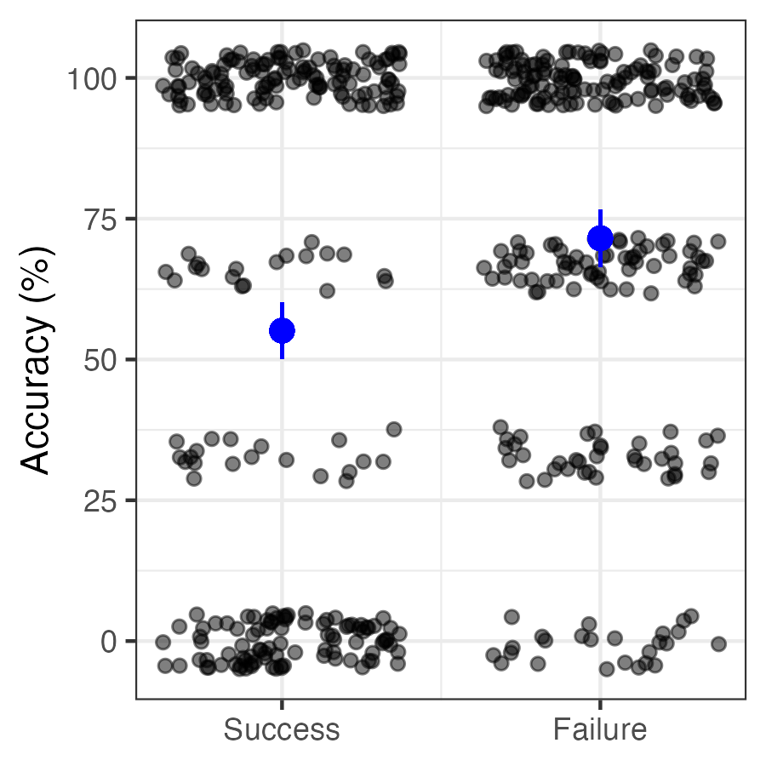
Effect Reverses With Different Stimuli
Earlier Placebo Experiment
Experiment S1 (with feedback)
Error bars represent 95% confidence intervals

Slide 24
Additional Findings
This alternative can account for each of the original findings
Careful stimulus selection can generate systematic inconsistency across rounds
With such stimuli, performance is better after failure than success, reversing the effect (Experiment S1)
If reverse or randomize condition labels in original data, and then re-score quizzes, success still outperforms failure
Reinforces that the answer key is a critical part of manipulation

Slide 25
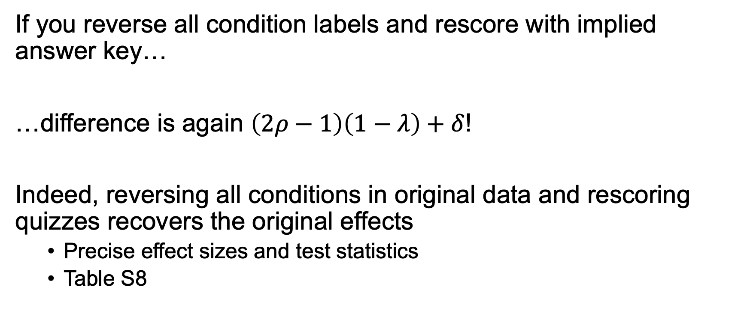
Reverse Condition Labels
If you reverse all condition labels and rescore with implied answer key…
…difference is again $\left(2ρ−1\right)\left(1−λ\right)+δ$!
Indeed, reversing all conditions in original data and rescoring quizzes recovers the original effects
Precise effect sizes and test statistics
Table S8

Slide 26
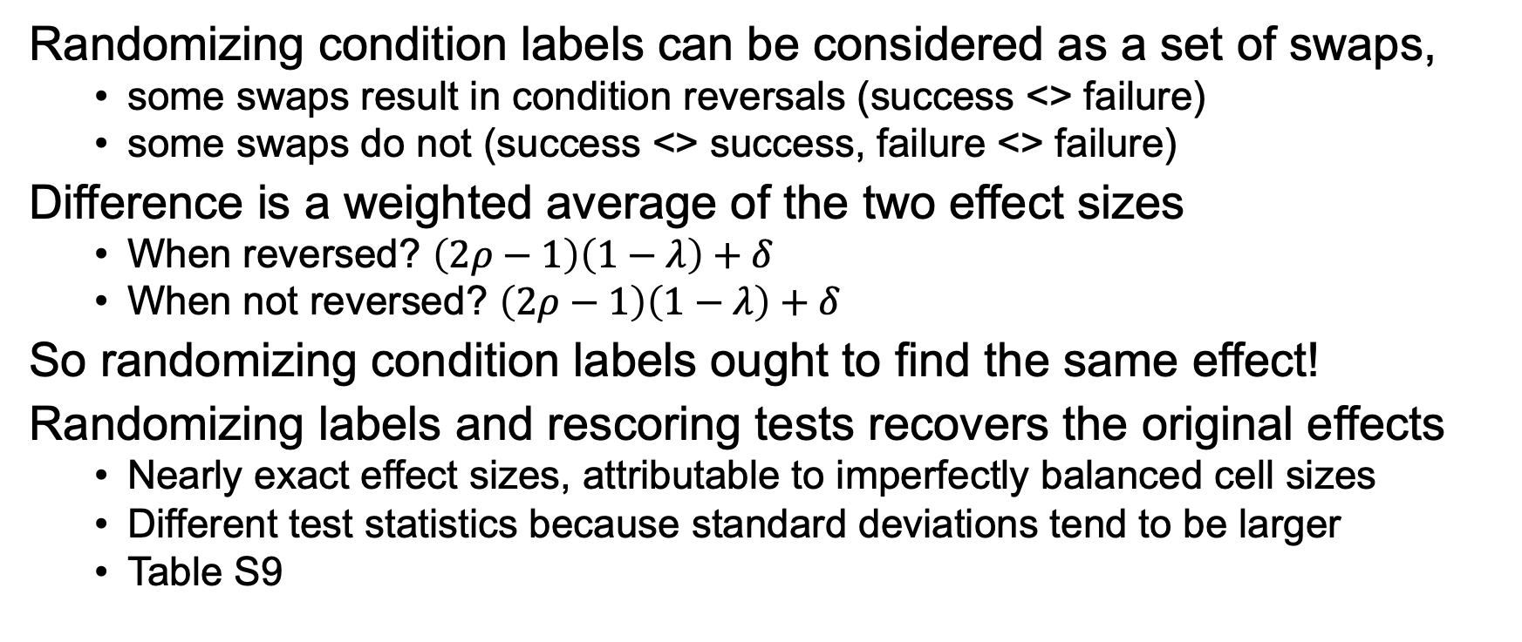
Randomize Condition Labels
Randomizing condition labels can be considered as a set of swaps,
some swaps result in condition reversals (success <> failure)
some swaps do not (success <> success, failure <> failure)
Difference is a weighted average of the two effect sizes
When reversed? $\left(2ρ−1\right)\left(1−λ\right)+δ$
When not reversed? $\left(2ρ−1\right)\left(1−λ\right)+δ$
So randomizing condition labels ought to find the same effect!
Randomizing labels and rescoring tests recovers the original effects
Nearly exact effect sizes, attributable to imperfectly balanced cell sizes
Different test statistics because standard deviations tend to be larger
Table S9

Slide 27
Takeaways
We may need to rethink what we think we know about learning from failure vs. learning from success
Sometimes lack of knowledge is a strong assumption, even when there is no ground truth
Observing a 50/50 split does not imply random answering
Heterogeneity matters a lot!
Be vigilant when differentially transforming dependent variables by condition
Useful to consider: What would a null model predict?

Slide 28
Thank you! Preprint, data, materials, and code at www.StephenASpiller.com

