Slide 1
Class A addressing
32 bit
0
8 bit
8 bit
8 bit
Network id (8 bit)
Host id
(24 bit)
In class A addressing the first bit of first octate is reserved as 0.
Total ip address possible = 2^31
0 0000000 = 0
0 0000001 = 1
.
.
.
0 1111111 = 127
Total Network possible = 2^7
Out of 128 the first and last address is not used.
Because the first address indicates the particular network and the last id is used for broadcast.
So, actual usable network possible = (2^7) -2 = 126.
No. of host possible = (2^24) - 2
Range : (0.0.0.0 to 127.255.255.255)
- By Sayak Pal

Slide 2
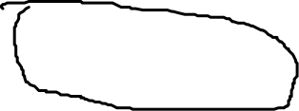
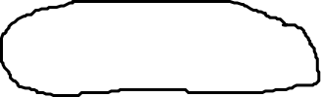
Class B addressing
32 bit
1
0
8 bit
8 bit
Network id (16 bit)
Host id
(16 bit)
In class B addressing the first two bit of first octate is reserved as 10.
Total ip address possible = 2^30
10 000000 = 128
10 000001 = 129
.
.
.
10 1111111 = 191
Total Network possible = 2^14
So, actual usable network possible = (2^14)
No. of host possible = (2^16) - 2
128.0.0.0 to 191.255.255.255 belonging to class B.
There is another octate, so for 64 values(128 to 191) there are (0 to 255) values. Therefore total 64*256 = 2^14 networks.
- By Sayak Pal

Slide 3
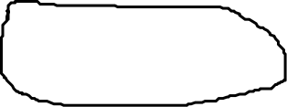
Class C addressing
32 bit
1
1
0
8 bit
Network id (24 bit)
Host id
(8 bit)
In class C addressing the first three bit of first octate is reserved as 110.
Total ip address possible = 2^29
110 00000 = 192
110 00001 = 193
.
.
.
110 111111 = 223
Total Network possible = 2^21
No. of host possible = (2^8) - 2
192.0.0.0 to 223.255.255.255 belonging to class C.
There is another two octates, so for 32 values(192 to 223) there are (0 to 255) values and another 0 to 255 values. Therefore total 32*256*256 = 2^21 networks.
- By Sayak Pal

Slide 4
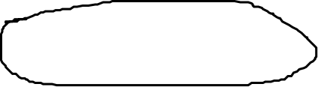
Class D addressing
32 bit
1
1
1
0
In class D addressing the first four bit of first octate is reserved as 1110.
There is no network id and host id part in class D.
Total ip address possible = 2^28
1110 0000 = 224
1110 0001 = 225
.
.
.
1110 11111 = 239
224.0.0.0 to 239.255.255.255 belonging to class D.
- By Sayak Pal

Slide 5
Class E addressing
32 bit
1
1
1
1
In class E addressing the first four bit of first octate is reserved as 1111.
There is no network id and host id part in class E.
Total ip address possible = 2^28
1111 0000 = 240
1111 0001 = 241
.
.
.
1111 11111 = 255
240.0.0.0 to 255.255.255.255 belonging to class E.
IP addresses belonging to class E are reserved for experimental and research purposes.
- By Sayak Pal

