Slide 1
SOFTWARE PRODUCT DEVELOPMENTFOR MODELING THE CHEMICALGAS RELAXATION BEHIND A SHOCK WAVEWAVE

Slide 2
Введение
For modeling of gas relaxations, proprietary closed-source software is currently used. The purpose of this work is to implement a software package based on open-source libraries

Slide 3
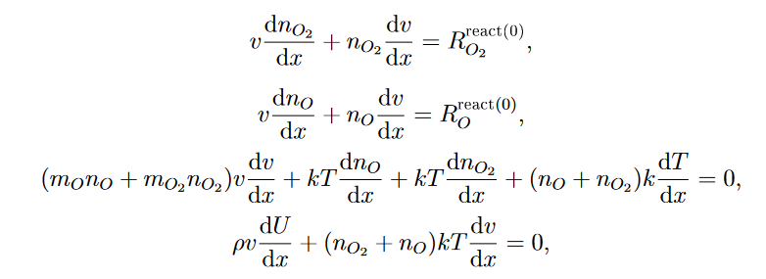
ТЕОРИЯ
Let's write out a system of equations:

Slide 4
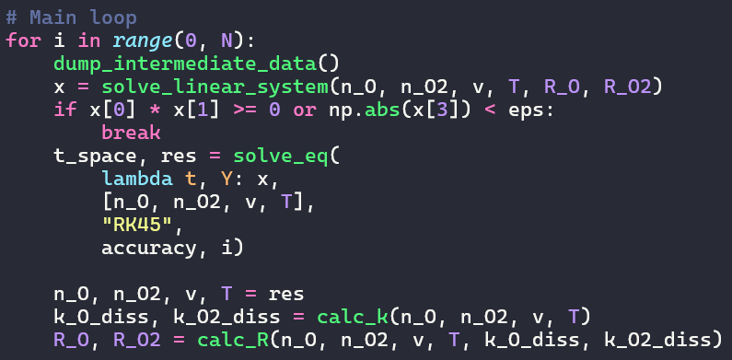
РЕЗУЛЬТАТЫ
Computation pipeline

Slide 5
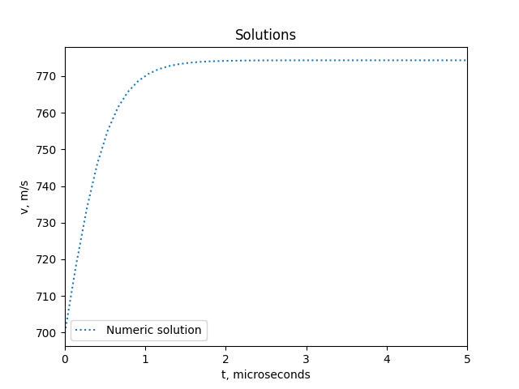
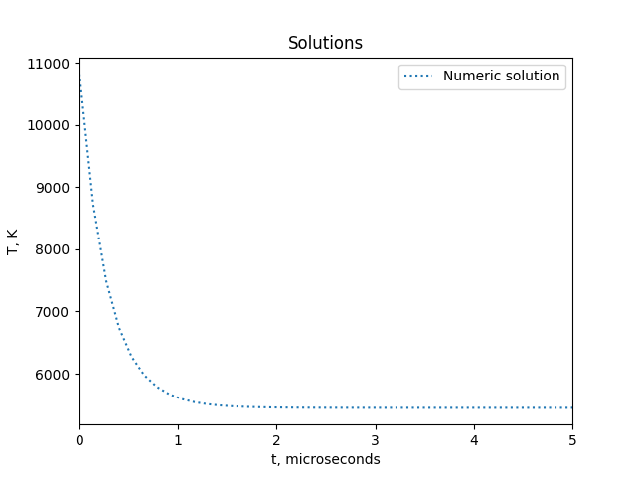
Результаты

Slide 6
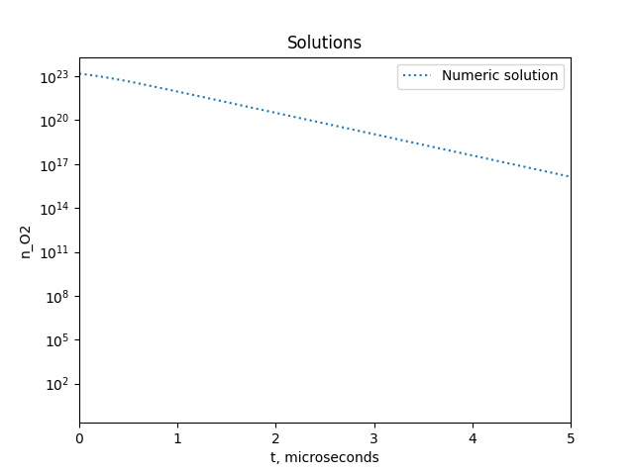
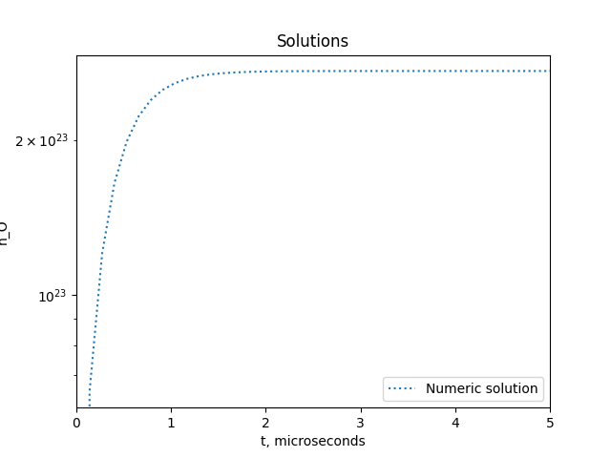
Результаты

Slide 7
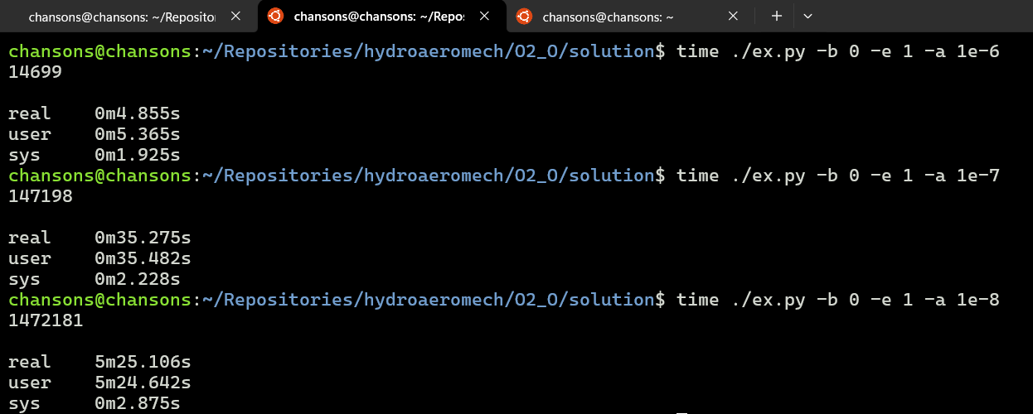
Результаты
Computing time

Slide 8
Заключение
The problem of gas modeling in the one-temperature approximation is solved
A physically based solution is obtained
MVP developed
In the future: KAPPA integration, calculation in level approximation, comparison with experiment, support for universal mixtures and initial conditions

