Slide 1
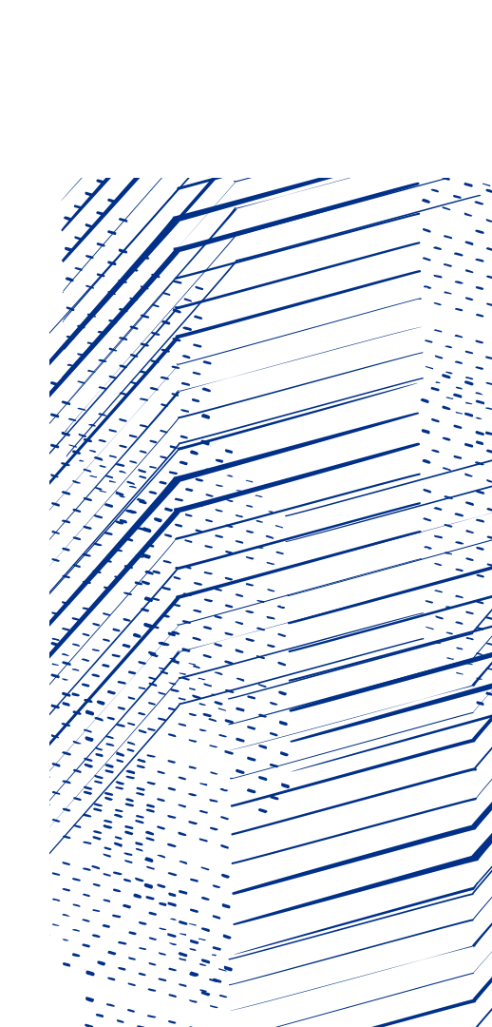

Linear Spin Wave Calculations with SpinW
Duc Le & Lucas Wilkins
Magnetic Neutron Scattering Data Analysis Workshop 2026
Notes:
The abstract pattern can be removed or repositioned if required. Be careful to ‘Send to Back’ so that it does not obscure any important information.

Slide 2
Before we begin
Last night we fixed a bug related to today's tutorial...
Please run:
pip install --upgrade spinw-python
in your virtual environment

Slide 3
Contents
Linear Spin Wave Theory
Magnetic Hamiltonian
Holstein-Primakoff expansion
Diagonalisation
Incommensurate single-k structure
SpinW
Hamiltonian parameters (exchange, anisotropy) input
Magnetic structure input
Plotting the model
Structure refinement
Dispersion calculation

Slide 4

Hamiltonian
SpinW can solve the magnetic Hamiltonian:
It uses the convention that:
Positive values of the exchange J means an antiferromagnetic interaction.
Positive values of the single ion anisotropy A means an easy-plane anisotropy.
The Hamiltonian above usually leads to magnetic ordering below a critical temperature.
Spin waves are the collective excitations of this ordered state.
General bi-linear
interactions
Single-ion
anistropy
Applied magnetic
field (Zeeman)

Slide 5
Steps in a Spin Wave Calculation
Spin waves arise from deviations of the ordered magnetic state.
We use the spin deviations as the basis states for calculating the magnetic Hamiltonian.
The Hamiltonian is then partly solved by a Fourier transform
For a ferromagnet the FT diagonalises the Hamiltonian
More generally another transformation is required to diagonalise H.
The eigenvalues of H(q) gives the magnon energies and the eigenvectors can be used to calculate the spin-spin correlation function and INS intensity.

Slide 6



Holstein-Primakoff Transformation
Express the spin operators as the ladder operators:
Map the raising / lowering operators to bosonic creation and annihilation operators taking only terms linear in
ground state is fully
saturated state.
n^{th} magnon is n^{th}
deviation from this
vs
linear spin wave theory means ignoring the terms
in blue.

Slide 7



Hamiltonian
We could now substitute the Holstein-Primakoff operators back into the Hamiltonian, but then the maths gets complicated because of the dependence of the operators on the magnetic structure (spin orientation).
Instead we define a set of 3x3 rotation matrices R_{i} which rotates all the spin to ferromagnetic alignment, e.g.:
Where S_{i}’ are all ferromagnetic.
Remembering that:
If we define two sets of vectors u_{i} formed from the first two columns of the matrix R_{i} and v_{i} formed from the third column as:
Then we have:
Where the bar indicates complex conjugation.

Slide 8


Hamiltonian
The Hamiltonian thus becomes:
The terms in curly braces can be expressed as a vector of the H-P operators (basis states), giving:
Where H_{ij} is a 2n x 2n matrix whose matrix elements can be determined by the braced expressions above and is given in the SpinW paper.
The expression above will contain terms which mix spins at i and j – a Fourier Transform will separate this, e.g. as in:
We now Fourier transform the Hamiltonian and diagonalise it for every q point.

Slide 9
Incommensurate structure
Remember that we introduced a rotation matrix which rotates every spin into the ferromagnetic state – actually SpinW introduces two such rotations.
The first applies to all spins within a crystalline unit cell and is used for the “incommensurate” (single-q) calculations.
The second then rotates the spins within a unit cell into the ferromagnetic state.
It turns out that for structures which can be described by a rotation from one unit cell to another, that the spin-spin correlation function (and hence INS intensity S(Q,ω)) has three branches:
At Q
At Q ± k , where k is the ordering wavevector / magnetic propagation vector
Expressions for the spin-spin correlation function can be found in the SpinW paper:
S. Toth and B. Lake, J. Phys.: Condens. Matter, 27 (2015) 166002

Slide 10
Questions so far?

Slide 11
Some History of the SpinW Organisation
MATLAB SpinW Developed by Sándor Tóth in Berlin
Pioneered using a rotating coordinate frame for fast calculations of spin waves in helical magnets.
Project taken on by Simon Ward, Duc Le and Richard Waite
Python version developed as part of an ISIS/PSI Collaboration starting 2025

Slide 12
PySpinW vs SpinW Design
 | SpinW | pySpinW
Interaction Language | MATLAB | Python
Core Language | C++ | Rust
Interaction method | Modify the spinw object | Build objects out of components
Classes | Few | Many
Mutability | One spinw object, change it | Make copies if you want something different

Slide 13
PySpinW Object Construction
Single Class
Multiple Classes
Fitting Helpers
LatticeSite[s]
UnitCell
SpaceGroup
Structure
Anisotropy[s]
Supercell
Exchange[s]
PropagationVector[s]
Hamiltonian
ParameterizedHamiltonian
Sample
Experiment
ParameterizedPowder
https://spinw.org/pyspinw/

Slide 14
Documentation
www.spinw.org
Overview – Quick description of the classes
Tutorials – The tutorials we're using here
API – More detailed description
www.github.com/spinw/pySpinW/
Further examples can be found on the github under "docs"
www.github.com/spinw/munich26

Slide 15
Github Issues
Report bugs
See what we're planning
Communicate and/or contribute
General feedback welcome!!!
https://github.com/spinw/pyspinw/issues

Slide 16
Questions so far?

Slide 17
PySpinW Coordinates
SpinW
pySpinW uses four coordinate systems:
Lattice units (l.u.) – defines the atomic positions; set by the unit cell parameters (a,b,c,α,β,γ)
Reciprocal lattice units (r.l.u.) – defines the momentum transfer Q and magnetic propagation k vectors.
Cartesian coordinates – defined w.r.t. lattice coordinates by x||a, z⊥(a,b) and y⊥(x,z). Used for:
J, A, g matrices (exchange, SIA, g-tensor)
Magnetic field directions
Magnetic moment (spin) directions
Components of the spin-spin correlation function.
Blume-Maleev cartesian coordinates – used for polarised neutron cross-section calculations, and defined w.r.t the momentum transfer Q such that x||Q, y⊥Q in the horizontal plane and z is vertical.

Slide 18
Magnetic Structure
SpinW – Getting Started
To start, you have to define a lattice and the magnetic atom positions. You can either use the interface functions generate_structure or generate_helical_structure:
This generates a ferromagnetic chain in the a-direction.
We see that we have used one of the classes here UnitCell. The alternative to using the interface functions is to define using the classes directly:
from pyspinw import *
struc = generate_structure(UnitCell(3, 5, 5),
positions=[[0,0,0]],
spins=[[1,0,0]])
view(struc)
uc = UnitCell(3, 5, 5)
site = LatticeSite(0, 0, 0, 1, 0, 0)
struc = Structure([site], unit_cell=uc)
view(struc)

Slide 19
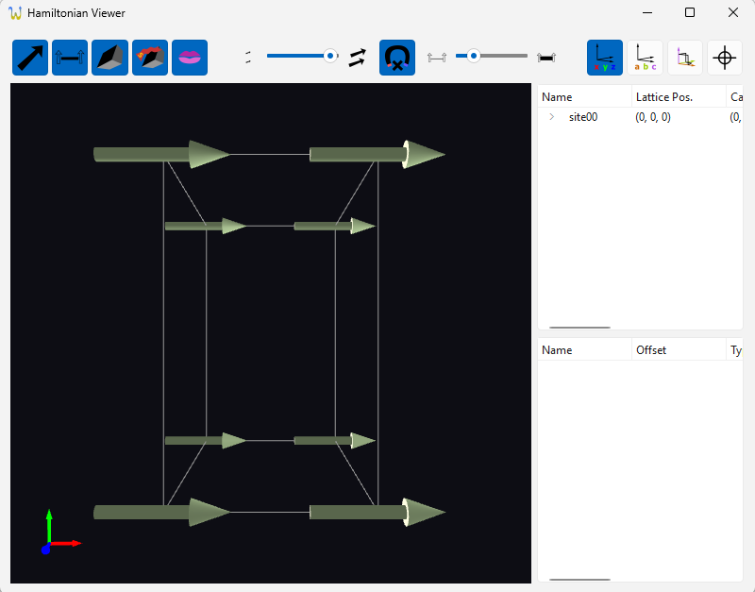
Magnetic Structure
SpinW – Getting Started
To start, you have to define a lattice and the magnetic atom positions. You can either use the interface functions generate_structure or generate_helical_structure:
This generates a ferromagnetic chain in the a-direction.
We see that we have used one of the classes here UnitCell. The alternative to using the interface functions is to define using the classes directly:
from pyspinw import *
struc = generate_structure(UnitCell(3, 5, 5),
positions=[[0,0,0]],
spins=[[1,0,0]])
view(struc)
uc = UnitCell(3, 5, 5)
site = LatticeSite(0, 0, 0, 1, 0, 0)
struc = Structure([site], unit_cell=uc)
view(struc)

Slide 20

Exchanges
After defining the structure, we need to define the magnetic exchange interactions (and optionally the single-ion anisotropy).
For multiple exchanges we recommend using generate_exchanges:
For more control, the classes can be called directly but in this case only a single bond is created:
heisenberg = generate_exchanges(struc, bond=1, j=1)
dm = generate_exchanges(struc, bond=1,
exchange_type=DMExchange,
d_x=1, d_y=2, d_z=3)
ising = generate_exchanges(struc, bond=2,
exchange_type=IsingExchange,
j_z=-1)
exchanges = dm + ising
exchanges = [HeisenbergExchange(s1, s2, cell_offset=(0,0,0)),
HeisenbergExchange(s1, s2, cell_offset=(0,0,1))]

Slide 21
Exchange Classes
HeisenbergExchange – Diagonal, single j
DMExchange - Dzyaloshinskii–Moriya
IsingExchange – Just the z component
XYExchange – Diagonal, x and y the same, z zero
XXZExchange - Diagonal, x and y the same, z different
DiagonalExchange – Diagonal, Different x, y and z
Exchange – General matrix

Slide 22
Filters
generate_exchanges can take filter objects that narrow down the search
InPlaneFilter
InDirectionFilter
BiDirectionFilter
There is also the helper function filter

Slide 23
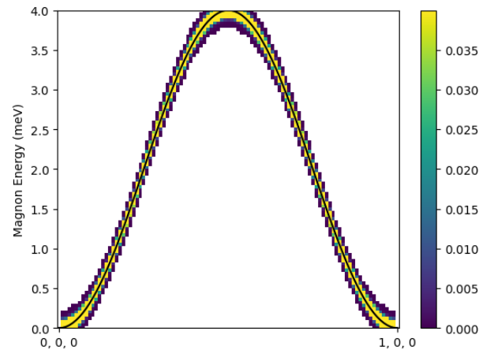
Hamiltonian
After defining the magnetic structure and exchange interactions we can create a Hamiltonian model and calculate a spin wave dispersion:
hamiltonian = Hamiltonian(struc, [heisenberg])
hamiltonian.spaghetti_plot(Path([0,0,0],[1,0,0]]))

Slide 24
Anisotropies
SpinW – Getting Started
Single-ion anisotropy terms can be specified by creating Anisotropy objects, either individually
AxisMagnitudeAnisotopy(site, axis, a)
Anisotopy(site, anisotropy_matrix)
Or batch created...
axis_anisotropies(sites, axis, a)
matrix_anisotropies(sites, axis, a)
Then added to the Hamiltonian
Hamiltonian(structure, exchanges, anisotropies)

Slide 25
Viewer
Also, don't forget print_summary()

Slide 26
Questions so far?

Slide 27
Exercises: 01_chains.py
www.github.com/spinw/munich26​

Slide 28
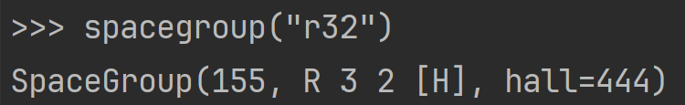
Space Groups
The helper function spacegroup(…) takes a string, and tries to give you a corresponding spacegroup.
It's not too picky...
and will try to help

Slide 29
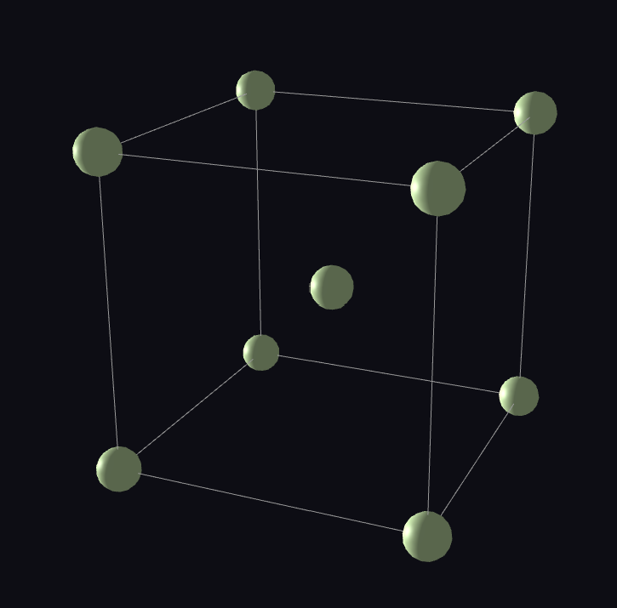
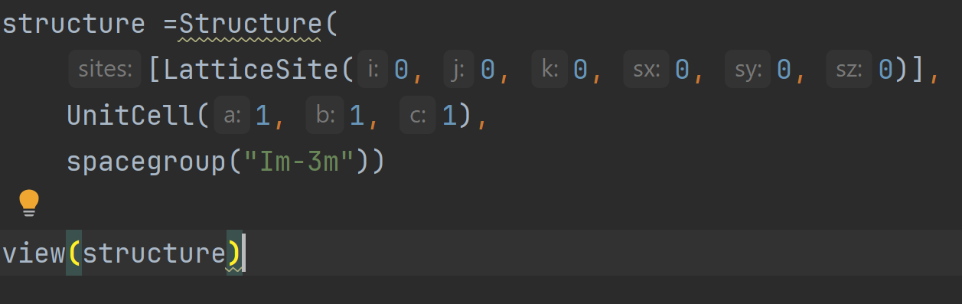
Spacegroup Example

Slide 30
Supercells
TiledSupercell
TransformationSupercell
SummationSupercell
RotatingSupercell

Slide 31
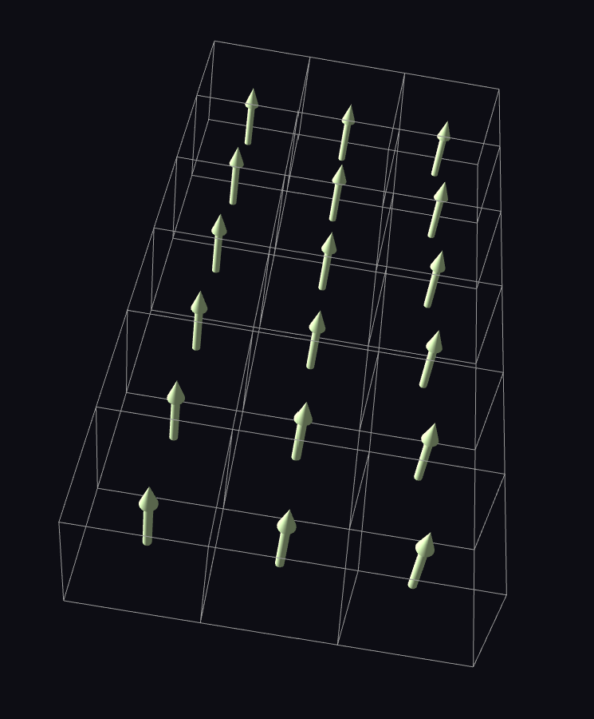
TiledSupercell
Many copies... useful for sanity checks but not much else
from pyspinw import * structure = Structure( [LatticeSite(0.5, 0.5, 0.5, 0, 0, 1)], UnitCell(1, 1, 1), spacegroup("p1"), supercell=TiledSupercell(scaling=(3,6,1))) view(structure)

Slide 32
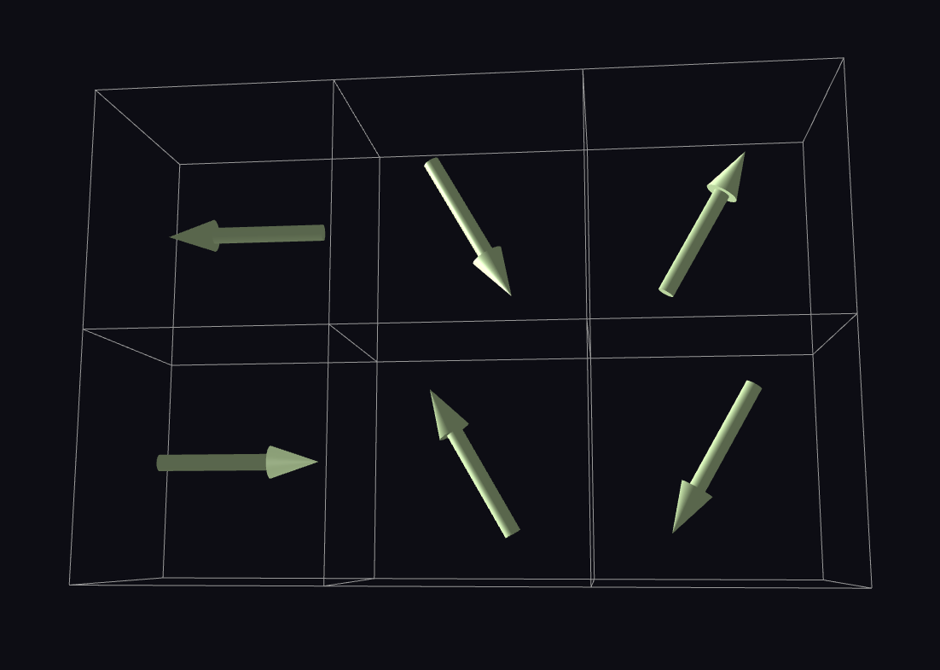
TransformationSupercell
Applies a linear transformation along a propagation vector
Use for easy rotations
Other uses are "advanced"
supercell = TransformationSupercell([ (CommensuratePropagationVector(1/3, 0, 0), RotationTransform([0, 0, 1])), (CommensuratePropagationVector(0, 1/2, 0), RotationTransform([0, 0, 1]))])

Slide 33
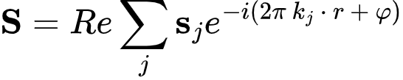
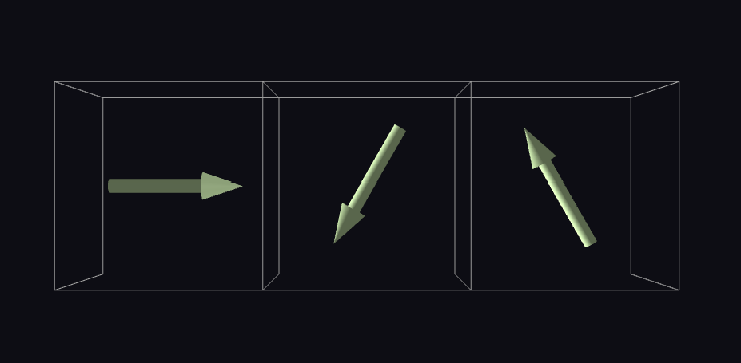
Summation Supercell
SpinW – Magnetic Structures
import numpy as np from pyspinw import * x = LatticeSite(0.5, 0.5, 0.5, supercell_spins=[[1,0,0], [0,1,0]]) supercell = SummationSupercell([ CommensuratePropagationVector(1/3, 0, 0), CommensuratePropagationVector(1/3, 0, 0, phase=np.pi/2)]) structure = Structure([x], UnitCell(1, 1, 1), supercell=supercell)
The spin in the unit cell at r from the origin can be expressed as:
Where s_{i} is contribution to each spin, specified in supercell_spins, k_{i} is the propagation vector and phi is phase.

Slide 34
RotationSupercell: The Incommensurate One
Single propagation vector restriction
Not restricted to rational entries
generate_helical_structure helper function
Requires a direction and perpendicular direction
Difference from MATLAB: never uses complex representations
WIP: Optimisation of period

Slide 35
Magnetic Structure Optimisation
Magnetic Structure Optimisation
Often the initial magnetic structure you input doesn’t quite agree with the exchange parameters you put in – this will result in a “non-Hermitian Hamiltonian” error.
pySpinW can optimise the magnetic structure to minimise the classical magnetic ground state energy
Hamiltonian.ground_state( fixed, # list of lattice sites that do not change, planar, # list of sites that are constrained to planes planar_axis, # which planes? field, # Magnetic field for optimisation step_size, # 0.1 - tune for speed / convergence initial_randomisation # RANDOM / JITTER / NONE,
# Extra parameters seed: int | None = None, rtol: float=1e-10, atol: float=1e-12, max_iters: int=1000, verbose: bool=True)

Slide 36
Parameterisation
You can parameterise the exchanges and anisotropies of a Hamiltonian using the parameterized(…) method.
This will give you a Callable that gives you ground state optimised Hamiltonian if find_ground_state_with is not None.
swapping_chain_series.py

Slide 37
Questions so far?

Slide 38
Exercises: 02_supercells.py
www.github.com/spinw/munich26​

Slide 39
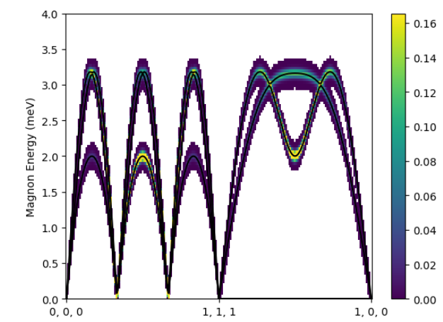
Rotating frame example
One defining feature of SpinW is its ability to use a rotating frame to speed up spin wave calculations of helical structure. We use it by defining a structure using the generate_helical_structure helper function:
struc = generate_helical_structure(UnitCell(3,3,6,gamma=120),
positions=[[0,0,0]], spins=[[1,0,0]],
propagation_vector=[1/3, 1/3, 0],
perpendicular=[0,0,1])
exchanges = generate_exchanges(struc, bond=1, j=1)
ham = Hamiltonian(struc, exchanges)
ham.spaghetti_plot(Path([[0,0,0],[1,1,1],[1,0,1]]))

Slide 40
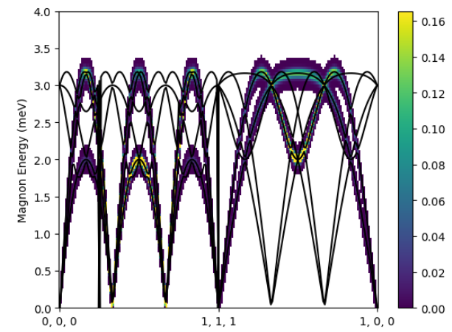
Rotating frame example
One defining feature of SpinW is its ability to use a rotating frame to speed up spin wave calculations of helical structure. We use it by defining a structure using the generate_helical_structure helper function:
Now try with a supercell instead
struc = generate_helical_structure(UnitCell(3,3,6,gamma=120),
positions=[[0,0,0]], spins=[[1,0,0]],
propagation_vector=[1/3, 1/3, 0],
perpendicular=[0,0,1])
exchanges = generate_exchanges(struc, bond=1, j=1)
ham = Hamiltonian(struc, exchanges)
ham.spaghetti_plot(Path([[0,0,0],[1,1,1],[1,0,1]]),
use_rotating=False)

Slide 41
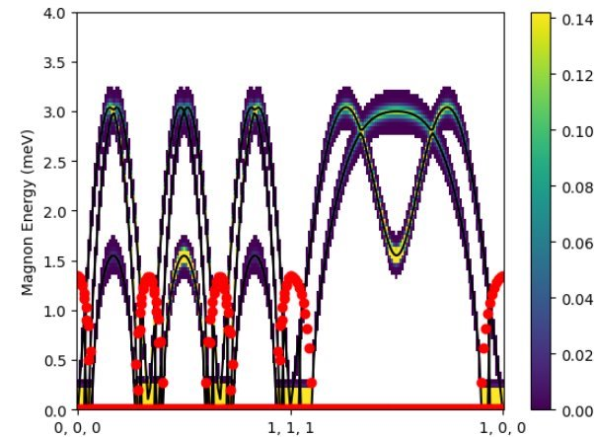
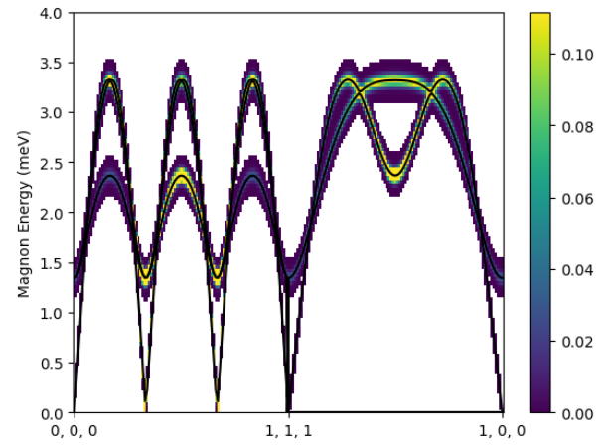
Rotating frame with anisotropy
We now introduce some anisotropy into the Hamiltonian.
First, a planar anisotropy:
struc = generate_helical_structure(UnitCell(3,3,6,gamma=120),
positions=[[0,0,0]], spins=[[1,0,0]],
propagation_vector=[1/3, 1/3, 0],
perpendicular=[0,0,1])
exchanges = generate_exchanges(struc, bond=1, j=1)
sia = axis_anisotopies(struc, 0.2)
ham = Hamiltonian(struc, exchanges, sia)
ham.spaghetti_plot(Path([[0,0,0],[1,1,1],[1,0,1]]))

Slide 42
Rotating frame with anisotropy
We now introduce some anisotropy into the Hamiltonian.
Second, we change it to an axial anisotropy
Now we have red dots on the plots – these indicate imaginary magnon energies because the magnetic structure no longer agrees with the Hamiltonian.
struc = generate_helical_structure(UnitCell(3,3,6,gamma=120),
positions=[[0,0,0]], spins=[[1,0,0]],
propagation_vector=[1/3, 1/3, 0],
perpendicular=[0,0,1])
exchanges = generate_exchanges(struc, bond=1, j=1)
sia = axis_anisotopies(struc, -0.2)
ham = Hamiltonian(struc, exchanges, sia)
ham.spaghetti_plot(Path([[0,0,0],[1,1,1],[1,0,1]]))

Slide 43
Questions so far?

Slide 44
Exercises: 03_rotating_frame.py
www.github.com/spinw/munich26​

Slide 45
Summary
Summary
Linear spin wave theory
Strictly only valid for large S
Requires an ordered magnetic state
SpinW
Uses a rotating frame description which can calculate certain single-k magnetic structure dispersion efficiently
Need to define the Hamiltonian and magnetic structure before can calculate dispersion
Can optimise the input magnetic structure to better agree with the Hamiltonian.
Lots of examples / tutorials on spinw.org

Slide 46
Short break!

Slide 47
Spin-spin correlation function
By default SpinW just outputs the unpolarised neutron intensities (called Sperp) but the calculation itself has to first compute a 3x3 matrix S^{αβ} for each magnon energy at each Q-point.
With polarised neutrons we can measure some components of this spin-spin correlation tensor, and this can be computed in SpinW, using the components keyword.
ham.spaghetti_plot(Path([[0,0,0],[1,1,1],[1,0,1]]),
components='Sperp')
ham.spaghetti_plot(Path([[0,0,0],[1,1,1],[1,0,1]]),
components='Pxy+Pzx')

Slide 48
Blume-Maleev coordinates
The spin-spin correlation tensor S^{αβ} is defined in the crystal-Cartesian coordinate system which SpinW uses: x||a, z⊥(a,b) and y⊥(x,z).
Polarised neutron components, however, uses the Blume-Maleev coordinate system, where x||Q, y⊥x in the horizontal plane, z is vertical
There are three options:
'Pa' – a=x,y,z – half polarised intensity with incident beam polarised along direction a
'Pab' – a,b=x,y,z – xyz polarized intensity σ^{αβ} with incident and scattered beam polarized along the specified direction
'Mab' – a,b=x,y,z – projection of S^{αβ} along the specified direction.
In all cases you need to specify the horizontal plane or use the default a-b plane.
This is specified by a comma after the components and two reciprocal lattice vectors
ham.spaghetti_plot(path, components='Pz')
ham.spaghetti_plot(path, components='Pxy+Pzx')
ham.spaghetti_plot(path, components='Myz-Mzy')
ham.spaghetti_plot(path, components='Pzz,[1 1 0]-[0 0 1]')

Slide 49
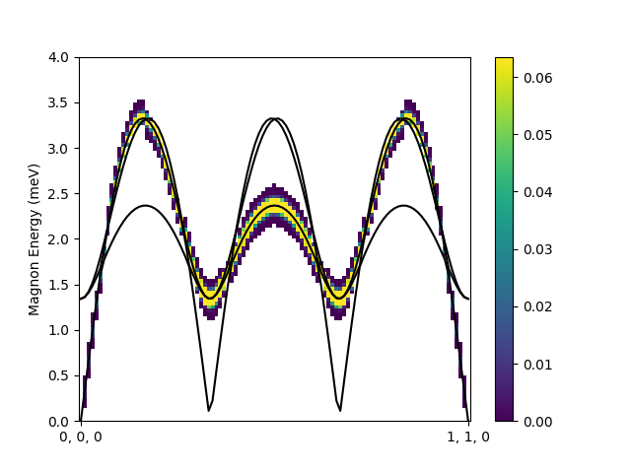
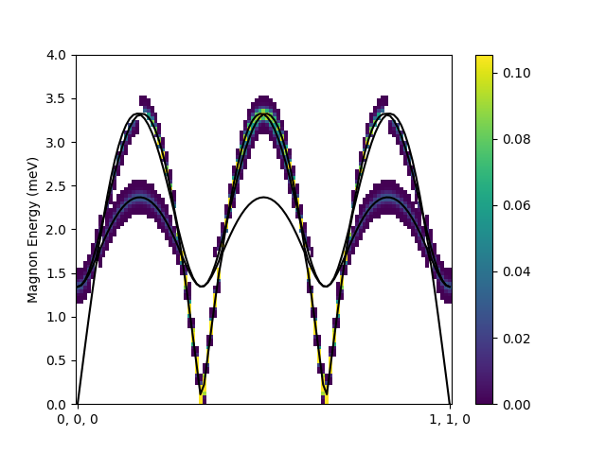
Polarised neutron example
Using the triangular lattice with planar anisotropy from before:
Pzz
Pyy

Slide 50
Questions so far?

Slide 51
Exercises: 04_polarised.py
www.github.com/spinw/munich26​

Slide 52
Sample Classes
SingleCrystal
Twin
Multidomain
Powder

Slide 53
Twin
Multidomain
Multiple components, each with a different and weight
n components, n weights, n transforms
Give a relative transform and a weight
2 components, 1 weight, 1 transform
Easier to specify than multidomain

Slide 54
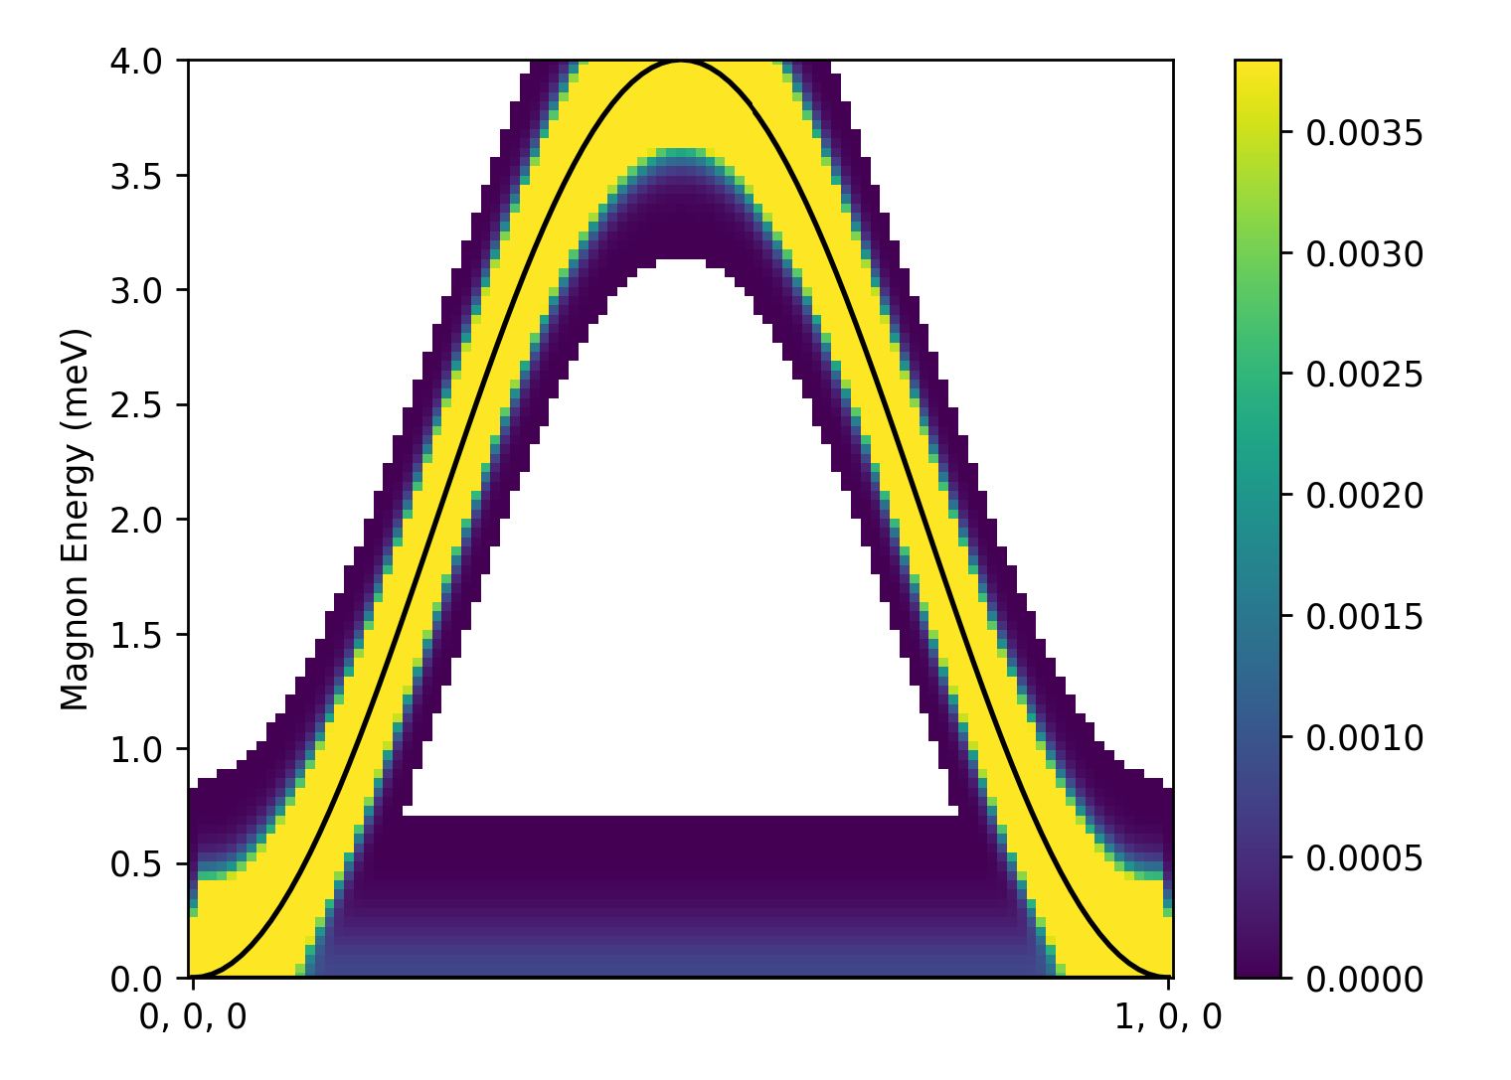
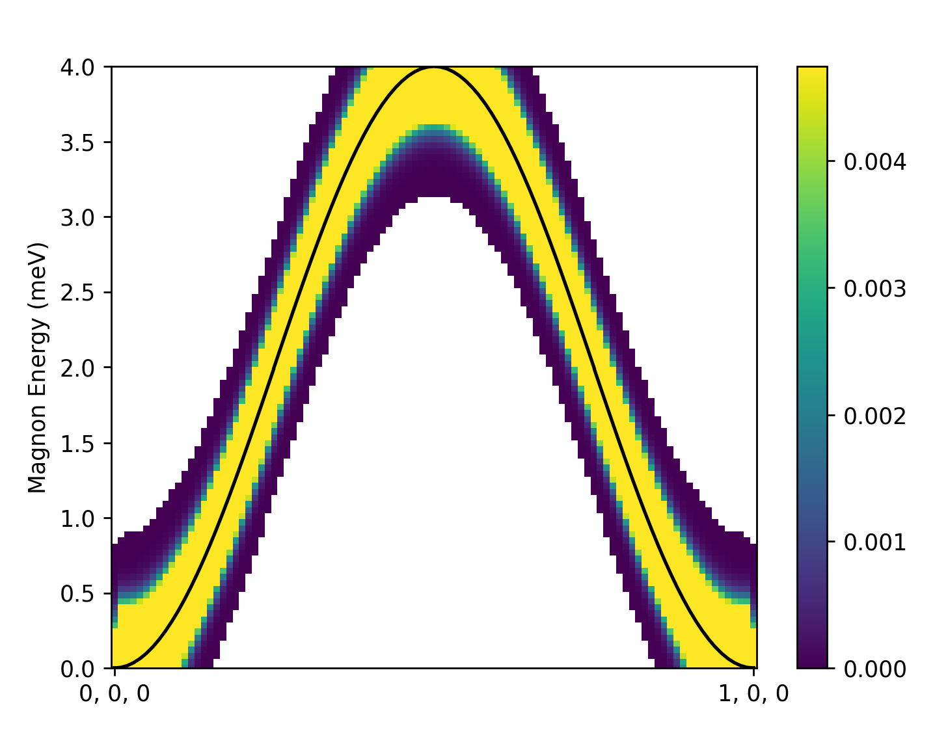
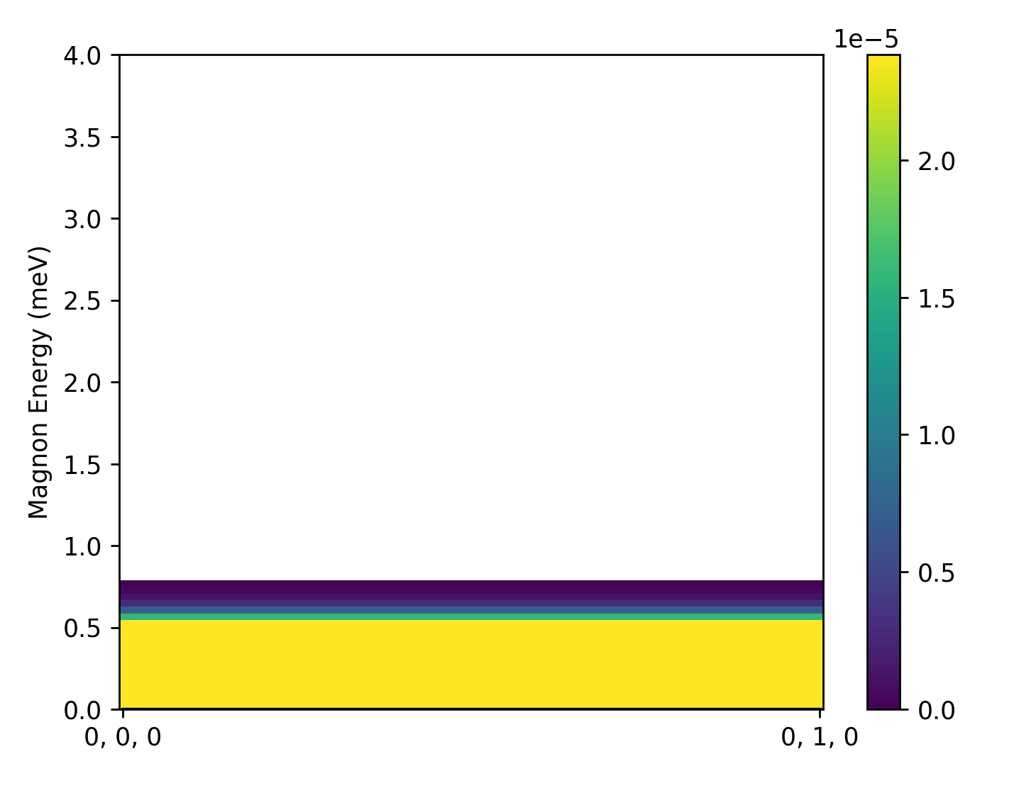
Twin Example
Twin
X direction
Y direction
twin = Twin(hamiltonian,
np.array([[0,1,0],[-1,0,0],[0,0,1]], dtype=float), 0.2)
twin_example.py

Slide 55
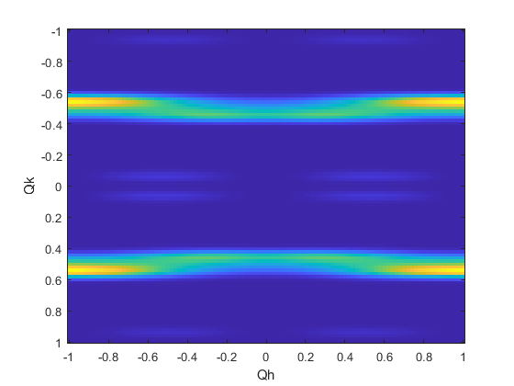
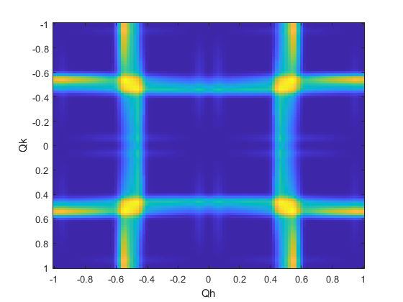
Twinned Crystal
Twinned Crystals
Example for a cut integrating over energy, with a model of Pr(Ca,Sr)Mn₂O₇
Without twin calculation
Twin calculation

Slide 56
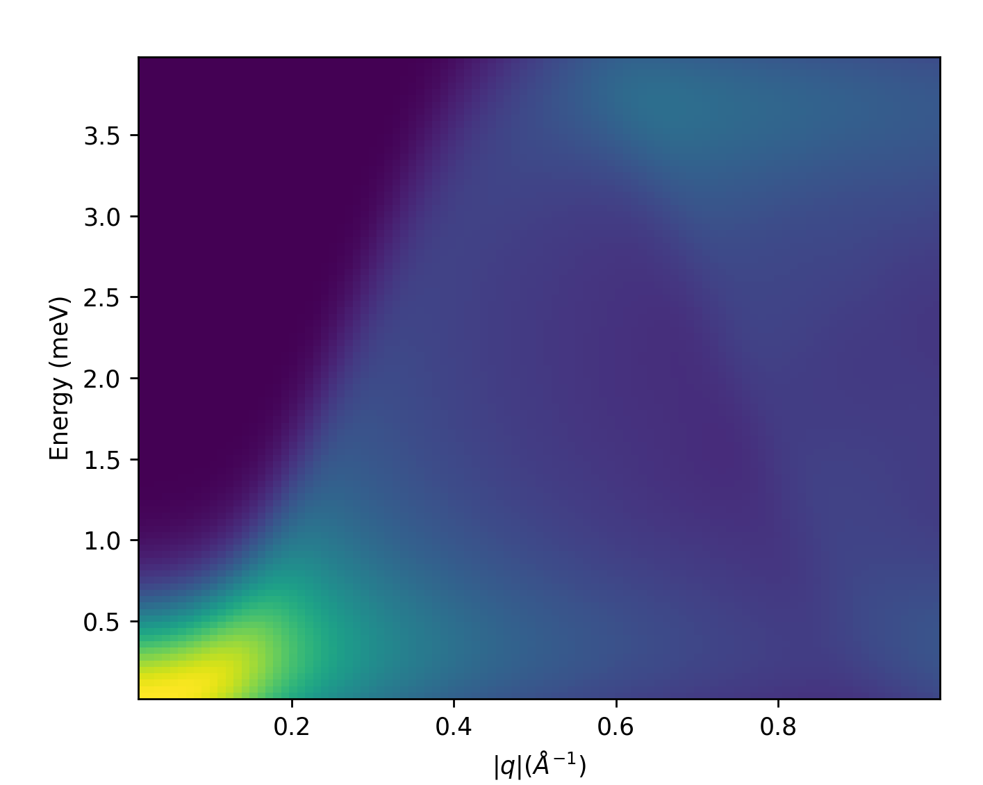
Powder average
Powder average
sample = Powder(hamiltonian) path1D = Path1D(0.01, 1) sample.show_spectrum(path1D,
n_energy_bins=100,
n_samples=500,
energy_stddev=0.4)
powder_spectrum.py

Slide 57
Powder Fitting
powder_fitting.py
Parameterise the Power class spectrum...
spectrum = sample.parameterized_spectrum( parameters=["J.j"], path=path1D, n_energy_bins=n_energy, n_samples=n_samples, energy_stddev=0.4, find_ground_state_with={"fixed": [x], "verbose": False})
Create an objective function from it...
def objective(x): return (target - spectrum(x)).reshape(-1)
Minimise...
bounds = Bounds([0.5], [1.5])
solution = least_squares(objective, x0=1.0, bounds=bounds, callback=callback, diff_step=1e-2)

Slide 58
Questions so far?

Slide 59
Exercises: 05_samples.py
www.github.com/spinw/munich26​

Slide 60
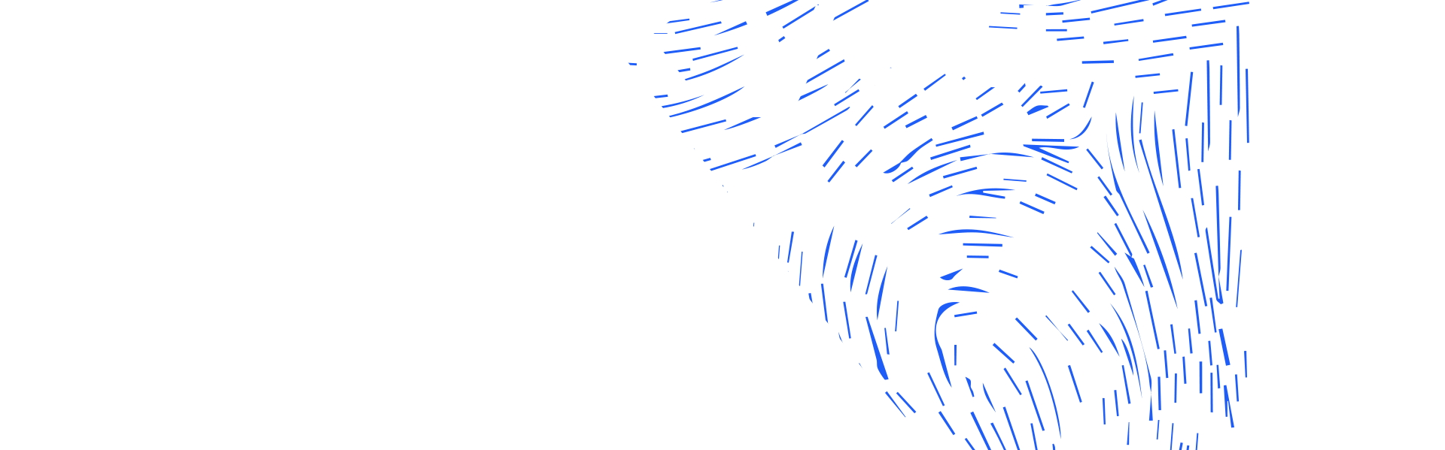



isis.stfc.ac.uk
@ISISNeutronMuon
STFC
Notes:
The abstract pattern can be removed or repositioned if required. Be careful to ‘Send to Back’ so that it does not obscure any important information.

