Slide 1
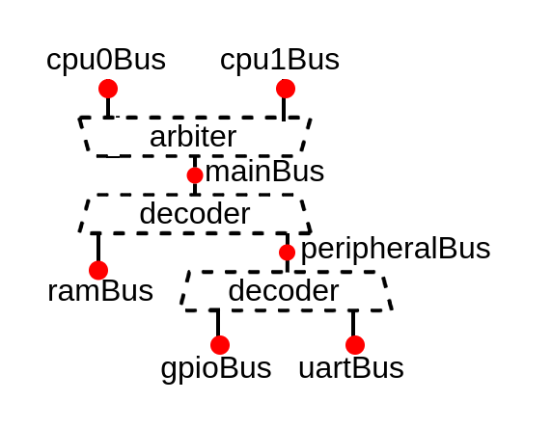
A progressive introduction to memory bus interconnect API in Software-Defined Hardware
Charles Papon

Slide 2
Wire sea
wire [19:0] apb_PADDR;
wire [0:0] apb_PSEL;
wire apb_PENABLE;
wire apb_PREADY;
wire apb_PWRITE;
wire [31:0] apb_PWDATA;
wire [31:0] apb_PRDATA;

Slide 3
Wire sea
wire axi_awvalid;
wire axi_awready;
wire [19:0] axi_awaddr;
wire [3:0] axi_awid;
wire [7:0] axi_awlen;
wire [2:0] axi_awsize;
wire axi_wvalid;
wire axi_wready;
wire [31:0] axi_wdata;
wire [3:0] axi_wstrb;
wire axi_wlast;
wire axi_bvalid;
wire axi_bready;
wire [3:0] axi_bid;
wire [1:0] axi_bresp;
wire axi_arvalid;
wire axi_arready;
wire [19:0] axi_araddr;
wire [3:0] axi_arid;
wire [7:0] axi_arlen;
wire [2:0] axi_arsize;
wire axi_rvalid;
wire axi_rready;
wire [31:0] axi_rdata;
wire [3:0] axi_rid;
wire [1:0] axi_rresp;
wire axi_rlast;
wire [19:0] apb_PADDR;
wire [0:0] apb_PSEL;
wire apb_PENABLE;
wire apb_PREADY;
wire apb_PWRITE;
wire [31:0] apb_PWDATA;
wire [31:0] apb_PRDATA;

Slide 4
Bus definition
case class Apb3(addressWidth: Int,
dataWidth : Int) extends Bundle with IMasterSlave {
val PADDR = UInt(addressWidth bits)
val PSEL = Bool()
val PENABLE = Bool()
val PREADY = Bool()
val PWRITE = Bool()
val PWDATA = Bits(dataWidth bits)
val PRDATA = Bits(dataWidth bits)
override def asMaster(): Unit = {
out(PADDR, PSEL, PENABLE, PWRITE, PWDATA)
in(PREADY, PRDATA)
}
}
val myBus = Apb3(20, 32)
val myBus = Apb3(
addressWidth = 20,
dataWidth = 32
)

Slide 5
Bus definition
case class Apb3(addressWidth: Int,
dataWidth : Int) extends Bundle with IMasterSlave {
val PADDR = UInt(addressWidth bits)
val PSEL = Bool()
val PENABLE = Bool()
val PREADY = Bool()
val PWRITE = Bool()
val PWDATA = Bits(dataWidth bits)
val PRDATA = Bits(dataWidth bits)
override def asMaster(): Unit = {
out(PADDR, PSEL, PENABLE, PWRITE, PWDATA)
in(PREADY, PRDATA)
}
}
val myBus = Apb3(20, 32)
val myBus = Apb3(
addressWidth = 20,
dataWidth = 32
)

Slide 6
Bus definition
case class Apb3(addressWidth: Int,
dataWidth : Int) extends Bundle with IMasterSlave {
val PADDR = UInt(addressWidth bits)
val PSEL = Bool()
val PENABLE = Bool()
val PREADY = Bool()
val PWRITE = Bool()
val PWDATA = Bits(dataWidth bits)
val PRDATA = Bits(dataWidth bits)
override def asMaster(): Unit = {
out(PADDR, PSEL, PENABLE, PWRITE, PWDATA)
in(PREADY, PRDATA)
}
}
val myBus = Apb3(20, 32)
val myBus = Apb3(
addressWidth = 20,
dataWidth = 32
)

Slide 7
Bus definition
case class Apb3(addressWidth: Int,
dataWidth : Int) extends Bundle with IMasterSlave {
val PADDR = UInt(addressWidth bits)
val PSEL = Bool()
val PENABLE = Bool()
val PREADY = Bool()
val PWRITE = Bool()
val PWDATA = Bits(dataWidth bits)
val PRDATA = Bits(dataWidth bits)
override def asMaster(): Unit = {
out(PADDR, PSEL, PENABLE, PWRITE, PWDATA)
in(PREADY, PRDATA)
}
}
val myBus = Apb3(20, 32)
val myBus = Apb3(
addressWidth = 20,
dataWidth = 32
)

Slide 8
Bus definition
case class Apb3(addressWidth: Int,
dataWidth : Int) extends Bundle with IMasterSlave {
val PADDR = UInt(addressWidth bits)
val PSEL = Bool()
val PENABLE = Bool()
val PREADY = Bool()
val PWRITE = Bool()
val PWDATA = Bits(dataWidth bits)
val PRDATA = Bits(dataWidth bits)
override def asMaster(): Unit = {
out(PADDR, PSEL, PENABLE, PWRITE, PWDATA)
in(PREADY, PRDATA)
}
}
val myBus = Apb3(20, 32)
val myBus = Apb3(
addressWidth = 20,
dataWidth = 32
)

Slide 9
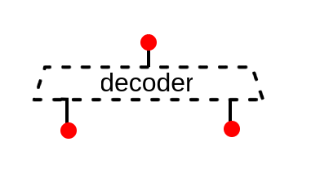
Software API
val commonBus = Apb3(20,32)
val uartBus = Apb3(12, 32)
val gpioBus = Apb3(12, 32)

Slide 10
Software API
val commonBus = Apb3(20,32)
val apbDecoder = Apb3Decoder(
master = commonBus,
slaves = List(
gpioBus -> (0x2000, 4 kB),
uartBus -> (0x5000, 4 kB)
)
)
val uartBus = Apb3(12, 32)
val gpioBus = Apb3(12, 32)

Slide 11
Software API
val commonBus = Apb3(20,32)
val apbDecoder = Apb3Decoder(
master = commonBus,
slaves = List(
gpioBus -> (0x2000, 4 kB),
uartBus -> (0x5000, 4 kB)
)
)
val uartBus = Apb3(12, 32)
val gpioBus = Apb3(12, 32)

Slide 12
Software API
val commonBus = Apb3(20,32)
val apbDecoder = Apb3Decoder(
master = commonBus,
slaves = List(
gpioBus -> (0x2000, 4 kB),
uartBus -> (0x5000, 4 kB)
)
)
val uartBus = Apb3(12, 32)
val gpioBus = Apb3(12, 32)

Slide 13
Automation
val cpu0Bus, cpu1Bus = Axi4(32, 32, 2)
val mainBus = Axi4(32, 32, 4)
val ramBus = Axi4(16, 32, 6)
val peripheralBus = Axi4(20, 32, 6)
val gpioBus, uartBus = Axi4(12, 32, 8)
val axiCrossbar = Axi4CrossbarFactory()
axiCrossbar.addSlaves(
mainBus -> (0x00000000, 4 GB),
ramBus -> (0x80000000, 64 kB),
peripheralBus -> (0x10000000, 1 MB),
gpioBus -> ( 0x2000, 4 kB),
uartBus -> ( 0x5000, 4 kB)
)
axiCrossbar.addConnections(
cpu0Bus -> List(mainBus),
cpu1Bus -> List(mainBus),
mainBus -> List(ramBus, peripheralBus),
peripheralBus -> List(gpioBus, uartBus)
)
axiCrossbar.build()

Slide 14
Automation
val cpu0Bus, cpu1Bus = Axi4(32, 32, 2)
val mainBus = Axi4(32, 32, 4)
val ramBus = Axi4(16, 32, 6)
val peripheralBus = Axi4(20, 32, 6)
val gpioBus, uartBus = Axi4(12, 32, 8)
val axiCrossbar = Axi4CrossbarFactory()
axiCrossbar.addSlaves(
mainBus -> (0x00000000, 4 GB),
ramBus -> (0x80000000, 64 kB),
peripheralBus -> (0x10000000, 1 MB),
gpioBus -> ( 0x2000, 4 kB),
uartBus -> ( 0x5000, 4 kB)
)
axiCrossbar.addConnections(
cpu0Bus -> List(mainBus),
cpu1Bus -> List(mainBus),
mainBus -> List(ramBus, peripheralBus),
peripheralBus -> List(gpioBus, uartBus)
)
axiCrossbar.build()

Slide 15
Automation
val cpu0Bus, cpu1Bus = Axi4(32, 32, 2)
val mainBus = Axi4(32, 32, 4)
val ramBus = Axi4(16, 32, 6)
val peripheralBus = Axi4(20, 32, 6)
val gpioBus, uartBus = Axi4(12, 32, 8)
val axiCrossbar = Axi4CrossbarFactory()
axiCrossbar.addSlaves(
mainBus -> (0x00000000, 4 GB),
ramBus -> (0x80000000, 64 kB),
peripheralBus -> (0x10000000, 1 MB),
gpioBus -> ( 0x2000, 4 kB),
uartBus -> ( 0x5000, 4 kB)
)
axiCrossbar.addConnections(
cpu0Bus -> List(mainBus),
cpu1Bus -> List(mainBus),
mainBus -> List(ramBus, peripheralBus),
peripheralBus -> List(gpioBus, uartBus)
)
axiCrossbar.build()

Slide 16
Automation
val cpu0Bus, cpu1Bus = Axi4(32, 32, 2)
val mainBus = Axi4(32, 32, 4)
val ramBus = Axi4(16, 32, 6)
val peripheralBus = Axi4(20, 32, 6)
val gpioBus, uartBus = Axi4(12, 32, 8)
val axiCrossbar = Axi4CrossbarFactory()
axiCrossbar.addSlaves(
mainBus -> (0x00000000, 4 GB),
ramBus -> (0x80000000, 64 kB),
peripheralBus -> (0x10000000, 1 MB),
gpioBus -> ( 0x2000, 4 kB),
uartBus -> ( 0x5000, 4 kB)
)
axiCrossbar.addConnections(
cpu0Bus -> List(mainBus),
cpu1Bus -> List(mainBus),
mainBus -> List(ramBus, peripheralBus),
peripheralBus -> List(gpioBus, uartBus)
)
axiCrossbar.build()

Slide 17
Automation
val cpu0Bus, cpu1Bus = Axi4(32, 32, 2)
val mainBus = Axi4(32, 32, 4)
val ramBus = Axi4(16, 32, 6)
val peripheralBus = Axi4(20, 32, 6)
val gpioBus, uartBus = Axi4(12, 32, 8)
val axiCrossbar = Axi4CrossbarFactory()
axiCrossbar.addSlaves(
mainBus -> (0x00000000, 4 GB),
ramBus -> (0x80000000, 64 kB),
peripheralBus -> (0x10000000, 1 MB),
gpioBus -> ( 0x2000, 4 kB),
uartBus -> ( 0x5000, 4 kB)
)
axiCrossbar.addConnections(
cpu0Bus -> List(mainBus),
cpu1Bus -> List(mainBus),
mainBus -> List(ramBus, peripheralBus),
peripheralBus -> List(gpioBus, uartBus)
)
axiCrossbar.build()

Slide 18
Automation
val cpu0Bus, cpu1Bus = Axi4(32, 32, 2)
val mainBus = Axi4(32, 32, 4)
val ramBus = Axi4(16, 32, 6)
val peripheralBus = Axi4(20, 32, 6)
val gpioBus, uartBus = Axi4(12, 32, 8)
val axiCrossbar = Axi4CrossbarFactory()
axiCrossbar.addSlaves(
mainBus -> (0x00000000, 4 GB),
ramBus -> (0x80000000, 64 kB),
peripheralBus -> (0x10000000, 1 MB),
gpioBus -> ( 0x2000, 4 kB),
uartBus -> ( 0x5000, 4 kB)
)
axiCrossbar.addConnections(
cpu0Bus -> List(mainBus),
cpu1Bus -> List(mainBus),
mainBus -> List(ramBus, peripheralBus),
peripheralBus -> List(gpioBus, uartBus)
)
axiCrossbar.build()

Slide 19
Issues
Centralized monolith
No parameter negotiation / propagation
  Data width
  Address width
  Type of accesses (read / write / atomic / ...)
  ID width
  ID to master mapping (Tilelink)
Lack of awareness
  Memory mapping from a given master perspective
  Physical memory attributes

Slide 20
Issues
Centralized monolith
No parameter negotiation / propagation
  Data width
  Address width
  Type of accesses (read / write / atomic / ...)
  ID width
  ID to master mapping (Tilelink)
Lack of awareness
  Memory mapping from a given master perspective
  Physical memory attributes

Slide 21
Issues
Centralized monolith
No parameter negotiation / propagation
  Data width
  Address width
  Type of accesses (read / write / atomic / ...)
  ID width
  ID to master mapping (Tilelink)
Lack of awareness
  Memory mapping from a given master perspective
  Physical memory attributes

Slide 22
Issues
Centralized monolith
No parameter negotiation / propagation
  Data width
  Address width
  Type of accesses (read / write / atomic / ...)
  ID width
  ID to master mapping (Tilelink)
Lack of awareness
  Memory mapping from a given master perspective
  Physical memory attributes

Slide 23
Decentralization
val cpu0Bus, cpu1Bus = tilelink.Node()
val mainBus = tilelink.Node()
val ramBus = tilelink.Node()
val peripheralBus = tilelink.Node()
val gpioBus, uartBus = tilelink.Node()
mainBus at 0x00000000 of(cpu0Bus, cpu1Bus)
ramBus at 0x80000000 of mainBus
peripheralBus at 0x10000000 of ramBus
gpioBus at 0x2000 of peripheralBus
uartBus at 0x5000 of peripheralBus

Slide 24
Decentralization
val cpu0Bus, cpu1Bus = tilelink.Node()
val mainBus = tilelink.Node()
val ramBus = tilelink.Node()
val peripheralBus = tilelink.Node()
val gpioBus, uartBus = tilelink.Node()
mainBus at 0x00000000 of(cpu0Bus, cpu1Bus)
ramBus at 0x80000000 of mainBus
peripheralBus at 0x10000000 of ramBus
gpioBus at 0x2000 of peripheralBus
uartBus at 0x5000 of peripheralBus

Slide 25
Decentralization
val cpu0Bus, cpu1Bus = tilelink.Node()
val mainBus = tilelink.Node()
val ramBus = tilelink.Node()
val peripheralBus = tilelink.Node()
val gpioBus, uartBus = tilelink.Node()
mainBus at 0x00000000 of(cpu0Bus, cpu1Bus)
ramBus at 0x80000000 of mainBus
peripheralBus at 0x10000000 of ramBus
gpioBus at 0x2000 of peripheralBus
uartBus at 0x5000 of peripheralBus

Slide 26
Decentralization
class Node extends Area{
// Node data model
val bus = Handle[tilelink.Bus]()
val ups = ArrayBuffer[Connection]()
val downs = ArrayBuffer[Connection]()
//Fork an elaboration thread
val thread = Fiber build new Area{
// Generate the required arbiter / decoder logic.
}
}

Slide 27
Decentralization
class Node extends Area{
// Node data model
val bus = Handle[tilelink.Bus]()
val ups = ArrayBuffer[Connection]()
val downs = ArrayBuffer[Connection]()
//Fork an elaboration thread
val thread = Fiber build new Area{
// Generate the required arbiter / decoder logic.
}
}

Slide 28
Decentralization
class Node extends Area{
// Node data model
val bus = Handle[tilelink.Bus]()
val ups = ArrayBuffer[Connection]()
val downs = ArrayBuffer[Connection]()
//Fork an elaboration thread
val thread = Fiber build new Area{
// Generate the required arbiter / decoder logic.
}
}

Slide 29
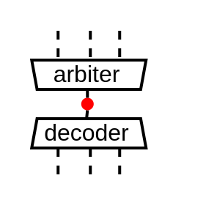
Decentralization
class Node extends Area{
// Node data model
val bus = Handle[tilelink.Bus]()
val ups = ArrayBuffer[Connection]()
val downs = ArrayBuffer[Connection]()
//Fork an elaboration thread
val thread = Fiber build new Area{
// Generate the required arbiter / decoder logic.
}
}

Slide 30
Decentralization
class Connection(val m : Node, val s : Node){
val thread = Fiber build new Area{
// Connect the m.decoder to the s.arbiter
}
}
class Node extends Area{
// Node data model
val bus = Handle[tilelink.Bus]()
val ups = ArrayBuffer[Connection]()
val downs = ArrayBuffer[Connection]()
//Fork an elaboration thread
val thread = Fiber build new Area{
// Generate the required arbiter / decoder logic.
}
}

Slide 31
Decentralization
class Connection(val m : Node, val s : Node){
val thread = Fiber build new Area{
// Connect the m.decoder to the s.arbiter
}
}
class Node extends Area{
// Node data model
val bus = Handle[tilelink.Bus]()
val ups = ArrayBuffer[Connection]()
val downs = ArrayBuffer[Connection]()
//Fork an elaboration thread
val thread = Fiber build new Area{
// Generate the required arbiter / decoder logic.
}
}

Slide 32
Future, Promise, Async, Fibers...
val bus = Handle[tilelink.Bus]
val thread1 = Fiber build new Area{
//Will wait on bus.load (from thread 2)
bus.a.valid := False
bus.a.address := 42
}
val thread2 = Fiber build new Area{
//Will allow thread 1 to continue
bus load tilelink.Bus(config)
}

Slide 33
Future, Promise, Async, Fibers...
val bus = Handle[tilelink.Bus]
val thread1 = Fiber build new Area{
//Will wait on bus.load (from thread 2)
bus.a.valid := False
bus.a.address := 42
}
val thread2 = Fiber build new Area{
//Will allow thread 1 to continue
bus load tilelink.Bus(config)
}

Slide 34
Future, Promise, Async, Fibers...
val bus = Handle[tilelink.Bus]
val thread1 = Fiber build new Area{
//Will wait on bus.load (from thread 2)
bus.a.valid := False
bus.a.address := 42
}
val thread2 = Fiber build new Area{
//Will allow thread 1 to continue
bus load tilelink.Bus(config)
}

Slide 35
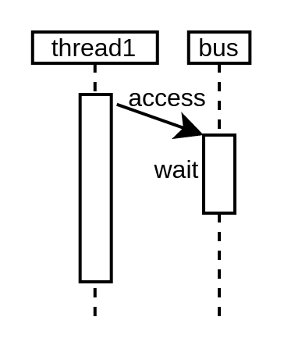
Future, Promise, Async, Fibers...
val bus = Handle[tilelink.Bus]
val thread1 = Fiber build new Area{
//Will wait on bus.load (from thread 2)
bus.a.valid := False
bus.a.address := 42
}
val thread2 = Fiber build new Area{
//Will allow thread 1 to continue
bus load tilelink.Bus(config)
}

Slide 36
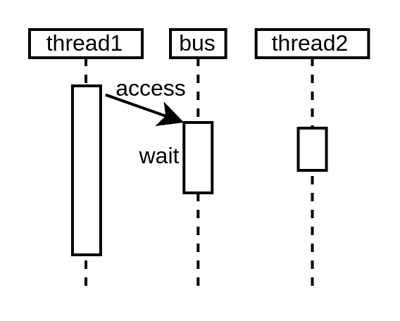
Future, Promise, Async, Fibers...
val bus = Handle[tilelink.Bus]
val thread1 = Fiber build new Area{
//Will wait on bus.load (from thread 2)
bus.a.valid := False
bus.a.address := 42
}
val thread2 = Fiber build new Area{
//Will allow thread 1 to continue
bus load tilelink.Bus(config)
}

Slide 37
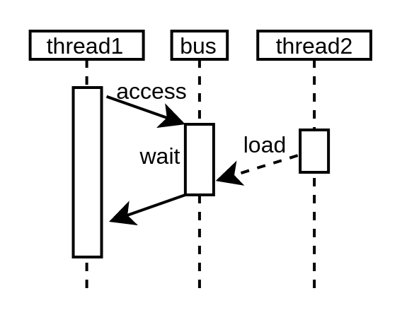
Future, Promise, Async, Fibers...
val bus = Handle[tilelink.Bus]
val thread1 = Fiber build new Area{
//Will wait on bus.load (from thread 2)
bus.a.valid := False
bus.a.address := 42
}
val thread2 = Fiber build new Area{
//Will allow thread 1 to continue
bus load tilelink.Bus(...)
}

Slide 38
Negotiation
class Node extends Area{
// Node data model
val proposed = Handle[M2sSupport]()
val supported = Handle[M2sSupport]()
val parameters = Handle[M2sParameters]()
//Fork an elaboration thread
val thread = Fiber build new Area{
// Do the Negotiation
// Generate the required arbiter / decoder logic.
}
}

Slide 39
Negotiation
class Node extends Area{
// Node data model
val proposed = Handle[M2sSupport]()
val supported = Handle[M2sSupport]()
val parameters = Handle[M2sParameters]()
//Fork an elaboration thread
val thread = Fiber build new Area{
// Do the Negotiation
// Generate the required arbiter / decoder logic.
}
}

Slide 40
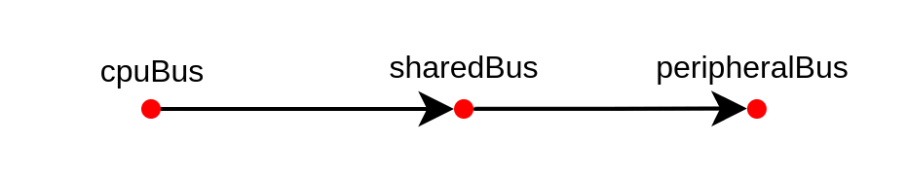
Negotiation
class Node extends Area{
// Node data model
val proposed = Handle[M2sSupport]()
val supported = Handle[M2sSupport]()
val parameters = Handle[M2sParameters]()
//Fork an elaboration thread
val thread = Fiber build new Area{
// Do the Negotiation
// Generate the required arbiter / decoder logic.
}
}

Slide 41
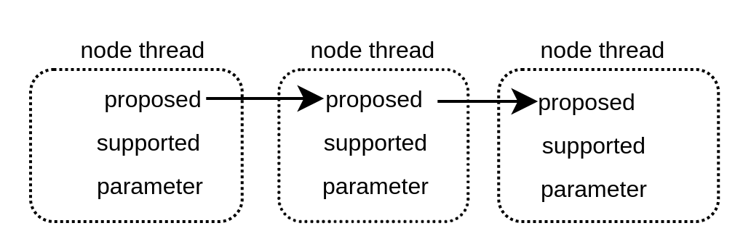
Negotiation
class Node extends Area{
// Node data model
val proposed = Handle[M2sSupport]()
val supported = Handle[M2sSupport]()
val parameters = Handle[M2sParameters]()
//Fork an elaboration thread
val thread = Fiber build new Area{
// Do the Negotiation
// Generate the required arbiter / decoder logic.
}
}

Slide 42
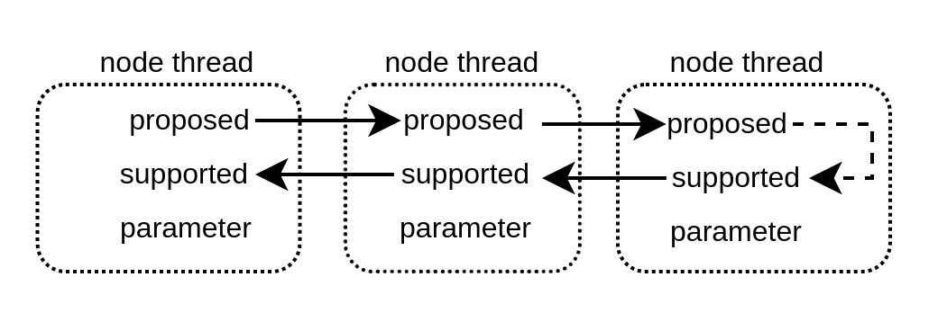
Negotiation
class Node extends Area{
// Node data model
val proposed = Handle[M2sSupport]()
val supported = Handle[M2sSupport]()
val parameters = Handle[M2sParameters]()
//Fork an elaboration thread
val thread = Fiber build new Area{
// Do the Negotiation
// Generate the required arbiter / decoder logic.
}
}

Slide 43
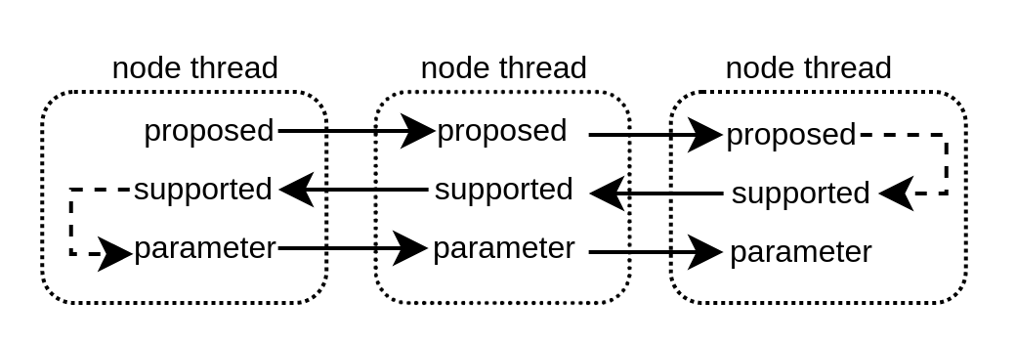
Negotiation
class Node extends Area{
// Node data model
val proposed = Handle[M2sSupport]()
val supported = Handle[M2sSupport]()
val parameters = Handle[M2sParameters]()
//Fork an elaboration thread
val thread = Fiber build new Area{
// Do the Negotiation
// Generate the required arbiter / decoder logic.
}
}

Slide 44
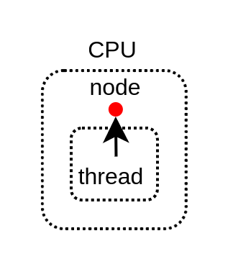
Master example
class Cpu() extends Area {
val node = Node.master()
val thread = Fiber build new Area {
// Negotiate things
node.proposed load M2sSupport(
addressWidth = 32,
dataWidth = 64,
transfers = ...
)
node.parameters load M2sParameters(
support = node.supported,
sourceCount = 4
)
// Implement the actual CPU hardware
node.bus.a.valid := False
node.bus.a.address := 0x42
}
}

Slide 45
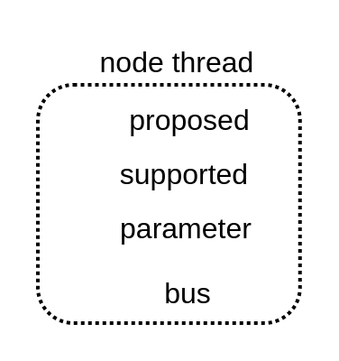
Master example
class Cpu() extends Area {
val node = Node.master()
val thread = Fiber build new Area {
// Negotiate things
node.proposed load M2sSupport(
addressWidth = 32,
dataWidth = 64,
transfers = ...
)
node.parameters load M2sParameters(
support = node.supported,
sourceCount = 4
)
// Implement the actual CPU hardware
node.bus.a.valid := False
node.bus.a.address := 0x42
}
}

Slide 46
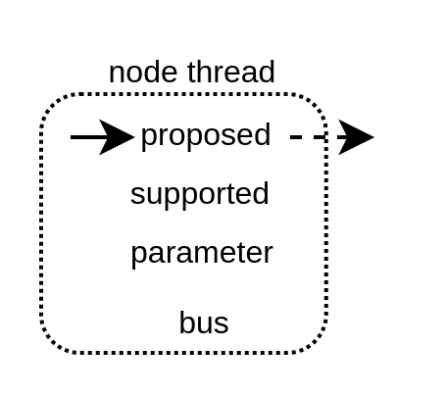
Master example
class Cpu() extends Area {
val node = Node.master()
val thread = Fiber build new Area {
// Negotiate things
node.proposed load M2sSupport(
addressWidth = 32,
dataWidth = 64,
transfers = ...
)
node.parameters load M2sParameters(
support = node.supported,
sourceCount = 4
)
// Implement the actual CPU hardware
node.bus.a.valid := False
node.bus.a.address := 0x42
}
}

Slide 47
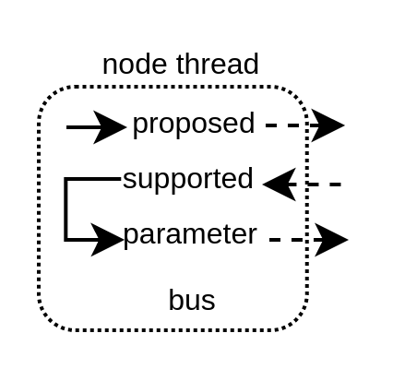
Master example
class Cpu() extends Area {
val node = Node.master()
val thread = Fiber build new Area {
// Negotiate things
node.proposed load M2sSupport(
addressWidth = 32,
dataWidth = 64,
transfers = ...
)
node.parameters load M2sParameters(
support = node.supported,
sourceCount = 4
)
// Implement the actual CPU hardware
node.bus.a.valid := False
node.bus.a.address := 0x42
}
}

Slide 48
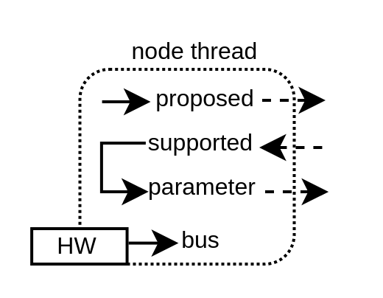
Master example
class Cpu() extends Area {
val node = Node.master()
val thread = Fiber build new Area {
// Negotiate things
node.proposed load M2sSupport(
addressWidth = 32,
dataWidth = 64,
transfers = ...
)
node.parameters load M2sParameters(
support = node.supported,
sourceCount = 4
)
// Implement the actual CPU hardware
node.bus.a.valid := False
node.bus.a.address := 0x42
}
}

Slide 49
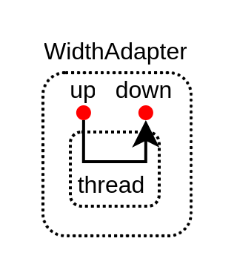
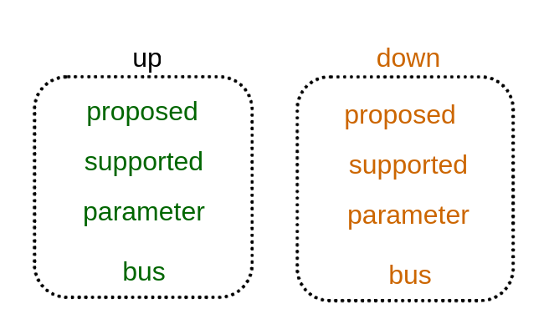
Adapter example
class WidthAdapter() extends Area{
val up = Node.slave()
val down = Node.master()
val thread = Fiber build new Area{
down.proposed load up.proposed
up.supported load down.supported.copy(
dataWidth = up.proposed.dataWidth
)
down.parameters load up.parameters.copy(
dataWidth = down.supported.dataWidth
)
val bridge = new WidthAdapterHw(up.bus.p, down.bus.p)
bridge.io.up << up.bus
bridge.io.down >> down.bus
}
}

Slide 50
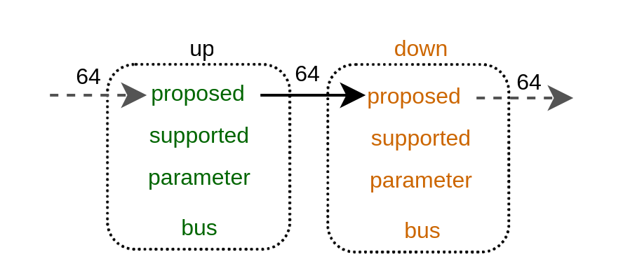
Adapter example
class WidthAdapter() extends Area{
val up = Node.slave()
val down = Node.master()
val thread = Fiber build new Area{
down.proposed load up.proposed
up.supported load down.supported.copy(
dataWidth = up.proposed.dataWidth
)
down.parameters load up.parameters.copy(
dataWidth = down.supported.dataWidth
)
val bridge = new WidthAdapterHw(up.bus.p, down.bus.p)
bridge.io.up << up.bus
bridge.io.down >> down.bus
}
}

Slide 51
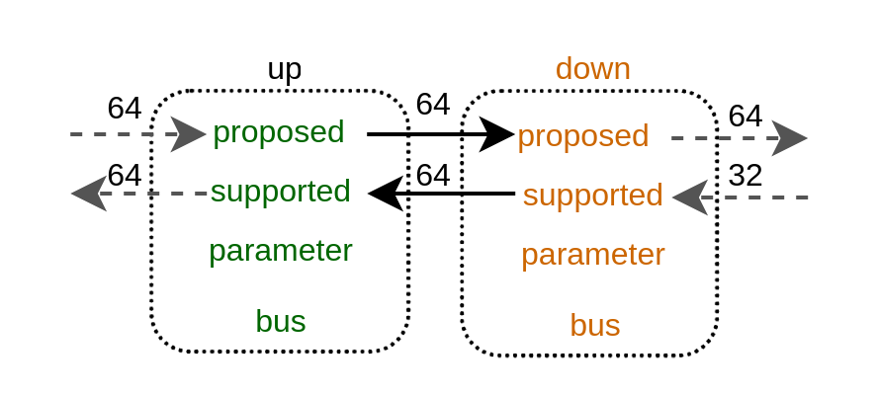
Adapter example
class WidthAdapter() extends Area{
val up = Node.slave()
val down = Node.master()
val thread = Fiber build new Area{
down.proposed load up.proposed
up.supported load down.supported.copy(
dataWidth = up.proposed.dataWidth
)
down.parameters load up.parameters.copy(
dataWidth = down.supported.dataWidth
)
val bridge = new WidthAdapterHw(up.bus.p, down.bus.p)
bridge.io.up << up.bus
bridge.io.down >> down.bus
}
}

Slide 52
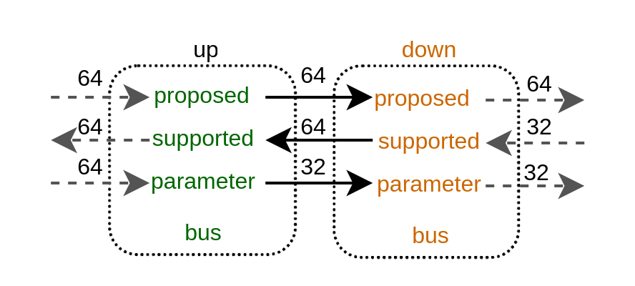
Adapter example
class WidthAdapter() extends Area{
val up = Node.slave()
val down = Node.master()
val thread = Fiber build new Area{
down.proposed load up.proposed
up.supported load down.supported.copy(
dataWidth = up.proposed.dataWidth
)
down.parameters load up.parameters.copy(
dataWidth = down.supported.dataWidth
)
val bridge = new WidthAdapterHw(up.bus.p, down.bus.p)
bridge.io.up << up.bus
bridge.io.down >> down.bus
}
}

Slide 53
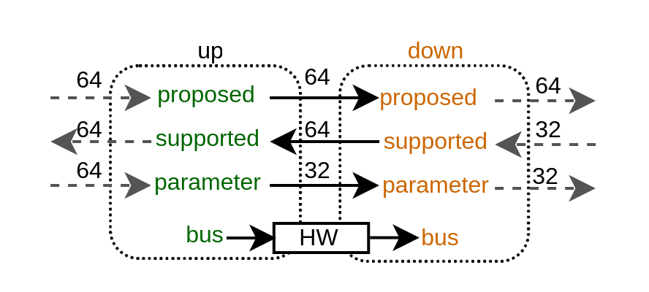
Adapter example
class WidthAdapter() extends Area{
val up = Node.slave()
val down = Node.master()
val thread = Fiber build new Area{
down.proposed load up.proposed
up.supported load down.supported.copy(
dataWidth = up.proposed.dataWidth
)
down.parameters load up.parameters.copy(
dataWidth = down.supported.dataWidth
)
val bridge = new WidthAdapterHw(up.bus.p, down.bus.p)
bridge.io.up << up.bus
bridge.io.down >> down.bus
}
}

Slide 54
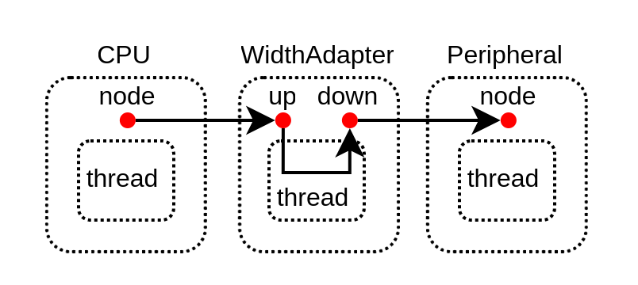
Deployment
val cpu = new Cpu()
val adapter = new WidthAdapter()
val peripheral = new Peripheral()
adapter.up at 0x00000000 of cpu.node
peripheral.node at 0x2000 of adapter.down

Slide 55
Deployment
val cpu = new Cpu()
val adapter = new WidthAdapter()
val peripheral = new Peripheral()
adapter.up at 0x00000000 of cpu.node
peripheral.node at 0x2000 of adapter.down

Slide 56
Introspection
val counter = Reg(UInt(8 bits))
counter := counter + 1
class CustomTag(val str : String) extends SpinalTag
counter.addTag(new CustomTag("hello"))
counter.addTag(new CustomTag("miaou"))
counter.foreachTag{
case ct : CustomTag => println(ct.str)
case _ =>
}

Slide 57
Introspection
val counter = Reg(UInt(8 bits))
counter := counter + 1
class CustomTag(val str : String) extends SpinalTag
counter.addTag(new CustomTag("hello"))
counter.addTag(new CustomTag("miaou"))
counter.foreachTag{
case ct : CustomTag => println(ct.str)
case _ =>
}

Slide 58
Introspection
val counter = Reg(UInt(8 bits))
counter := counter + 1
class CustomTag(val str : String) extends SpinalTag
counter.addTag(new CustomTag("hello"))
counter.addTag(new CustomTag("miaou"))
counter.foreachTag{
case ct : CustomTag => println(ct.str)
case _ =>
}

Slide 59
Introspection
val counter = Reg(UInt(8 bits))
counter := counter + 1
class CustomTag(val str : String) extends SpinalTag
counter.addTag(new CustomTag("hello"))
counter.addTag(new CustomTag("miaou"))
counter.foreachTag{
case ct : CustomTag => println(ct.str)
case _ =>
}
hello
miaou

Slide 60
Introspection
trait MemoryConnection extends SpinalTag {
def m : SpinalTagReady
def s : SpinalTagReady
def mapping : SizeMapping
}

Slide 61
Introspection
trait MemoryConnection extends SpinalTag {
def m : SpinalTagReady
def s : SpinalTagReady
def mapping : SizeMapping
override def toString = s"$m $s $mapping"
}

Slide 62
Introspection
trait MemoryConnection extends SpinalTag {
def m : SpinalTagReady
def s : SpinalTagReady
def mapping : SizeMapping
override def toString = s"$m $s $mapping"
}
val tag = new MemoryConnection{
def m = peripheralBus
def s = gpioBus
def mapping = SizeMapping(0x5000, 0x1000)
}
peripheralBus.addTag(tag)
gpioBus.addTag(tag)

Slide 63
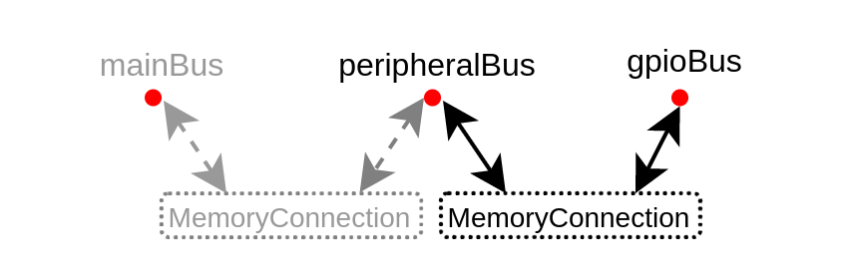
Introspection
trait MemoryConnection extends SpinalTag {
def m : SpinalTagReady
def s : SpinalTagReady
def mapping : SizeMapping
override def toString = s"$m $s $mapping"
}
val tag = new MemoryConnection{
def m = peripheralBus
def s = gpioBus
def mapping = SizeMapping(0x5000, 0x1000)
}
peripheralBus.addTag(tag)
gpioBus.addTag(tag)

Slide 64
Introspection
def visit(node : SpinalTagReady, level : Int){
node.foreachTag{
case mc : MemoryConnection if mc.m == node => {
println(" " * level + mc)
visit(mc.s, level + 1)
}
case _ =>
}
}
visit(cpu0Bus, 0)

Slide 65
Introspection
def visit(node : SpinalTagReady, level : Int){
node.foreachTag{
case mc : MemoryConnection if mc.m == node => {
println(" " * level + mc)
visit(mc.s, level + 1)
}
case _ =>
}
}
visit(cpu0Bus, 0)

Slide 66
Introspection
def visit(node : SpinalTagReady, level : Int){
node.foreachTag{
case mc : MemoryConnection if mc.m == node => {
println(" " * level + mc)
visit(mc.s, level + 1)
}
case _ =>
}
}
visit(cpu0Bus, 0)

Slide 67
Introspection
def visit(node : SpinalTagReady, level : Int){
node.foreachTag{
case mc : MemoryConnection if mc.m == node => {
println(" " * level + mc)
visit(mc.s, level + 1)
}
case _ =>
}
}
visit(cpu0Bus, 0)

Slide 68
Introspection
def visit(node : SpinalTagReady, level : Int){
node.foreachTag{
case mc : MemoryConnection if mc.m == node => {
println(" " * level + mc)
visit(mc.s, level + 1)
}
case _ =>
}
}
visit(cpu0Bus, 0)
cpu0Bus mainBus 0 100000000
mainBus ramBus 40000000 10000
mainBus peripheralBus 10000000 100000
peripheralBus gpioBus 2000 1000
peripheralBus uartBus 5000 1000

Slide 69
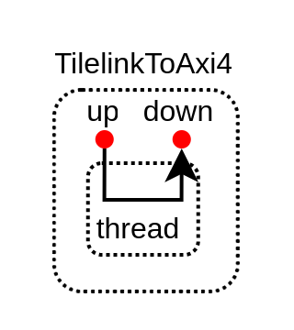
Interoperability
class TilelinkToAxi4() extends Area{
val up = tilelink.Node.slave()
val down = axi4.Node.master()
val tag = new MemoryConnection {
def m = up
def s = down
def mapping = ...
}
up.add(tag)
down.add(tag)
val thread = Fiber build new Area{
// Handle the negotiation from Tilelink to AXI
// ...
// Generate the hardware
// ...
}
}

Slide 70
Interoperability
class TilelinkToAxi4() extends Area{
val up = tilelink.Node.slave()
val down = axi4.Node.master()
val tag = new MemoryConnection {
def m = up
def s = down
def mapping = ...
}
up.add(tag)
down.add(tag)
val thread = Fiber build new Area{
// Handle the negotiation from Tilelink to AXI
// ...
// Generate the hardware
// ...
}
}

Slide 71
Interoperability
class TilelinkToAxi4() extends Area{
val up = tilelink.Node.slave()
val down = axi4.Node.master()
val tag = new MemoryConnection {
def m = up
def s = down
def mapping = ...
}
up.add(tag)
down.add(tag)
val thread = Fiber build new Area{
// Handle the negotiation from Tilelink to AXI
// ...
// Generate the hardware
// ...
}
}

Slide 72
Summarize
Paradigms (keeps things clean)
Elaboration thread
Decentralized negotiation / elaboration
Introspection
Interoperability

Slide 73
Question ?
Open Discussion about the tilelink interconnect API / framework :
  https://github.com/SpinalHDL/SpinalHDL/discussions/1115
Roadmap
  Tilelink interconnect with
    memory coherency
    L2 cache
  NaxRiscv with tilelink memory coherency
Looking for buddies :)

Slide 74
Miaou
Wuff

