Slide 1
Coroutines applied to a tilelink interconnect elaboration

Slide 2
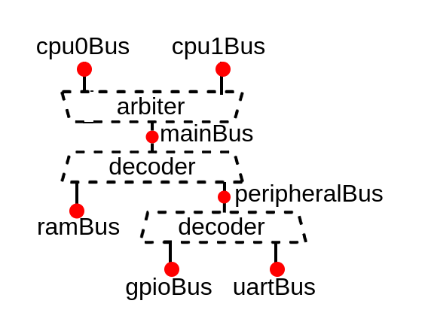
Coroutines applied to a tilelink interconnect elaboration

Slide 3
Wire sea
wire axi_awvalid;
wire axi_awready;
wire [19:0] axi_awaddr;
wire [3:0] axi_awid;
wire [7:0] axi_awlen;
wire [2:0] axi_awsize;
wire axi_wvalid;
wire axi_wready;
wire [31:0] axi_wdata;
wire [3:0] axi_wstrb;
wire axi_wlast;
wire axi_bvalid;
wire axi_bready;
wire [3:0] axi_bid;
wire [1:0] axi_bresp;
wire axi_arvalid;
wire axi_arready;
wire [19:0] axi_araddr;
wire [3:0] axi_arid;
wire [7:0] axi_arlen;
wire [2:0] axi_arsize;
wire axi_rvalid;
wire axi_rready;
wire [31:0] axi_rdata;
wire [3:0] axi_rid;
wire [1:0] axi_rresp;
wire axi_rlast;
wire [19:0] apb_PADDR;
wire [0:0] apb_PSEL;
wire apb_PENABLE;
wire apb_PREADY;
wire apb_PWRITE;
wire [31:0] apb_PWDATA;
wire [31:0] apb_PRDATA;

Slide 4
Bus definition
val apb = Apb3(
addressWidth = 20,
dataWidth = 32
)
val apb = Apb3(20, 32)

Slide 5
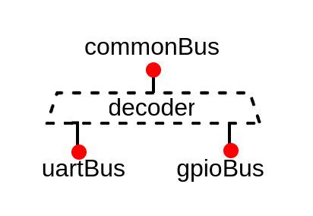
Software API
val commonBus = Apb3(
addressWidth = 20,
dataWidth = 32
)
val apbDecoder = Apb3Decoder(
master = commonBus,
slaves = List(
gpioBus -> (0x2000, 4 kB),
uartBus -> (0x5000, 4 kB)
)
)
val uartBus = Apb3(
addressWidth = 12,
dataWidth = 32
)
val gpioBus = Apb3(
addressWidth = 12,
dataWidth = 32
)

Slide 6
Automation
val cpu0Bus, cpu1Bus = Axi4(32, 32, idWidth = 2)
val mainBus = Axi4(32, 32, idWidth = 4)
val ramBus = Axi4(16, 32, idWidth = 6)
val peripheralBus = Axi4(20, 32, idWidth = 6)
val gpioBus, uartBus = Axi4(12, 32, idWidth = 8)
val axiCrossbar = Axi4CrossbarFactory()
axiCrossbar.addSlaves(
mainBus -> (0x00000000, 4 GB),
ramBus -> (0x80000000, 64 kB),
peripheralBus -> (0x10000000, 1 MB),
gpioBus -> ( 0x2000, 4 kB),
uartBus -> ( 0x5000, 4 kB)
)
axiCrossbar.addConnections(
cpu0Bus -> List(mainBus),
cpu1Bus -> List(mainBus),
mainBus -> List(ramBus, peripheralBus),
peripheralBus -> List(gpioBus, uartBus)
)
axiCrossbar.build()

Slide 7
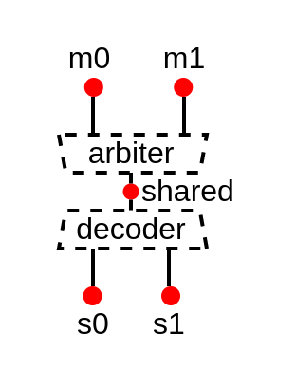
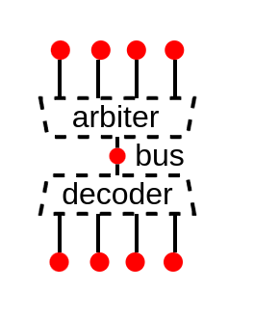
Decentralization
import spinal.lib.bus.tilelink.fabric.Node
val cpu0Bus, cpu1Bus = Node()
val mainBus = Node()
val ramBus = Node()
val peripheralBus = Node()
val gpioBus, uartBus = Node()
mainBus << List(cpu0Bus, cpu1Bus)
ramBus at 0x80000000 of mainBus
peripheralBus at 0x10000000 of ramBus
gpioBus at 0x2000 of peripheralBus
uartBus at 0x5000 of peripheralBus
val bus = tilelink.fabric.Node()

Slide 8
Decentralization
class Connection(val m : Node, val s : Node){
val thread = Fiber build new Area{
// Connect the m.decoder to the s.arbiter
}
}
class Node extends Area{
// Node data model
val bus = Handle[tilelink.Bus]()
val ups = ArrayBuffer[Connection]()
val downs = ArrayBuffer[Connection]()
//Fork an elaboration thread
val thread = Fiber build new Area{
// Generate the required arbiter / decoder logic.
}
}

Slide 9
Future, Promise, Async, ...
val bus = Handle[tilelink.Bus]
val thread1 = Fiber build {
println("Thread 1 start")
//Will wait on bus.load (from thread 2)
bus.a.valid := False
bus.a.address := 42
println("Thread 1 done")
}
val thread2 = Fiber build {
println("Thread 2 start")
val config = tilelink.BusParameter.simple(
addressWidth = 32,
dataWidth = 64,
sizeBytes = 16,
sourceWidth = 4
)
//Will allow thread 1 to continue
bus load tilelink.Bus(config)
println("Thread 2 done")
}
Thread 1 start
Thread 2 start
Thread 2 done
Thread 1 done
assign bus_a_valid = 1'b0;
assign bus_a_address = 32'h00000042;

Slide 10
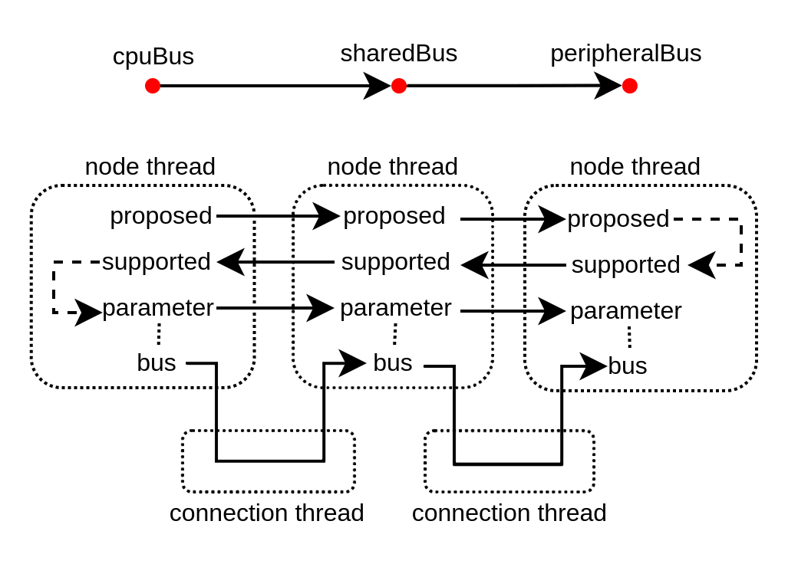
Negotiation
class Node extends Area{
// Node data model
val proposed = Handle[M2sSupport]()
val supported = Handle[M2sSupport]()
val parameters = Handle[M2sParameters]()
val bus = Handle[Bus]()
//Fork an elaboration thread
val thread = Fiber build new Area{
// Do the Negotiation
// Generate the required arbiter / decoder logic.
}
}

Slide 11
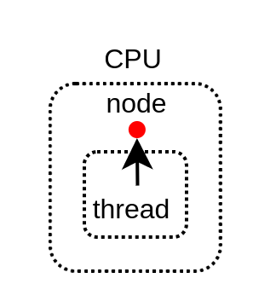
Master example
case class Cpu() extends Area {
val node = Node.master()
val thread = Fiber build new Area {
// Negotiate things
node.proposed load M2sSupport(
addressWidth = 32,
dataWidth = 64,
transfers = M2sTransfers(
get = SizeRange.upTo(64),
putFull = SizeRange.upTo(64)
)
)
node.parameters load M2sParameters(
support = node.supported,
sourceCount = 4
)
// Implement the actual CPU hardware
node.bus.a.valid := False
node.bus.a.address := 0x42
}
}

Slide 12
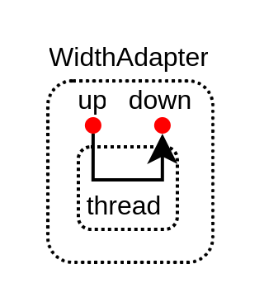
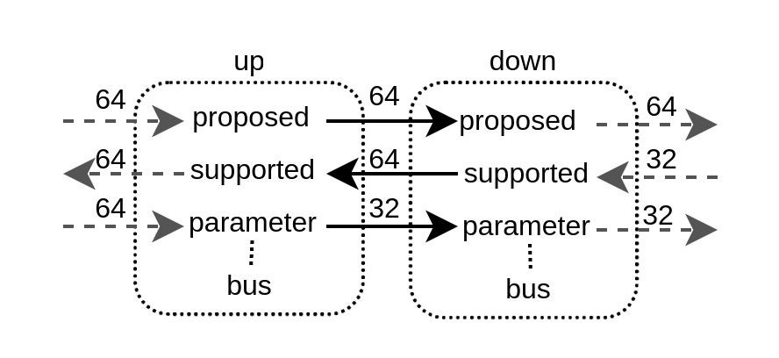
Adapter example
class WidthAdapter() extends Area{
val up = Node.slave()
val down = Node.master()
val thread = Fiber build new Area{
down.proposed load up.proposed
up.supported load down.supported.copy(
dataWidth = up.proposed.dataWidth
)
down.parameters load up.parameters.copy(
dataWidth = down.supported.dataWidth
)
val bridge = new WidthAdapter(up.bus.p, down.bus.p)
bridge.io.up << up.bus
bridge.io.down >> down.bus
}
}

Slide 13
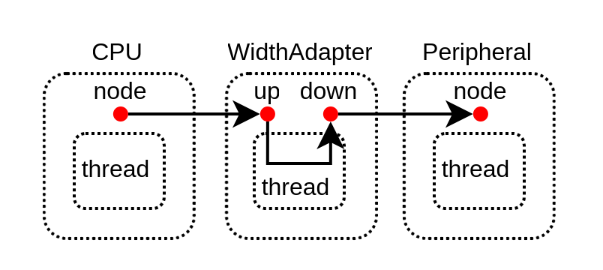
Deployment
val cpu = Cpu()
val adapter = WidthAdapter()
val peripheral = Peripheral()
adapter.up << cpu.node
peripheral.node at 0x2000 of adapter.down

Slide 14
Introspection
class CustomTag(val str : String) extends SpinalTag
val counter = Reg(UInt(8 bits))
counter := counter + 1
counter.addTag(new CustomTag("hello"))
counter.addTag(new CustomTag("miaou"))
counter.foreachTag{
case ct : CustomTag => println(ct.str)
case _ =>
}
hello
miaou

Slide 15
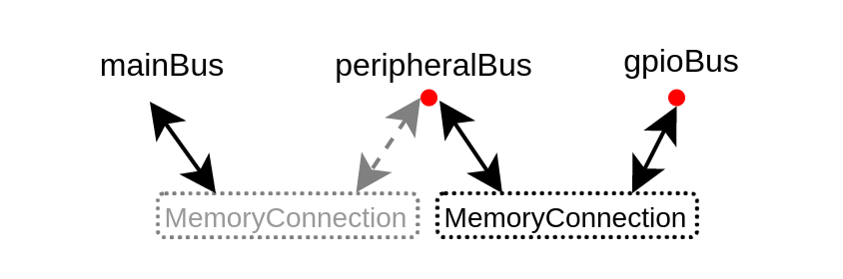
Introspection
trait MemoryConnection extends SpinalTag {
def m : Nameable with SpinalTagReady
def s : Nameable with SpinalTagReady
def mapping : SizeMapping
override def toString = s"${m.getName()} ${s.getName()} $mapping"
}
val tag = new MemoryConnection{
def m = peripheralBus
def s = gpioBus
def mapping = SizeMapping(0x5000, 0x1000)
}
peripheralBus.addTag(tag)
gpioBus.addTag(tag)

Slide 16
Introspection
def visite(node : Nameable with SpinalTagReady, level : Int){
node.foreachTag{
case mc : MemoryConnection if mc.m == node => {
println(" " * level + mc)
visite(mc.s, level + 1)
}
case _ =>
}
}
visite(cpu0Bus, 0)
cpu0Bus mainBus 0 100000000
mainBus ramBus 40000000 10000
mainBus peripheralBus 10000000 100000
peripheralBus gpioBus 2000 1000
peripheralBus uartBus 5000 1000

Slide 17
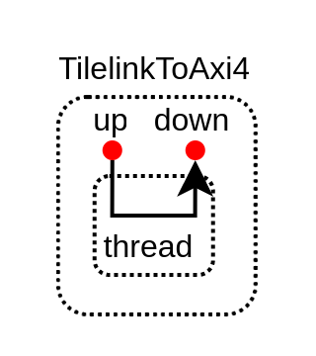
Interoperability
class TilelinkToAxiBridge() extends Area{
val up = tilelink.fabric.Node.slave()
val down = axi4.fabric.Node.master()
val tag = new MemoryConnection {
def m = peripheralBus
def s = apbBus
def mapping = SizeMapping(0, 0x1000)
}
up.add(tag)
down.add(tag)
val thread = Fiber build new Area{
// Handle the negotiation from Tilelink to AXI
// ...
// Generate the hardware
// ...
}
}

Slide 18
Question ?
Open Discussion about the tilelink interconnect API / framework :
  https://github.com/SpinalHDL/SpinalHDL/discussions/1115
Roadmap
  Tilelink interconnect with
    memory coherency
    L2 cache
  NaxRiscv with tilelink memory coherency
Looking for buddies :)

Slide 19
Miaou
Wuff

