Slide 1
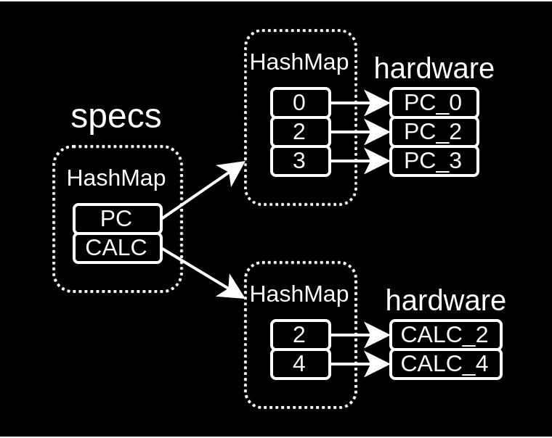
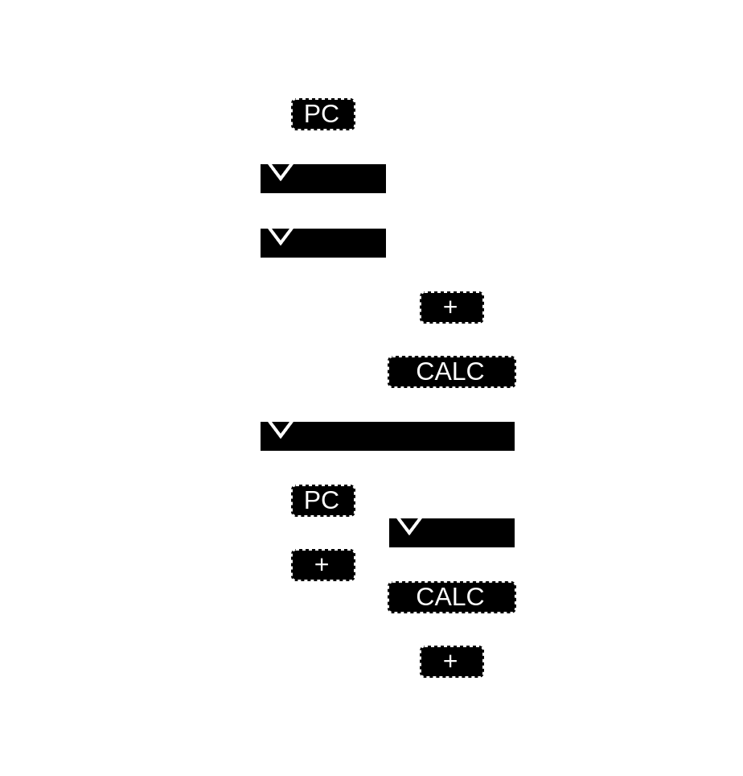
Writing software to elaborate hardware (SpinalHDL)

Slide 2
Background / whoami
Dolu1990 on github
Active on open/free project
  SpinalHDL (2015) / VexRiscv (2017) / NaxRiscv(2021) / VexiiRiscv (2023)
Software / Hardware background
  Industrial system / Electronic degree

Slide 3
Let’s use a software language
object Main extends App{
println("Hello world")
}

Slide 4
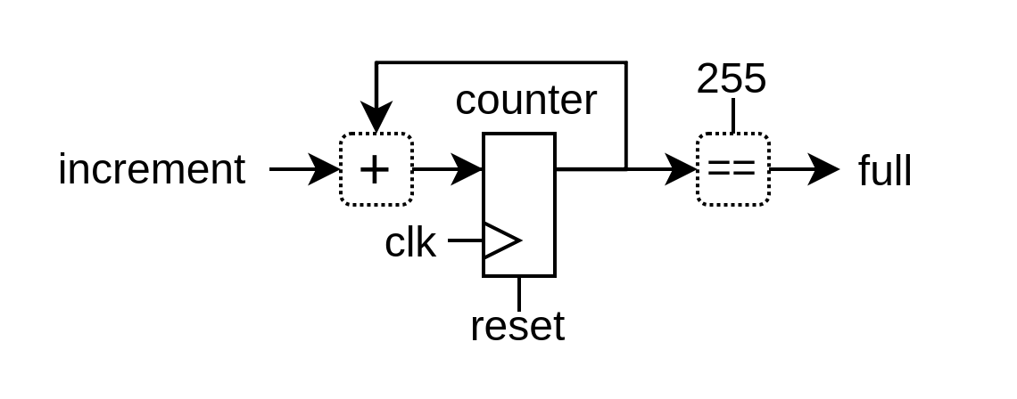
Let’s use an hardware description library (HDL)

Slide 5
Let’s use an hardware description library (HDL)
import spinal.core._
object Main extends App{
SpinalVerilog(new Timer)
}
class Timer extends Component {
val increment = in(Bool())
val counter = Reg(UInt(8 bits)) init(0)
val full = out(counter === 255)
when(increment){
counter := counter + 1
}
}

Slide 6
Let’s use an hardware description library (HDL)
module Timer (
input wire increment,
output wire full,
input wire clk,
input wire reset
);
reg [7:0] counter;
assign full = (counter == 8'hff);
always @(posedge clk or posedge reset) begin
if(reset) begin
counter <= 8'h00;
end else begin
if(increment) begin
counter <= (counter + 8'h01);
end
end
end
endmodule
import spinal.core._
object Main extends App{
SpinalVerilog(new Timer)
}
class Timer extends Component {
val increment = in(Bool())
val counter = Reg(UInt(8 bits)) init(0)
val full = out(counter === 255)
when(increment){
counter := counter + 1
}
}

Slide 7
Data structure / parameters
case class Pixel(width: Int) extends Bundle{
val r, g, b = UInt(width bits)
}
case class Stream[T <: Data](dataType: HardType[T]) extends Bundle {
val valid = Bool()
val ready = Bool()
val data = dataType()
}
val bus = Stream(Pixel(8))
bus.valid := False
bus.data.r := 0x11
bus.data.g := 0x22
bus.data.b := 0x33

Slide 8
Integrated linting
Latches
Combinatorial loops
Unspecified clock crossing
Undriven signals
Width mismatch
...
LATCH DETECTED from the combinatorial signal (toplevel/result : out UInt[8 bits]), defined at ...
val cond = in Bool()
val result = out UInt(8 bits)
when(cond){
result := 0
}

Slide 9
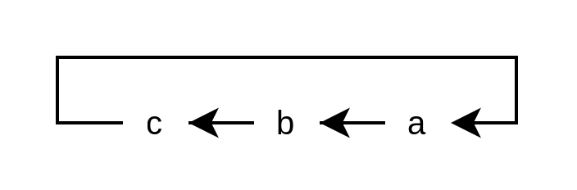
Integrated linting
val a,b,c = Bool()
c := b; b := a; a := c
COMBINATORIAL LOOP :
(toplevel/a : Bool)
(toplevel/b : Bool)
(toplevel/c : Bool)
(toplevel/a : Bool)
Latches
Combinatorial loops
Unspecified clock crossing
Undriven signals
Width mismatch
...
LATCH DETECTED from the combinatorial signal (toplevel/result : out UInt[8 bits]), defined at ...
val cond = in Bool()
val result = out UInt(8 bits)
when(cond){
result := 0
}

Slide 10
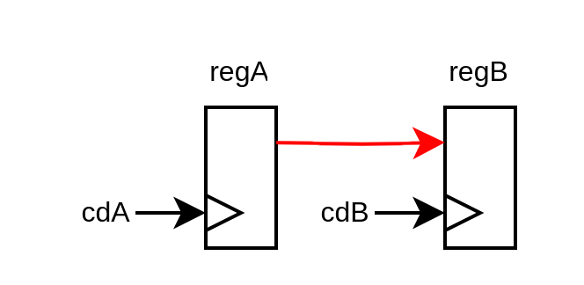
Integrated linting
val a,b,c = Bool()
c := b; b := a; a := c
COMBINATORIAL LOOP :
(toplevel/a : Bool)
(toplevel/b : Bool)
(toplevel/c : Bool)
(toplevel/a : Bool)
Latches
Combinatorial loops
Unspecified clock crossing
Undriven signals
Width mismatch
...
class Toplevel(cdA : ClockDomain, cdB : ClockDomain) extends Component {
val regA = cdA(Reg(Bool()))
val regB = cdB(Reg(Bool()))
regB := regA
}
CLOCK CROSSING VIOLATION :
- Source : (toplevel/regA : Bool) spinal.tester.code.Toplevel….(PresentationDsl.scala:1494)
- Source clock : (cdA_clk : Bool)
- Destination : (toplevel/regB : Bool) spinal.tester.code.Toplevel….(PresentationDsl.scala:1495)
- Destination clock : (cdB_clk : Bool)
LATCH DETECTED from the combinatorial signal (toplevel/result : out UInt[8 bits]), defined at ...
val cond = in Bool()
val result = out UInt(8 bits)
when(cond){
result := 0
}

Slide 11
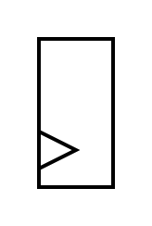
Using software to elaborate your hardware
if(featureEnabled){
Reg(UInt(8 bits))
}
Control flow : if / for
Data collections : dynamic array / hash map / hash set
Lambda function : reduce / fold / map / filter / ...
OOP : class / software interface
See https://spinalhdl.github.io/NaxRiscv-Rtd/main/NaxRiscv/abstraction/index.html

Slide 12
Using software to elaborate your hardware
for(i <- 0 to 2){
Reg(UInt(8 bits))
}
Control flow : if / for
Data collections : dynamic array / hash map / hash set
Lambda function : reduce / fold / map / filter / ...
OOP : class / software interface
See https://spinalhdl.github.io/NaxRiscv-Rtd/main/NaxRiscv/abstraction/index.html

Slide 13

Using software to elaborate your hardware
Control flow : if / for
Data collections : dynamic array / hash map / hash set
Lambda function : reduce / fold / map / filter / ...
OOP : class / software interface

Slide 14
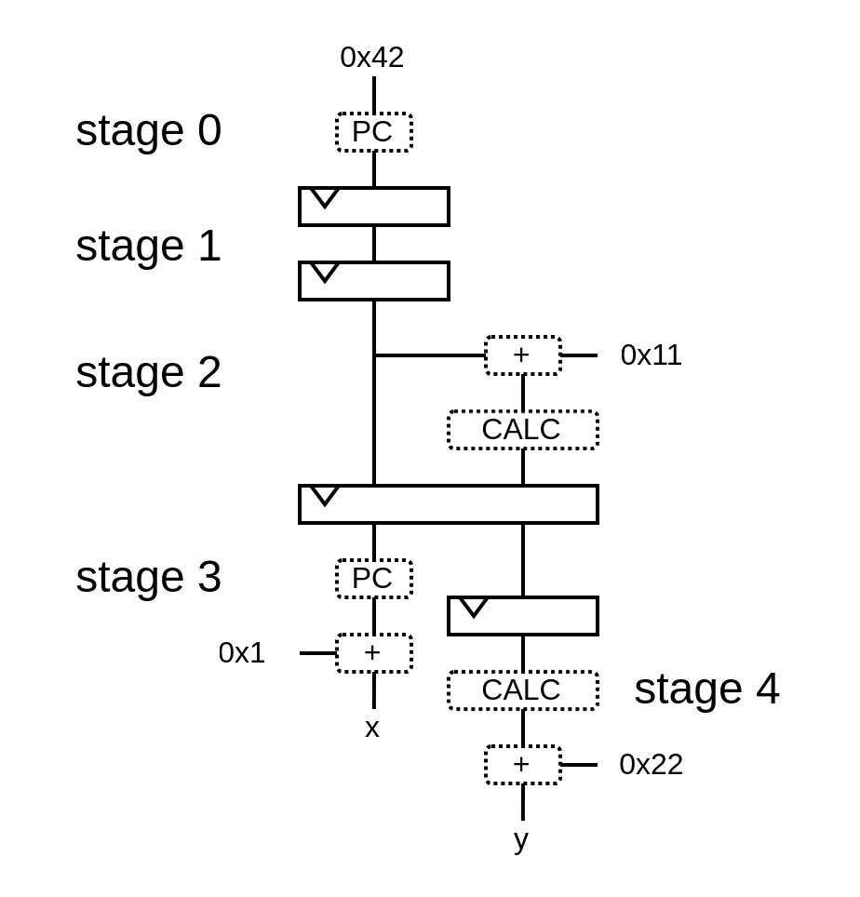
Pipeline API

Slide 15
Pipeline API
val pip = new Pipeline()

Slide 16
Pipeline API
val pip = new Pipeline()
val PC = NamedType(UInt(32 bits))
pip(PC, 0) := 0x42

Slide 17
Pipeline API
val pip = new Pipeline()
val PC = NamedType(UInt(32 bits))
pip(PC, 0) := 0x42
val CALC = NamedType(UInt(32 bits))
pip(CALC, 2) := pip(PC, 2) + 0x11

Slide 18
Pipeline API
val pip = new Pipeline()
val PC = NamedType(UInt(32 bits))
pip(PC, 0) := 0x42
val CALC = NamedType(UInt(32 bits))
pip(CALC, 2) := pip(PC, 2) + 0x11
val x = pip(PC, 3) + 1
val y = pip(CALC, 4) + 0x22

Slide 19
Pipeline API
val pip = new Pipeline()
val PC = NamedType(UInt(32 bits))
pip(PC, 0) := 0x42
val CALC = NamedType(UInt(32 bits))
pip(CALC, 2) := pip(PC, 2) + 0x11
val x = pip(PC, 3) + 1
val y = pip(CALC, 4) + 0x22
pip.build()

Slide 20
Pipeline API
wire [31:0] PC_0;
wire [31:0] PC_3;
wire [31:0] x;
wire [31:0] CALC_2;
wire [31:0] PC_2;
wire [31:0] CALC_4;
wire [31:0] y;
wire [31:0] PC_1;
reg [31:0] PC_0_regNext;
reg [31:0] PC_1_regNext;
reg [31:0] PC_2_regNext;
wire [31:0] CALC_3;
reg [31:0] CALC_2_regNext;
reg [31:0] CALC_3_regNext;
assign PC_0 = 32'h00000042;
assign x = (PC_3 + 32'h00000001);
assign CALC_2 = (PC_2 + 32'h00000011);
assign y = (CALC_4 + 32'h00000022);
assign PC_1 = PC_0_regNext;
assign PC_2 = PC_1_regNext;
assign PC_3 = PC_2_regNext;
assign CALC_3 = CALC_2_regNext;
assign CALC_4 = CALC_3_regNext;
always @(posedge clk) begin
PC_0_regNext <= PC_0;
PC_1_regNext <= PC_1;
PC_2_regNext <= PC_2;
CALC_2_regNext <= CALC_2;
CALC_3_regNext <= CALC_3;
end
val pip = new Pipeline()
val PC = NamedType(UInt(32 bits))
pip(PC, 0) := 0x42
val CALC = NamedType(UInt(32 bits))
pip(CALC, 2) := pip(PC, 2) + 0x11
val x = pip(PC, 3) + 1
val y = pip(CALC, 4) + 0x22
pip.build()

Slide 21
Pipeline API
class Pipeline{
//Define the pipeline data model
val specs = LinkedHashMap[NamedType[Data], LinkedHashMap[Int, Data]]()
//Define how we can access the pipeline
def apply[T <: Data](what: NamedType[T], stageId: Int) = {
val spec = specs.getOrElseUpdate(what.asInstanceOf[NamedType[Data]], new LinkedHashMap[Int, Data])
spec.getOrElseUpdate(stageId, what().setName(what.getName + "_" + stageId)).asInstanceOf[T]
}
//Translate specs into hardware
def build(): Unit = {
for ((what, nodes) <- specs) {
for (i <- nodes.keys.min until nodes.keys.max) {
apply(what, i + 1) := RegNext(apply(what, i))
}
}
}
}

Slide 22
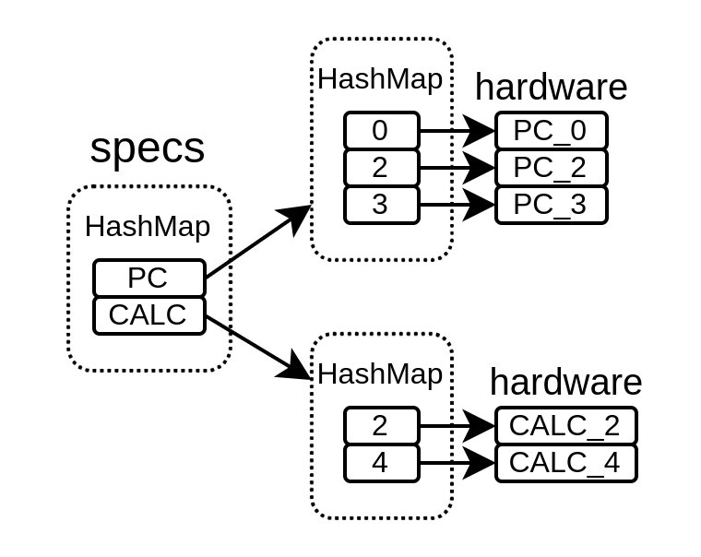
Pipeline API
class Pipeline{
//Define the pipeline data model
val specs = LinkedHashMap[NamedType[Data], LinkedHashMap[Int, Data]]()
//Define how we can access the pipeline
def apply[T <: Data](what: NamedType[T], stageId: Int) = {
val spec = specs.getOrElseUpdate(what.asInstanceOf[NamedType[Data]], new LinkedHashMap[Int, Data])
spec.getOrElseUpdate(stageId, what().setName(what.getName + "_" + stageId)).asInstanceOf[T]
}
//Translate specs into hardware
def build(): Unit = {
for ((what, nodes) <- specs) {
for (i <- nodes.keys.min until nodes.keys.max) {
apply(what, i + 1) := RegNext(apply(what, i))
}
}
}
}

Slide 23
Pipeline API
class Pipeline{
//Define the pipeline data model
val specs = LinkedHashMap[NamedType[Data], LinkedHashMap[Int, Data]]()
//Define how we can access the pipeline
def apply[T <: Data](what: NamedType[T], stageId: Int) = {
val spec = specs.getOrElseUpdate(what.asInstanceOf[NamedType[Data]], new LinkedHashMap[Int, Data])
spec.getOrElseUpdate(stageId, what().setName(what.getName + "_" + stageId)).asInstanceOf[T]
}
//Translate specs into hardware
def build(): Unit = {
for ((what, nodes) <- specs) {
for (i <- nodes.keys.min until nodes.keys.max) {
apply(what, i + 1) := RegNext(apply(what, i))
}
}
}
}

Slide 24
Pipeline API
class Pipeline{
//Define the pipeline data model
val specs = LinkedHashMap[NamedType[Data], LinkedHashMap[Int, Data]]()
//Define how we can access the pipeline
def apply[T <: Data](what: NamedType[T], stageId: Int) = {
val spec = specs.getOrElseUpdate(what.asInstanceOf[NamedType[Data]], new LinkedHashMap[Int, Data])
spec.getOrElseUpdate(stageId, what().setName(what.getName + "_" + stageId)).asInstanceOf[T]
}
//Translate specs into hardware
def build(): Unit = {
for ((what, nodes) <- specs) {
for (i <- nodes.keys.min until nodes.keys.max) {
apply(what, i + 1) := RegNext(apply(what, i))
}
}
}
}

Slide 25
Pipeline API
wire [31:0] PC_0;
wire [31:0] PC_3;
wire [31:0] x;
wire [31:0] CALC_2;
wire [31:0] PC_2;
wire [31:0] CALC_4;
wire [31:0] y;
wire [31:0] PC_1;
reg [31:0] PC_0_regNext;
reg [31:0] PC_1_regNext;
reg [31:0] PC_2_regNext;
wire [31:0] CALC_3;
reg [31:0] CALC_2_regNext;
reg [31:0] CALC_3_regNext;
assign PC_0 = 32'h00000042;
assign x = (PC_3 + 32'h00000001);
assign CALC_2 = (PC_2 + 32'h00000011);
assign y = (CALC_4 + 32'h00000022);
assign PC_1 = PC_0_regNext;
assign PC_2 = PC_1_regNext;
assign PC_3 = PC_2_regNext;
assign CALC_3 = CALC_2_regNext;
assign CALC_4 = CALC_3_regNext;
always @(posedge clk) begin
PC_0_regNext <= PC_0;
PC_1_regNext <= PC_1;
PC_2_regNext <= PC_2;
CALC_2_regNext <= CALC_2;
CALC_3_regNext <= CALC_3;
end
val pip = new Pipeline()
val PC = NamedType(UInt(32 bits))
pip(PC, 0) := 0x42
val CALC = NamedType(UInt(32 bits))
pip(CALC, 2) := pip(PC, 2) + 0x11
val x = pip(PC, 3) + 1
val y = pip(CALC, 4) + 0x22
pip.build()

Slide 26
VexiiRiscv
RISC-V softcore
Very large design space
Can run linux (RV32 / RV64 IMACSU)
Multiple issue
Early + late ALU
5.24 coremark/Mhz 2.50 dhystone/Mhz
https://github.com/SpinalHDL/VexiiRiscv

Slide 27
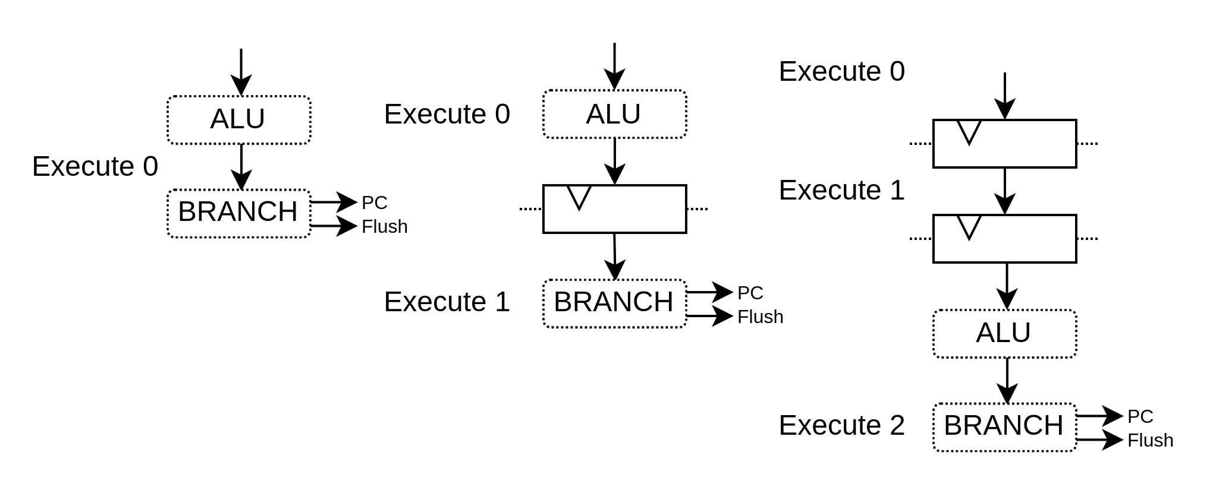
VexiiRiscv : Pipeline API

Slide 28
VexiiRiscv : Pipeline API
val alu = new pipeline.Execute(0) {
val TAKEN = insert(RS1 === RS2);
}

Slide 29
VexiiRiscv : Pipeline API
val alu = new pipeline.Execute(0) {
val TAKEN = insert(RS1 === RS2);
}
val branch = new pipeline.Execute(1) {
flushPort.valid := alu.TAKEN
pcPort.valid := alu.TAKEN
pcPort.pc := ..
}

Slide 30
VexiiRiscv : Pipeline API
val aluAt = 0
val branchAt = 1
...
val alu = new pipeline.Execute(aluAt) {
val TAKEN = insert(RS1 === RS2);
}
val branch = new pipeline.Execute(branchAt) {
flushPort.valid := alu.TAKEN
pcPort.valid := alu.TAKEN
pcPort.pc := ..
}

Slide 31
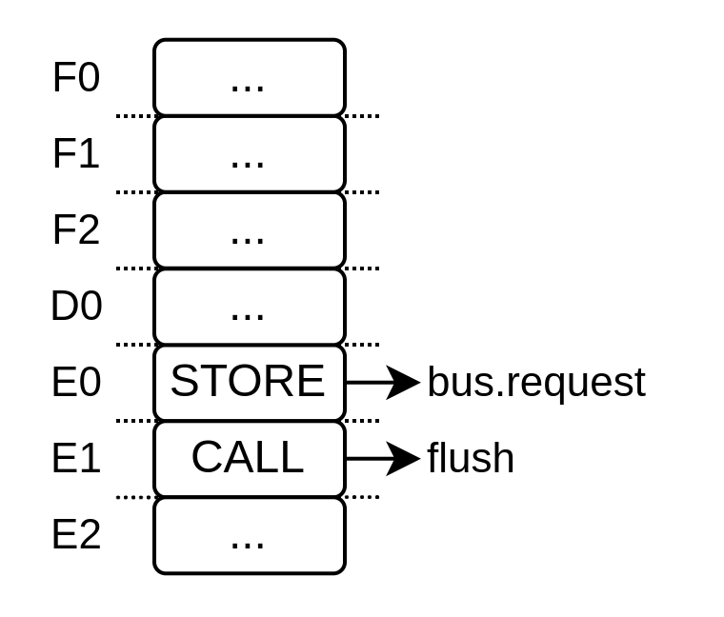
VexiiRiscv : Decoding / Scheduling

Slide 32
VexiiRiscv : Specification structure
case class OpSpec(
encoding : String,
mayFlush : Boolean,
sideEffect: Boolean,
)

Slide 33
VexiiRiscv : Define instructions spec
case class OpSpec(
encoding : String,
mayFlush : Boolean,
sideEffect: Boolean,
)
val ADD = OpSpec("000-----0110011", false, false)
val CALL = OpSpec("--------1101111", true, false)
val SW = OpSpec("100-----1100011", false, true)

Slide 34
VexiiRiscv : Collect the specifications
case class OpSpec(
encoding : String,
mayFlush : Boolean,
sideEffect: Boolean,
)
val ADD = OpSpec("000-----0110011", false, false)
val CALL = OpSpec("--------1101111", true, false)
val SW = OpSpec("100-----1100011", false, true)
val opsSpec = List(ADD, CALL, SW)

Slide 35
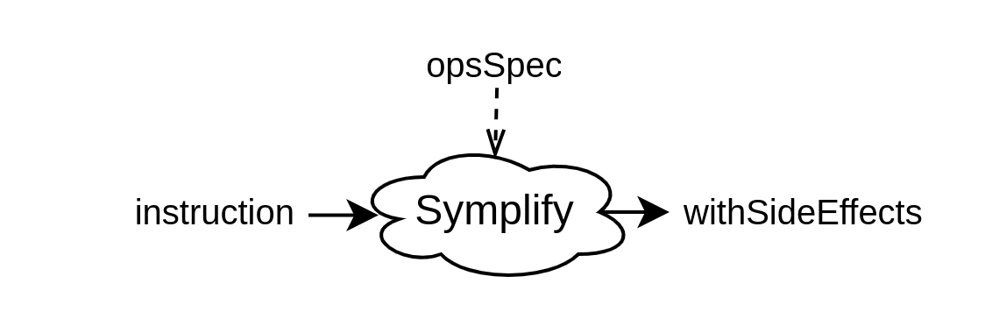
VexiiRiscv : Decode
case class OpSpec(
encoding : String,
mayFlush : Boolean,
sideEffect: Boolean,
)
val ADD = OpSpec("000-----0110011", false, false)
val CALL = OpSpec("--------1101111", true, false)
val SW = OpSpec("100-----1100011", false, true)
val opsSpec = List(ADD, CALL, SW)
val instruction = in Bits(32 bits)
val withSideEffects = Symplify(
input = instruction,
trueTerms = opsSpec.filter(_.sideEffect).map(_.encoding),
falseTerms = opsSpec.filter(!_.sideEffect).map(_.encoding)
)

Slide 36
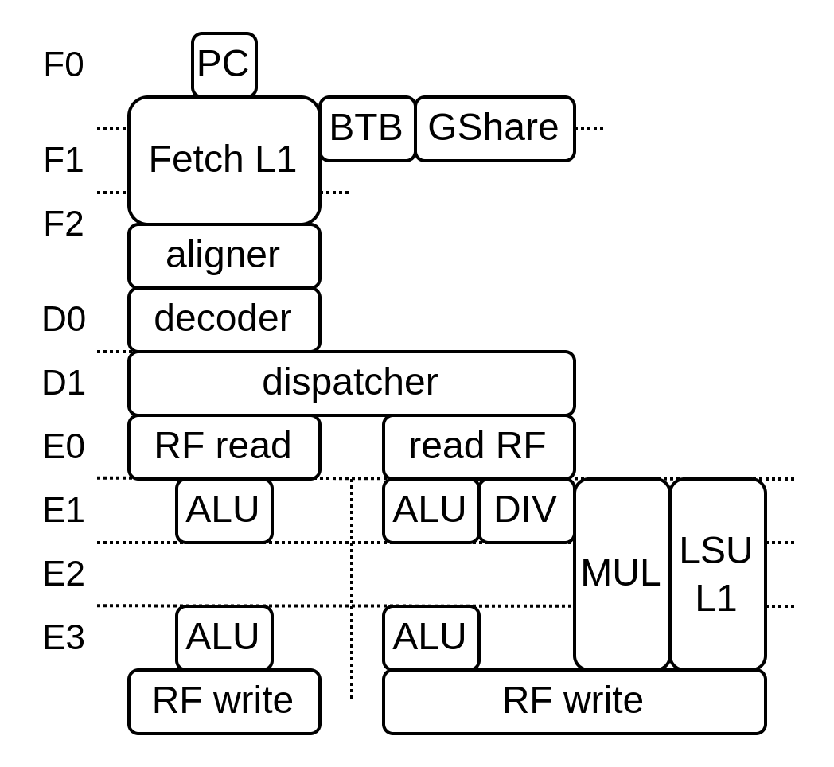
No more toplevel / design space
class VexiiRiscv(...) extends Component{
val database = ...
val host = ...
}
val plugins = ArrayBuffer[Hostable]()
plugins += new fetch.FetchPipelinePlugin()
plugins += new fetch.PcPlugin(resetVector)
plugins += new fetch.FetchL1Plugin(...)
plugins += new prediction.BtbPlugin(...)
plugins += new prediction.GSharePlugin (...)
plugins += new prediction.HistoryPlugin(...)
...
plugins += new execute.SimdAddPlugin(...)
val cpu = VexiiRiscv(plugins)

Slide 37
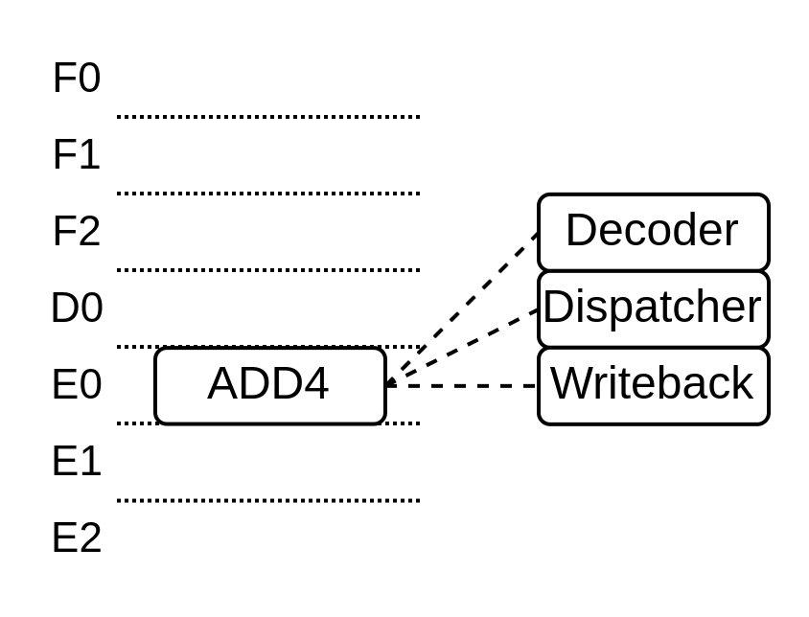
Custom instruction
object SimdAddPlugin {
val ADD4 = IntRegFile.TypeR(M"0000000----------000-----0001011")
}
class SimdAddPlugin(val layer: LaneLayer) extends ExecutionUnitElementSimple(layer) {
val logic = during setup new Logic {
awaitBuild()
val wb = newWriteback(ifp, 0)
val add4 = add(SimdAddPlugin.ADD4).spec
add4.addRsSpec(RS1, executeAt = 0)
add4.addRsSpec(RS2, executeAt = 0)
uopRetainer.release()
val process = new el.Execute(id = 0) {
val rs1 = el(IntRegFile, RS1).asUInt
val rs2 = el(IntRegFile, RS2).asUInt
val rd = UInt(32 bits)
rd( 7 downto 0) := rs1( 7 downto 0) + rs2( 7 downto 0)
rd(16 downto 8) := rs1(16 downto 8) + rs2(16 downto 8)
rd(23 downto 16) := rs1(23 downto 16) + rs2(23 downto 16)
rd(31 downto 24) := rs1(31 downto 24) + rs2(31 downto 24)
wb.valid := SEL
wb.payload := rd.asBits
}
}
}
}

Slide 38
How to lower barriers to hardware design ?
VHDL / [System]Verilog alternatives
  SpinalHDL, Chisel, Migen, Amaranth, ...
Hardware design can leverage software engineering
  API / Tooling / abstraction
  New pool of people profiles
Closed industry tools limits the scale of free/open-source hardware
  Alternatives (Verilator, GHDL, IVerilog, openroad, ..)

Slide 39
Question ?

