Slide 1


SaxonSoc
Notes:
<numéro>

Slide 2
In short
Started in parallel to VexRiscv SMP
Based on
  SpinalHDL “Generator” tool
  Banana Memory Bus
Key features
  Memory atomics
  Memory coherency
  SDR/DDR2/DDR3 controller
  Multi-core Linux
  BMB (Memory bus)
<numéro>
Notes:
<numéro>

Slide 3
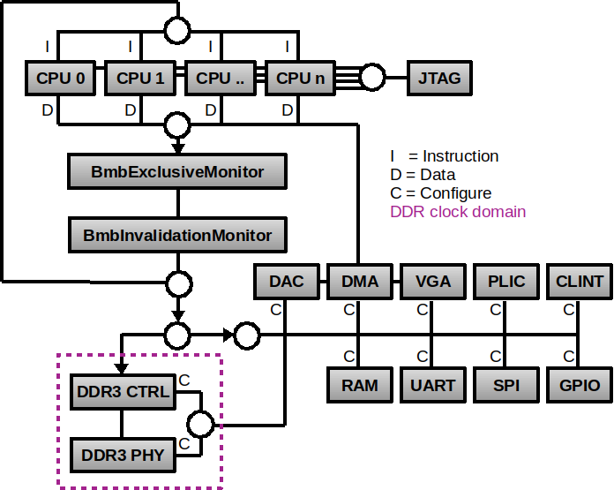
ArtyA7 port
<numéro>
Notes:
<numéro>

Slide 4

BMB (Banana Memory Bus)
Goal :
  Allow both cache-less and cache-full designs (latency / bandwidth)
  Avoid FPGA expensive interconnects
  No license of any sort
Key concepts
  cmd / rsp streams for accesses
  cmd.context retrieved in rsp.context
  [inv / ack / sync] stream for cache invalidation
  [out of order]
<numéro>
Notes:
<numéro>

Slide 5
Generator example
val a,b = Handle[Int]
//Print a + b
val calculator = new Generator{
//Specify that this generator need a and b before executing his tasks
dependencies += a
dependencies += b
//Create a new task that will run when all the dependencies are loaded
add task{
val sum = a.get + b.get
println(s"a + b = $sum") //Will print a + b = 7
}
}
//load a and b with values, which will then unlock the calculator generator
a.load(3)
b.load(4)
<numéro>
Notes:
<numéro>

