Slide 1


Simulation

Slide 2
Flow
Setup
  Scala to Verilog (via SpinalHDL)
  Verilog to C++ (via Verilator)
  C++ to shared object (via GCC)
  Shared object binding into Scala (via JNI)
Advantages
  It test the generated Verilog
  C++ model from Verilator are realy fast, free, open source and accurate
  You can use all the Scala world to interract with your DUT (TCP, GUI, ...)

Slide 3
API
The Simulation API provide the following primitives :
  read/write DUT interface signals
  sleep a given time
  waitUntil a given condition
  fork/join threads
  Scala for everything else
It behave like a regular event-driven HDL simulation
  It manage delta cycles
  When you write a dut signals, the changed value will only be readable after the end of the current delta cycle
  It remain deterministic

Slide 4
Testbench template
object DutTestbench extends App{
val compiled = SimConfig.withWave.compile(rtl = new Dut)
compiled.doSim("test1"){ dut =>
//Testbench code
}
compiled.doSim("test2"){ dut =>
//Testbench code
}
}

Slide 5
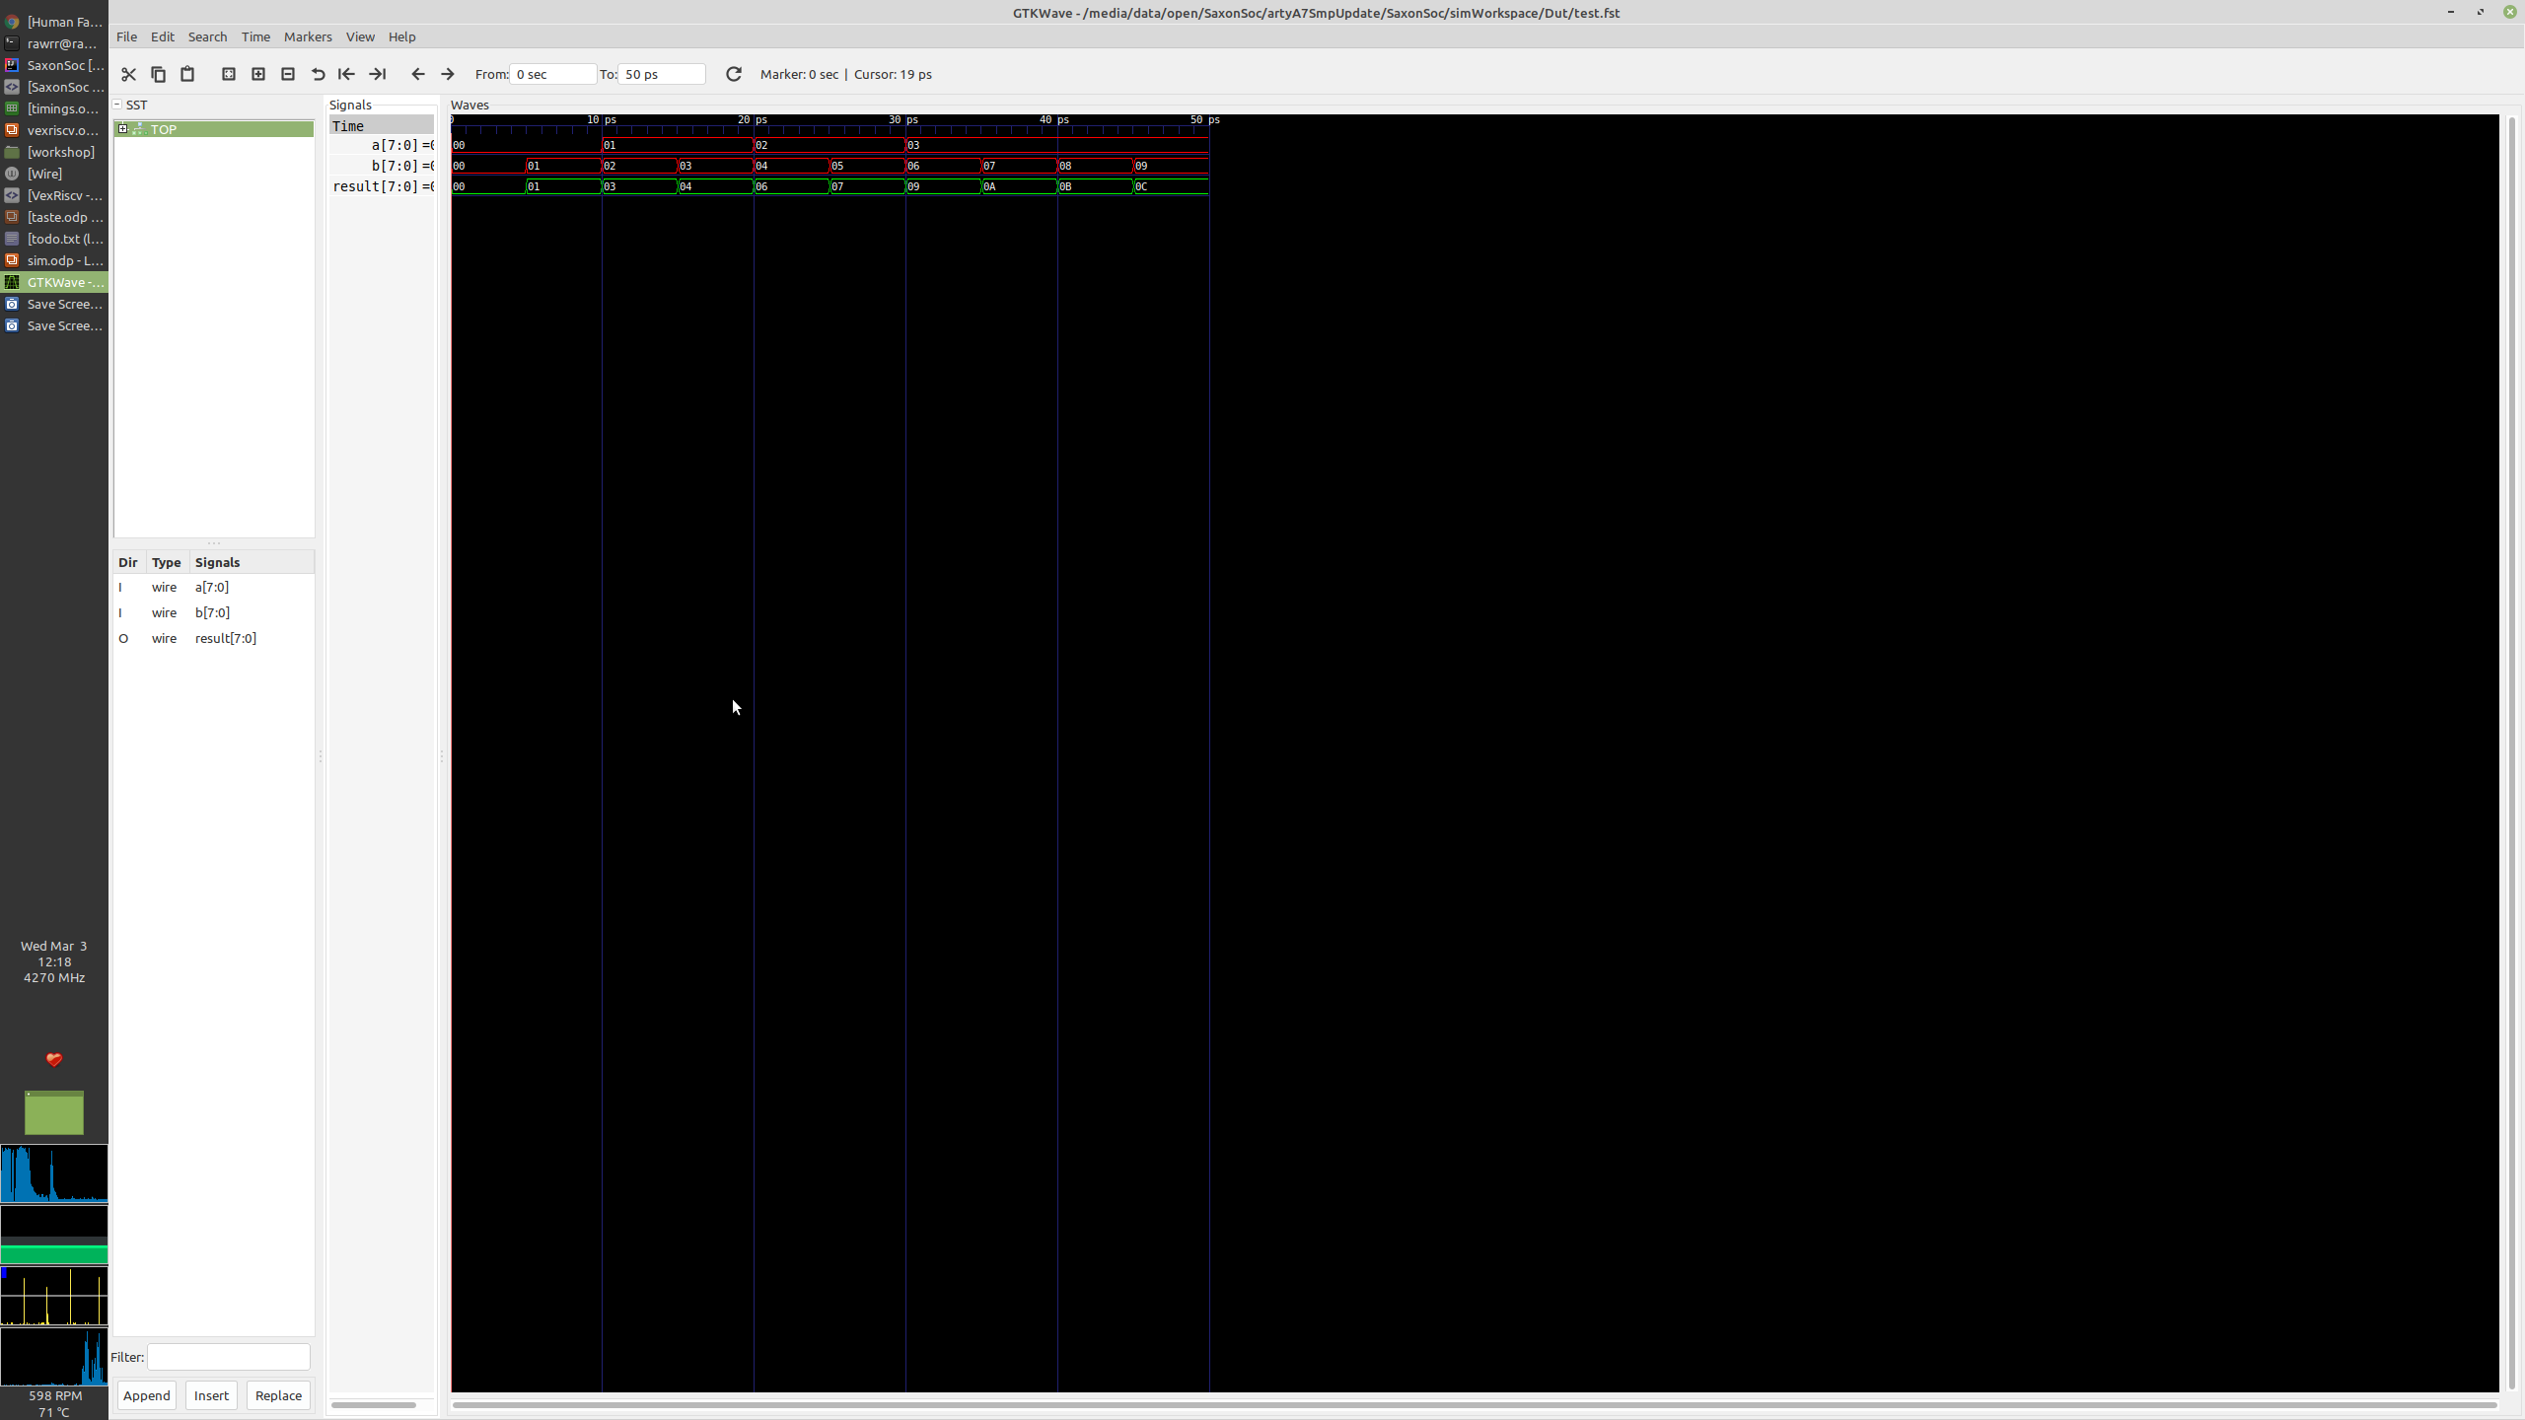
Threads
SimConfig.withFstWave.compile(new Dut).doSimUntilVoid{dut =>
fork{
dut.a #= 0; sleep(6)
dut.a #= 1; sleep(6)
dut.a #= 2; sleep(6)
dut.a #= 3; sleep(6)
}
fork{
for(i <- 0 until 10){
dut.b #= i
sleep(i)
}
}
}
class Dut extends Component{
val a,b = in UInt(8 bits)
val result = out(a + b)
}

Slide 6
Simple example
import spinal.core.sim._
object DutTestbench extends App{
SimConfig.withWave.compile(new Dut).doSim{ dut =>
dut.clockDomain.forkStimulus(period = 10)
var idx = 0
var resultModel = 0
while(idx < 100) {
dut.io.a #= Random.nextInt(256)
dut.io.b #= Random.nextInt(256)
dut.io.c #= Random.nextInt(256)
dut.clockDomain.waitSampling()
assert(dut.io.result.toInt == resultModel)
resultModel = (dut.io.a.toInt + dut.io.b.toInt - dut.io.c.toInt) & 0xFF
idx += 1
}
}
}
class Dut extends Component {
val io = new Bundle {
val a, b, c = in UInt (8 bits)
val result = out UInt (8 bits)
}
io.result := RegNext(io.a + io.b - io.c) init(0)
}

Slide 7
Example : JTAG TCP server
// Variables (shared)
var inputStream: InputStream = null
var outputStream: OutputStream = null
// Scala side thread used to provide a TCP connection
val server = new Thread {
override def run() = {
val socket = new ServerSocket(7894)
println("WAITING FOR TCP JTAG CONNECTION")
while (true) {
val connection = socket.accept()
connection.setTcpNoDelay(true)
outputStream = connection.getOutputStream()
inputStream = connection.getInputStream()
println("TCP JTAG CONNECTION")
}
}
}
server.start()
// Simulation thread used to read/execute the TCP stream
fork {
while (true) {
sleep(jtagClkPeriod * 200)
while (inputStream != null && inputStream.available() != 0) {
val buffer = inputStream.read()
jtag.tms #= (buffer & 1) != 0;
jtag.tdi #= (buffer & 2) != 0;
jtag.tck #= (buffer & 8) != 0;
if ((buffer & 4) != 0) {
outputStream.write(if (jtag.tdo.toBoolean) 1 else 0)
}
sleep(jtagClkPeriod / 2)
}
}
}

Slide 8
Questions ?
Online documentation :
    https://spinalhdl.github.io/SpinalDoc-RTD/SpinalHDL/Simulation/index.html
Ready to use project :
    https://github.com/SpinalHDL/SpinalTemplateSbt

