Slide 1
VexiiRiscv :
Pushing FPGA softcore performances forward
Charles Papon

Slide 2
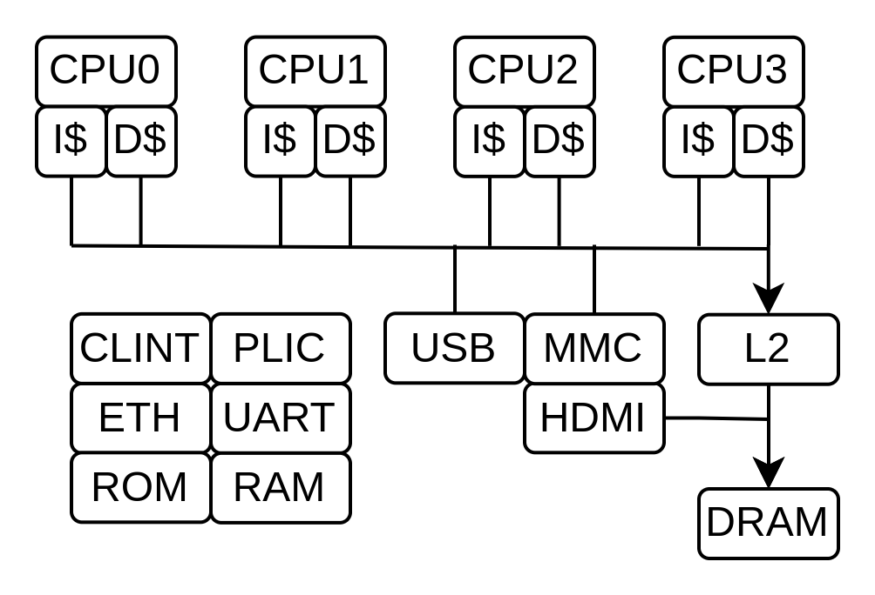
SoC in this demo
Use litex infrastructure
Tilelink based
RV64GC x4
256 KB L2
16 KB I$
16 KB D$
Artix A7-1
~65KLUT
100 Mhz

Slide 3
VexiiRiscv feature set
Mainly :
  RV32/RV64, optional MAFDCBSU
  Can run linux / buildroot / Debian
  Optional multi-issue
  Optional late-ALU
  Up to 5.24 coremark/Mhz 2.50 dhystone/Mhz
  Free / open-source
  RISC-V official jtag debug
  Litex port

Slide 4
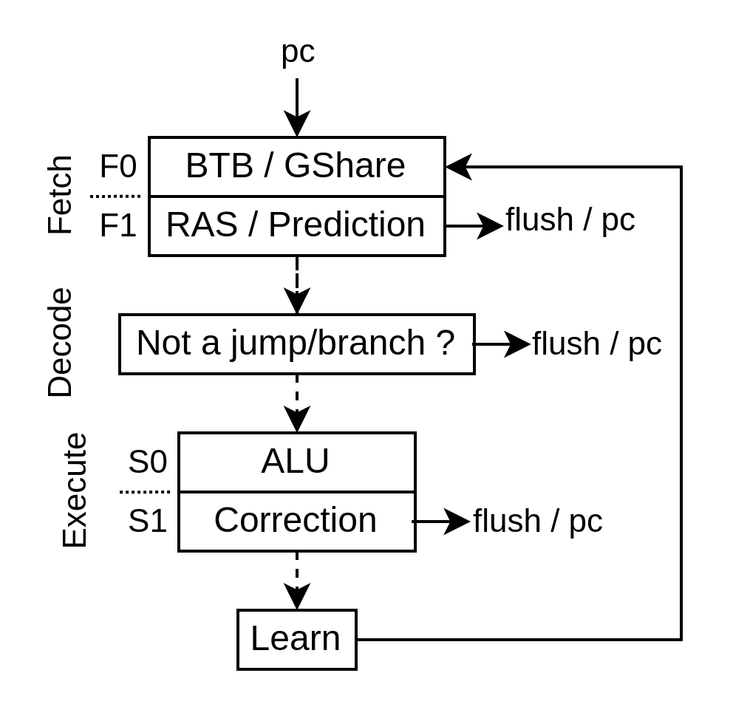
“Branch” prediction

Slide 5
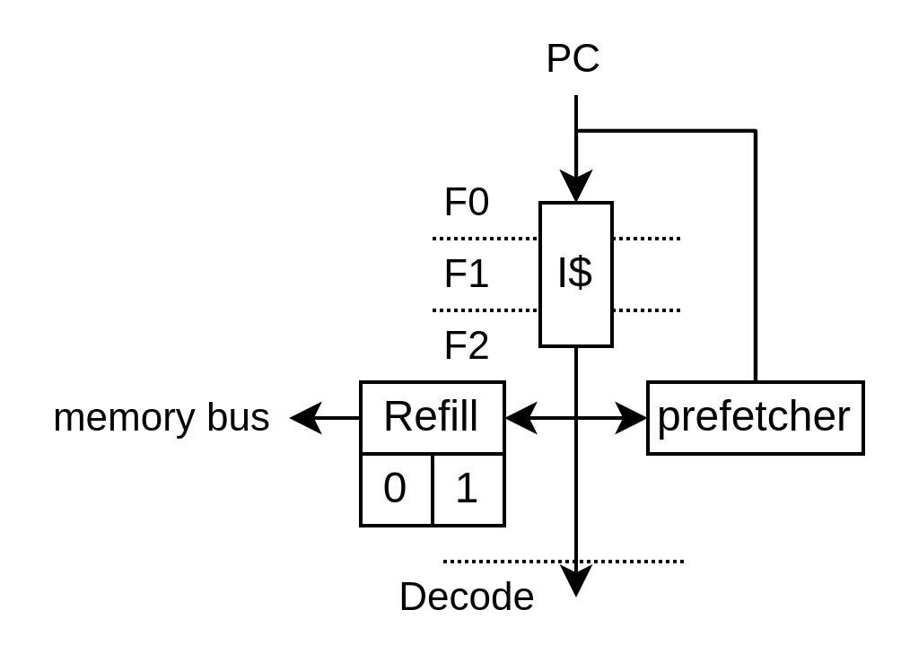
I$ prefetcher
On I$ miss
- prefetch next line
On I$ accessing the last prefetched address
- prefetch next line

Slide 6
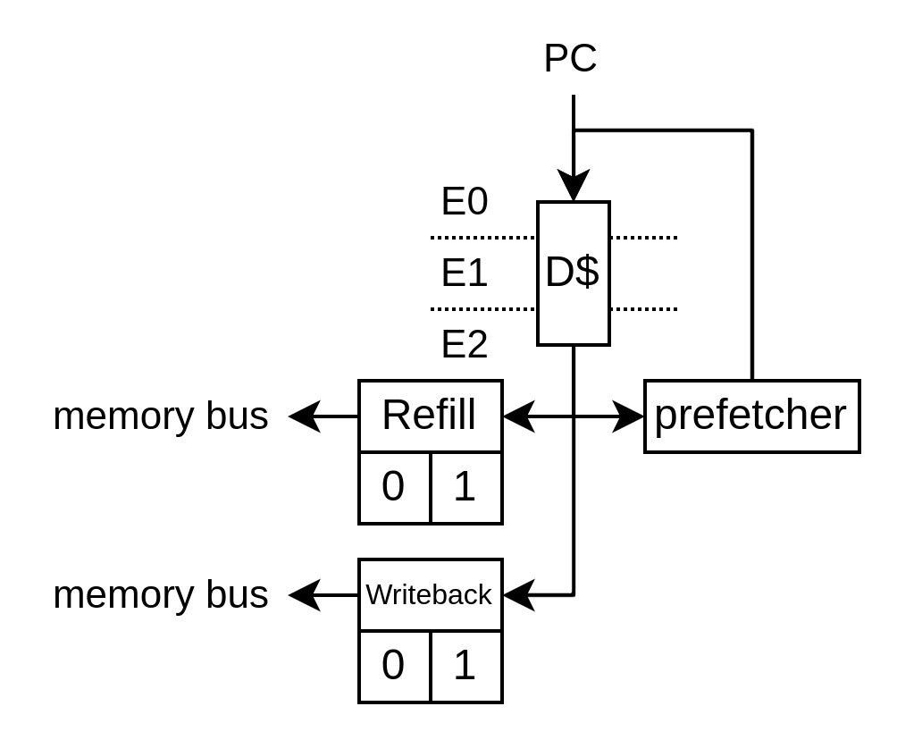
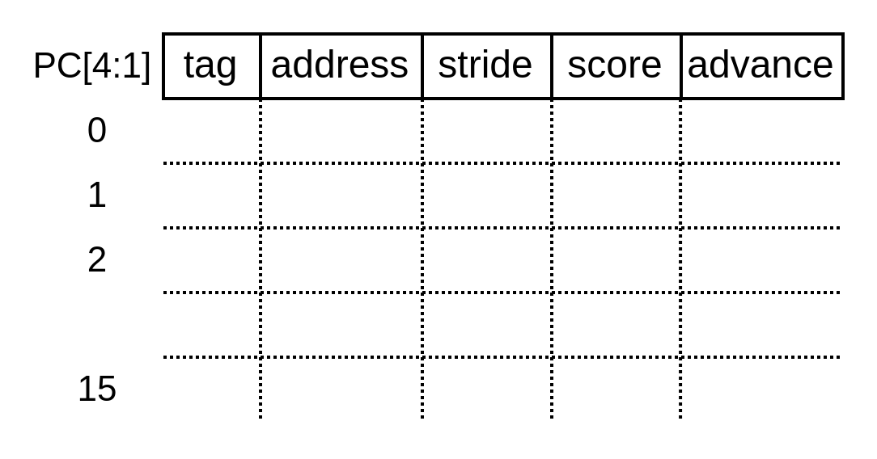
D$ prefetcher
Write speed: 168.4MiB/s
Read speed: 113.3MiB/s
Write speed: 250.5MiB/s
Read speed: 422.9MiB/s

Slide 7
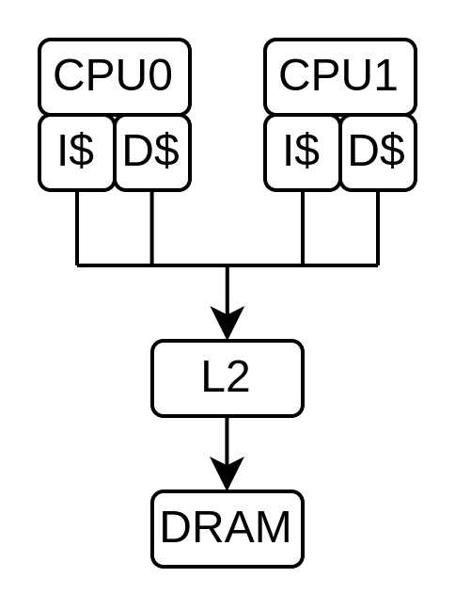
Memory system
Memory coherency
Out of order
Tilelink

Slide 8

Looking for contributions
Already a few
  RVB (Andreas Wallner)
  Compact divider (Thomas Kramer)
Looking for help
  Features additions
  Performance improvements
  Testing
  ASIC port
  …
https://github.com/SpinalHDL/VexiiRiscv
https://github.com/SpinalHDL/VexiiRiscv/tree/dev/doc/litex/debian
Thanks

