Slide 1
HDL
By another way

Slide 2
Summary
Pointing problems by using non-common HDL
Verbosity
Parameterization / reusability
Logic inferation
Lack of abstraction
Lack of structure

Slide 3
About SpinalHDL
It’s a Scala library to describe digital hardware
Abstraction level :
Begins at the same level than VHDL
Finishes between VHDL and HLS
The user can extend it

Slide 4
Unify logic and FF
val mySignal = Bool val myRegister = Reg(UInt(4 bit)) val myRegisterWithInit = Reg(UInt(4 bit)) init(3) mySignal := False when(???){ mySignal := True myRegister := myRegister + 1 }
Notes:
In VHDL you need to split the logic between combinatoral / sequancial with reset / sequancial without reset

Slide 5
Extend scope of things
val valid = Bool val regA = Reg(UInt(4 bit)) def doSomething(value : Int) = { valid := True regA := value } when(???){ doSomething(4) }
Notes:
In VHDL you can’t create a function that assign combinatoral and sequancial logic

Slide 6
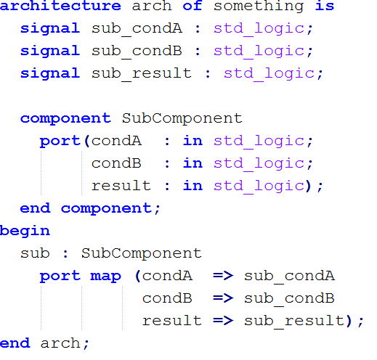
No more component binding
class TopComponent extends Component{ val sub = new SubComponent }
Notes:
By making the consideration that an component instance is like an object, you can directly access its inputs/outpus by typing instanceName.portName

Slide 7
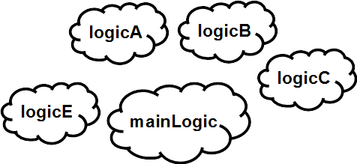
Organize things
class UartCtrlTx extends Component { val io = new Bundle { // io definition } val timer = new Area { // emit a pulse that is used as time reference
// in the state machine } val stateMachine = new Area { // some logic } }
Notes:
In VHDL you have to define sub component (overkill) or for each area, define internal signal with the same prefix each time (weak)

Slide 8
Organize things
val timer = new Area { val counter = Reg(UInt(8 bit)) val reset = False val tick = counter === 192 counter := counter + 1 when(tick || reset) { counter := 0 } } val stateMachine = new Area { // some logic when(timer.tick){ // do something } }
Notes:
In VHDL it will be timer_counter …
timer_reset ….
timer_tick …
In VHDL you can’t exprime things like val tick = counter === 192 in a single line. You need to split it between declaration and logic area.
You can’t exprime directly a wire with a default value like val reset = False

Slide 9
Create/use abstractions
val timeout = Timeout(1000) when(timeout){ //implicit conversion to Bool timeout.clear() //Clear the flag and the internal counter } //Create a counter of 10 states (0 to 9) val counter = Counter(10) counter.clear() //When called it reset the counter. It's not a flag counter.increment() //When called it increment the counter. It's not a flag counter.value //current value counter.valueNext //Next value counter.willOverflow //Flag that indicate if the counter overflow this cycle when(counter === 5){ } //counter is implicitly its value
Notes:
You can very easly create some abstraction like the counter abstraction. Then using it is simple.
(the timeout abstraction is 20 lines, counter is 34 lines)
In VHDL or in (system) verilog, if you need a counter, you will alwas write his beavorial by yourself, because using a component is need too much setup.
With spinalHDL, because it’s so easy to instanciate, you will probably use this counter abstraction.

Slide 10
Make things parameterizable
case class Color(channelWidth: Int) extends Bundle { val red = UInt(channelWidth bit) val green = UInt(channelWidth bit) val blue = UInt(channelWidth bit) } case class Stream[T <: Data](dataType: T) extends Bundle { val valid = Bool val ready = Bool val data: T = cloneOf(dataType) }
val myStreamOfColor = Stream(Color(8))
Notes:
In VHDL you can’t give parameter to records, Package is not an solution good solution.
You can’t use generic datatype in VHDL, you will have to play with std_logic_vector that will store multiple fields (ex fifo pack unpack)

Slide 11
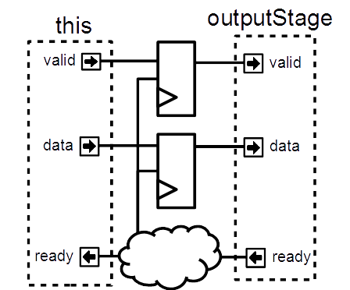
And extend them !
case class Stream[T <: Data](dataType: T) extends Bundle { // ... def connectFrom(that: Stream[T]) = { // some connections between this and that } def m2sPipe(): Stream[T] = { val outputStage = cloneOf(this) val validReg = RegInit(False) val dataReg = Reg(dataType) // some logic return outputStage } def << (that: Stream[T]) = this.connectFrom(that) def <-< (that: Stream[T]) = this << that.m2sPipe() } val myStreamA,myStreamB = Stream(UInt(8 bit)) myStreamA <-< myStreamB
Notes:
In system verilog, even if you can define interface, you can’t define function/task inside it that will generate flops and logic.
This is the breaking point with systemverilog, some application of that will come in next slides

Slide 12
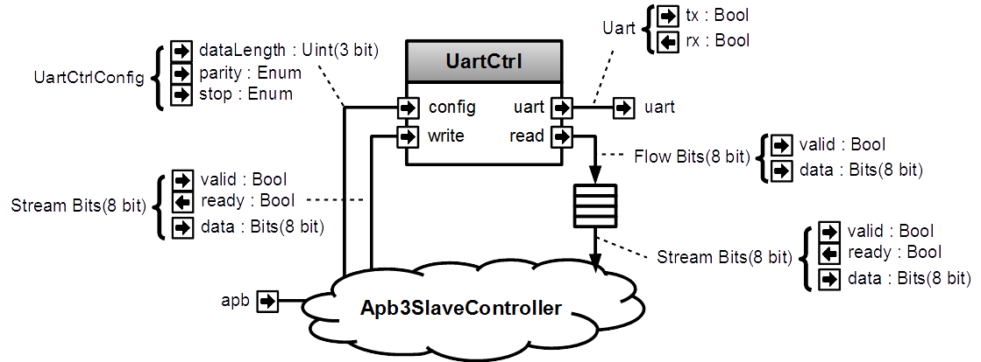
Logic generator

Slide 13
Logic generator
class ApbUartCtrl(apbConfig: Apb3Config) extends Component { val io = new Bundle { val apb = slave(new Apb3Slave(apbConfig)) val uart = master(Uart()) } val uartCtrl = new UartCtrl() uartCtrl.io.uart <> io.uart val busCtrl = new Apb3SlaveController(io.apb) busCtrl.writeOnlyReg(uartCtrl.io.config, 0x10) busCtrl.writeStream(uartCtrl.io.write, 0x20) busCtrl.readStream(uartCtrl.io.read.toStream.queue(16), 0x30) }
Notes:
Apb3SlaveController isn’t a component, it’s a logic generator.
You can call functon on it (writeOnlyReg, writeStream, readStream) and it will generate the corresponding hardware to make the APB bus able to access the given data.
Apb3SlaveController is not something from spinalHDL, it’s something that you as user of the spinalHDL, you can create very easly.

Slide 14
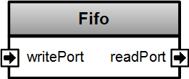
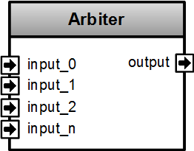
Example of components
class Fifo[T <: Data](dataType: T, depth: Int) extends Component { val io = new Bundle { val writePort = slave Stream (dataType) val readPort = master Stream (dataType) }
//… } class Arbiter[T <: Data](dataType: T, portCount: Int) extends Component { val io = new Bundle { val inputs = Vec(slave(Stream(dataType)), portCount) val output = master(Stream(dataType)) } //... }
Notes:
VHDL => pack/unpack + 2D things packed into a single std_logic_vector

Slide 15
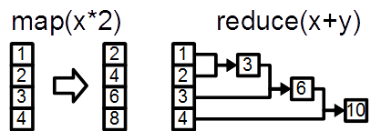
Functional programming
class LineTag extends Bundle { val valid = Bool val address = UInt(32 bit) val dirty = Bool def hit(targetAddress : UInt) : Bool = valid && address === targetAddress } val lineTags = Vec(new LineTag, 8) val lineHits = lineTags.map(lineTag => lineTag.hit(targetAddress)) val lineHitValid = lineHits.reduce((a,b) => a || b) val lineHitIndex = OHToUInt(lineHits)
Notes:
VHDL => pack/unpack + 2D things packed into a single std_logic_vector

Slide 16
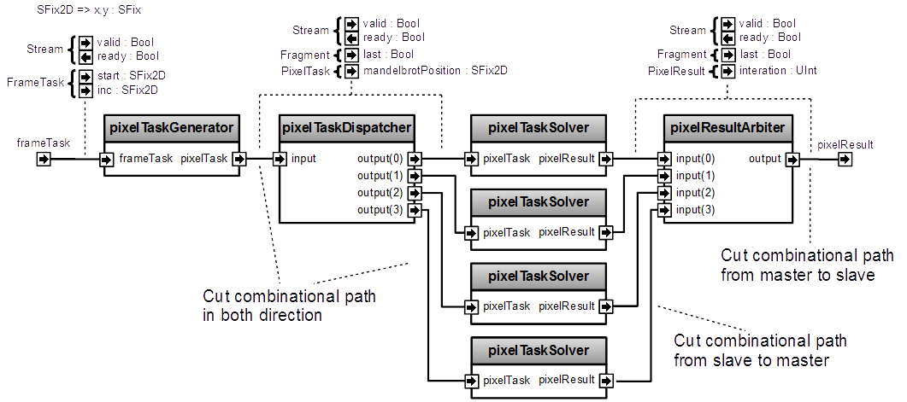

Less line
How many lines of code ?

Slide 17
Less line
class FrameTaskSolver(p: MandelbrotCoreParameters) extends Component { val io = new Bundle { val frameTask = slave Stream FrameTask(p) val pixelResult = master Stream Fragment(PixelResult(p)) } val pixelTaskGenerator = new PixelTaskGenerator(p) val pixelTaskDispatcher = new DispatcherInOrder(Fragment(PixelTask(p)), p.pixelTaskSolverCount) val pixelTaskSolver = for (i <- 0 until p.pixelTaskSolverCount) yield new PixelTaskSolver(p) val pixelResultArbiter = StreamArbiter.inOrder.build(Fragment(PixelResult(p)), p.pixelTaskSolverCount) pixelTaskGenerator.io.frameTask << io.frameTask pixelTaskDispatcher.io.input <-/< pixelTaskGenerator.io.pixelTask for (solverId <- 0 until p.pixelTaskSolverCount) { pixelTaskSolver(solverId).io.pixelTask <-/< pixelTaskDispatcher.io.outputs(solverId) pixelResultArbiter.io.inputs(solverId) </< pixelTaskSolver(solverId).io.pixelResult } io.pixelResult <-< pixelResultArbiter.io.output }

Slide 18
Produce files
{ "reports": [ { "p":{ "iterationLimit":256, "pixelTaskSolverCount":6, "screenResX":640, "screenResY":480, "fixExp":7, "fixWidth":51 }, "uid":"-1442547524", "clazz":"uidPeripheral", "kind":"mandelbrotCore" } ] }
Hardware
generation
Driver

Slide 19
Netlist analyser
class MyComponentWithLatencyAssert extends Component { val io = new Bundle { val slavePort = slave Stream (UInt(8 bit)) val masterPort = master Stream (UInt(8 bit)) } //These 3 line are equivalent to io.slavePort.queue(16) >/-> io.masterPort val fifo = new StreamFifo((UInt(8 bit)),16) fifo.io.push << io.slavePort fifo.io.pop >/-> io.masterPort assert(3 == latencyAnalysis(io.slavePort.data,io.masterPort.data)) assert(2 == latencyAnalysis(io.masterPort.ready,io.slavePort.ready)) }

Slide 20
Scala
Free Scala IDE (eclipse, intelij)
Highlight syntax error
Renaming flexibility
Intelligent auto completion
Code’s structure overview
Navigation tools
Allow you to extend the language
Library

Slide 21
SpinalHDL
Open source project
Generate synthesizable VHDL
Can instantiate VHDL as an blackbox
Keep the hierarchy and names
https://github.com/SpinalHDL/SpinalHDL

Slide 22
?

Slide 23
Clock domains
val coreClk = in Bool val coreReset = in Bool val coreClockDomain = ClockDomain(coreClk,coreReset) val coreClockedArea = new ClockingArea(coreClockDomain){ val counter = Reg(UInt(8 bit)) }
Notes:
In VHDL you have to carry every where your clock and reset signal, you can’t clearly define clocking area.

