Slide 1
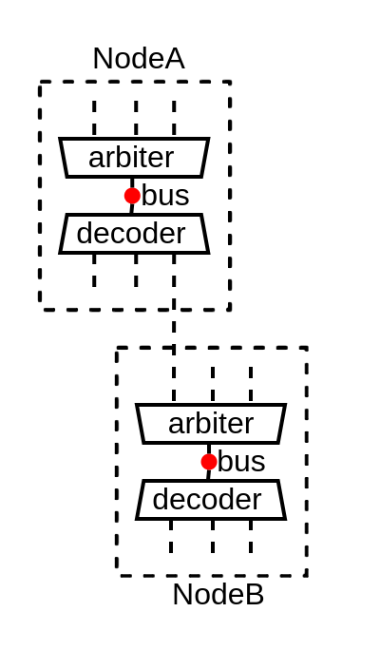
spinal.lib.bus.tilelink
An Tilelink interconnect generator based on fiber
Charles Papon

Slide 2
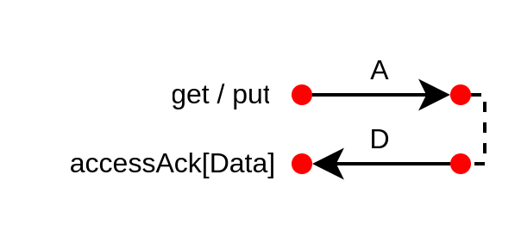
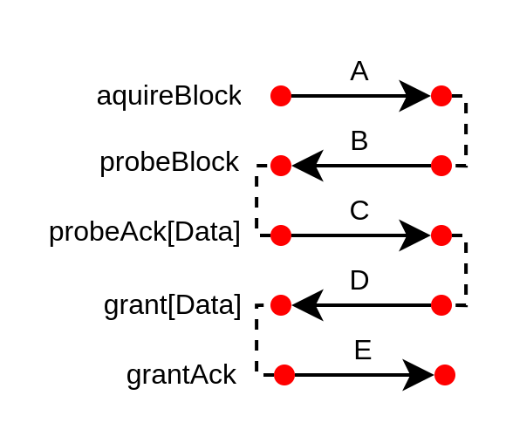
Tilelink in short
Memory bus specification
Free / Open source
Few specificities
  Out of order
  Only aligned accesses
Optional memory coherency
  Memory block ownership (probe)

Slide 3
Parameter propagation / negotiation
Source / Sink identifier width
  Expends / mutate
Address / Data width
  Inference
Memory region attributes
  Cacheable, IO, Speculative, …
Atomic support
Coherent memory block size
...

Slide 4
Some context
Hardware Description Library (HDL) (SpinalHDL, Chisel, Migen, Amaranth)
  Embedded in a general purpose programming language (Scala, Python)
  Sequential hardware elaboration
import spinal.core._
class Mux extends Component {
// Define some IO
val a,b = in UInt(8 bits)
val sel = in Bool()
val result = out UInt(8 bits)
// Define some behaviour
when(sel){
result := a
} otherwise {
result := b
}
}

Slide 5
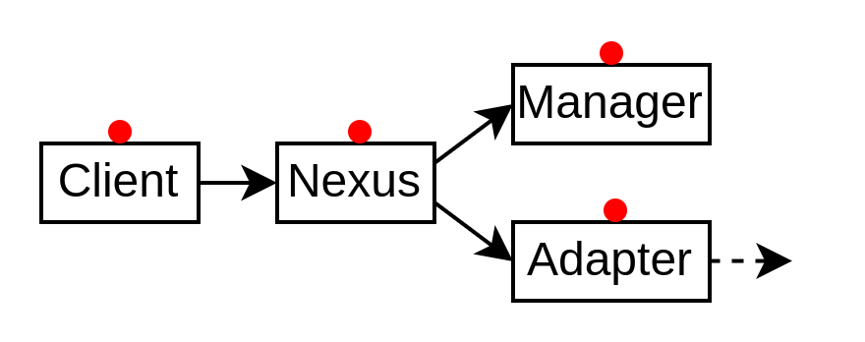
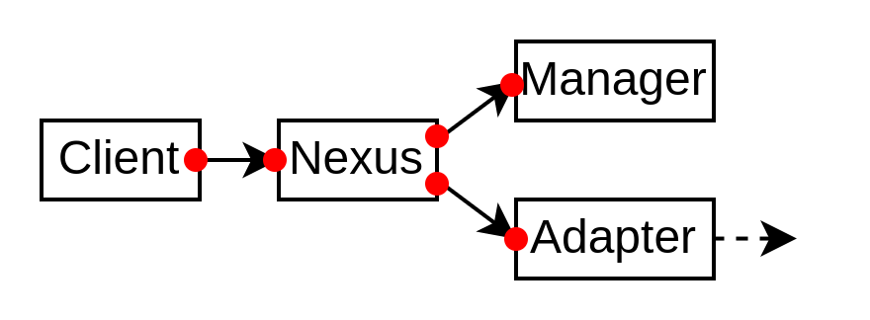
Propagation / negotiation API design possibilities
Callback based (ex : Litex)
  Agents implements a software interface and are registered in a centralized elaboration scheduler
Rocket-Chip diplomacy
  Module centric (Client, Manager, Adapter, Nexus, …)
  Based on scala lazy val
spinal.lib.bus.tilelink
  Interface centric
  Based on fiber

Slide 6
Fiber
User space “thread”
No pre-emption
Deterministic
Can be applied to hardware elaboration as :
  Imagine, parts of your hardware elaboration run in its own Fiber
    CPU instruction decoder => Fiber
    CPU execution unit => Fiber
    CPU integer ALU => Fiber
    …
  And you get NaxRiscv

Slide 7
NaxRiscv
//EXECUTION UNITES
plugins += new ExecutionUnitBase("EU0")
plugins += new SrcPlugin("EU0", earlySrc = true)
plugins += new IntAluPlugin("EU0", aluStage = 0)
plugins += new ShiftPlugin("EU0" , aluStage = 0)
plugins += new BranchPlugin("EU0")
plugins += new ExecutionUnitBase("EU1")
plugins += new SrcPlugin("EU1")
plugins += new IntAluPlugin("EU1")
plugins += new ShiftPlugin("EU1")
plugins += new BranchPlugin("EU1")
plugins += new ExecutionUnitBase("EU2", writebackCountMax = 1)
plugins += new SrcPlugin("EU2", earlySrc = true)
plugins += new MulPlugin("EU2", writebackAt = 2, staticLatency = false)
plugins += new DivPlugin("EU2", writebackAt = 2)
plugins += new LoadPlugin("EU2")
plugins += new StorePlugin("EU2")
plugins += new EnvCallPlugin("EU2")(rescheduleAt = 2)
plugins += new CsrAccessPlugin("EU2")(
decodeAt = 0,
readAt = 1,
writeAt = 2,
writebackAt = 2,
staticLatency = false
)
An Out Of Order, multi issue, RISC-V CPU
Target FPGA
  Artix7-3 : RV32IMACSU 155 Mhz 13.3 KLUT
  2.93 DMIPS/Mhz 5.02 Coremark/Mhz
Can run Debian (64 bits config)
Plugin based, like VexRiscv
  But those plugins are based on Fibers
https://spinalhdl.github.io/NaxRiscv-Rtd/main/NaxRiscv/abstraction/index.html

Slide 8
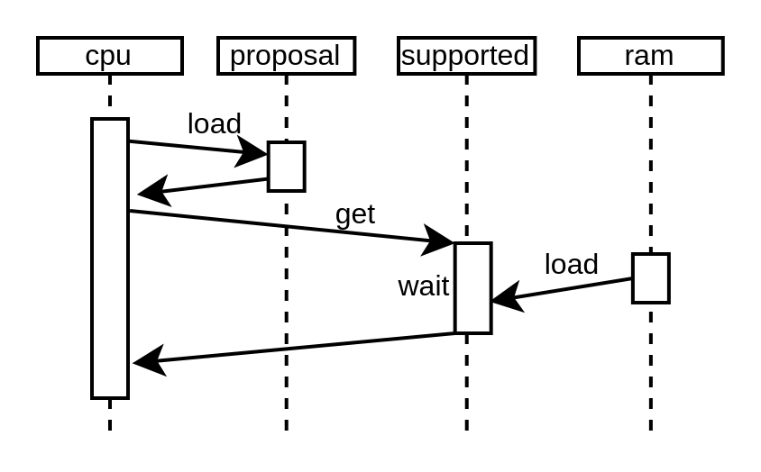
Fiber : Negotiation example
val widthProposal = Handle[Int]
val widthSupported = Handle[Int]
val cpu = Fiber build {
widthProposal.load(64)
val data = UInt(widthSupported.get bits)
}
val ram = Fiber build {
widthSupported.load(math.min(widthProposal, 32))
}

Slide 9
Tilelink Node
What is it
  A Tilelink bus instance
  Can optionally have masters
  Can optionally have slaves
Automatically :
  Negotiate / propagate Tilelink parameters
  Add arbiter / decoder
  Add Width adapter
  Add Cross clock domain adapter

Slide 10
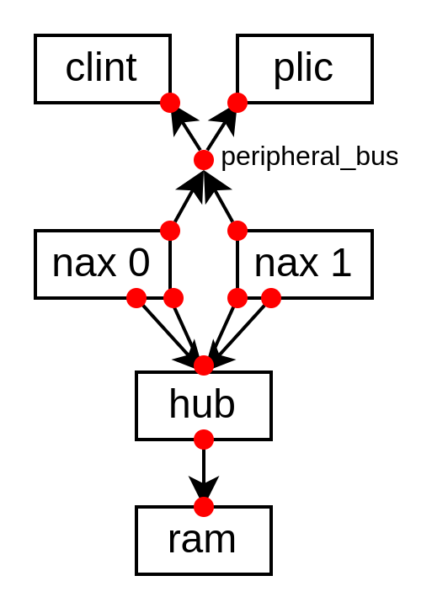
Little SoC
(with memory coherency)
class SocDemoSmall(cpuCount : Int) extends Component {
val naxes = List.fill(cpuCount)(new TilelinkNaxRiscvFiber())
for((nax, hartId) <- naxes.zipWithIndex)
nax.setCoherentConfig(hartId)
val hub = new HubFiber()
for(nax <- naxes) hub.up << (nax.iBus, nax.dBus)
val ram = new Ram()
ram.node at (0x80000000, 64 kB) of (hub.down)
val peripheral = new Area {
val bus = Node()
val clint = new TilelinkClintFiber()
clint.node at 0x10000 of bus
val plic = new TilelinkPlicFiber()
plic.node at 0xC00000 of bus
for(nax <- naxes) {
nax.bind(clint)
nax.bind(plic)
bus at(0x10000000, 16 MB) of(nax.pBus)
}
}
peripheral.bus.setUpConnection(a = StreamPipe.FULL)
}

Slide 11
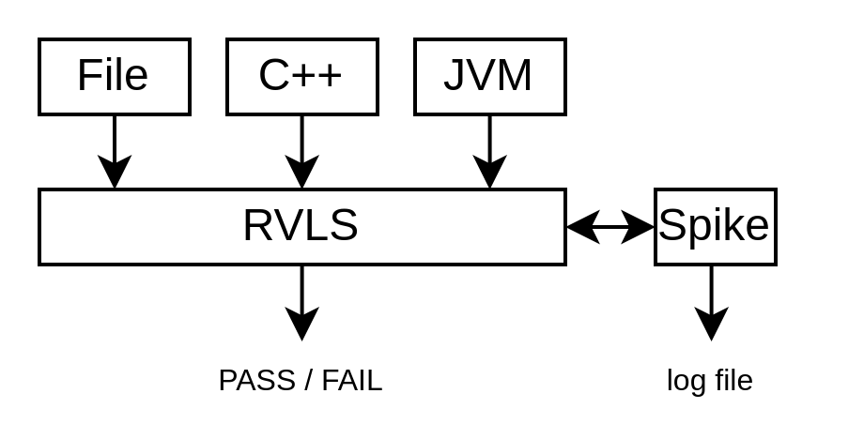
RVLS
RVLS (Risc-V Lock Step) is a RISC-V simulation trace checker
Traces Frontends
  Human-readable text file
  C++ / Java JNI calls
Spike used as golden model
Support multi-core systems (including some memory coherency traces)
https://github.com/SpinalHDL/rvls

Slide 12
Question ?
Open Discussion about the tilelink interconnect API / framework :
  https://github.com/SpinalHDL/SpinalHDL/discussions/1115
Multicore NaxRiscv / tilelink cluster integrated in Litex
  Can run linux and doom
Looking for buddies :)

