Slide 1
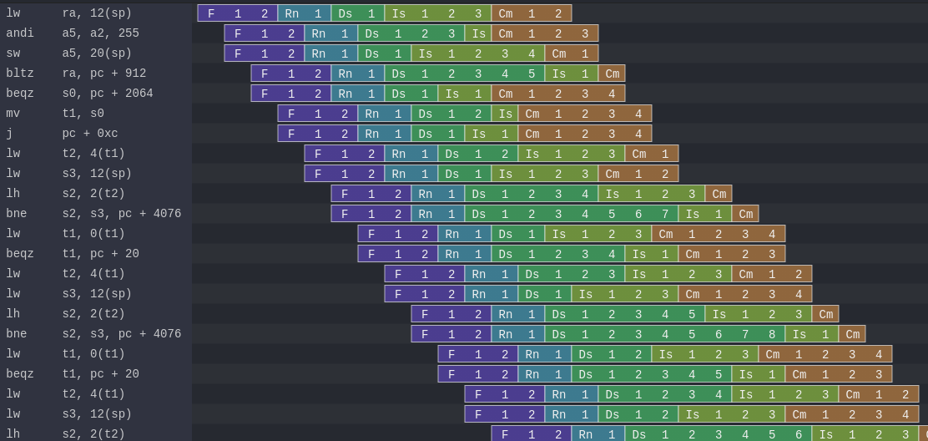
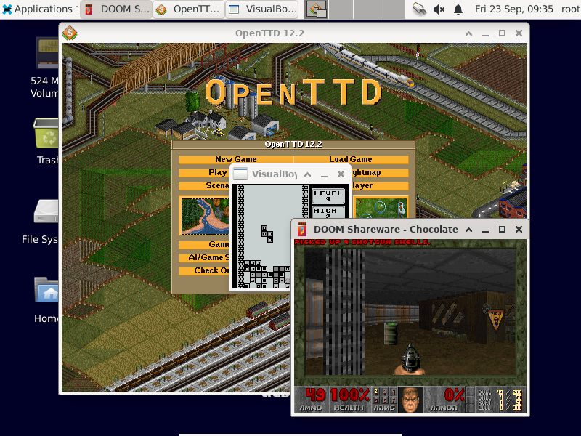
Open CPU / SoC design, all the way up to Debian

Slide 2
Background / whoami
Dolu1990 on github
Active on open/free project
  SpinalHDL / VexRiscv / NaxRiscv
Software / Hardware background
  Without computer science degree
  With Industrial system / Electronic degree

Slide 3
Introduction
This talk will be based on NaxRiscv
  Opensource https://github.com/SpinalHDL/NaxRiscv
    RISC-V softcore
    out of order, multi-issue, multi core, memory coherent
What the talk will do
  Share experience
  Give tips / keywords

Slide 4
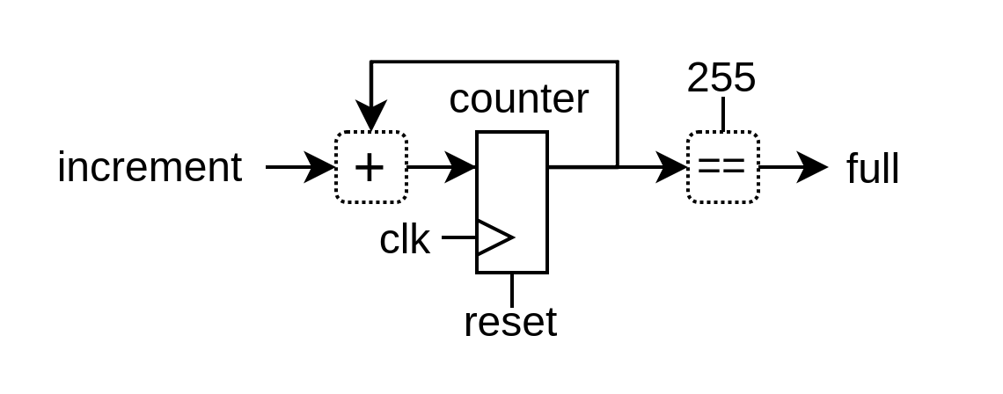

Digital Hardware description
“There is no alternative” (VHDL / Verilog)
  Scala based : SpinalHDL, Chisel
  Python based : Migen, Amaranth
  ...

Slide 5
It can be pretty / explicit
class Timer extends Component {
val increment = in Bool()
val counter = Reg(UInt(8 bits)) init(0)
val full = counter === 255
when(increment){
counter := counter + 1
}
}

Slide 6
Using software to elaborate your hardware
Control flow : if / for
Data structures : dynamic array / hash map / hash set
Lambda function : reduce / fold / map / filter / ...
OOP : class / software interface
See https://spinalhdl.github.io/NaxRiscv-Rtd/main/NaxRiscv/abstraction/index.html

Slide 7


CPU instruction set
A few open / free ISA (OpenRISC, , …)
RISC-V
  https://riscv.org/technical/specifications/
  Secretly being embedded in ASICs
  Bloat free (Mostly, from a FPGA perspective)
  GCC / LLVM
  Qemu support
  Linux / Debian port
  ...

Slide 8

Basics for an out of order CPU (NaxRiscv)
https://github.com/SpinalHDL/NaxRiscv

Slide 9
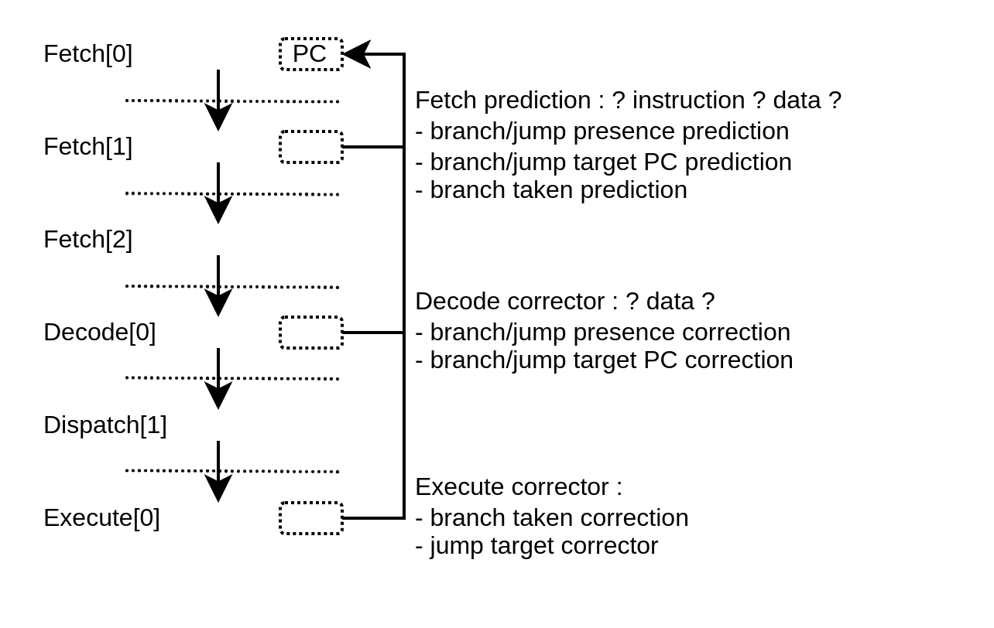
“Branch prediction”

Slide 10

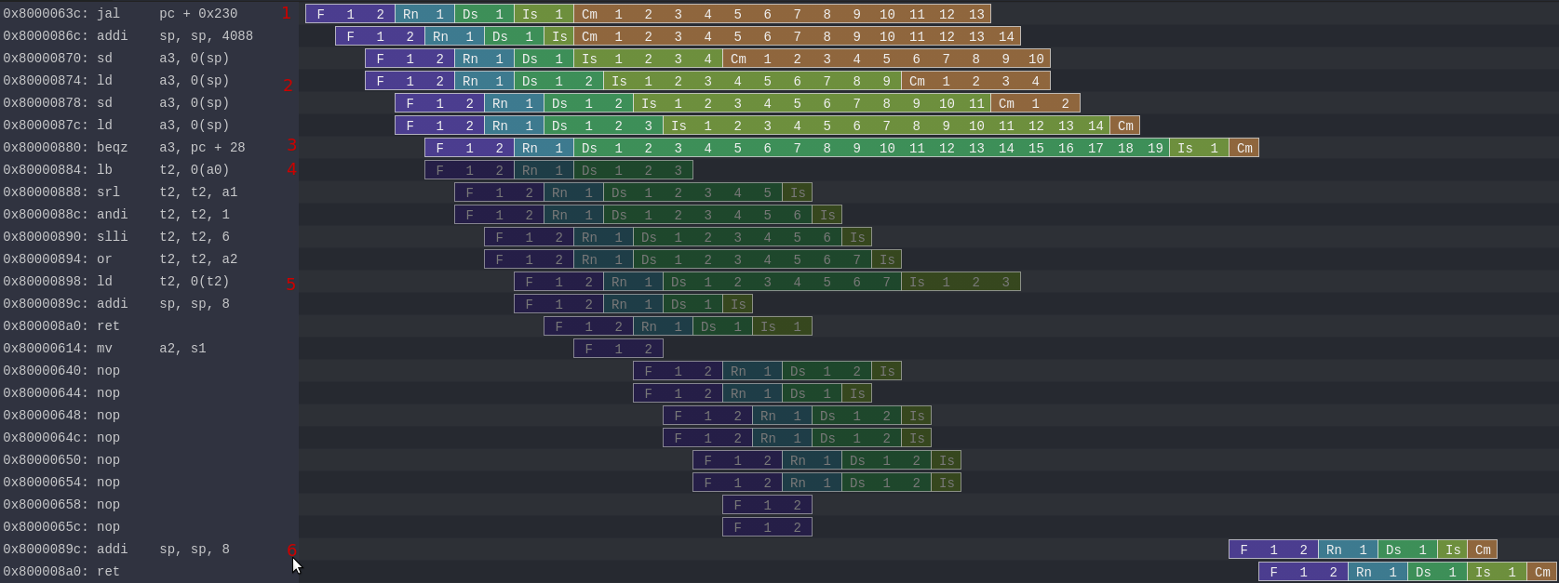
Secret leak (Konata trace)
https://spinalhdl.github.io/NaxRiscv-Rtd/main/NaxRiscv/misc/index.html#security
Spectre

Slide 11
Secret leak
Spectre
Generate long dependencies

Slide 12
Secret leak
Spectre
Laaaaaaate branch miss prediction

Slide 13
Secret leak
Spectre
RAM[secret] -> (page fault)

Slide 14
Secret leak
Spectre
probe + RAM[secret]

Slide 15
Secret leak
Spectre
RAM[probe + RAM[secret]]

Slide 16
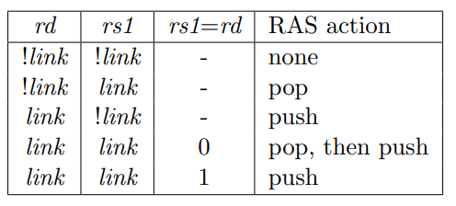
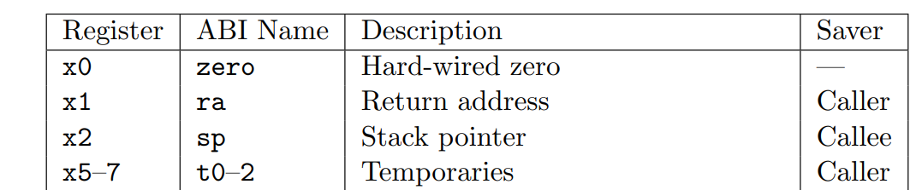
Details can throw you off
From https://github.com/SpinalHDL/NaxRiscv/issues/67
  [Performance bug] Incorrect register dependency tracking
# Triggering bad speculation
jalr x0, t0 # Doesn’t work
jalr x0, t1 # Work
riscv-calling.pdf :
“A JAL instruction should push the return address onto a return-address stack (RAS) only when rd=x1/x5. JALR instructions should push/pop a RAS as shown in the Table 2.1.”
riscv-calling.pdf

Slide 17
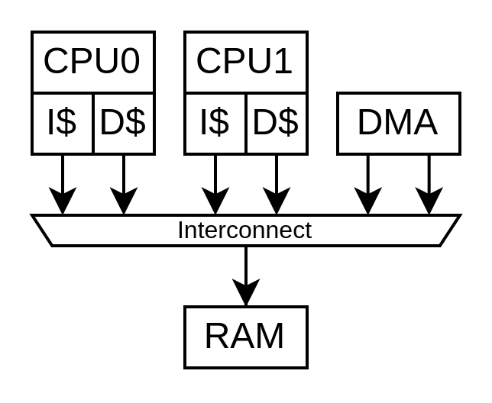
Multi core requirements (RISC-V linux)
Hardware cache coherency
Inter-CPU software interrupts

Slide 18
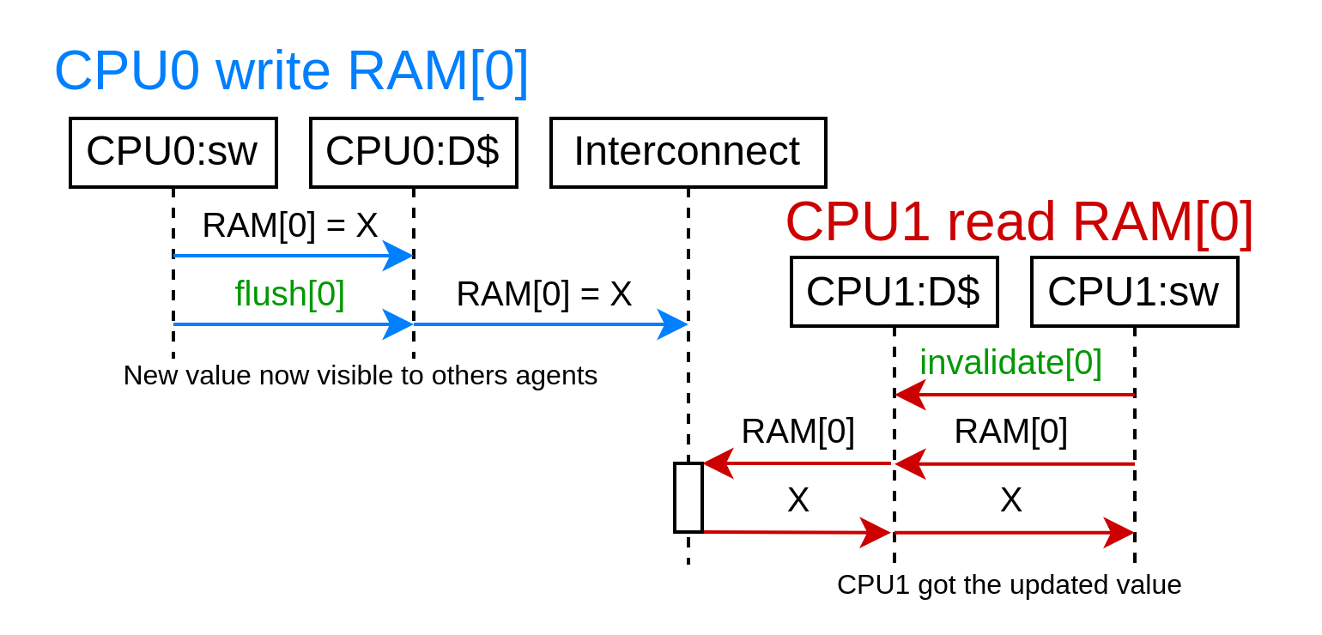
Software cache coherency

Slide 19
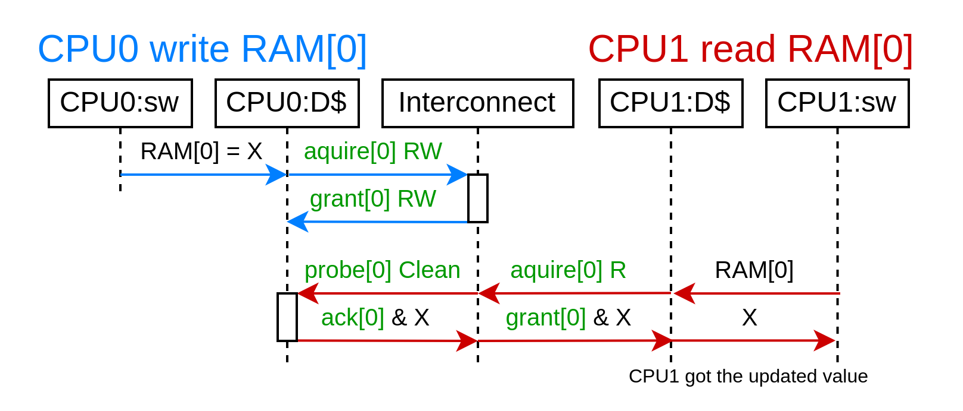
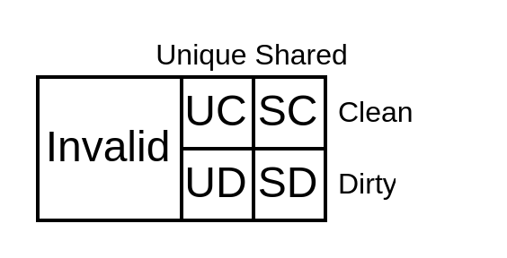
Hardware cache coherency with memory block copy and permissions

Slide 20
Hardware cache coherency
And its side effects
volatile int array[2];
void thread_0() {
while(1) {
array[0] += 1;
}
}
void thread_1() {
while(1) {
array[1] += 1;
}
}
Same memory block (64 bytes): 18486 ps/iteration
Different memory blocks : 902 ps/iteration
(on a 2 years old CPU)

Slide 21
Cache coherency
Open specification : Tilelink
Multiple open source implementations, ex :
  https://github.com/SpinalHDL/SpinalHDL/tree/dev/lib/src/main/scala/spinal/lib/bus/tilelink
Coherent L2 design
  https://github.com/SpinalHDL/SpinalHDL/blob/dev/lib/src/main/scala/spinal/lib/bus/tilelink/coherent/Cache.scala
  Exposes a lot of performance tricks
    1 pending transaction per 64 bytes block
    64 bytes per burst max
    Keep bursts aligned

Slide 22

Memory / Peripherals / Deployment
LiteX
  Open-source SoC framework (in Python)
  Integrate many peripherals
    DDRx controller
    SDCARD
    Ethernet, USB host
    SATA, PCIe, ...

Slide 23
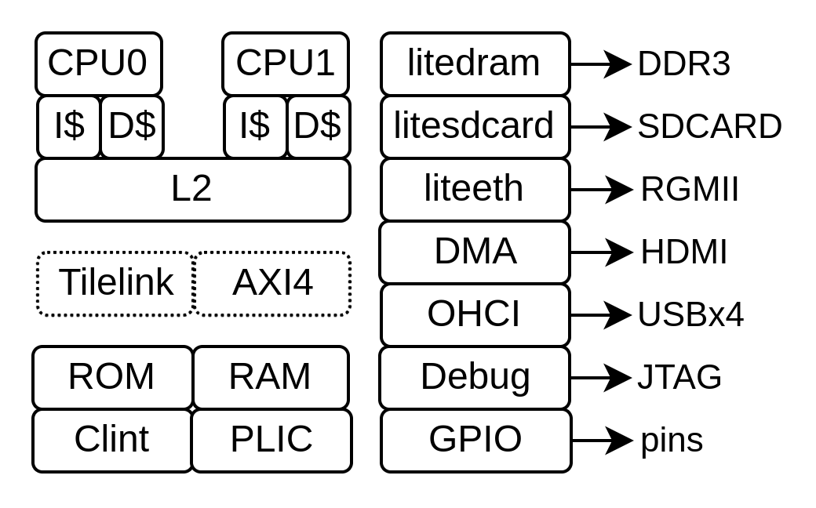
Memory / Peripherals / Deployment
python3 -m litex_boards.targets.digilent_nexys_video --cpu-type=naxriscv --bus-standard axi-lite --with-video-framebuffer --with-coherent-dma --with-sdcard --with-ethernet --xlen=64 --scala-args='rvc=true,rvf=true,rvd=true,alu-count=2,decode-count=2' --with-jtag-tap --sys-clk-freq 100000000 --cpu-count 2 --build –load
+ minor for USB / JTAG

Slide 24
USB host support
USB host support =>
  Keyboard / mouse / audio / flash drive / sdcard / uart / ethernet / bluetooth
Open specification :
  Open Host Controller Interface Specification for USB (OHCI)
  USB 12 Mb/s
  Up to 15 ports, 2 FPGA GPIO per port
Open implementation :
  https://spinalhdl.github.io/SpinalDoc-RTD/master/SpinalHDL/Libraries/Com/usb_ohci.html
  https://github.com/SpinalHDL/SpinalHDL/blob/dev/lib/src/main/scala/spinal/lib/com/usb/ohci/UsbOhci.scala
  https://github.com/litex-hub/pythondata-misc-usb_ohci/tree/master/pythondata_misc_usb_ohci/verilog

Slide 25
Synthesis / Place / Route
Some open source tools for
  Xilinx 7-Series
  Lattice ice40 / ecp5
  …
Synthesis : Yosys
Place and route : Nextpnr
...

Slide 26


Running Linux
Requirements on RISC-V
  Hardware cache coherency (between CPUs + DMA)
  Machine/Supervisor/User modes (riscv-privileged spec)
  SBI (Supervisor Binary Interface, kinda like BIOS)
  DTB (Device Tree Binary)
https://twitter.com/i/status/1493996880593887235

Slide 27

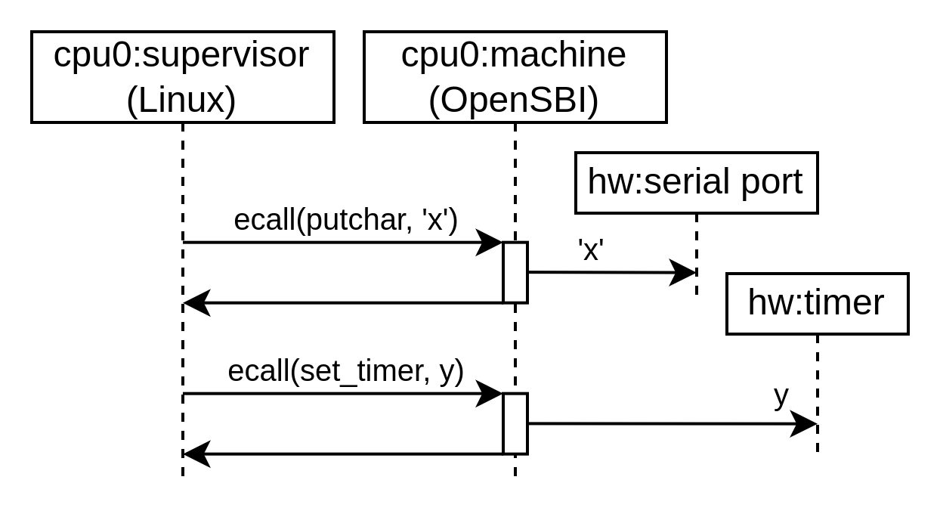
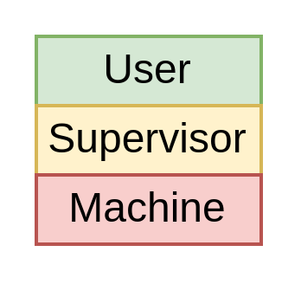
SBI (Supervisor Binary Interface)
https://github.com/riscv-non-isa/riscv-sbi-doc
https://github.com/riscv-software-src/opensbi

Slide 28
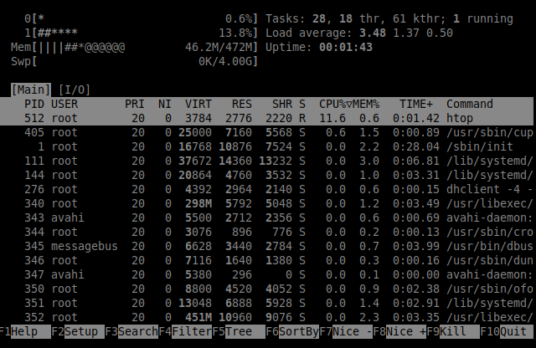
Running Debian
Requirements on RISC-V
  RV64IMAFDC
  Linux kernel
  Some storage (ex: SDCARD)
Doc : https://github.com/SpinalHDL/NaxSoftware/tree/main/debian_litex
Video : https://x.com/dolu1990/status/1712848731349889108

Slide 30
Verification / Debugging
May create rituals
May exhaust your sanity
May never end
May crush your soul
Hello darkness my old friend

Slide 31
Debugging – example (a real one)
Dual core Debian freeze (RCU error) after ~1h (360’000’000’000 cycles)
  Impossible to reproduced in simulation (~40 days of runtime @ 100 Khz)
Hope you get clues
  Core was still alive on JTAG => OpenOCD
  PC was in linux “_raw_spin_lock”
  Forcing it to unlock => Everything back on track
What it was :
  CPU D$ doing bad memory coherency
  (releasing data permissions once again after being probed out)

Slide 32



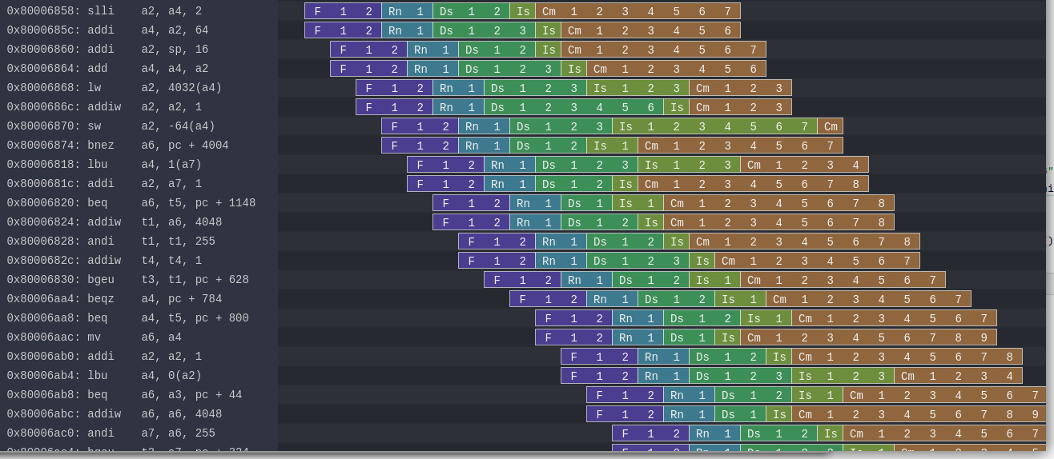
Simulation
A few open source simulation tools :
  GHDL, IVerilog, Verilator, ...
Based on Verilator (~150-200 Khz on a 4 years old CPU)
Lock-step checks against Spike / RVLS
Konata traces

Slide 33
0xAA55
I hope you had a good time
If you are looking for open-source project funding :
  NLnet Foundation (they helped me a lot)

Slide 34
Speculative execution
Execute as much as you can in advance
Bad speculation → no side effect on the ISA states
  x1, x2, .. , x31
  CSR
  Global memory (RAM)
But what’s about all the others hardware states
  Branch predictors (BTB, RAS, GShare)
  I$ D$ tags (is address X in the cache or not)
  Those are easy to probe

Slide 35
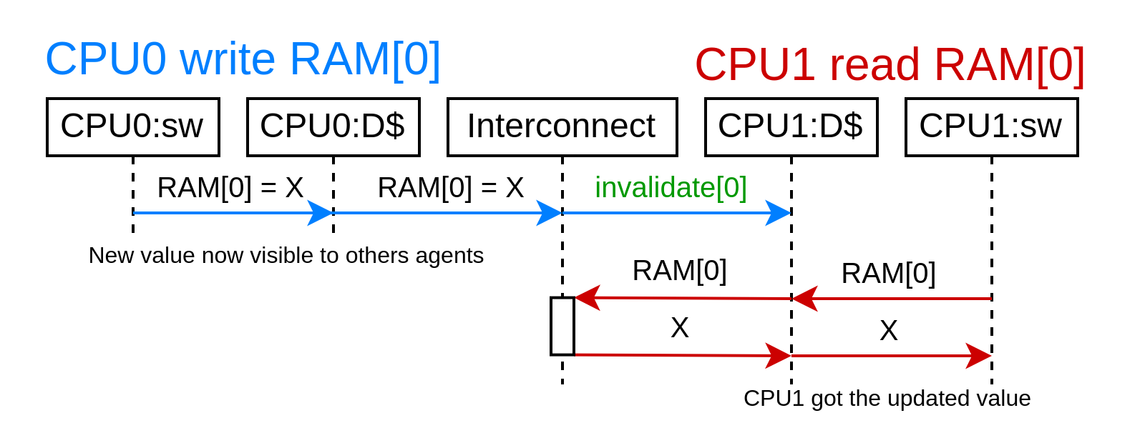
Hardware cache coherency without memory block ownership

Slide 36
Hardware cache coherency with memory block ownership
Caches have to acquire memory block permissions
  read [write] permissions
  64 bytes per block (typically), aligned
Cache line states
  Valid / Invalid
  Clean / Dirty
  Unique / Shared

Slide 37
Boot sequence
FPGA bitstream
Litex bios
OpenSBI
[Uboot]
Linux
Buildroot / Debian / ...

