Slide 1
Designing a open Linux capable SoC using software

Slide 2
Whoami
Charles Papon
Hardware/Software background
Main dev behind
  SpinalHDL, VexRiscv, SaxonSoc

Slide 3

Software capturing hardware a model
Hardware design → data structure

Slide 4
Software running simulations
HDL => Hardware description language
A „modern“ alternative to VHDL/Verilog/SystemVerilog
Technically it is a Scala iDSL
Also implement some modules
  DDR3 controller
  Ethernet controller
  USB host controller (NLnet funded)
  …
https://github.com/SpinalHDL/SpinalHDL

Slide 5
Software elaborated pipeline
CPU targeted for FPGA deployement
  RISC-V 32 bits
  Multi core
  Memory coherency
  Can run upstream linux
  64 bits FPU, AES (NLnet funded)
Allow peoples to extends it
Avoid FPGA vendor‘s IP creep
https://github.com/SpinalHDL/VexRiscv

Slide 6
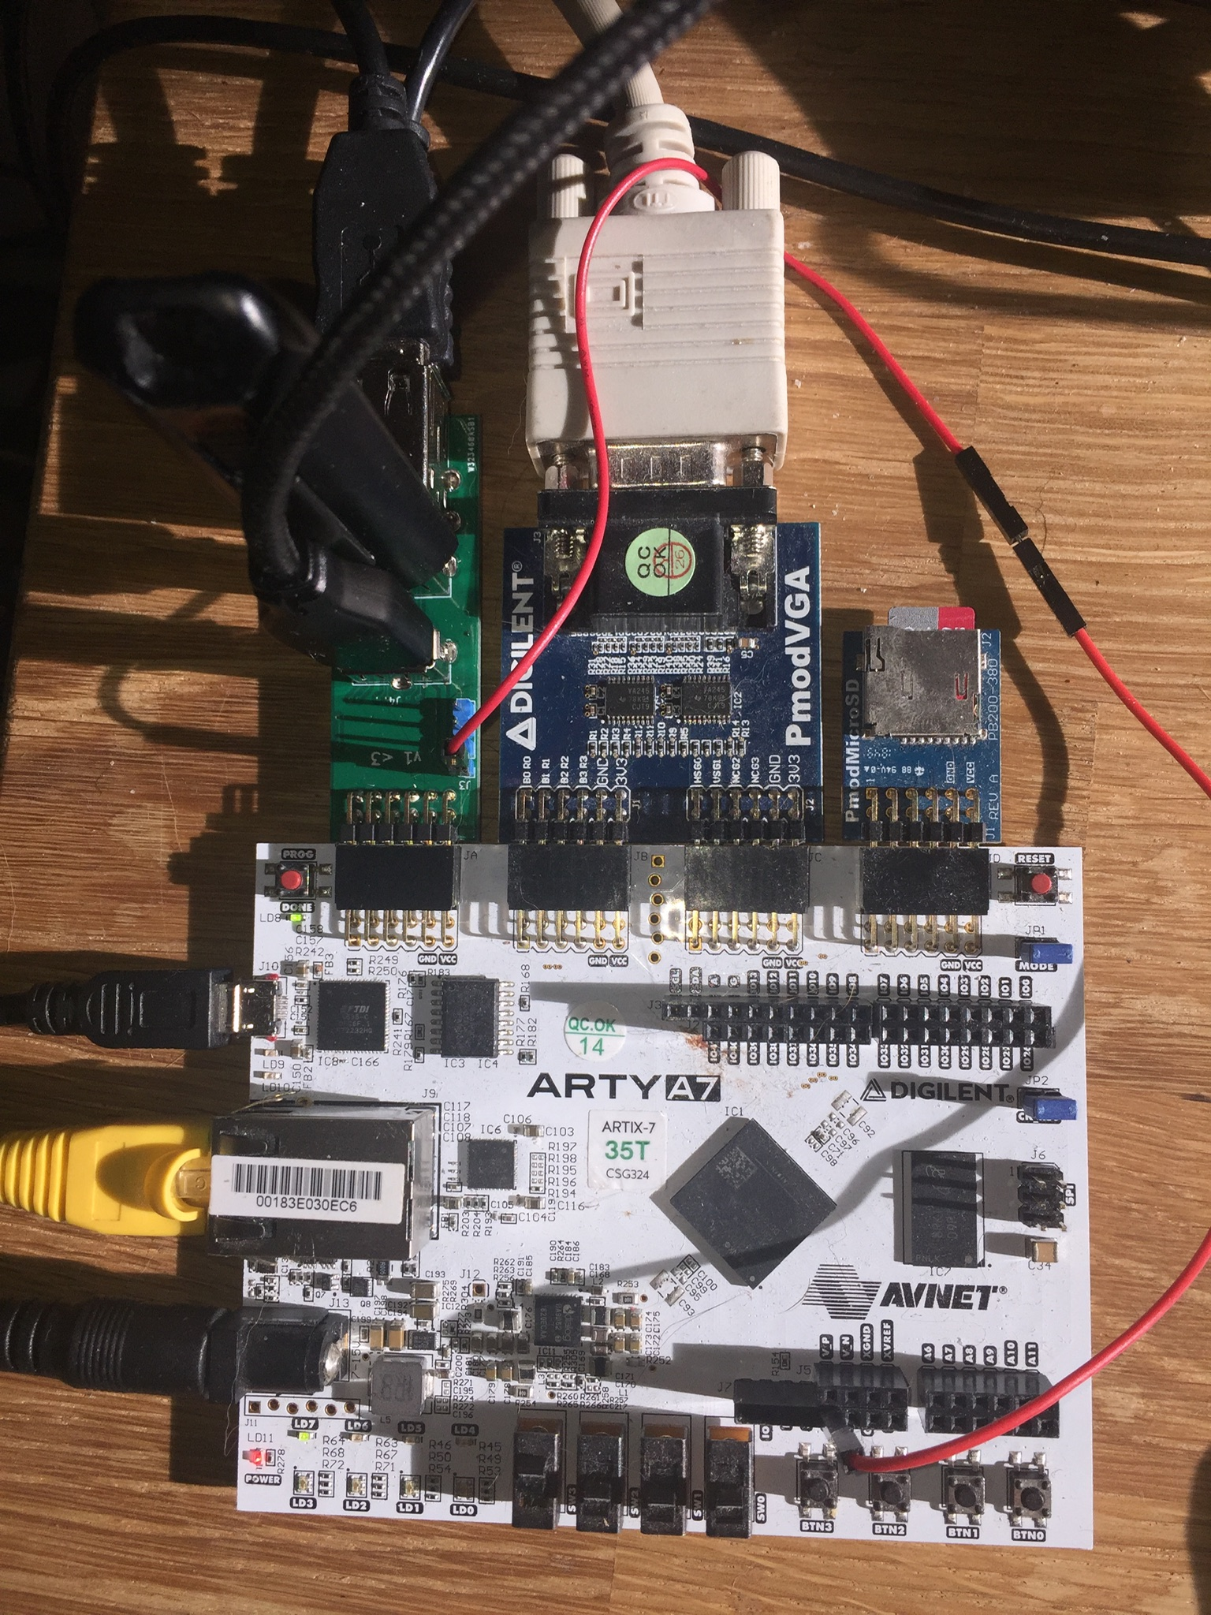
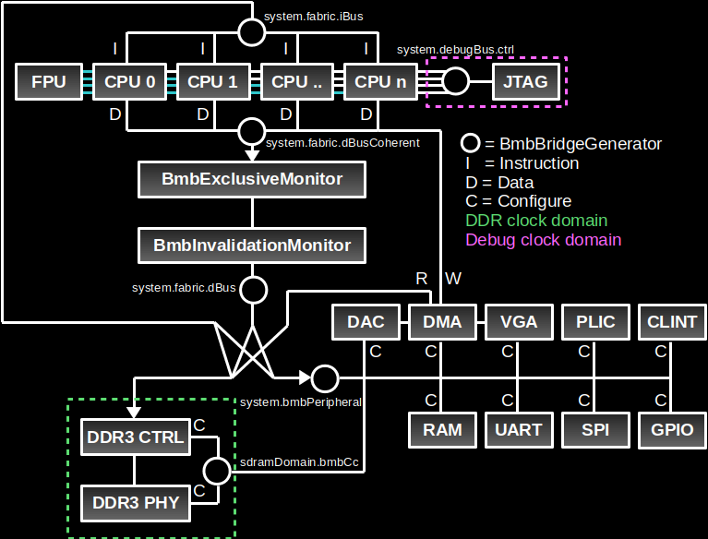
SaxonSoc
Framework to compose SoC
For instance on ArtyA7 35T
  2 VexRiscv ~100 Mhz
  Shared FPU
  DDR3 , Sdcard
  Ethernet, USB host,
  Video/Audio output
https://github.com/SpinalHDL/SaxonSoc/tree/dev-0.3/bsp/digilent/ArtyA7SmpLinux

Slide 7
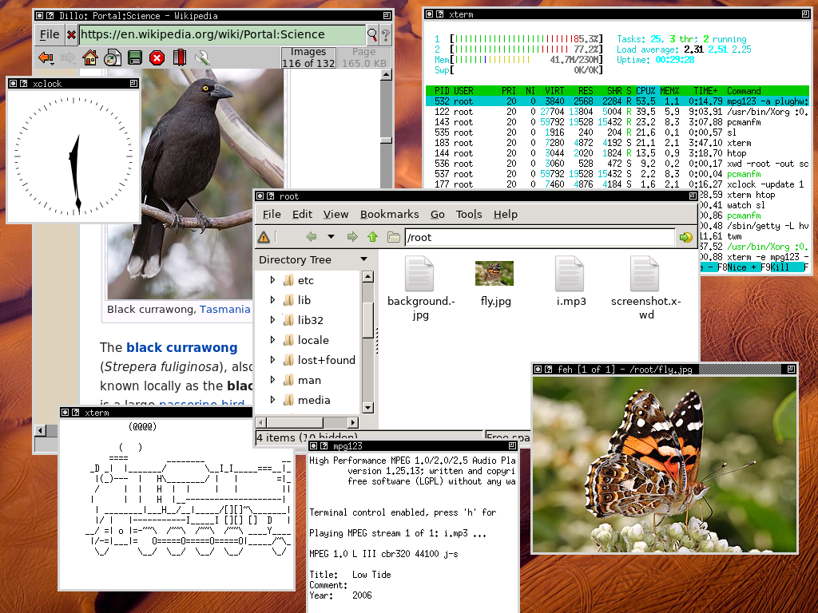
Linux
Buildroot
x11
mpg123
Dillo
USB boot
...

Slide 8
DDR3 controller
aaa

Slide 9
USB host controller
aaa

Slide 10
FPGA to deploy hardware
Pro
  Affordability (dev kit ~30$-200$, low initial cost)
  Iterate in a few minutes
Their limitations :
  Large volume => high cost
  Speed
  Design size
  Only digital
  ...

