Slide 1
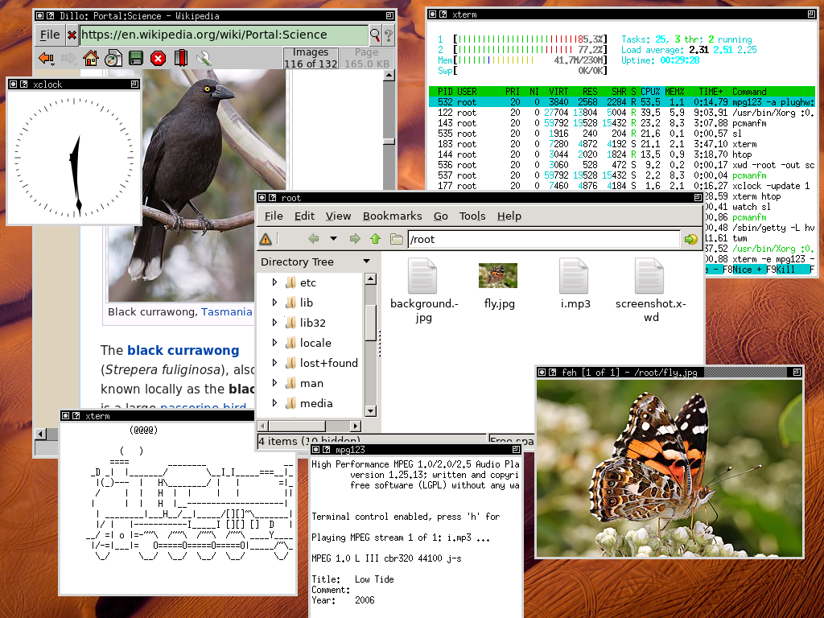
SpinalHDL / VexRiscv / SaxonSoc
Designing a open Linux capable SoC using software

Slide 2
Whoami
Charles Papon
Hardware/Software background
Work on :
  SpinalHDL, VexRiscv, SaxonSoc

Slide 3

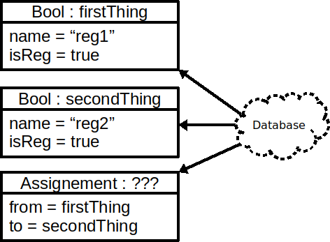
Internal domain specific language (iDSL)
val firstThing = Bool()
firstThing.setName("reg1")
firstThing.setAsReg()
val secondThing = Bool()
secondThing.setName("reg2")
secondThing.setAsReg()
secondThing.assignFrom(firstThing)
(Scala code using the SpinalHDL API)
val reg1, reg2 = Reg(Bool())
reg1 := reg2

Slide 4





The hardware flow
val reg1, reg2 = Reg(Bool())
reg1 := reg2

Slide 5
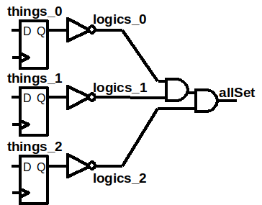
Host language as a elaboration tool
val things = ArrayBuffer[Bool]()
for(idx <- 0 to 2){
things += Reg(Bool())
}
val logics = things.map(r => !r)
val allSet = logics.reduce(_ && _)

Slide 6
Host language as a elaboration tool
Class
IO
Lambda function
Type parameter
Functional programming
Abstract interface
Inheritance
Data structures
Abstraction layering

Slide 7
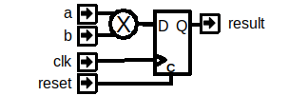

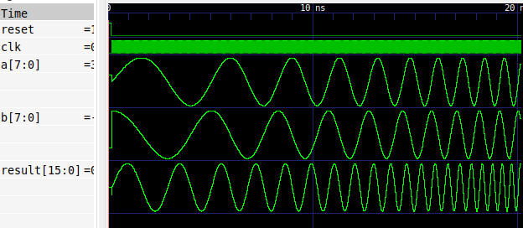
Software running simulations
class Toplevel extends Component{
val a,b = in(SInt(8 bits))
val result = out(RegNext(a * b) init(0))
}
SimConfig.withFstWave.compile(new Toplevel).doSim{ dut =>
dut.clockDomain.forkStimulus(10)
var phase = 0.0
var phaseIncr = 0.01
dut.clockDomain.onSamplings{
def rangeFit(value : Double) = (value*127).toInt
dut.a #= rangeFit(Math.sin(phase))
dut.b #= rangeFit(Math.cos(phase))
phase += phaseIncr
phaseIncr *= 1.001
}
dut.clockDomain.waitSampling(2000)
}

Slide 8
Software running simulations

Slide 9
Host language as a simulation tool
Class
IO
Lambda function
Type parameter
Functional programming
Abstract interface
Inheritance
Data structures
Abstraction layering

Slide 10
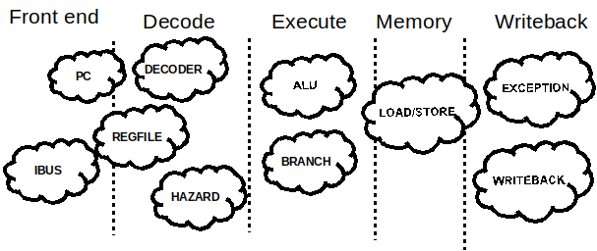
Modular CPU framework

Slide 11
Modular CPU framework
new MyCpu(
List(
new IBusSimplePlugin(resetVector = 0x80000000l),
new DBusSimplePlugin,
new CsrPlugin(CsrPluginConfig.smallest),
new DecoderSimplePlugin,
new RegFilePlugin(regFileReadyKind = plugin.SYNC),
new SrcPlugin,
new IntAluPlugin,
new BranchPlugin(earlyBranch = false),
new MulDivIterativePlugin(
mulUnrollFactor = 4,
divUnrollFactor = 1
),
new FullBarrelShifterPlugin,
new HazardSimplePlugin,
new YamlPlugin("cpu0.yaml")
)
)

Slide 12
Modular CPU framework
class MyCpu(plugins : List[Plugin]) extends Component {
val decode = new Stage
val execute = new Stage
val memory = new Stage
val writeBack = new Stage
for(p <- plugins) p.setup(this)
for(p <- plugins) p.build(this)
//...
}
class Stage {
val valid = Reg(Bool())
val stuck = Bool()
val discard = Bool()
}
trait Plugin {
def setup(p: MyCpu) : Unit
def build(p: MyCpu) : Unit
}

Slide 13
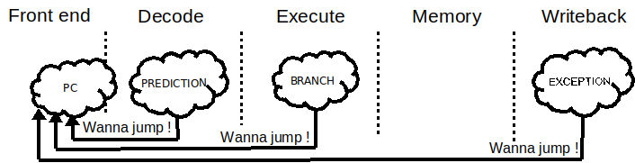
CPU framework - Connections
//Somewhere in the Branch plugin
val jumpInterface = pcPlugin.createJumpInterface(stage = execute)
//Later in the branch plugin
jumpInterface.valid := wannaJump
jumpInterface.payload := X
trait JumpService{
def createJumpInterface(stage : Stage) : Flow[UInt]
}

Slide 14
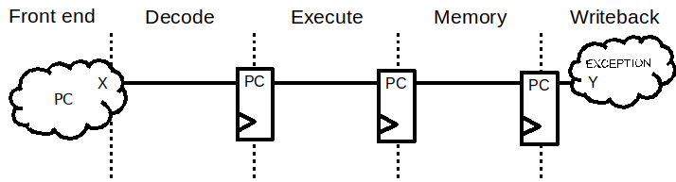
CPU framework - Connections
//Global definition of the Programm Counter concept
object PC extends Stageable(UInt(32 bits))
//Somewere in the plugin which manage the program counter
decode.insert(PC) := X
//Somewere in the MachineCsr plugin
Y := writeBack.input(PC)

Slide 15
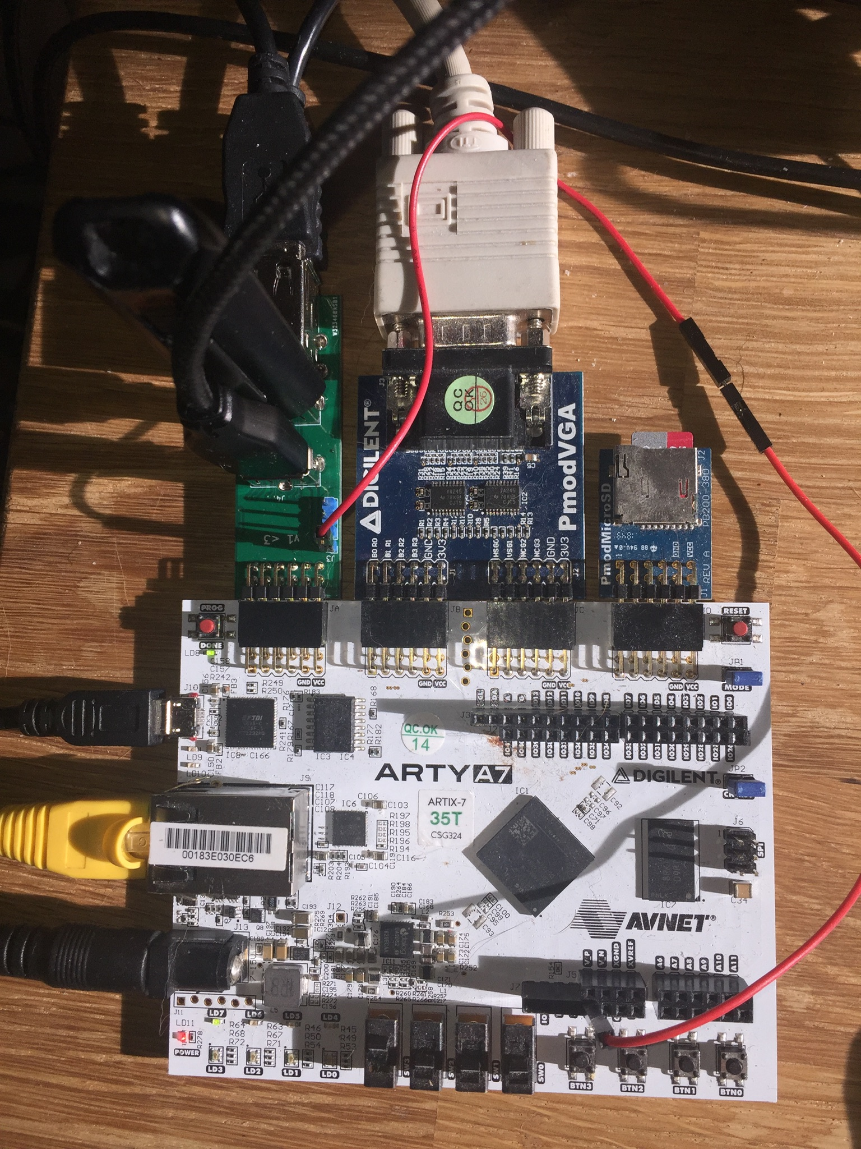
SoC
Framework to compose SoC
For instance on ArtyA7 35T
  2 VexRiscv ~100 Mhz
  RV32IMAFDC
  Shared FPU
  DDR3 , Sdcard
  Ethernet, USB host,
  Video/Audio output
https://github.com/SpinalHDL/SaxonSoc/tree/dev-0.3/bsp/digilent/ArtyA7SmpLinux

Slide 16
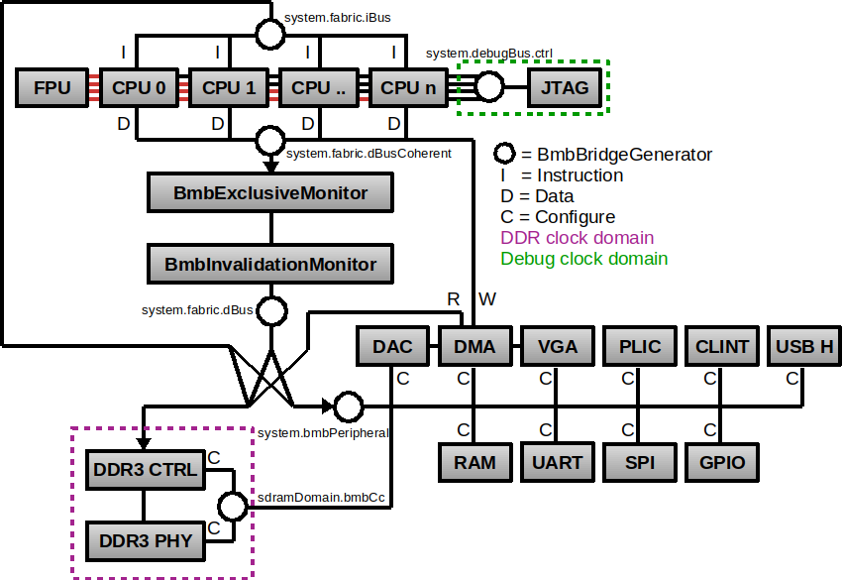
SoC

Slide 17
Distributed SoC elaboration
Similar to software
  Await / async / future
val a, b = Handle[Int]
val calculator = Handle {
a.get + b.get
}
val printer = Handle {
println(s"a + b = ${calculator.get}")
}
a.load(3)
b.load(4)

Slide 18
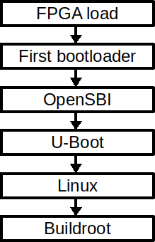
Boot sequence

Slide 19
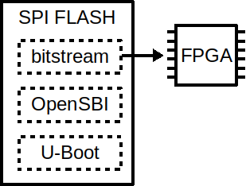
FPGA configuration

Slide 20
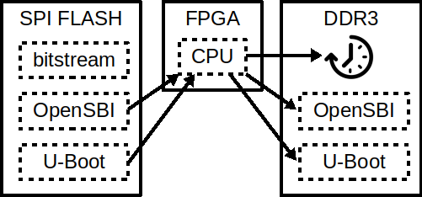
DDR3 calibration and firmware copy
DDR3 calibration
Copy from flash to DDR3
  OpenSBI
  UBoot

Slide 21
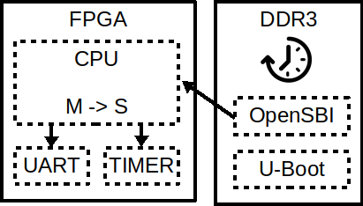
Low level management “Bios”

Slide 22
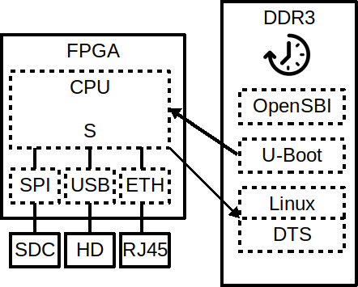
Fetching linux

Slide 23
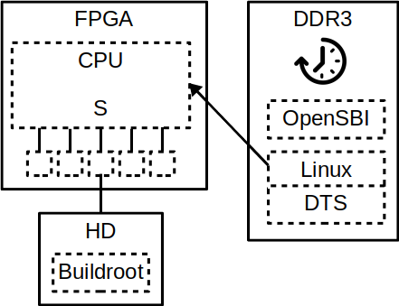
Linux boot

Slide 24
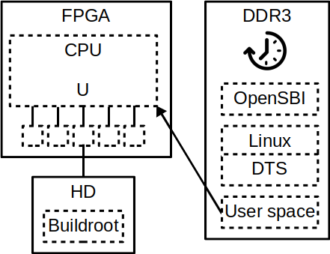
User space !

Slide 25
User space !
x11
mpg123
Dillo
xterm
htop
sl
feh
xclock
twm

Slide 26
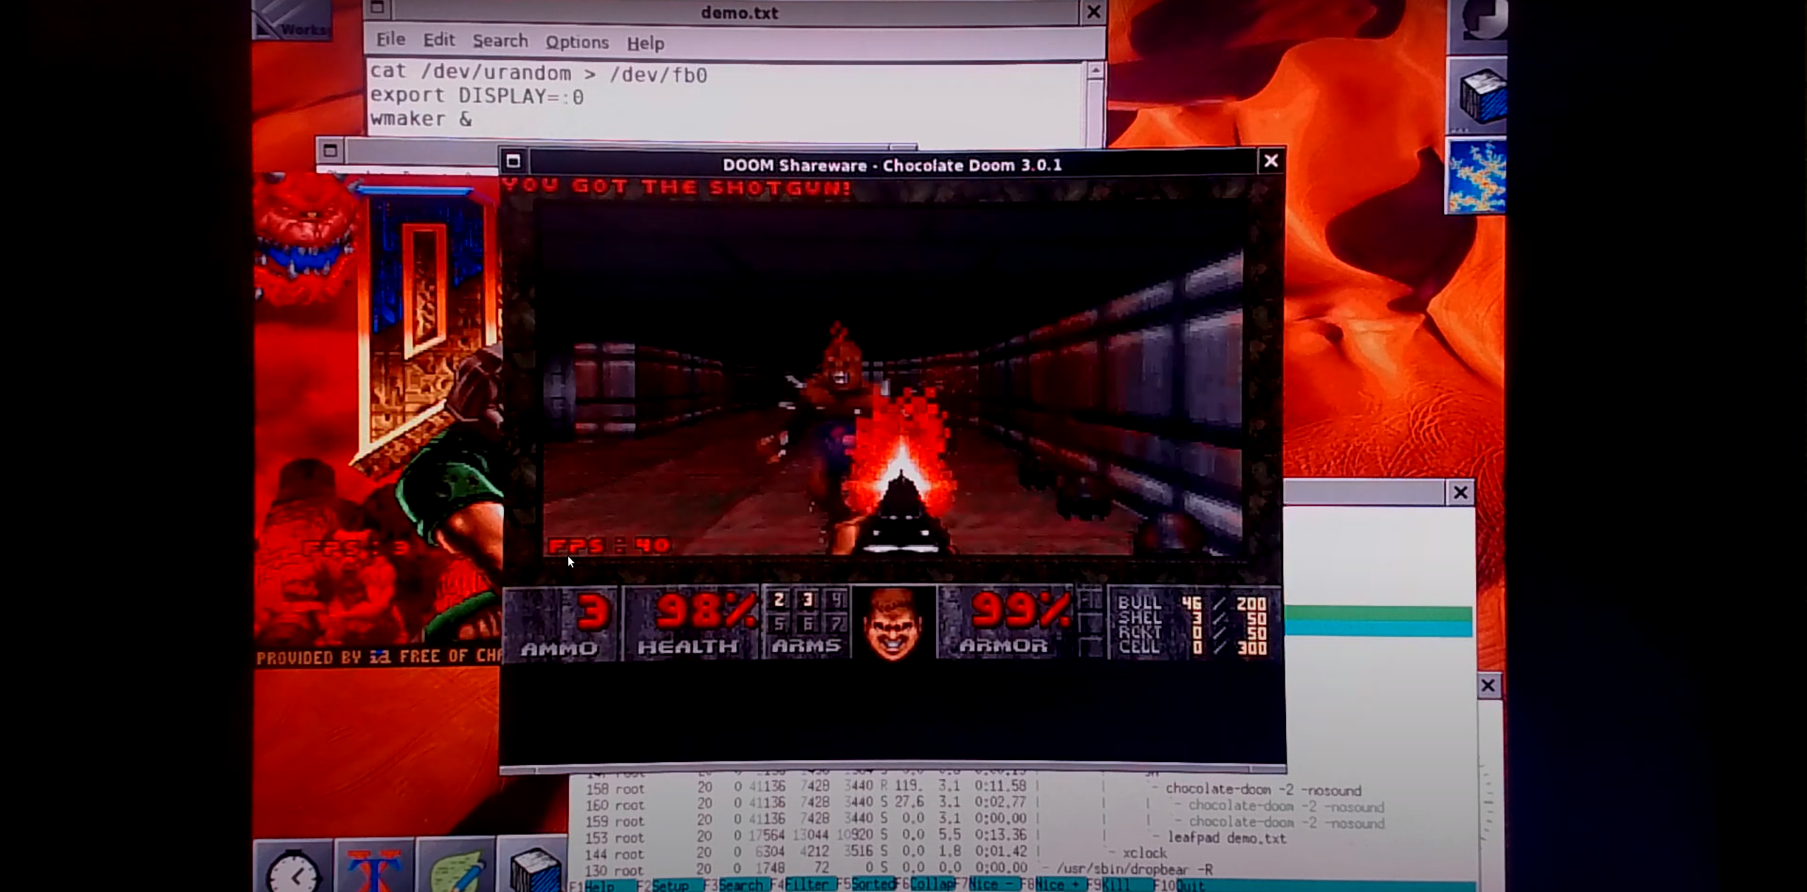
User space !
x11
mpg123
Dillo
xterm
htop
sl
feh
xclock

Slide 27
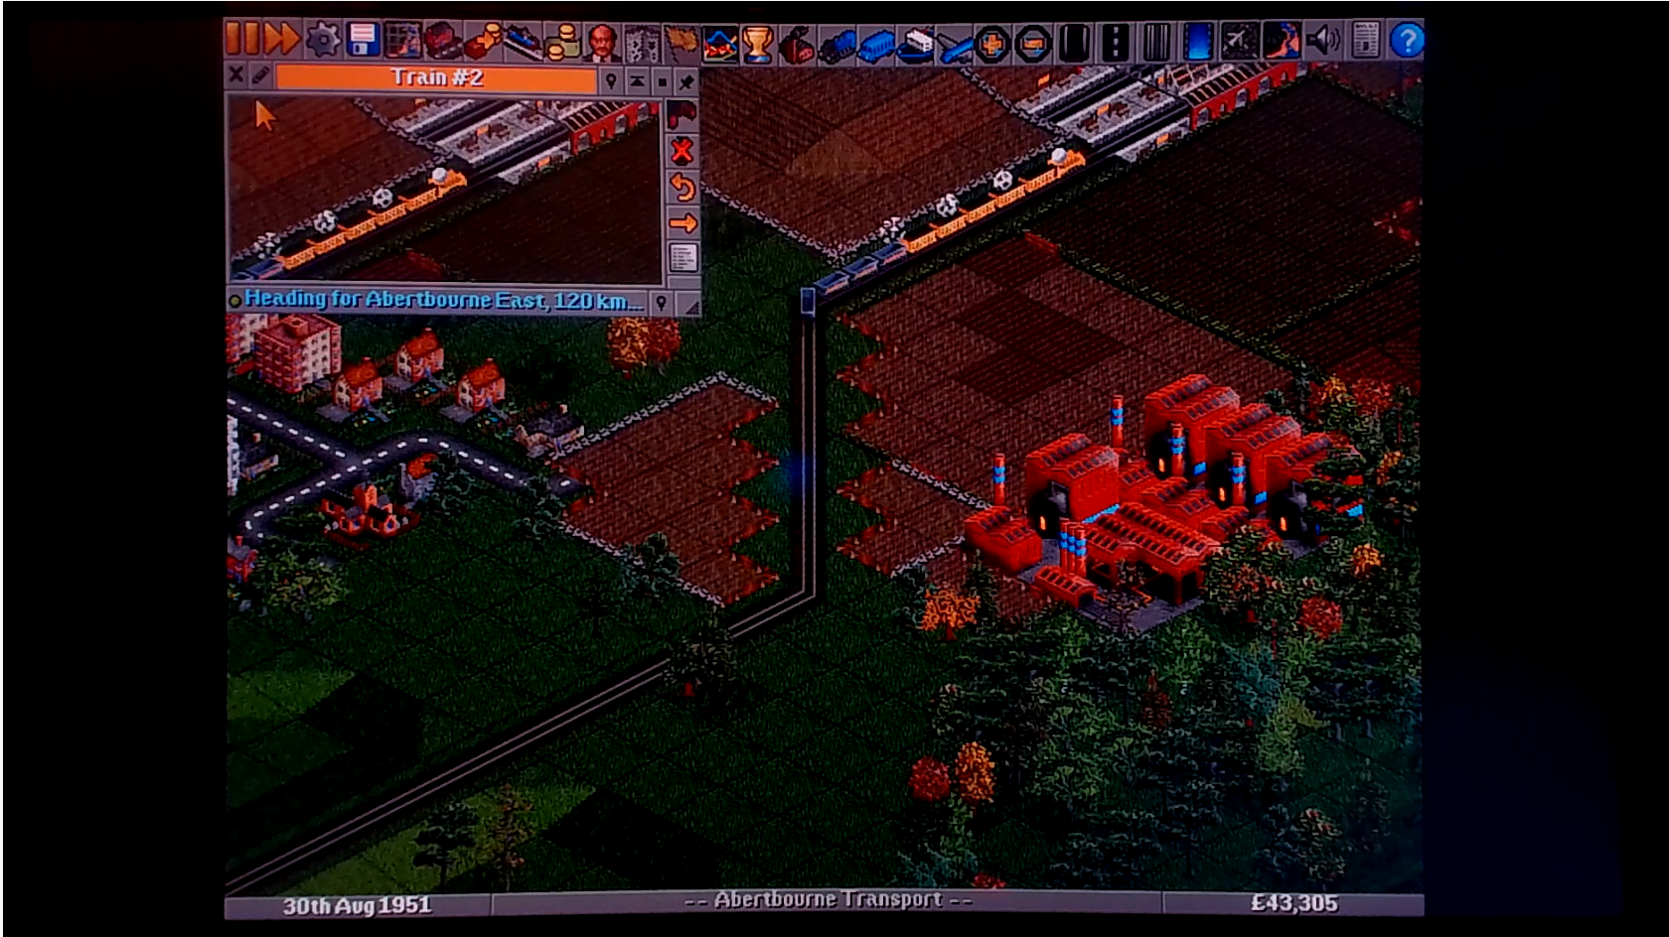
User space !
x11
mpg123
Dillo
xterm
htop
sl
feh
xclock
https://youtu.be/K5Vv32O9g7Q

Slide 28
Links
SpinalHDL
  https://spinalhdl.github.io/SpinalDoc-RTD/index.html
  https://github.com/SpinalHDL/SpinalHDL
VexRiscv
  https://github.com/SpinalHDL/VexRiscv
SaxonSoc
  https://github.com/SpinalHDL/SaxonSoc

