Slide 1
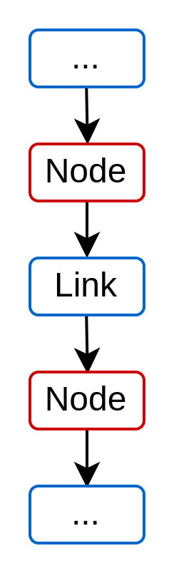
Pipelining API introduction
Charles Papon

Slide 2
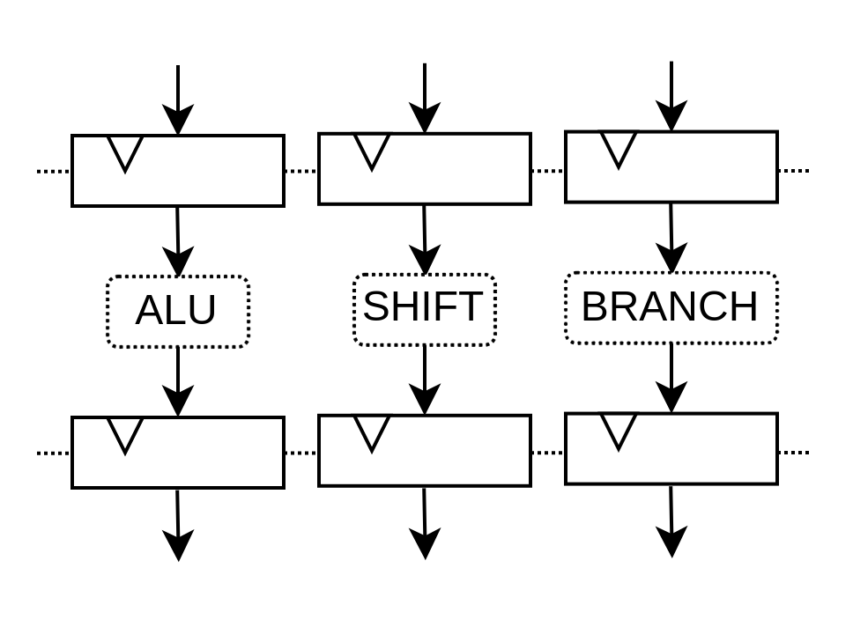
Composability needs

Slide 3
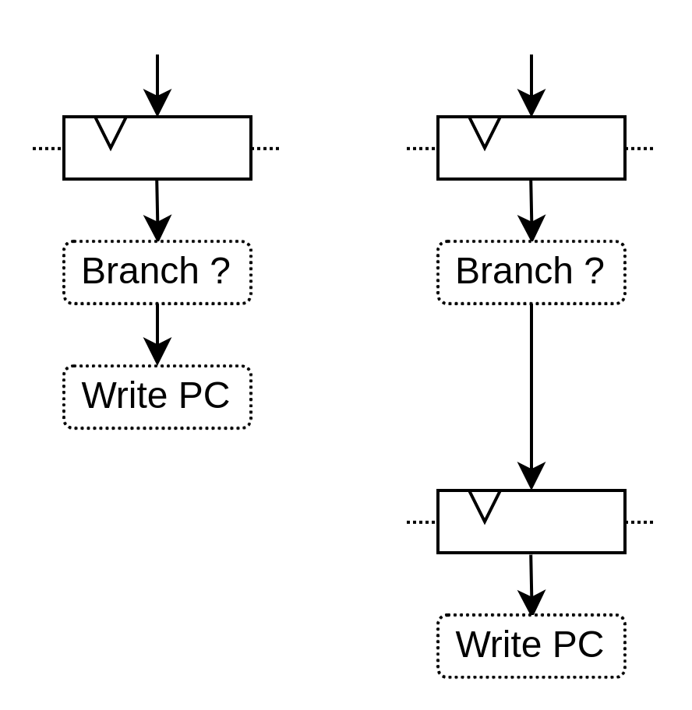
Timing adjustments needs

Slide 4
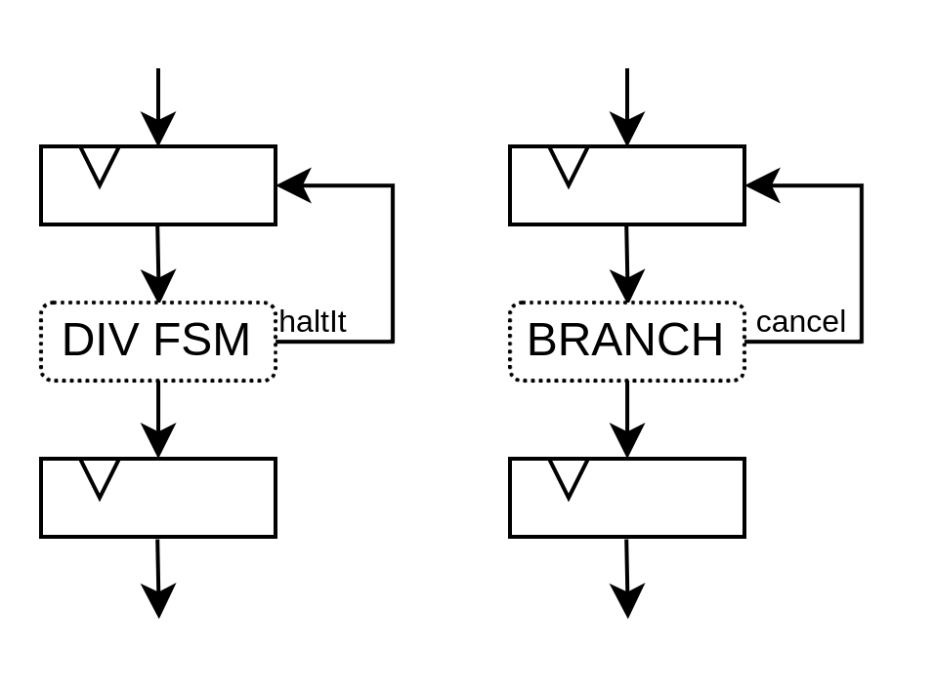
Arbitration needs

Slide 5
API structure
Node : A spot in the pipeline
  Has arbitration / data signals
Link : Connect some nodes up → down in multiple flavor
  DirectLink
  StageLink
  S2mLink
  ForkLink
  JoinLink
  CtrlLink
Payload : Some data which can go through the pipeline
Builder : Generate the pipeline

Slide 6
Some info
Doc : https://github.com/SpinalHDL/SpinalDoc-RTD/pull/226
SpinalHDL dev branch
  spinal.lib.misc.pipeline (not spinal.lib.pipeline)

Slide 7
Demo !

