Slide 1
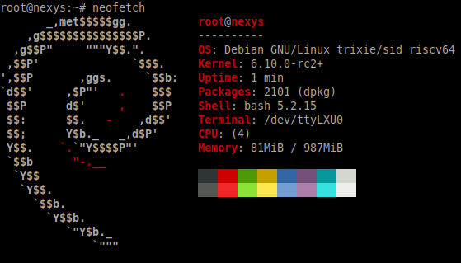
VexiiRiscv : A Debian demonstration
Charles Papon

Slide 2
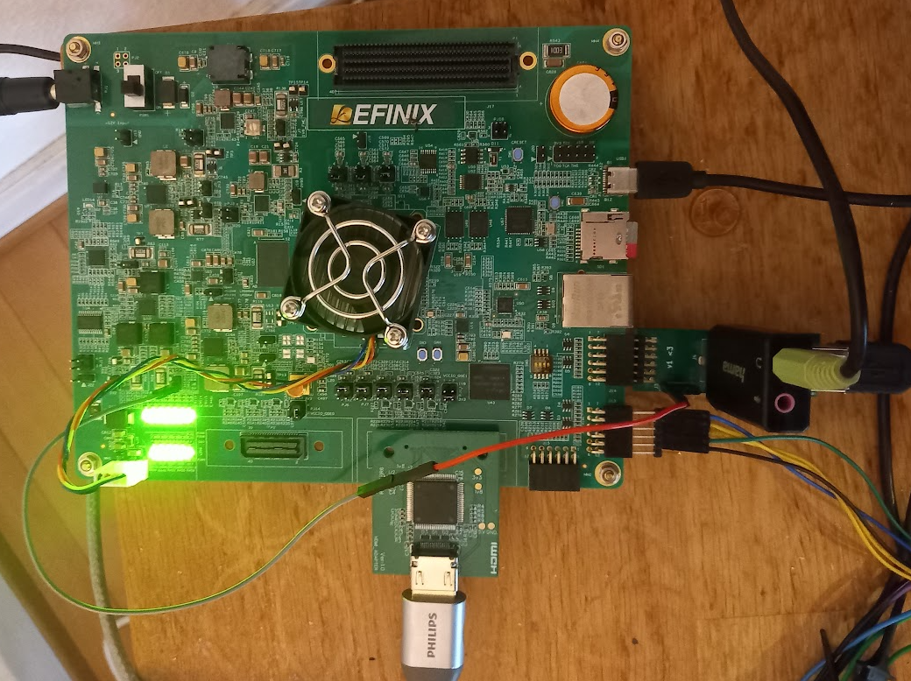
Whoami (FPGA + Board)
Efinix Titanium Ti375 C529 Development Kit
https://github.com/SpinalHDL/VexiiRiscv/issues/24

Slide 3
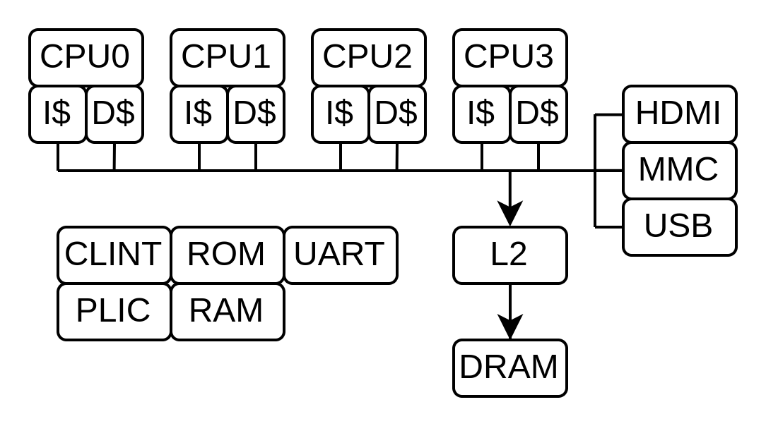
Whoami (SoC)
4x VexiiRiscv @ 200MHz
  RV64GC...
  Single issue / in-order
  BTB / GShare / RAS
  Store buffer
  Hardware prefetcher / non-blocking caches (I$ D$)
  16KB I$, 16KB D$ (per core)
L2 (512KB, non-blocking, out-of-order)
Tilelink bus (128 bits, memory coherent)
SpinalHDL + Litex → Verilog
EFX_ADD : 8679
EFX_LUT4 : 87660
1-2 Inputs : 12009
3 Inputs : 34680
4 Inputs : 40971
EFX_DSP48 : 68
EFX_FF : 56329
EFX_SRL8 : 106
EFX_RAM10 : 1284

Slide 4
VexiiRiscv feature set
Mainly :
  RV32/RV64, optional MAFDCBSU
  Can run linux / buildroot / Debian
  Optional multi-issue
  Optional late-ALU
  Up to 5.24 coremark/Mhz 2.50 dhystone/Mhz
  Free / open-source
Aswell :
  Optional I$ D$
  Optional BTB / RAS / Gshare branch prediction
  RISC-V official jtag debug
  ...

Slide 5
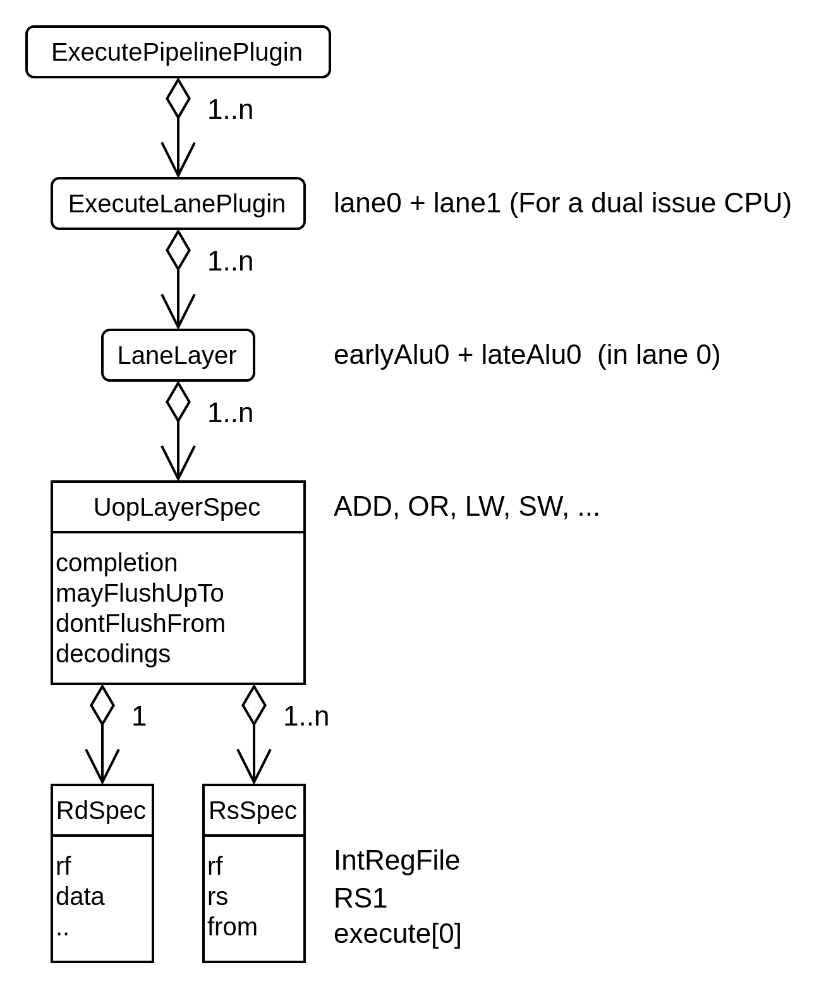
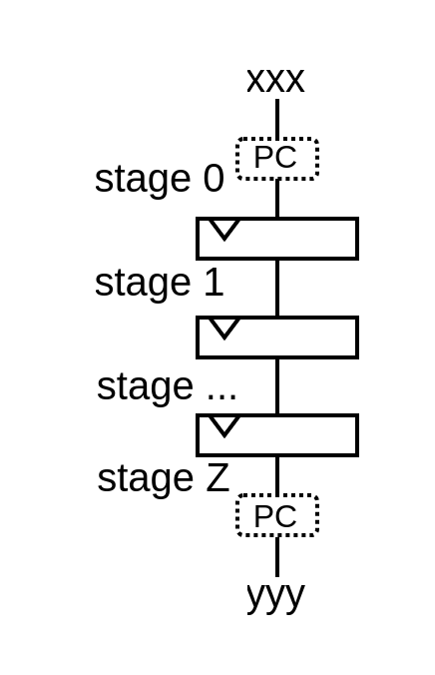
Hardware description
stage(0)(PC) := xxx
yyy := stage(Z)(PC)
plugins += new execute.fpu.FpuSqrtPlugin(early0)

Slide 6
Contributions
Already a few
  RVB (Andreas Wallner)
  Compact divider (Thomas Kramer)
Looking for help
  Features additions
  Alternative implementations
  Performance improvements
  Testing
  targeted implementations (ASIC)
  …
https://github.com/SpinalHDL/VexiiRiscv
Thanks NLnet

Slide 7
Why VexiiRiscv
VexRiscv limits
  Missing features : Multi-issue / RV64 / Writeback cache
  Could have been better : Branch prediction / framework
  The legacy : Technical debt / Ossification
Open-source gap between single-issue in-order / out-of-order
Expending the CPU design space you get from one design

