Slide 1
Open source cpu and soc design:
The flow, the challenges and a perspective
Charles Papon
[1377614.579833] rcu: INFO: rcu_sched self-detected stall on CPU
[1377614.579845] rcu: 18-....: (2099 ticks this GP) idle=54e/1/0x4000000000000002
[1377614.579895] (t=2100 jiffies g=155867385 q=20879)
[1377614.579898] Task dump for CPU 18:
[1377614.579899] CPU 1/KVM R running task 0 1030947 256019 0x06000004
[1377614.579902] Call Trace:
[1377614.579912] ([<0000001f1f4b4f52>] show_stack+0x7a/0xc0)
[1377614.579918] [<0000001f1ec8e96c>] sched_show_task.part.0+0xdc/0x100
[1377614.579919] [<0000001f1f4b7248>] rcu_dump_cpu_stacks+0xc0/0x100
[1377614.579924] [<0000001f1ecdd10c>] rcu_sched_clock_irq+0x75c/0x980
[1377614.579926] [<0000001f1eceb26c>] update_process_times+0x3c/0x80
[1377614.579931] [<0000001f1ecfcfea>] tick_sched_handle.isra.0+0x4a/0x70
[1377614.579932] [<0000001f1ecfd28e>] tick_sched_timer+0x5e/0xc0
[1377614.579933] [<0000001f1ecec294>] __hrtimer_run_queues+0x114/0x2f0
[1377614.579935] [<0000001f1ececfdc>] hrtimer_interrupt+0x12c/0x2a0
[1377614.579938] [<0000001f1ebecb6a>] do_IRQ+0xaa/0xb0
[1377614.579942] [<0000001f1f4c6d08>] ext_int_handler+0x130/0x134
[1377614.579945] [<0000001f1ec0af10>] ptep_zap_key+0x40/0x60

Slide 2
Background / whoami
Dolu1990 on github, independent dev
Active on open/free project
  SpinalHDL (2015) : Hardware Description Library
  VexRiscv (2017) NaxRiscv(2021) VexiiRiscv (2023) : RISC-V CPUs
Software / Hardware background
  Industrial system / Electronic degree

Slide 3
Introduction
Will talk about various things
  Hardware design
  Hardware tooling
  Challangees

Slide 4
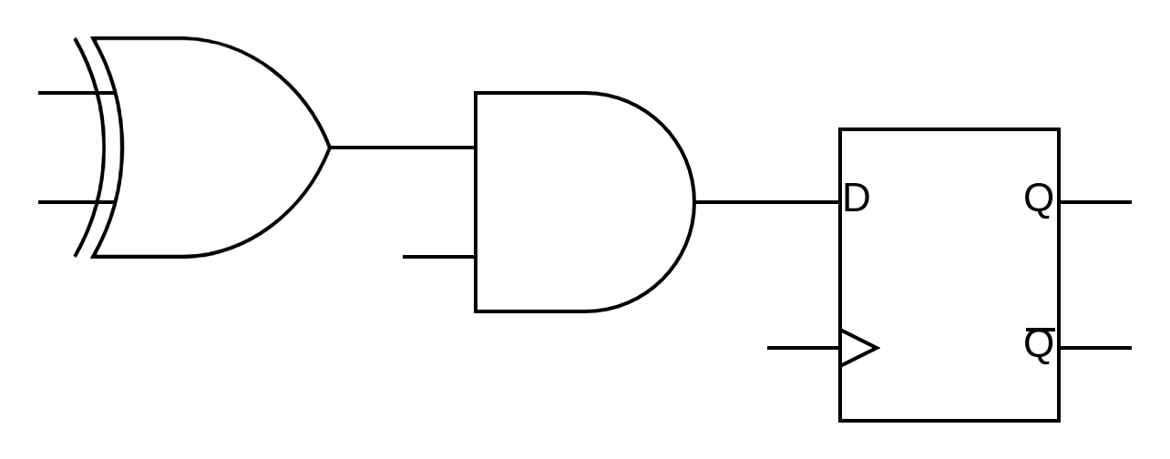
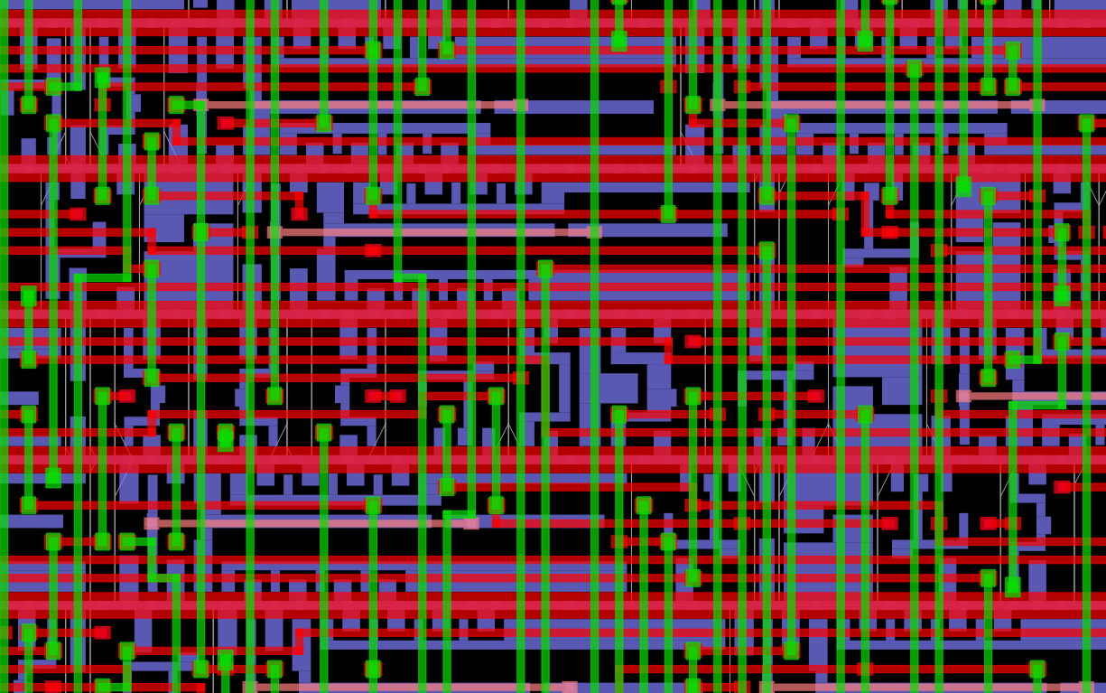
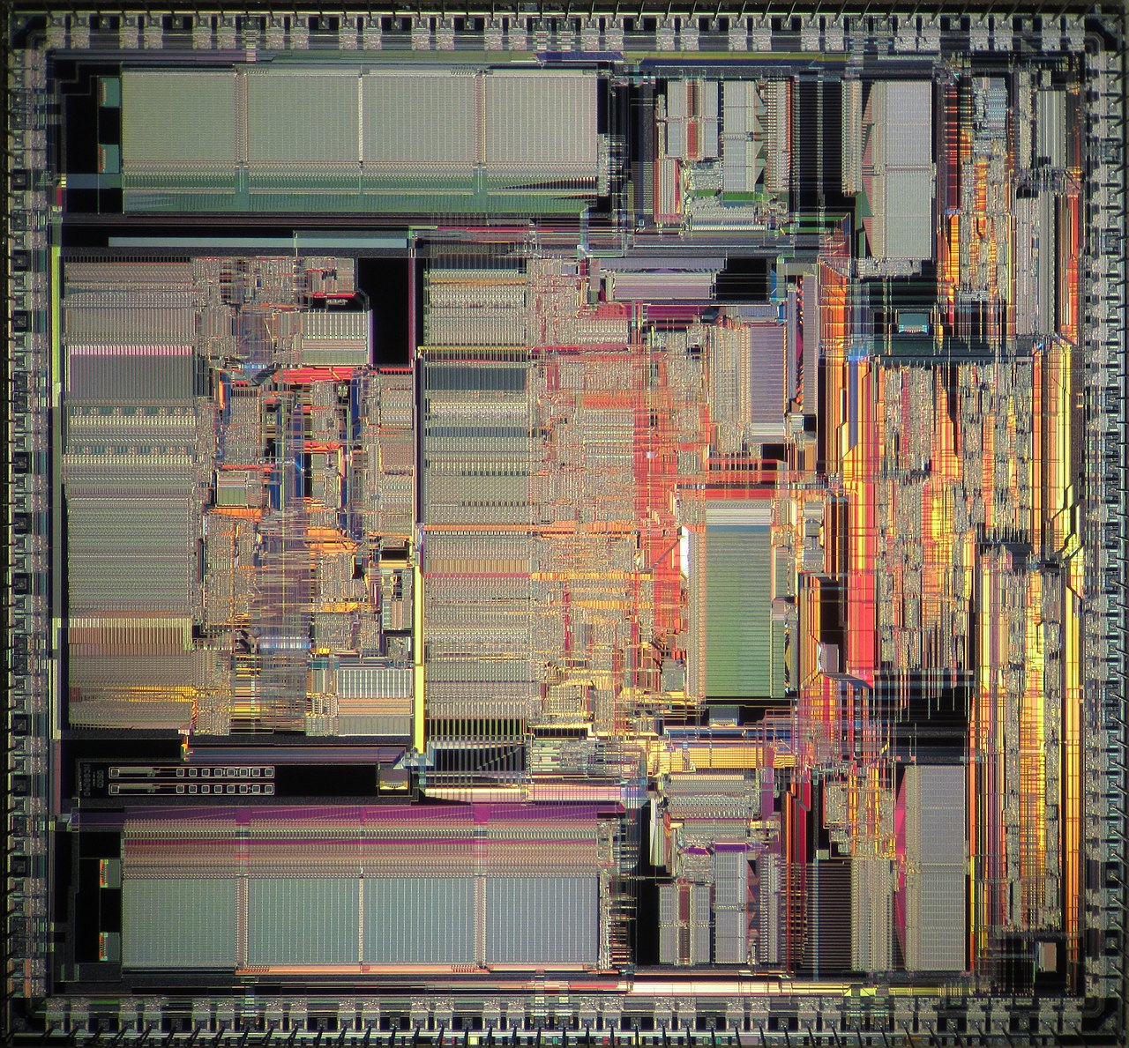
Digital Hardware design

Slide 5
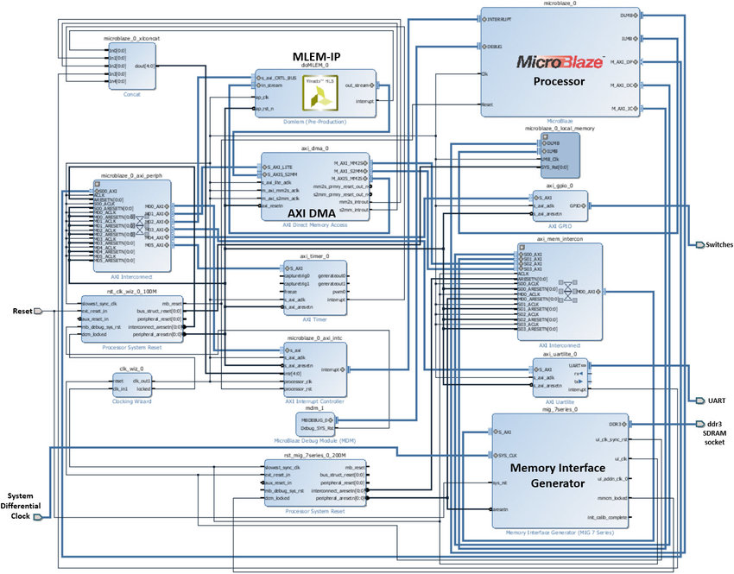
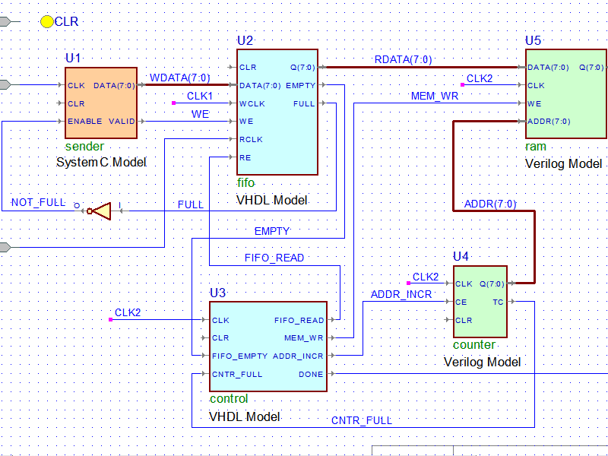
Schematic design

Slide 6
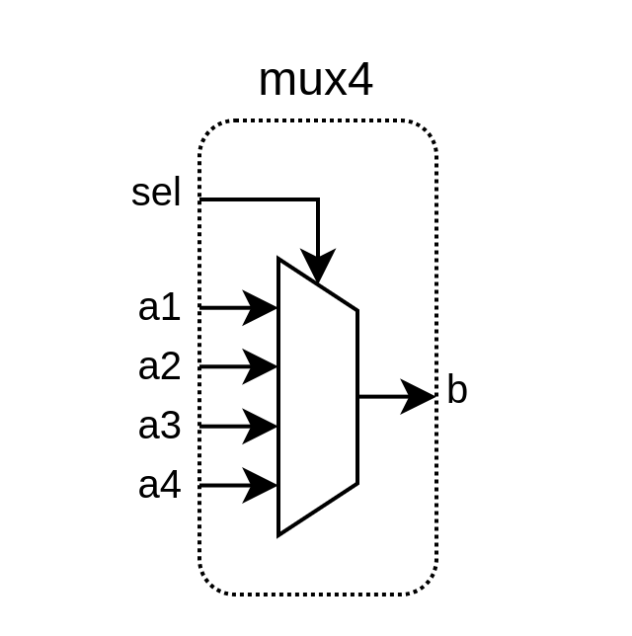
HDL based design
library IEEE;
use IEEE.std_logic_1164.all;
entity mux4 is
port(
a1 : in std_logic_vector(2 downto 0);
a2 : in std_logic_vector(2 downto 0);
a3 : in std_logic_vector(2 downto 0);
a4 : in std_logic_vector(2 downto 0);
sel : in std_logic_vector(1 downto 0);
b : out std_logic_vector(2 downto 0)
);
end mux4;
architecture rtl of mux4 is
-- declarative part: empty
begin
p_mux : process(a1,a2,a3,a4,sel)
begin
case sel is
when "00" => b <= a1 ;
when "01" => b <= a2 ;
when "10" => b <= a3 ;
when others => b <= a4 ;
end case;
end process p_mux;
end rtl;
https://en.wikipedia.org/wiki/VHDL

Slide 7
HDL based design
VHDL / [System]Verilog
  Industry standard / teached in universities
  Will not attract people with software background
  Will get you a job
  Throw enough manpower until the work is done
  Boring / unproductive / verbose / limited / cursed
def isOdd(value : Int) : Boolean = {
if (value == 1) return true
if (value == 2) return false
if (value == 3) return true
if (value == 4) return false
if (value == 5) return true
if (value == 6) return false
if (value == 7) return true
if (value == 8) return false
if (value == 9) return true
???
}

Slide 8

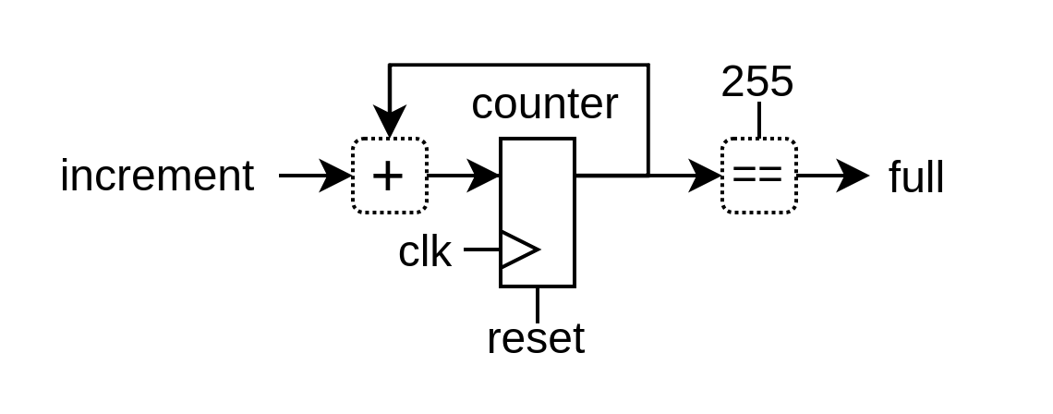
Open-source alternatives
SpinalHDL / Chisel / Migen / Amaranth / …
  Embedded in general purpose programming languages
import spinal.core._
object MyMain extends App{
SpinalVerilog(new Timer)
}
class Timer extends Component {
val increment = in Bool()
val counter = Reg(UInt(8 bits)) init(0)
val full = out(counter === 255)
when(increment){
counter := counter + 1
}
}

Slide 9
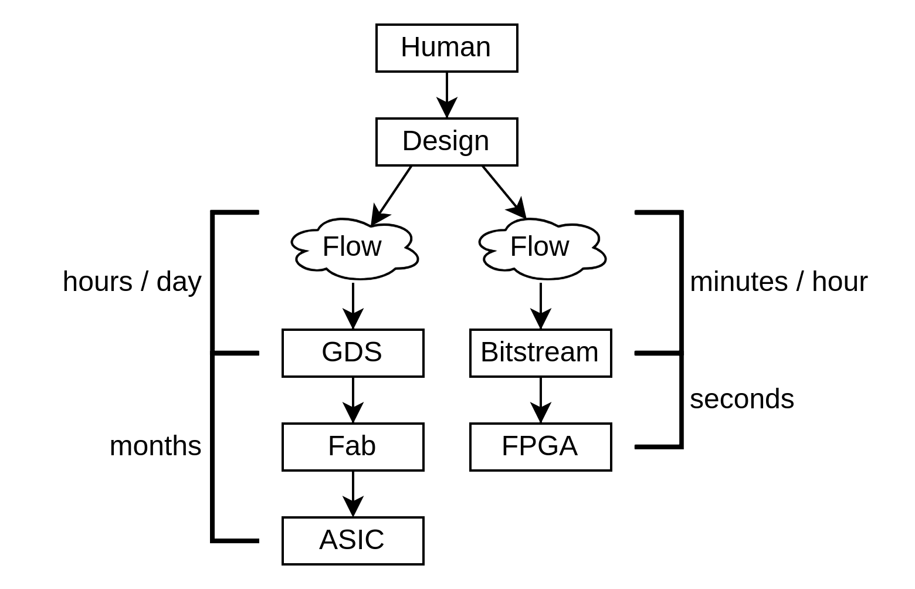
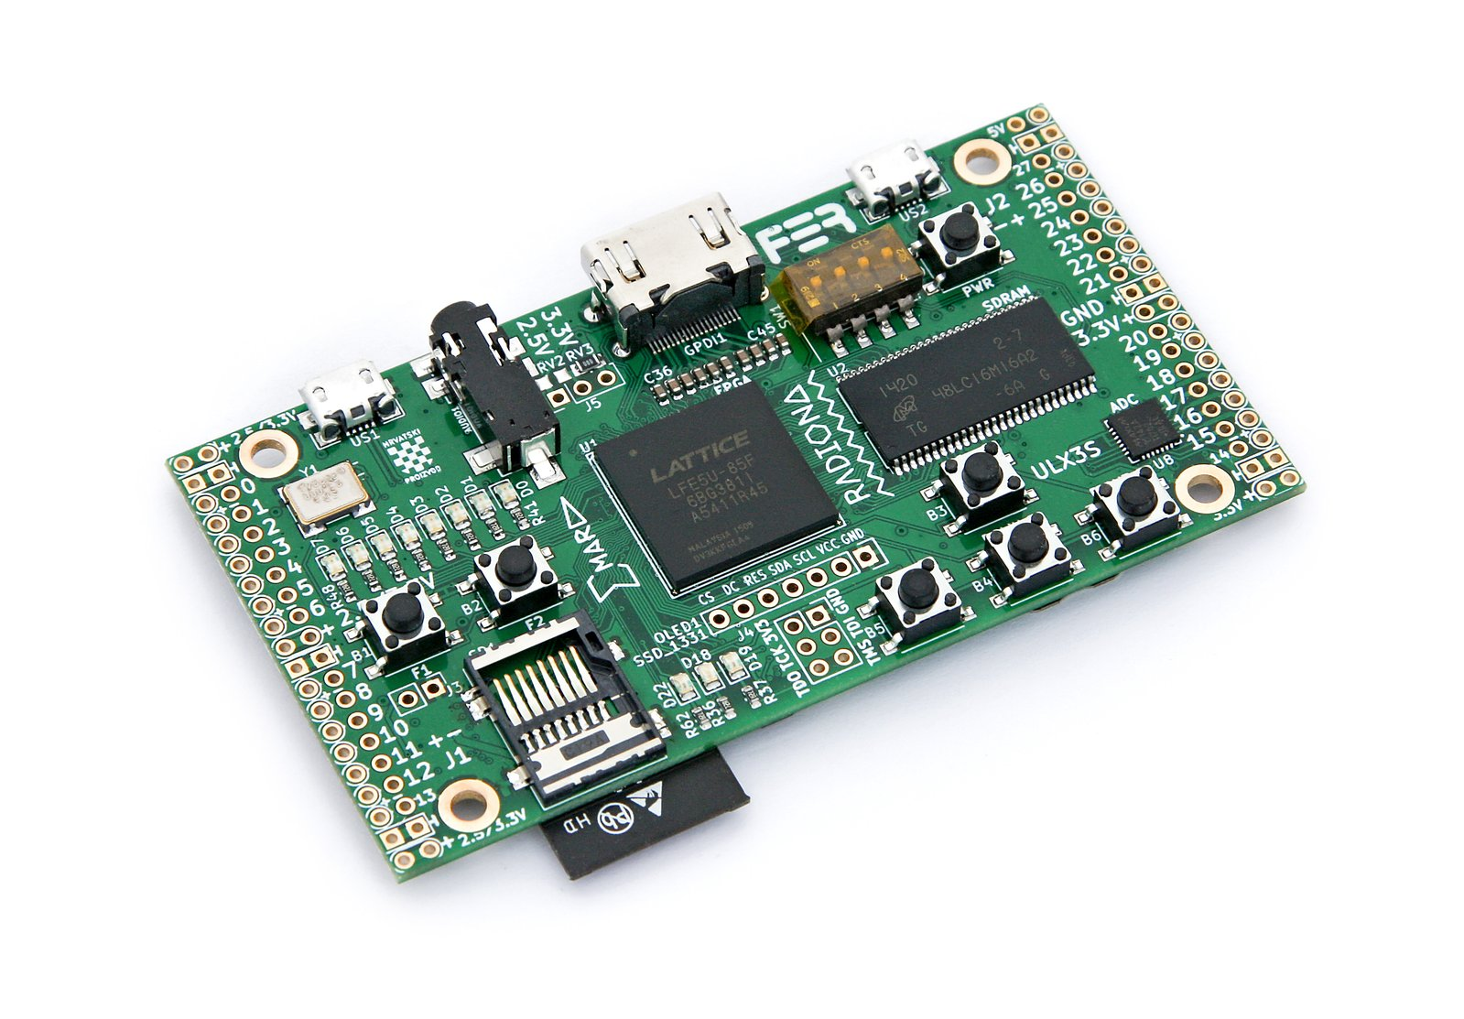
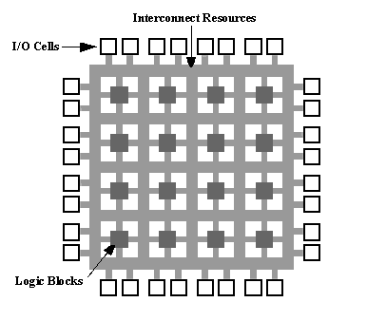
Deploying hardware => FPGA / ASIC
Two different world
ASIC
  Dedicated silicon / high performance
  Expensive for low volume
  Hard to access, (but things are changing)
    Sky130 PDK, Tinytapeout, …
FPGA
  Re
Two different world
ASIC
  Dedicated silicon / high performance
  Expensive for low volume
  Hard to access, (but things are changing)
    Sky130 PDK, Tinytapeout, …
FPGA
  Re

Slide 10
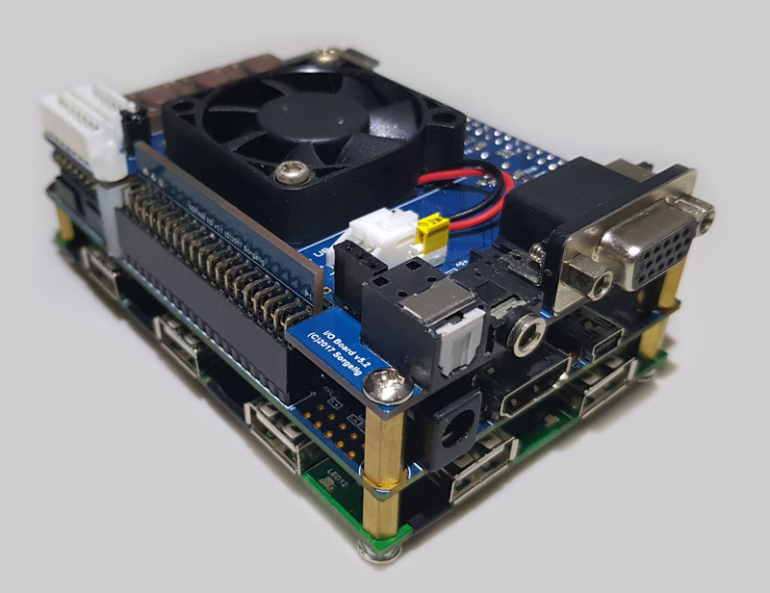
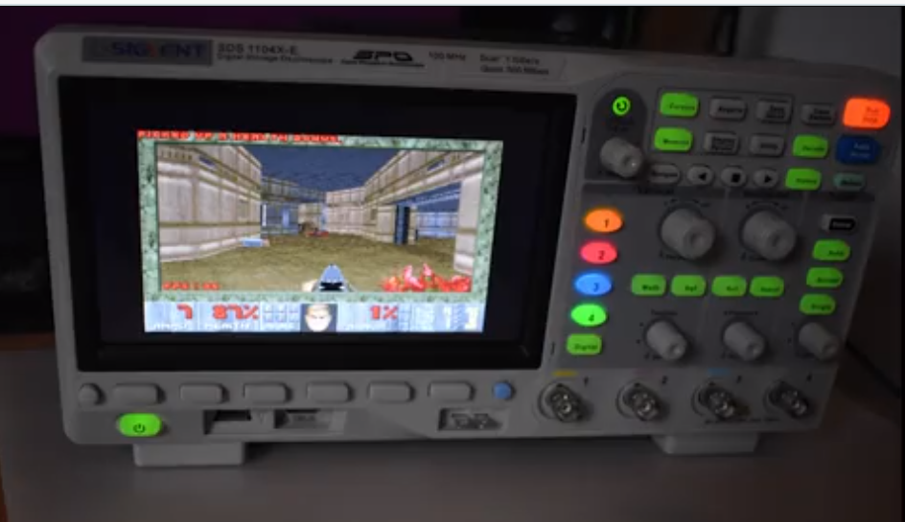
FPGA are a fertile land for open-source

Slide 11
Open-source push for ASIC
It is starting
  Openroad / Coriolis / Klayout / Magic
  Sky130 / Tinytapout
It is difficult
  ASIC cost
  Bug stress
  Slow iteration rate
  Very big / complex toolchain

Slide 12
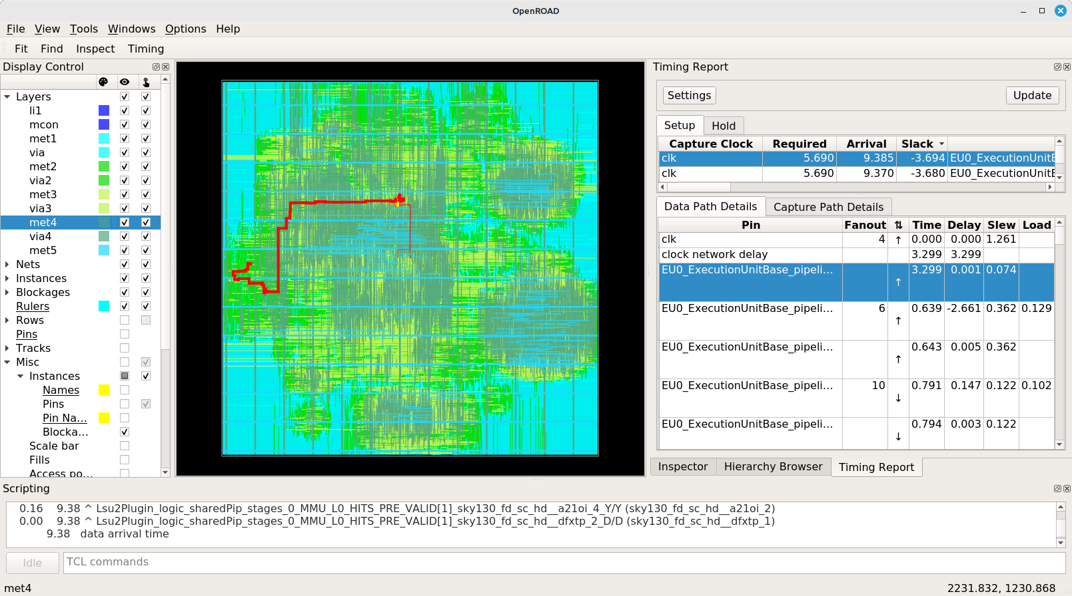

Slide 13
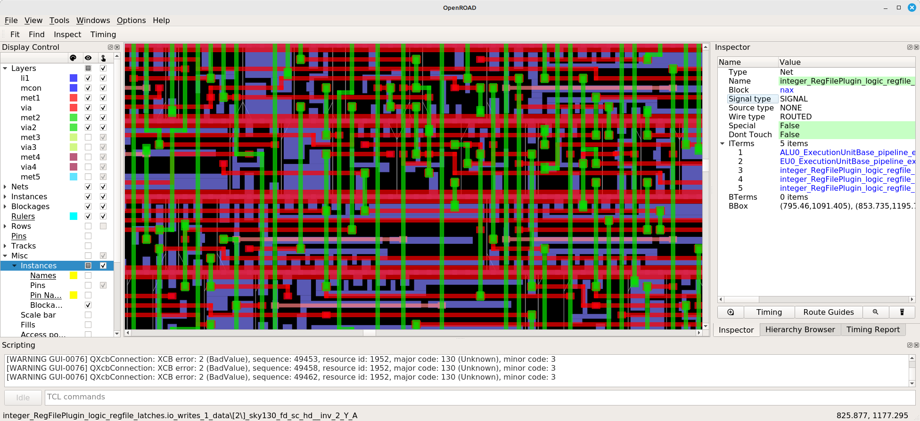

Slide 14
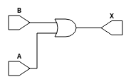
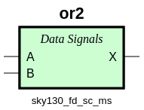
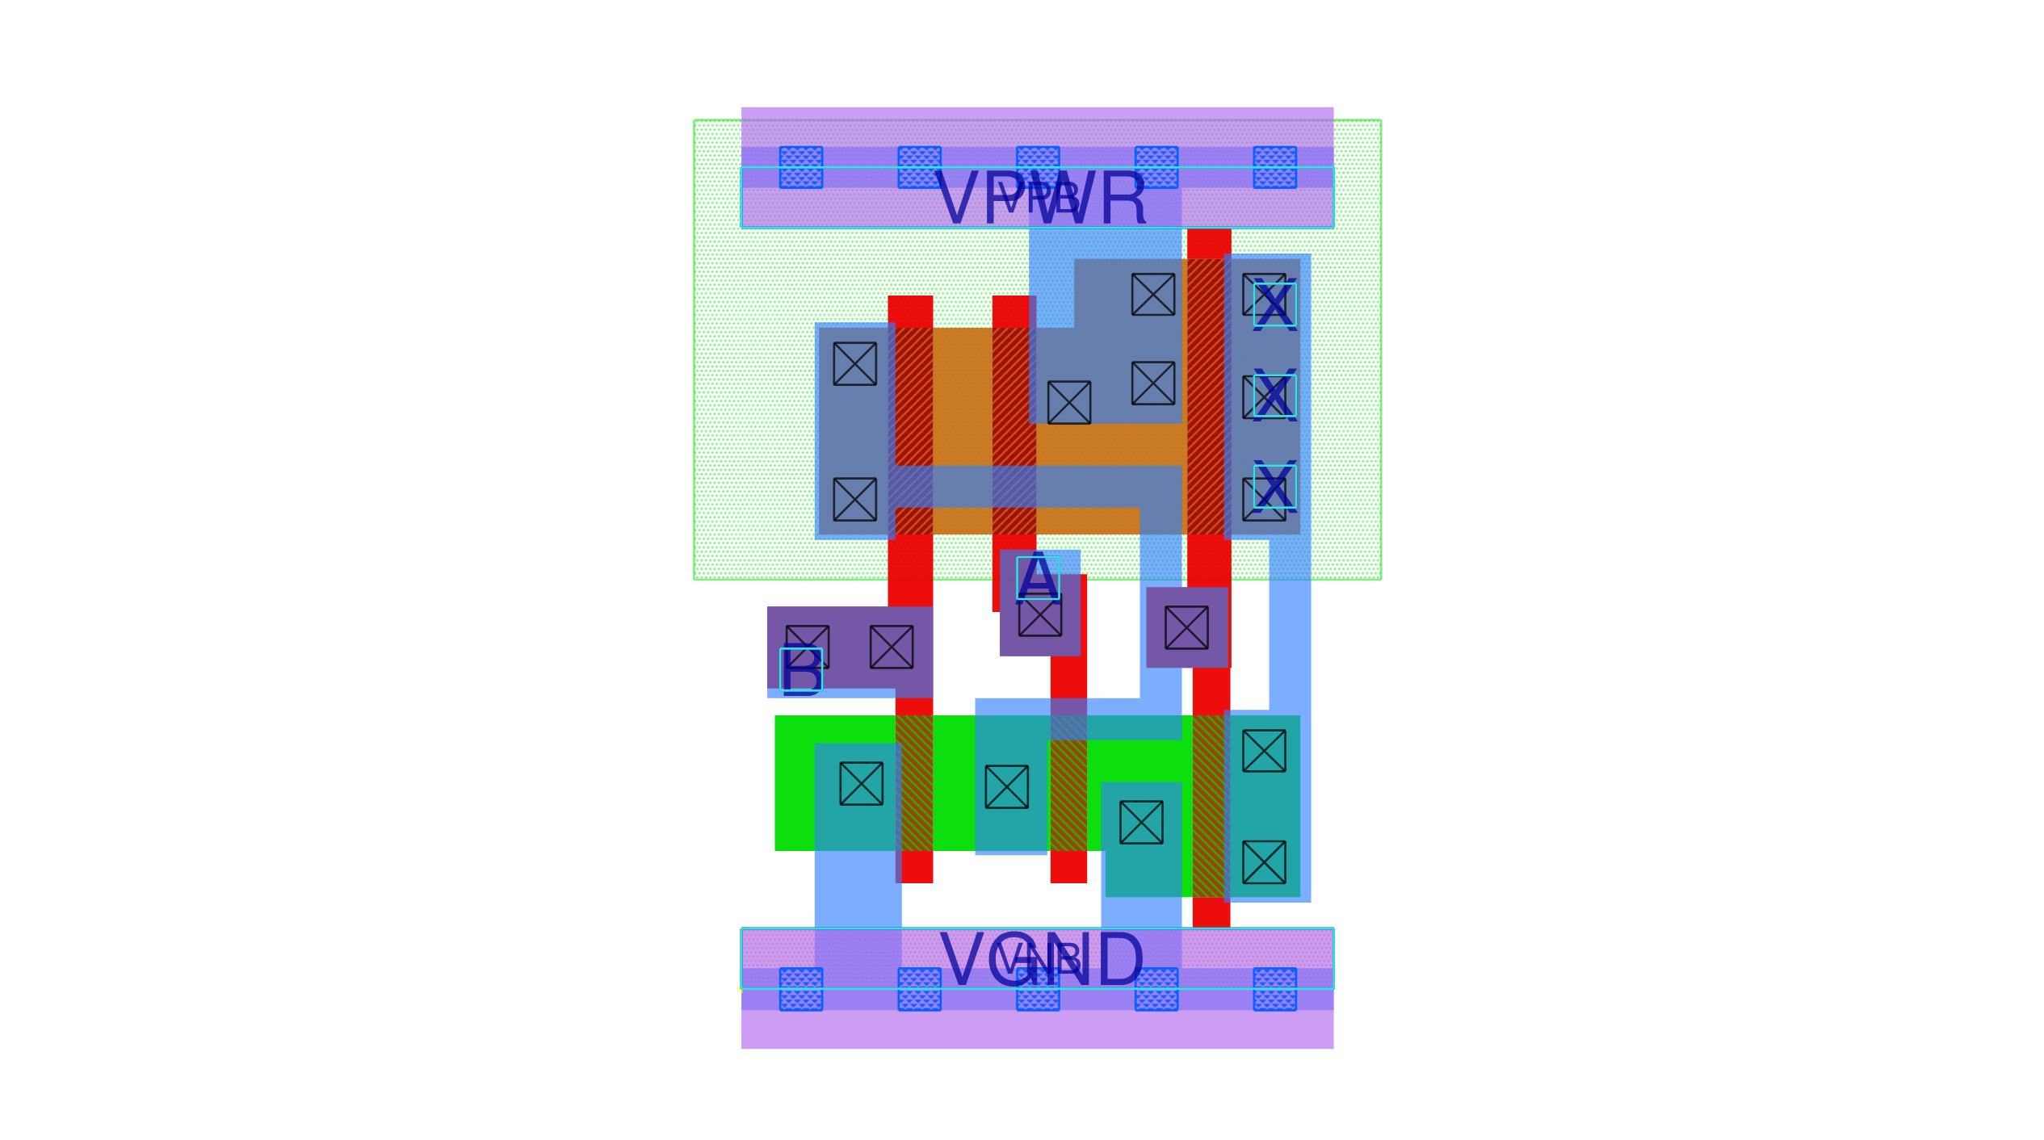
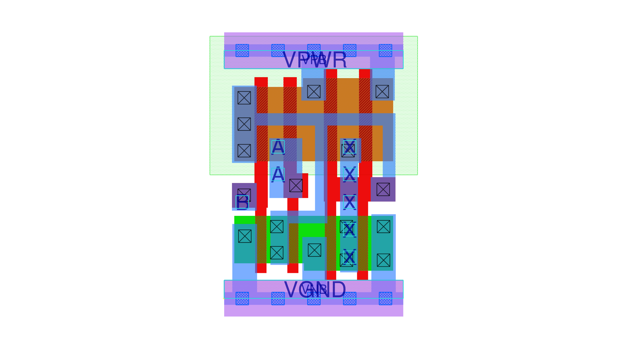
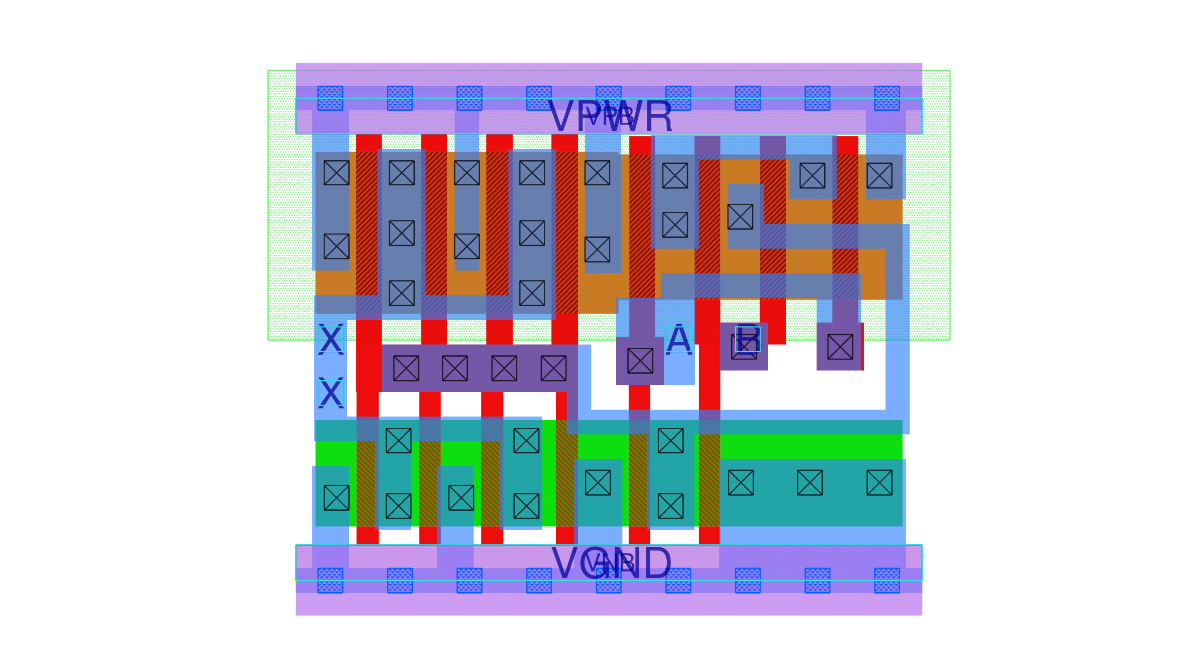
https://diychip.org/sky130/sky130_fd_sc_ms/cells/or2/

Slide 15
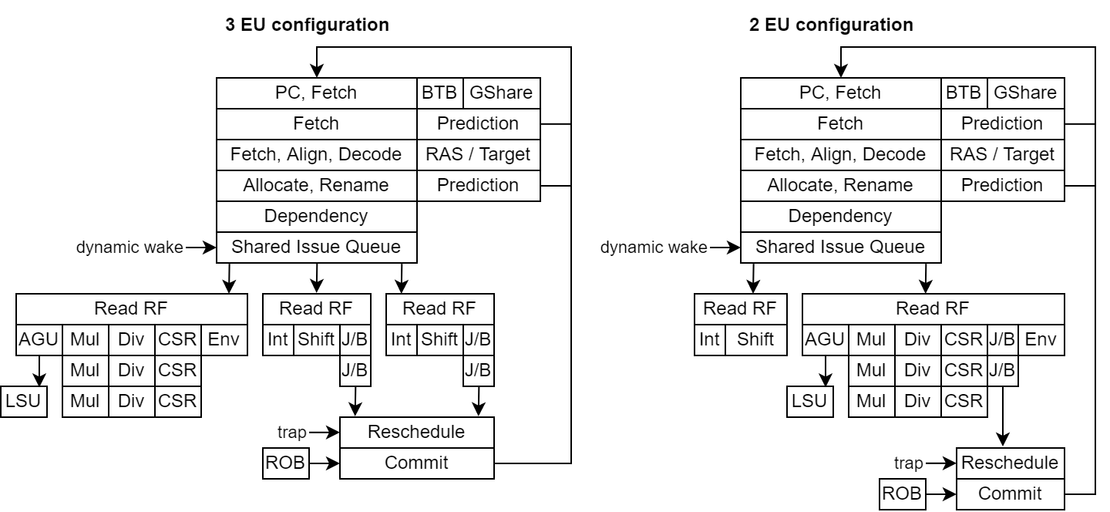

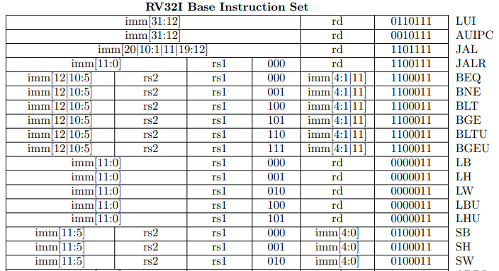
Open-source push for CPU
Very very strong since RISC-V
Maturing ecosystem
ASIC => Happy to get ride of the ARM “tax”
FPGA => Happy to not depend on FPGA vendors “free” IP
Both happy to customize things

Slide 16
Open-source push for CPU
Many many open-source RISC-V with different goals :
  Learning / fun (baremetal features)
  Demonstration (Academic paper, hardware description demo)
  Pushing the limits (Performance / Power / Area tradeoffs)
  Business (maybe)
bigPULP biRISC-V BOOM CV32E40P CVA6 DarkRISCV E203 Freedom FWRISC FWRISC-S Ibex KLESSYDRA-F03 KLESSYDRA-T02 KLESSYDRA-T03 KLESSYDRA-T13 Kronos Leros lipsi Lizard Maestro Minerva MR1 mriscv NaxRiscv NEORV32 OpenPiton NutShell patmos PicoRV32 PULP Rattlesnake Reindeer ReonV RISCV-CLaSH riscv-mini Riscy RiscyOO Rocket RPU RSD RV01 RV12 Sail RISC-V SCR1 SERV Shakti C-Class Shakti E-Class Sodor SSRV Starsea Steel SweRV SweRV EH2 SweRV EL2 Taiga Tiny Risc-V VexRiscv VexiiRiscv WARP-V FlexPRET ...

Slide 17
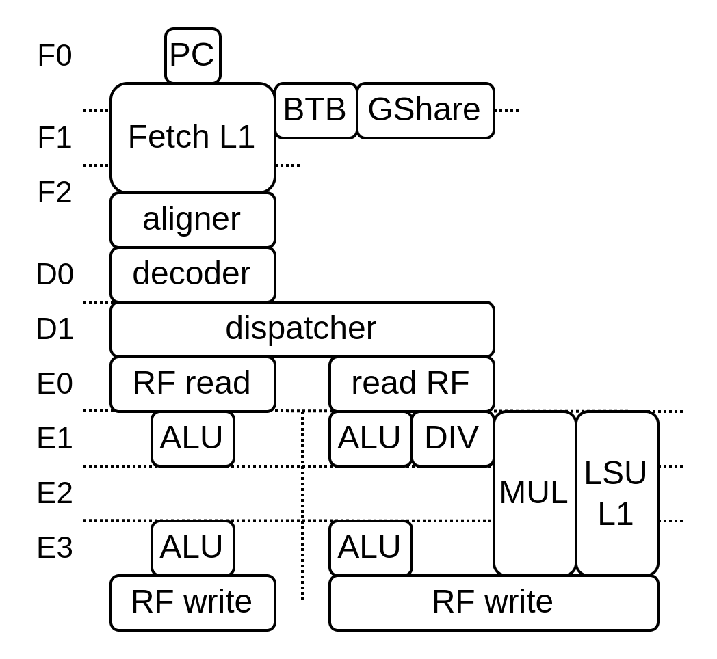
CPU design is hard
Design space is very large
Nuances => radically different outcomes
Latency and bandwidth sensitive
There should be no “low hanging fruit”
Constrained implementations
Many trade-off
Many tricks
  Inaccurate / pessimistic approaches
  Deflecting the bullet
  …
Horror stories

Slide 18
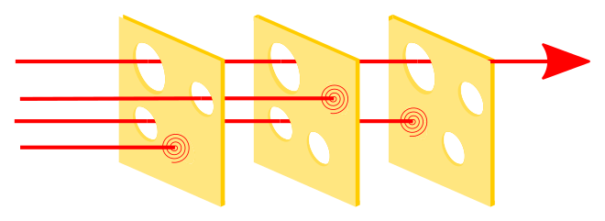
CPU debugging is harder
Lot of functionalities / side-effects
Real example
  Dual core Debian freeze (RCU error) after ~1h (360’000’000’000 cycles)
  Hardware simulation => 40 days of run time
Can’t ship a bugged CPU
  Can’t be fixed in ASIC
  Have some empathy with the software developers

Slide 19
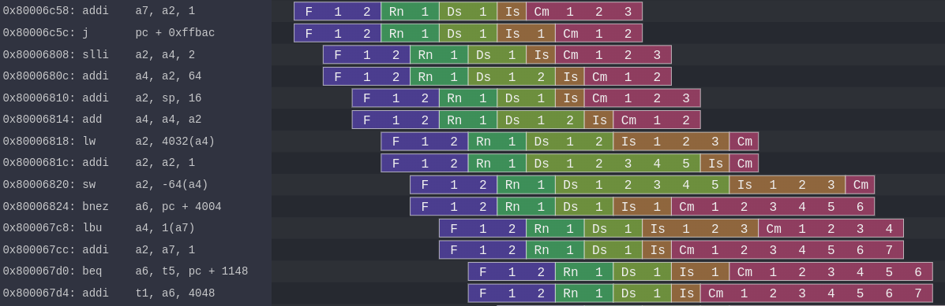
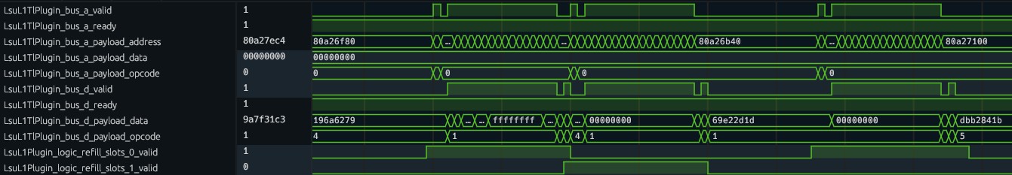
Ilustrations

Slide 20
SoC design

Slide 21
Hello darkness my old friend
[1377614.579833] rcu: INFO: rcu_sched self-detected stall on CPU
[1377614.579845] rcu: 18-....: (2099 ticks this GP) idle=54e/1/0x4000000000000002
[1377614.579895] (t=2100 jiffies g=155867385 q=20879)
[1377614.579898] Task dump for CPU 18:
[1377614.579899] CPU 1/KVM R running task 0 1030947 256019 0x06000004
[1377614.579902] Call Trace:
[1377614.579912] ([<0000001f1f4b4f52>] show_stack+0x7a/0xc0)
[1377614.579918] [<0000001f1ec8e96c>] sched_show_task.part.0+0xdc/0x100
[1377614.579919] [<0000001f1f4b7248>] rcu_dump_cpu_stacks+0xc0/0x100
[1377614.579924] [<0000001f1ecdd10c>] rcu_sched_clock_irq+0x75c/0x980
[1377614.579926] [<0000001f1eceb26c>] update_process_times+0x3c/0x80
[1377614.579931] [<0000001f1ecfcfea>] tick_sched_handle.isra.0+0x4a/0x70
[1377614.579932] [<0000001f1ecfd28e>] tick_sched_timer+0x5e/0xc0
[1377614.579933] [<0000001f1ecec294>] __hrtimer_run_queues+0x114/0x2f0
[1377614.579935] [<0000001f1ececfdc>] hrtimer_interrupt+0x12c/0x2a0
[1377614.579938] [<0000001f1ebecb6a>] do_IRQ+0xaa/0xb0
[1377614.579942] [<0000001f1f4c6d08>] ext_int_handler+0x130/0x134
[1377614.579945] [<0000001f1ec0af10>] ptep_zap_key+0x40/0x60

Slide 22
The scale of the project
Many skills involved
  Hardware design (to get the best performances)
    CPU design / FPU / JTAG debug
    Memory interconnect / memory coherency
    Peripheral design / USB / Ethernet / ...
  Hardware verification (to not miss a bug)
    Lock-step / software modeling / ...
  Hardware debugging (to not waste weeks on bugs)
    Assembly (objdump -S -d vmlinux nightmare.asm)
    Wave / execution traces
    Good guess / luck
  Hardware backends (FPGA / ASIC)
  Baremetal / linux drivers

Slide 23
The human side of things
People tends to specialise (too much / the field is too large)
  FPGA / ASIC / Verification / Baremetal software / “modern” software
  Few people have the “full picture”
  Hard for Open-source
  Missed performance bottlenecks
Very hard to steer away from the common path
  Graduation → Stress to find a job → Full time employment

Slide 24
Some other time sinks
Community related
  Issue tracker being used as a “stack overflow”
  False positive issues (scary / stressful)
  Additional feature requests
  Student spam / thesis
  The over ambitious email writers

Slide 25
Free and Open-source and the hardware industry
It depends the companies (startup / small / medium / large)
Incentives may be misaligned
  Companies looking for exclusive differentiation
  Companies looking to fill patents on what ever they can
  Companies trying to lock people in their ecosystem
  Companies trading cash for ownership
  Companies “owning” employee / non-compete clause

Slide 26
Let’s use an hardware description library (HDL)

Slide 27
Let’s use an hardware description library (HDL)
import spinal.core._
class Timer extends Component {
val increment = in Bool()
val counter = Reg(UInt(8 bits)) init(0)
val full = out(counter === 255)
when(increment){
counter := counter + 1
}
}
object MyMain extends App{
SpinalVerilog(new Timer)
}

Slide 28
Let’s use an hardware description library (HDL)
module Timer (
input wire increment,
output wire full,
input wire clk,
input wire reset
);
reg [7:0] counter;
assign full = (counter == 8'hff);
always @(posedge clk or posedge reset) begin
if(reset) begin
counter <= 8'h00;
end else begin
if(increment) begin
counter <= (counter + 8'h01);
end
end
end
endmodule
import spinal.core._
class Timer extends Component {
val increment = in Bool()
val counter = Reg(UInt(8 bits)) init(0)
val full = out(counter === 255)
when(increment){
counter := counter + 1
}
}
object MyMain extends App{
SpinalVerilog(new Timer)
}

Slide 29
Data structure / parameters
case class Stream[T <: Data](dataType: HardType[T]) extends Bundle {
val valid = Bool()
val ready = Bool()
val data = dataType()
}
case class Pixel(width: Int) extends Bundle{
val r, g, b = UInt(width bits)
}
val bus = Stream(Pixel(8))
bus.valid := False
bus.data.r := 0x11
bus.data.g := 0x22
bus.data.b := 0x33

Slide 30
Integrated linting
Latches
Combinatorial loops
Unspecified clock crossing
Undriven signals
Width mismatch
...
LATCH DETECTED from the combinatorial signal (toplevel/result : out UInt[8 bits]), defined at ...
val cond = in Bool()
val result = out UInt(8 bits)
when(cond){
result := 0
}

Slide 31
Integrated linting
val a,b,c = Bool()
c := b; b := a; a := c
COMBINATORIAL LOOP :
(toplevel/a : Bool)
(toplevel/b : Bool)
(toplevel/c : Bool)
(toplevel/a : Bool)
Latches
Combinatorial loops
Unspecified clock crossing
Undriven signals
Width mismatch
...
LATCH DETECTED from the combinatorial signal (toplevel/result : out UInt[8 bits]), defined at ...
val cond = in Bool()
val result = out UInt(8 bits)
when(cond){
result := 0
}

Slide 32
Integrated linting
val a,b,c = Bool()
c := b; b := a; a := c
COMBINATORIAL LOOP :
(toplevel/a : Bool)
(toplevel/b : Bool)
(toplevel/c : Bool)
(toplevel/a : Bool)
Latches
Combinatorial loops
Unspecified clock crossing
Undriven signals
Width mismatch
...
class Toplevel(cdA : ClockDomain, cdB : ClockDomain) extends Component {
val regA = cdA(Reg(Bool()))
val regB = cdB(Reg(Bool()))
regB := regA
}
CLOCK CROSSING VIOLATION :
- Source : (toplevel/regA : Bool) spinal.tester.code.Toplevel….(PresentationDsl.scala:1494)
- Source clock : (cdA_clk : Bool)
- Destination : (toplevel/regB : Bool) spinal.tester.code.Toplevel….(PresentationDsl.scala:1495)
- Destination clock : (cdB_clk : Bool)
LATCH DETECTED from the combinatorial signal (toplevel/result : out UInt[8 bits]), defined at ...
val cond = in Bool()
val result = out UInt(8 bits)
when(cond){
result := 0
}

Slide 33

Using software to elaborate your hardware
if(featureEnabled){
Reg(UInt(8 bits))
}
Control flow : if / for
Data structures : dynamic array / hash map / hash set
Lambda function : reduce / fold / map / filter / ...
OOP : class / software interface
See https://spinalhdl.github.io/NaxRiscv-Rtd/main/NaxRiscv/abstraction/index.html

Slide 34
Using software to elaborate your hardware
for(i <- 0 to 2){
Reg(UInt(8 bits))
}
Control flow : if / for
Data structures : dynamic array / hash map / hash set
Lambda function : reduce / fold / map / filter / ...
OOP : class / software interface
See https://spinalhdl.github.io/NaxRiscv-Rtd/main/NaxRiscv/abstraction/index.html

Slide 35

Using software to elaborate your hardware
Control flow : if / for
Data structures : dynamic array / hash map / hash set
Lambda function : reduce / fold / map / filter / ...
OOP : class / software interface

Slide 36
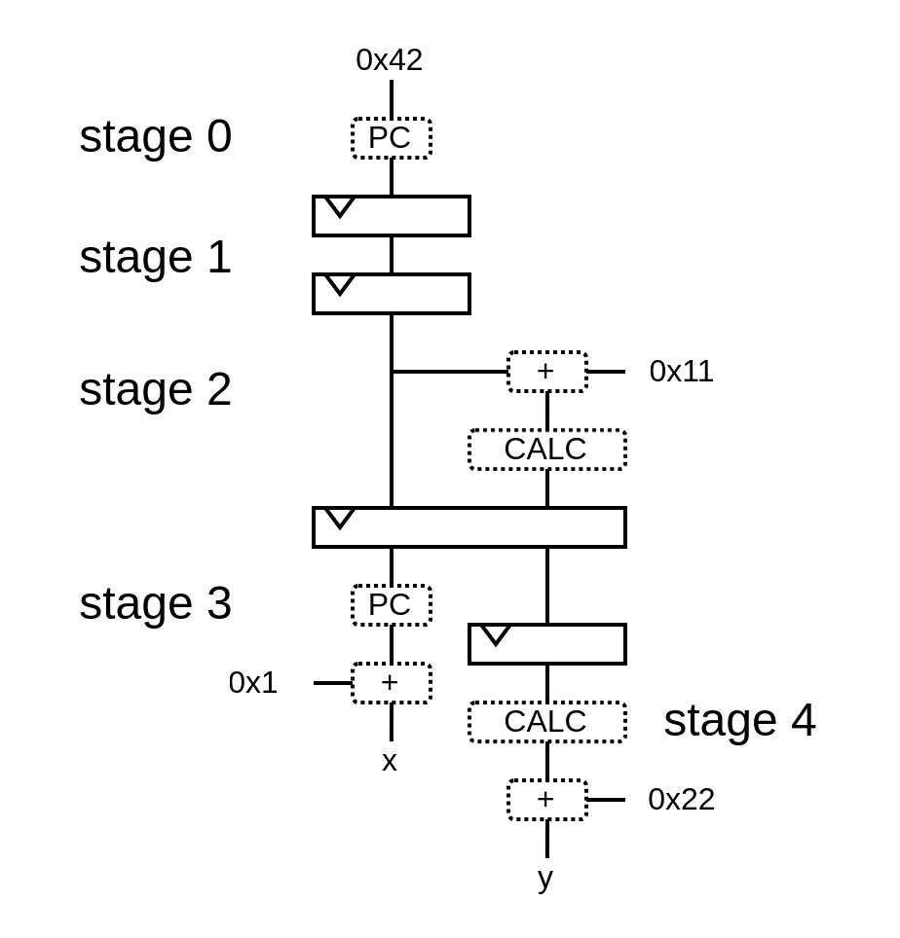
Pipeline API
val pip = new Pipeline()

Slide 37
Pipeline API
val pip = new Pipeline()
val PC = NamedType(UInt(32 bits))
pip(PC, 0) := 0x42

Slide 38
Pipeline API
val pip = new Pipeline()
val PC = NamedType(UInt(32 bits))
pip(PC, 0) := 0x42
val CALC = NamedType(UInt(32 bits))
pip(CALC, 2) := pip(PC, 2) + 0x11

Slide 39
Pipeline API
val pip = new Pipeline()
val PC = NamedType(UInt(32 bits))
pip(PC, 0) := 0x42
val CALC = NamedType(UInt(32 bits))
pip(CALC, 2) := pip(PC, 2) + 0x11
val x = pip(PC, 3) + 1
val y = pip(CALC, 4) + 0x22

Slide 40
Pipeline API
val pip = new Pipeline()
val PC = NamedType(UInt(32 bits))
pip(PC, 0) := 0x42
val CALC = NamedType(UInt(32 bits))
pip(CALC, 2) := pip(PC, 2) + 0x11
val x = pip(PC, 3) + 1
val y = pip(CALC, 4) + 0x22
pip.build()

Slide 41
Pipeline API
class Pipeline{
//Define the pipeline data model
val specs = LinkedHashMap[NamedType[Data], LinkedHashMap[Int, Data]]()
//Define how we can access the pipeline
def apply[T <: Data](what: NamedType[T], stageId: Int) = {
val spec = specs.getOrElseUpdate(what.asInstanceOf[NamedType[Data]], new LinkedHashMap[Int, Data])
spec.getOrElseUpdate(stageId, what().setName(what.getName + "_" + stageId)).asInstanceOf[T]
}
//Translate specs into hardware
def build(): Unit = {
for ((what, nodes) <- specs) {
for (i <- nodes.keys.min until nodes.keys.max) {
apply(what, i + 1) := RegNext(apply(what, i))
}
}
}
}

Slide 42
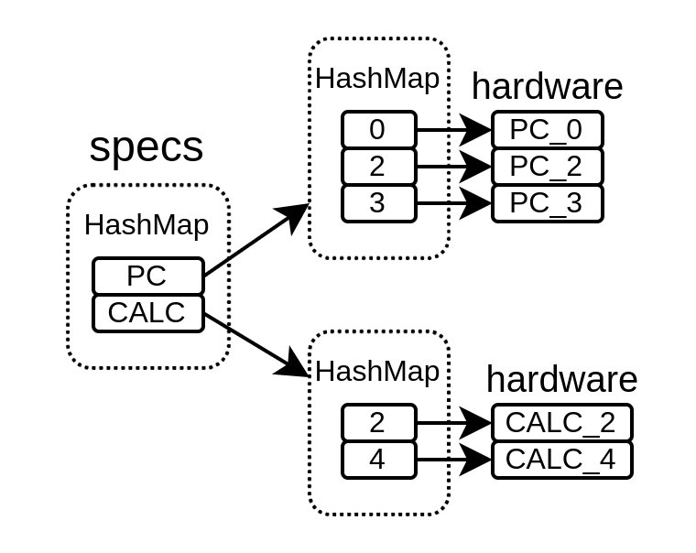
Pipeline API
class Pipeline{
//Define the pipeline data model
val specs = LinkedHashMap[NamedType[Data], LinkedHashMap[Int, Data]]()
//Define how we can access the pipeline
def apply[T <: Data](what: NamedType[T], stageId: Int) = {
val spec = specs.getOrElseUpdate(what.asInstanceOf[NamedType[Data]], new LinkedHashMap[Int, Data])
spec.getOrElseUpdate(stageId, what().setName(what.getName + "_" + stageId)).asInstanceOf[T]
}
//Translate specs into hardware
def build(): Unit = {
for ((what, nodes) <- specs) {
for (i <- nodes.keys.min until nodes.keys.max) {
apply(what, i + 1) := RegNext(apply(what, i))
}
}
}
}

Slide 43
Pipeline API
wire [31:0] PC_0;
wire [31:0] PC_3;
wire [31:0] x;
wire [31:0] CALC_2;
wire [31:0] PC_2;
wire [31:0] CALC_4;
wire [31:0] y;
wire [31:0] PC_1;
reg [31:0] PC_0_regNext;
reg [31:0] PC_1_regNext;
reg [31:0] PC_2_regNext;
wire [31:0] CALC_3;
reg [31:0] CALC_2_regNext;
reg [31:0] CALC_3_regNext;
assign PC_0 = 32'h00000042;
assign x = (PC_3 + 32'h00000001);
assign CALC_2 = (PC_2 + 32'h00000011);
assign y = (CALC_4 + 32'h00000022);
assign PC_1 = PC_0_regNext;
assign PC_2 = PC_1_regNext;
assign PC_3 = PC_2_regNext;
assign CALC_3 = CALC_2_regNext;
assign CALC_4 = CALC_3_regNext;
always @(posedge clk) begin
PC_0_regNext <= PC_0;
PC_1_regNext <= PC_1;
PC_2_regNext <= PC_2;
CALC_2_regNext <= CALC_2;
CALC_3_regNext <= CALC_3;
end
val pip = new Pipeline()
val PC = NamedType(UInt(32 bits))
pip(PC, 0) := 0x42
val CALC = NamedType(UInt(32 bits))
pip(CALC, 2) := pip(PC, 2) + 0x11
val x = pip(PC, 3) + 1
val y = pip(CALC, 4) + 0x22
pip.build()

Slide 44
VexiiRiscv
RISC-V softcore
Can run linux (RV32 / RV64 IMACSU)
Multiple issue
Early + late ALU
5.24 coremark/Mhz 2.50 dhystone/Mhz
Very large design space

Slide 45
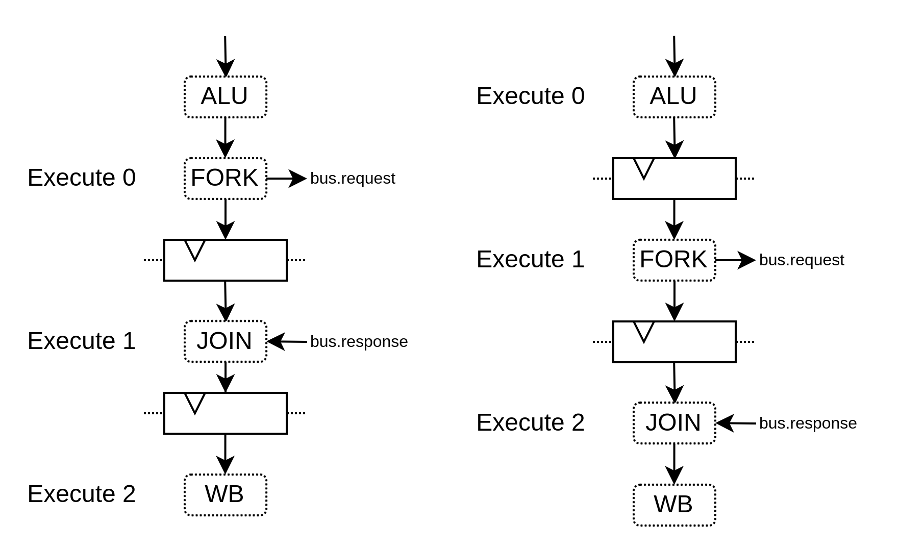
VexiiRiscv : Load/Store design space

Slide 46
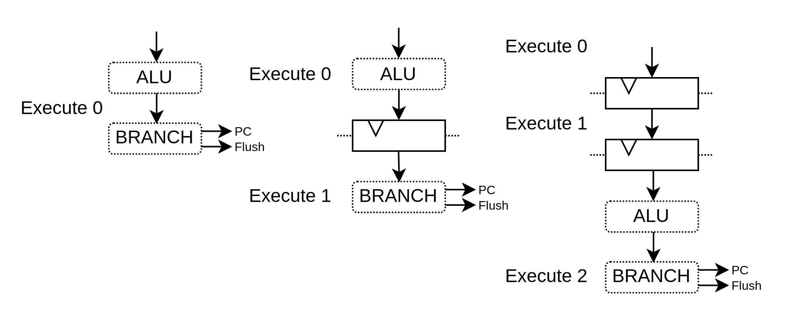
VexiiRiscv : Pipeline API

Slide 47
VexiiRiscv : Pipeline API
val alu = new pipeline.Execute(0) {
val TAKEN = insert(RS1 === RS2);
}

Slide 48
VexiiRiscv : Pipeline API
val alu = new pipeline.Execute(0) {
val TAKEN = insert(RS1 === RS2);
}
val branch = new pipeline.Execute(1) {
flushPort.valid := alu.TAKEN
pcPort.valid := alu.TAKEN
pcPort.pc := ..
}

Slide 49
VexiiRiscv : Pipeline API
val aluAt = 0
val branchAt = 1
...
val alu = new pipeline.Execute(aluAt) {
val TAKEN = insert(RS1 === RS2);
}
val branch = new pipeline.Execute(branchAt) {
flushPort.valid := alu.TAKEN
pcPort.valid := alu.TAKEN
pcPort.pc := ..
}

Slide 50
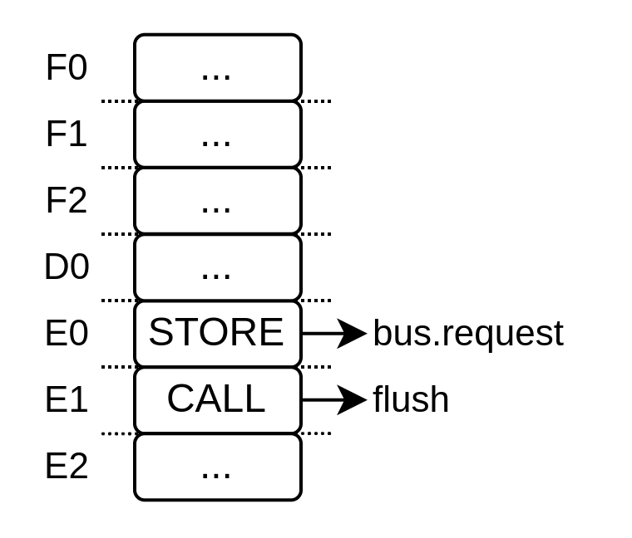
VexiiRiscv : Decoding / Scheduling

Slide 51
VexiiRiscv : Specification structure
case class OpSpec(
encoding : String,
mayFlush : Boolean,
sideEffect: Boolean,
)

Slide 52
VexiiRiscv : Define instructions spec
case class OpSpec(
encoding : String,
mayFlush : Boolean,
sideEffect: Boolean,
)
val ADD = OpSpec("000-----0110011", false, false)
val CALL = OpSpec("--------1101111", true, false)
val SW = OpSpec("100-----1100011", false, true)

Slide 53
VexiiRiscv : Collect the specifications
case class OpSpec(
encoding : String,
mayFlush : Boolean,
sideEffect: Boolean,
)
val ADD = OpSpec("000-----0110011", false, false)
val CALL = OpSpec("--------1101111", true, false)
val SW = OpSpec("100-----1100011", false, true)
val opsSpec = ArrayBuffer[OpSpec]()
opsSpec ++= List(ADD, CALL, SW)

Slide 54
VexiiRiscv : Decode
case class OpSpec(
encoding : String,
mayFlush : Boolean,
sideEffect: Boolean,
)
val ADD = OpSpec("000-----0110011", false, false)
val CALL = OpSpec("--------1101111", true, false)
val SW = OpSpec("100-----1100011", false, true)
val opsSpec = ArrayBuffer[OpSpec]()
opsSpec ++= List(ADD, CALL, SW)
val instruction = in Bits(32 bits)
val withSideEffects = Symplify(
input = instruction,
trueTerms = opsSpec.filter(_.sideEffect).map(_.encoding),
falseTerms = opsSpec.filter(!_.sideEffect).map(_.encoding)
)

Slide 55
VexiiRiscv : Scheduling
case class OpSpec(
encoding : String,
mayFlush : Boolean,
sideEffect: Boolean,
)
val ADD = OpSpec("000-----0110011", false, false)
val CALL = OpSpec("--------1101111", true, false)
val SW = OpSpec("100-----1100011", false, true)
val opsSpec = ArrayBuffer[OpSpec]()
opsSpec ++= List(ADD, CALL, SW)
val instruction = in Bits(32 bits)
val withSideEffects = Symplify(
input = instruction,
trueTerms = opsSpec.filter(_.sideEffect).map(_.encoding),
falseTerms = opsSpec.filter(!_.sideEffect).map(_.encoding)
)
val hazard = withSideEffects && pipelineMayFlush

Slide 56
VexiiRiscv : Composability

Slide 57
How to lower barriers to hardware design ?
VHDL / [System]Verilog can be repulsive / unproductive / busywork
  Alternatives could be more popular (SpinalHDL, Chisel, Migen, Amaranth, ...)
Hardware design can leverage software engineering
  New pool of people profiles
Industry tools are hard to access for many
  Open-source / free tools could be more popular (Verilator, GHDL, IVerilog, ..)

Slide 58
Question ?
https://github.com/SpinalHDL/SpinalHDL
https://github.com/SpinalHDL/NaxRiscv
https://github.com/SpinalHDL/VexiiRiscv

Slide 59
Let’s use software to elaborate hardware
class Toplevel extends Component {
val x,y,z = in(UInt(8 bits))
val elements = ArrayBuffer[UInt]()
elements += x
elements += y
elements += z
var tmp = U(0)
for(e <- elements){
tmp = tmp + e
}
val result = out(tmp)
}

Slide 60

Digital Hardware description
“There is no alternative” (VHDL / Verilog)
  Scala based : SpinalHDL, Chisel
  Python based : Migen, Amaranth
  ...

Slide 61
Using software to elaborate your hardware
if(featureEnabled){
Reg(UInt(8 bits))
}
Control flow : if / for
Data structures : dynamic array / hash map / hash set
Lambda function : reduce / fold / map / filter / ...
OOP : class / software interface
See https://spinalhdl.github.io/NaxRiscv-Rtd/main/NaxRiscv/abstraction/index.html

Slide 62
Using software to elaborate your hardware
for(i <- 0 to 2){
Reg(UInt(8 bits))
}
Control flow : if / for
Data structures : dynamic array / hash map / hash set
Lambda function : reduce / fold / map / filter / ...
OOP : class / software interface
See https://spinalhdl.github.io/NaxRiscv-Rtd/main/NaxRiscv/abstraction/index.html

Slide 63
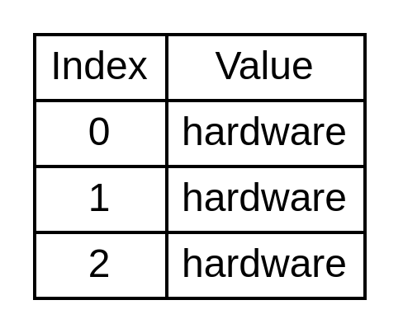
Using software to elaborate your hardware
val flushes = ArrayBuffer[Flush]()
flushes += new Flush()
flushes += new Flush()
if(featureEnabled){
flushes += new Flush()
}
Data structures : dynamic array / hash map / hash set
Lambda function : reduce / fold / map / filter / ...
OOP : class / software interface
See https://spinalhdl.github.io/NaxRiscv-Rtd/main/NaxRiscv/abstraction/index.html

Slide 64
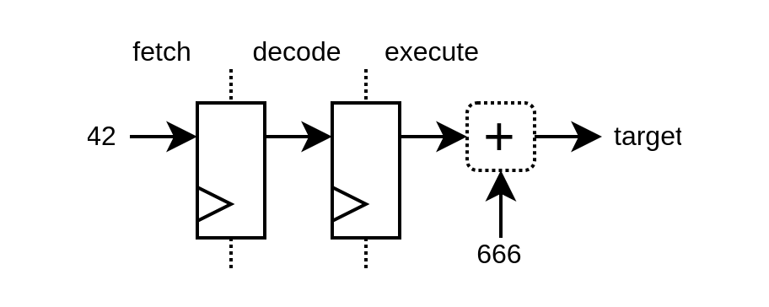
val PC = Hardtype(UInt(32 bits))
val instruction = Hardtype(UInt(32 bits))
val fetch, decode, execute = HashMap[Hardtype, Hardware]()
...
fetch(PC) = U(42)
...
val target = execute(PC) + U(666)
...
autoPipeline(fetch, decode, execute)
Data structures : dynamic array / hash map / hash set
Lambda function : reduce / fold / map / filter / ...
OOP : class / software interface
See https://spinalhdl.github.io/NaxRiscv-Rtd/main/NaxRiscv/abstraction/index.html

Slide 65


ISA (instruction set architecture)
A few open / free ISA (OpenRISC, , …)
RISC-V
  https://riscv.org/technical/specifications/
  Secretly being embedded in ASICs
  Mostly bloat free, from a FPGA perspective)
  GCC / LLVM / Qemu
  Linux / Debian port
  ...

Slide 66
CPU design (NaxRiscv)
https://github.com/SpinalHDL/NaxRiscv

Slide 67
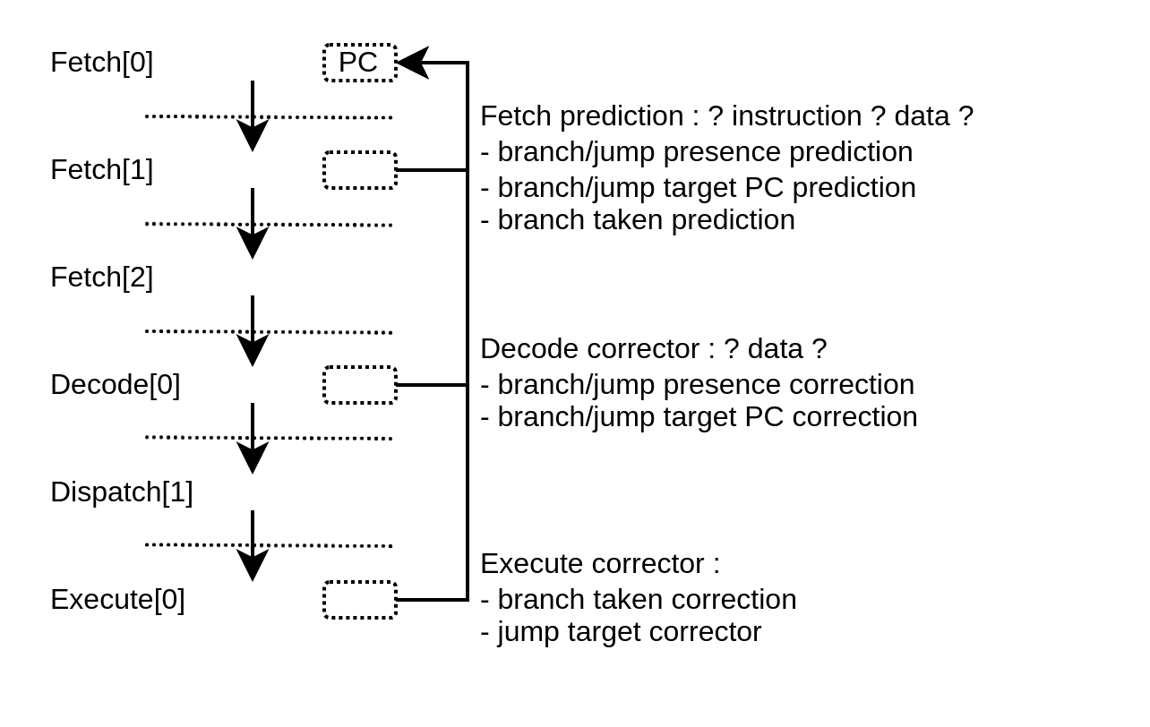
“Branch prediction”

Slide 68

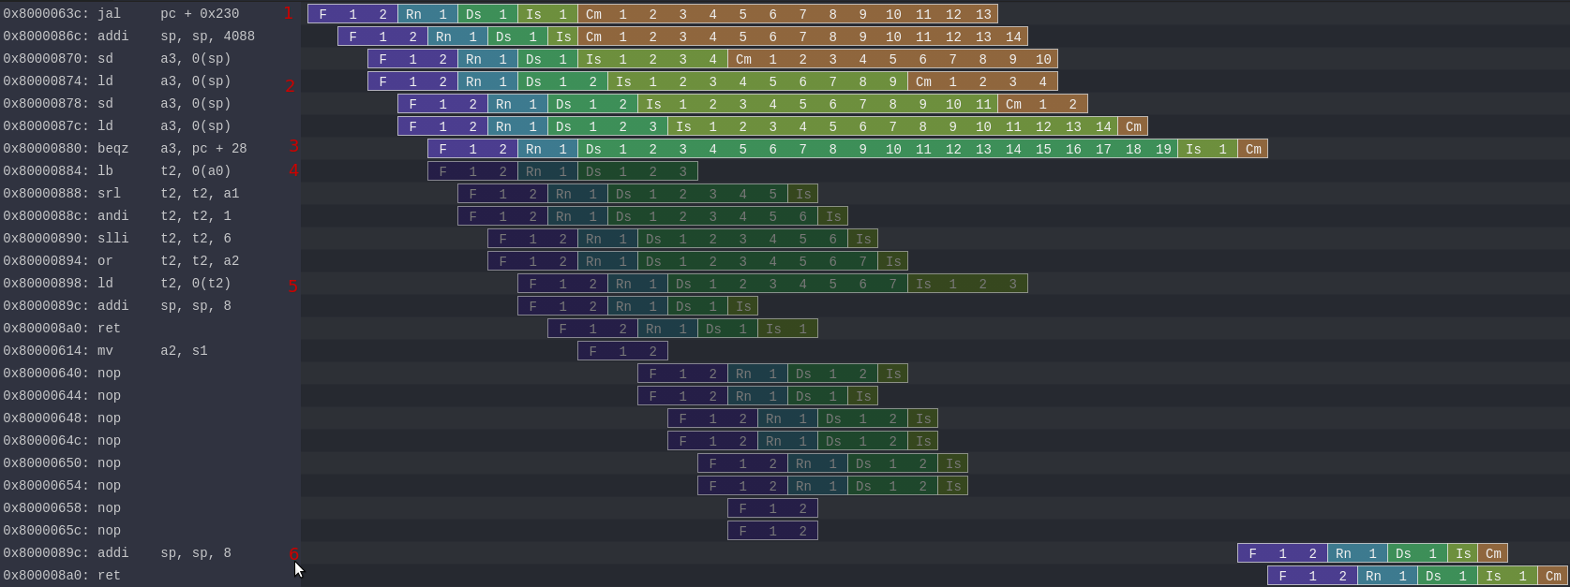
Secret leak (Konata trace)
https://spinalhdl.github.io/NaxRiscv-Rtd/main/NaxRiscv/misc/index.html#security
Spectre

Slide 69
Secret leak
Spectre
Generate long dependencies

Slide 70
Secret leak
Spectre
Laaaaaaate branch miss prediction

Slide 71
Secret leak
Spectre
RAM[secret] -> (page fault)

Slide 72
Secret leak
Spectre
probe + RAM[secret]

Slide 73
Secret leak
Spectre
RAM[probe + RAM[secret]]

Slide 74
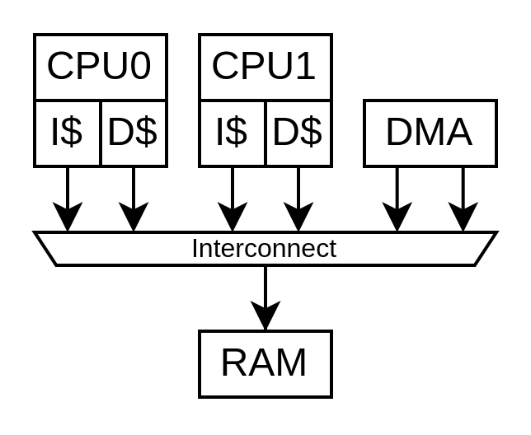
Multi core requirements (RISC-V linux)
Hardware cache coherency
Inter-CPU software interrupts

Slide 75
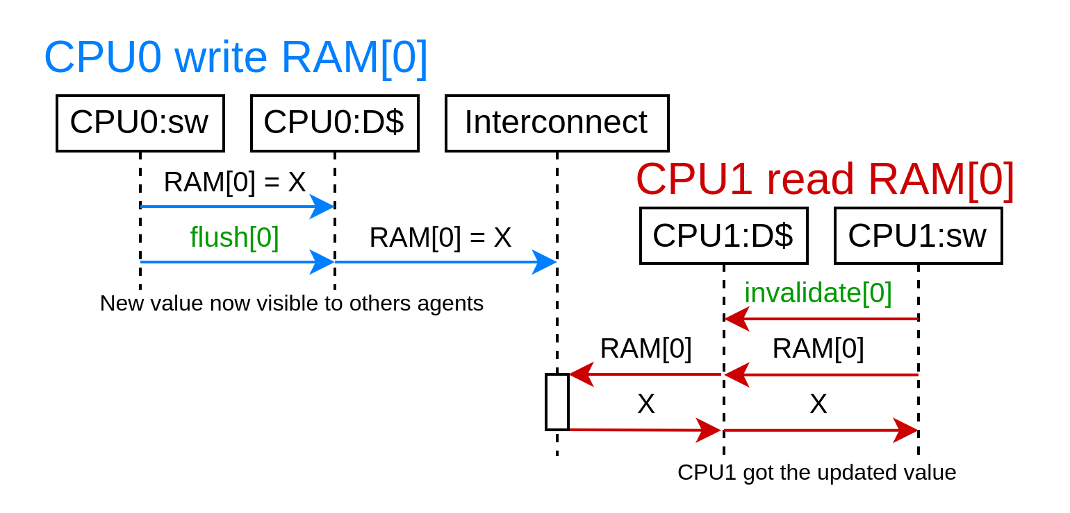
Software cache coherency

Slide 76
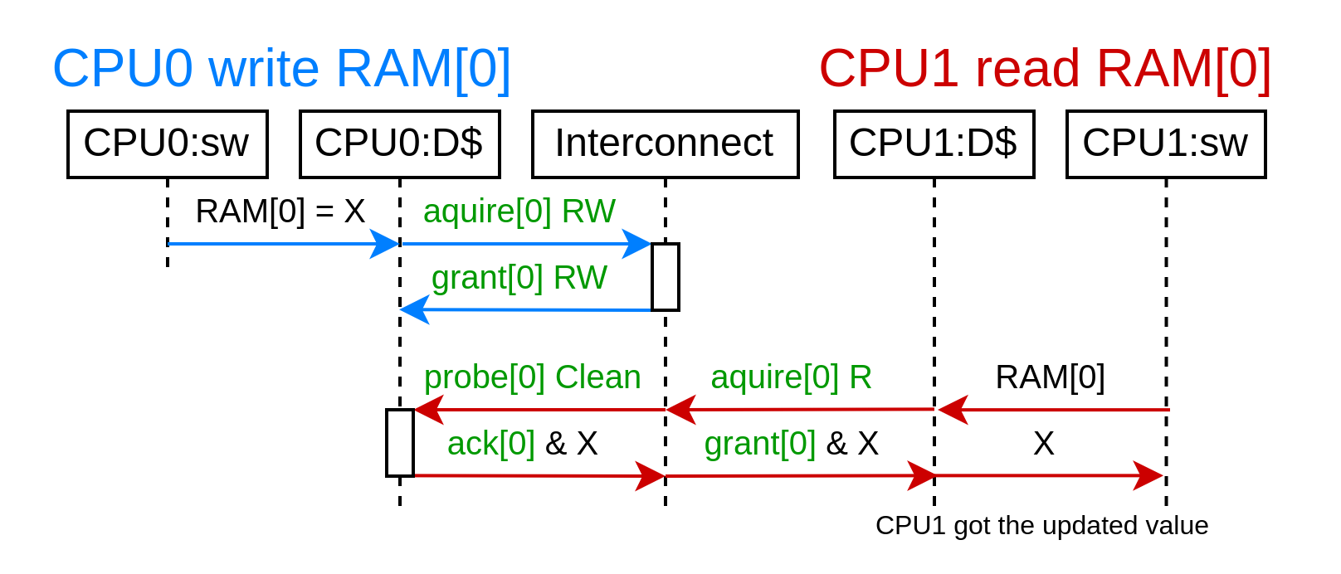
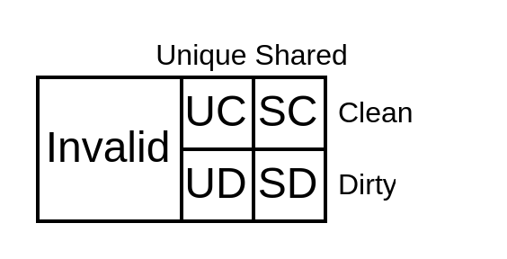
Hardware cache coherency with memory block copy and permissions

Slide 77
Hardware cache coherency
And its side effects
volatile int array[2];
void thread_0() {
while(1) {
array[0] += 1;
}
}
void thread_1() {
while(1) {
array[1] += 1;
}
}
Same memory block (64 bytes): 18486 ps/iteration
Different memory blocks : 902 ps/iteration
(on a 2 years old CPU)

Slide 78
Cache coherency
Open specification : Tilelink
Multiple open source implementations, ex :
  https://github.com/SpinalHDL/SpinalHDL/tree/dev/lib/src/main/scala/spinal/lib/bus/tilelink
Coherent L2 design
  https://spinalhdl.github.io/SpinalDoc-RTD/master/SpinalHDL/Libraries/Bus/tilelink/tilelink_fabric.html
  Exposes a lot of performance tricks
    1 pending transaction per 64 bytes block
    64 bytes per burst max
    Keep bursts aligned
    Alignment Aliasing

Slide 79

Memory / Peripherals / Deployment
LiteX
  Open-source SoC framework (in Python)
  Integrate many peripherals
    DDRx controller
    SDCARD
    Ethernet, USB host
    SATA, PCIe, ...

Slide 80
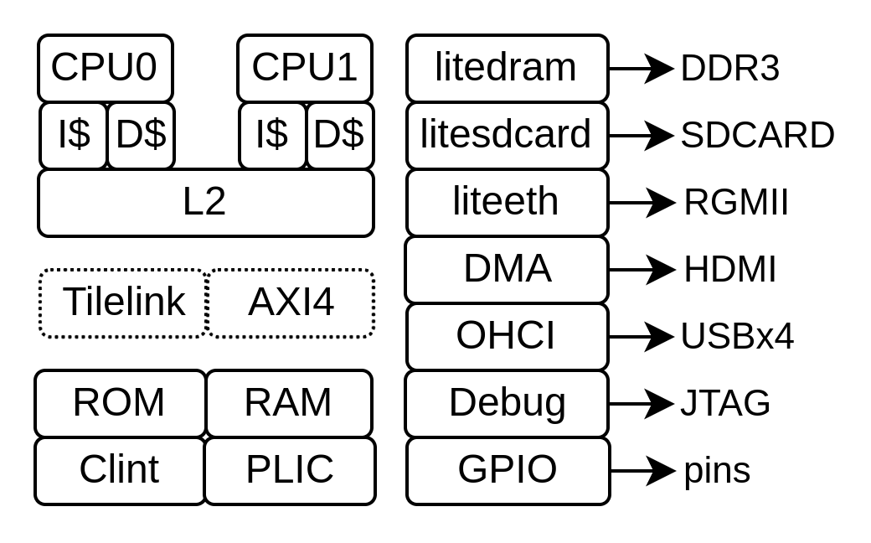
Memory / Peripherals / Deployment
python3 -m litex_boards.targets.digilent_nexys_video --cpu-type=naxriscv --bus-standard axi-lite --with-video-framebuffer --with-coherent-dma --with-sdcard --with-ethernet --xlen=64 --scala-args='rvc=true,rvf=true,rvd=true,alu-count=2,decode-count=2' --with-jtag-tap --sys-clk-freq 100000000 --cpu-count 2 --build –load
+ stuff for USB / JTAG

Slide 81
USB host support
USB host support =>
  Keyboard / mouse / audio / flash drive / sdcard / uart / ethernet / bluetooth
Open specification :
  Open Host Controller Interface Specification for USB (OHCI)
  USB 12 Mb/s, up to 15 ports, 2 FPGA GPIO per port
Open implementation :
  https://spinalhdl.github.io/SpinalDoc-RTD/master/SpinalHDL/Libraries/Com/usb_ohci.html
  https://github.com/SpinalHDL/SpinalHDL/blob/dev/lib/src/main/scala/spinal/lib/com/usb/ohci/UsbOhci.scala
  https://github.com/litex-hub/pythondata-misc-usb_ohci/tree/master/pythondata_misc_usb_ohci/verilog

Slide 82
Synthesis / Place / Route
Some open source tools for
  Xilinx 7-Series
  Lattice ice40 / ecp5
  …
Synthesis : Yosys
Place and route : Nextpnr
...

Slide 83

Running Linux
Requirements on RISC-V
  Hardware cache coherency (between CPUs + DMA)
  Machine/Supervisor/User modes (riscv-privileged spec)
  SBI (Supervisor Binary Interface, kinda like BIOS)
  DTB (Device Tree Binary)
https://twitter.com/i/status/1493996880593887235

Slide 84

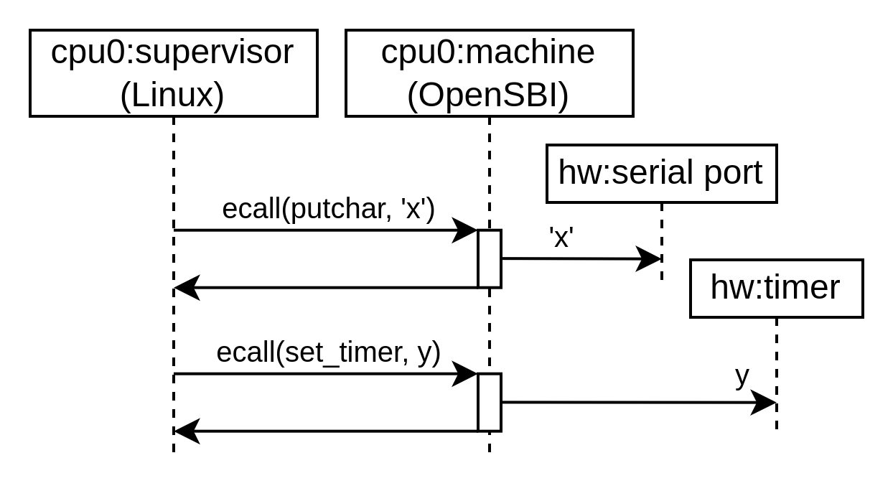
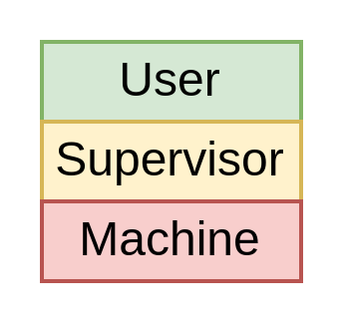
SBI (Supervisor Binary Interface)
https://github.com/riscv-non-isa/riscv-sbi-doc
https://github.com/riscv-software-src/opensbi

Slide 85
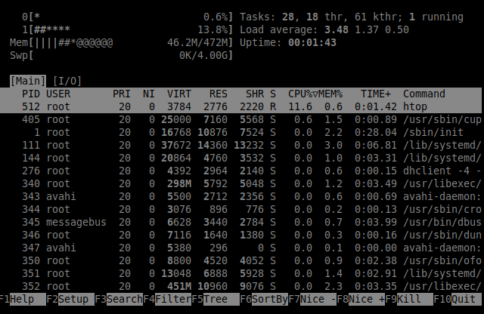
Running Debian
Requirements on RISC-V
  RV64IMAFDC
  Linux kernel
  Some storage (ex: SDCARD)
Doc : https://github.com/SpinalHDL/NaxSoftware/tree/main/debian_litex
Video : https://x.com/dolu1990/status/1712848731349889108

Slide 86
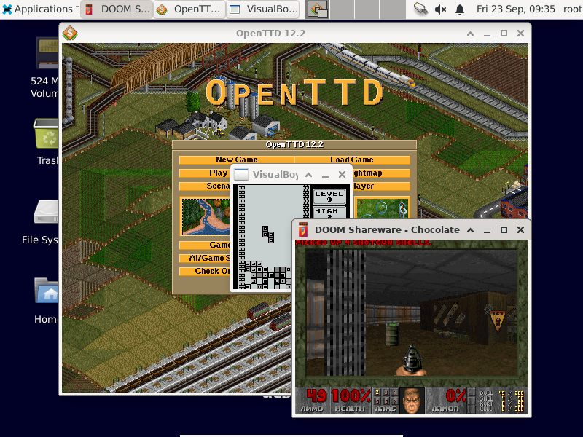

Slide 87
Verification / Debugging
May create rituals
May exhaust your sanity
May never end
May crush your soul
Hello darkness my old friend

Slide 88
Debugging – example (a real one)
Dual core Debian freeze (RCU error) after ~1h (360’000’000’000 cycles)
  Impossible to reproduced in simulation (~40 days of runtime @ 100 Khz)
Hope you get clues
  Core was still alive on JTAG => OpenOCD
  PC was in linux “_raw_spin_lock”
  Forcing it to unlock => Everything back on track
What it was :
  CPU D$ doing bad memory coherency
  (releasing data permissions once again after being probed out)

Slide 89



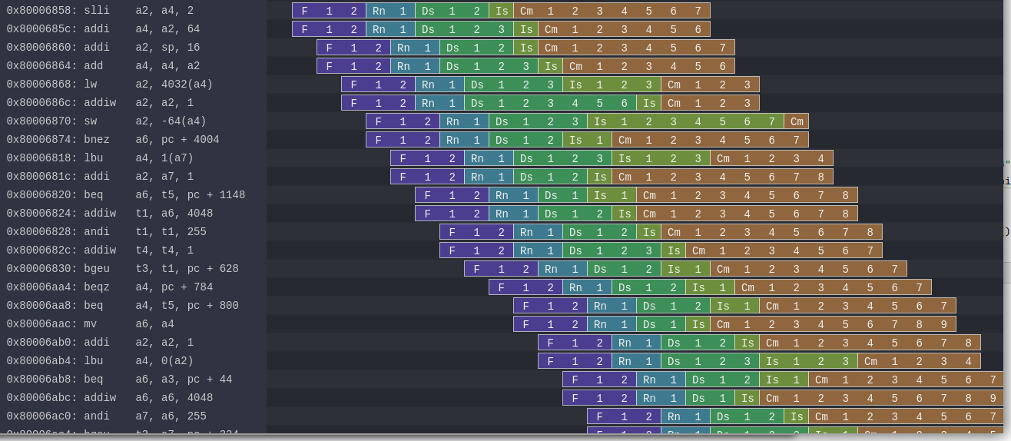
Simulation
A few open source simulation tools :
  GHDL, IVerilog, Verilator, ...
Based on Verilator (~150-200 Khz on a 4 years old CPU)
Lock-step checks against Spike / RVLS
Konata traces

Slide 90
0xAA55
I hope you had a good time
If you are looking for open-source project funding :
  NLnet Foundation (they helped me a lot)

Slide 91
Speculative execution
Execute as much as you can in advance
Bad speculation → no side effect on the ISA states
  x1, x2, .. , x31
  CSR
  Global memory (RAM)
But what’s about all the others hardware states
  Branch predictors (BTB, RAS, GShare)
  I$ D$ tags (is address X in the cache or not)
  Those are easy to probe

Slide 92
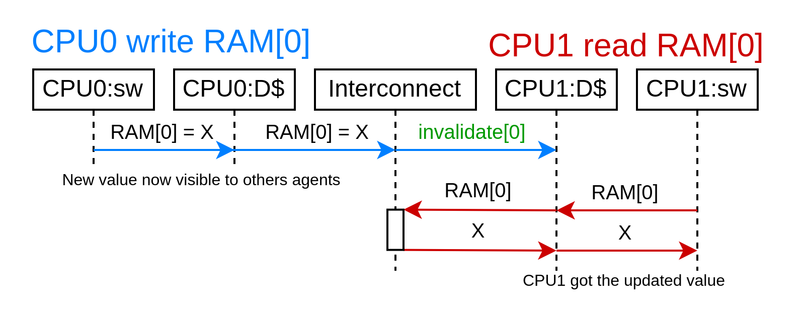
Hardware cache coherency without memory block ownership

Slide 93
Hardware cache coherency with memory block ownership
Caches have to acquire memory block permissions
  read [write] permissions
  64 bytes per block (typically), aligned
Cache line states
  Valid / Invalid
  Clean / Dirty
  Unique / Shared

Slide 94
Boot sequence
FPGA bitstream
Litex bios
OpenSBI
[Uboot]
Linux
Buildroot / Debian / ...

Slide 95
Using software to elaborate your hardware
val a,b,c = out UInt(8 bits)
val array = ArrayBuffer[UInt]()
array += a // By reference !
array += b
array += c
for(element <- array){
element := 0
}
output [7:0] a,
output [7:0] b,
output [7:0] c
assign a = 8'h0;
assign b = 8'h0;
assign c = 8'h0;
Data structures : dynamic array / hash map / hash set
Lambda function : reduce / fold / map / filter / ...
OOP : class / software interface
See https://spinalhdl.github.io/NaxRiscv-Rtd/main/NaxRiscv/abstraction/index.html

Slide 96
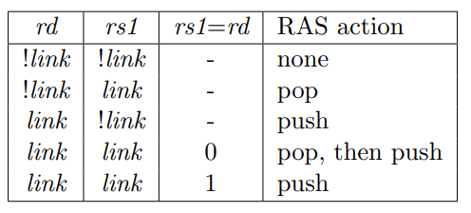
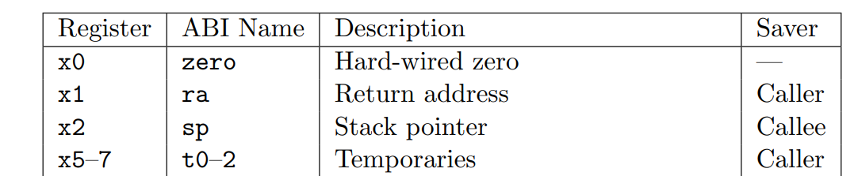
Details can throw you off
From https://github.com/SpinalHDL/NaxRiscv/issues/67
  [Performance bug] Incorrect register dependency tracking
# Triggering bad speculation
jalr x0, t0 # Doesn’t work
jalr x0, t1 # Work
riscv-calling.pdf :
“A JAL instruction should push the return address onto a return-address stack (RAS) only when rd=x1/x5. JALR instructions should push/pop a RAS as shown in the Table 2.1.”
riscv-calling.pdf

